Slide 1

STM32 SPI

Slide 2
SPI(Serial Peripheral Interface)
SPI is Multi Master ,Multislave Serial synchronous Communication protocol
It is Full duplex or data exchange protocol,also will work in half duplex communication
SPI has 4 wires which is MISO/SDI,MOSI/SDO,CS/SS,SCLK
SPI has maximum distance of 15cm and maximum speed 60mhz depend MCU clock frequency
SPI has two types of interface one is normal type and other one is daisy chain
SPI has 4 Clock Configuration modes based on clock polarity and clock phase
SPI slave will active by making SS pin low

Slide 3
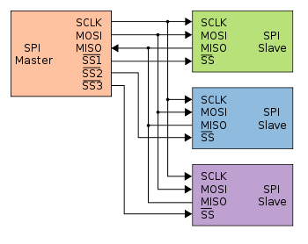
SPI Connection

Slide 4
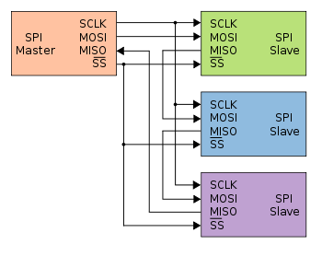
SPI Daisy Chain Connection

Slide 5
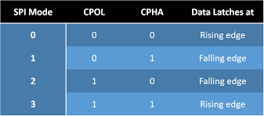
SPI Clock Modes for Data Transfer

Slide 6
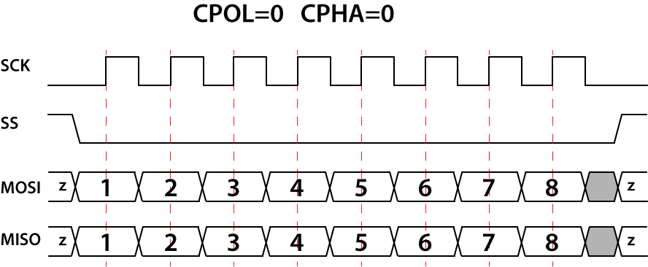
SPI Clock Mode 0
Clock polarity and clock phase both will be zero
Each bit will transmit as per each clock pulse when ss pin in low state
Data will be appear at falling edge and Data will sample at rising edge of clock pulse

Slide 7
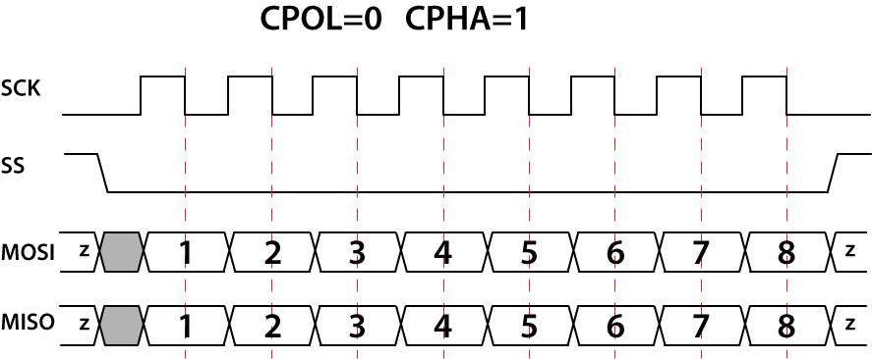
SPI Clock Mode 1
Clock polarity will be zero and clock phase will be one
Each bit will transmit as per each clock pulse when ss pin in low state
Data will be appear at rising edge and Data will sample at falling edge of clock pulse

Slide 8

SPI Clock Mode 2
Clock polarity will be one and clock phase will be zero
Each bit will transmit as per each clock pulse when ss pin in low state
Data will be appear at rising edge and Data will sample at falling edge of clock pulse

Slide 9

SPI Clock Mode 3
Clock polarity and clock phase both will be one
Each bit will transmit as per each clock pulse when ss pin in low state
Data will be appear at falling edge and Data will sample at rising edge of clock pulse

Slide 10
SPI in STM32
The serial peripheral interface (SPI) allows half/ full-duplex, synchronous, serial communication with external devices. The interface can be configured as the master and in this case it provides the communication clock (SCK) to the external slave device. The interface is also capable of operating in multimaster configuration.
It may be used for a variety of purposes, including simplex synchronous transfers on two lines with a possible bidirectional data line or reliable communication using CRC checking.
The I2S is also a synchronous serial communication interface. It can address four different audio standards including the I2S Philips standard, the MSB- and LSB-justified standards, and the PCM standard. It can operate as a slave or a master device in full-duplex mode (using 4 pins) or in half-duplex mode (using 6 pins). Master clock can be provided by the interface to an external slave component when the I2S is configured as the communication master.
8 master mode baud rate prescalers (fPCLK/2 max.)
Programmable data order with MSB-first or LSB-first shifting
Master mode fault, overrun and CRC error flags with interrupt capability

Slide 11
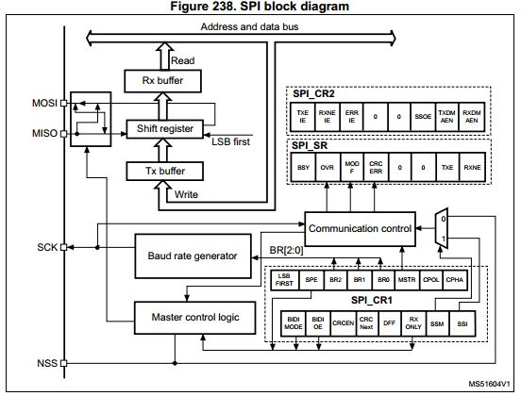
SPI Block Diagram

Slide 12
SPI Registers
SPI control register 1 (SPI_CR1)
SPI control register 2 (SPI_CR2)
SPI data register (SPI_DR)
SPI status register (SPI_SR)

Slide 13
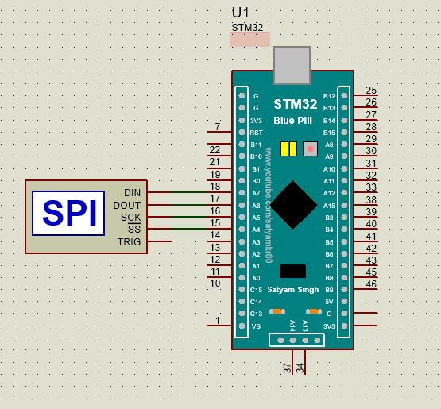
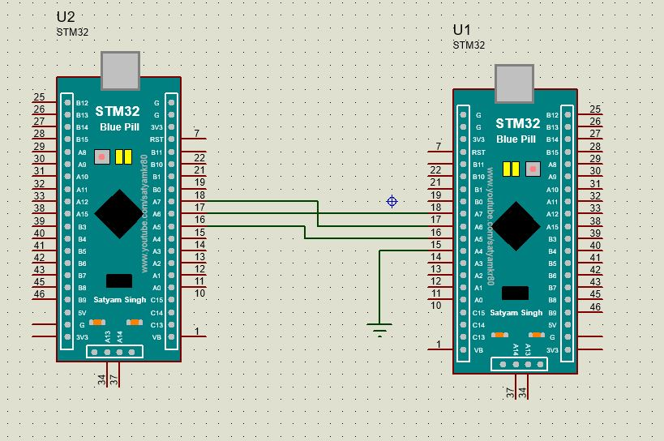
SPI interface

Slide 14
SPI Program
#include "stm32f10x.h" // Device header
void spi_master_init(void);
void spi_tx(unsigned char data);
void spi_rx(void);
void spi_tx_string(unsigned char *data);
void spi_gpio_init(void);
void delay(void);
unsigned char rx_buf[50]={0};
unsigned char count=0;
int main()
{
unsigned char msg[]="hello world";
spi_gpio_init();
spi_master_init();
spi_tx('t');
spi_tx_string(msg);
while(1)
{
}
return 0;
}

Slide 15
void spi_gpio_init()
{
//spi1: PA4,5,6,7 with some timer alter function
//PA4-nss
//PA5-clk (output)
//PA6-miso (input)
//PA7-mosi (output)
//spi2: PB12,13,14,15 without any timer alter function
//1.gpioa and spi1 clk enable
RCC->APB2ENR &=0x00000000; //reset
RCC->APB2ENR |=(1<<2); //porta clk enable
RCC->APB2ENR |=(1<<12); //spi1 clk enable
//2.gpio pins config for spi1
GPIOA->CRL &= 0x00000000; //reset
//sclk PA5
GPIOA->CRL |= 3<<20;
GPIOA->CRL |= 2<<22;
//mosi PA7
GPIOA->CRL |= 3<<28;
GPIOA->CRL |= 2<<30;
}
void spi_master_init(void)
{
SPI1->CR1 &=0x0000; //reset
//Baud rate control fPCLK/64
SPI1->CR1 |= 5<<3;
//Software slave management enabled
SPI1->CR1 |= 1<<9;
//SSI-Internal slave select NSS high1
SPI1->CR1 |= 1<<8;
//cpol and cpha both are disabled
// Hardware slave management enabled
//SS output enable, SS output is enabled in master mode and when the //cell is enabled.
//The cell cannot work in a multimaster environment
//SPI1->CR2 |= 1<<2;
SPI1->CR1 |= 1<<2; // Master configuration
SPI1->CR1 |= 1<<6; //SPI enable
}

Slide 16
void spi_tx(unsigned char data)
{
//check tx buffer empty
while(!((SPI1->SR)&(1<<1)));
SPI1->DR = data;
}
void spi_rx()
{
//check rx not buffer empty
while(!((SPI1->SR)&(1<<0)));
rx_buf[count]=SPI1->DR;
count++;
}
void spi_tx_string(unsigned char *data)
{
while(*data)
{
spi_tx(*data++);
}
}

