Slide 1

Interfacing Keypad with PIC16F877A Microcontroller

Slide 2
How Keypads Work
The buttons on a keypad are arranged in rows and columns. A 3X4 keypad has 4 rows and 3 columns, and a 4X4 keypad has 4 rows and 4 columns
Beneath each key is a membrane switch. Each switch in a row is connected to the other switches in the row by a conductive trace underneath the pad.
Each switch in a column is connected the same way – one side of the switch is connected to all of the other switches in that column by a conductive trace.
Each row and column is brought out to a single pin, for a total of 8 pins on a 4X4 keypad

Slide 3
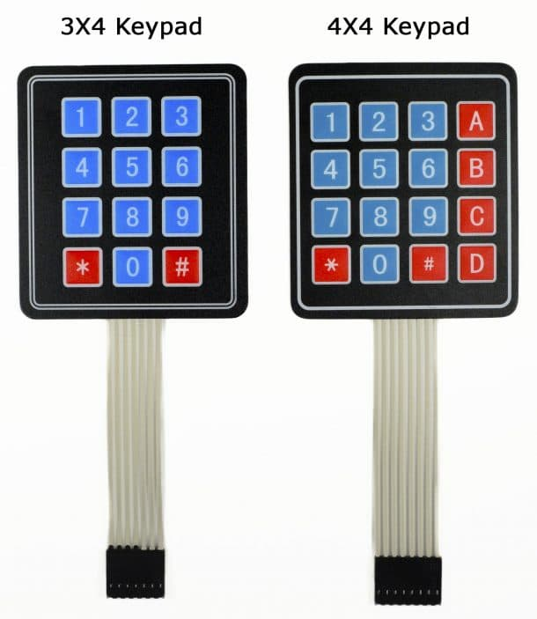
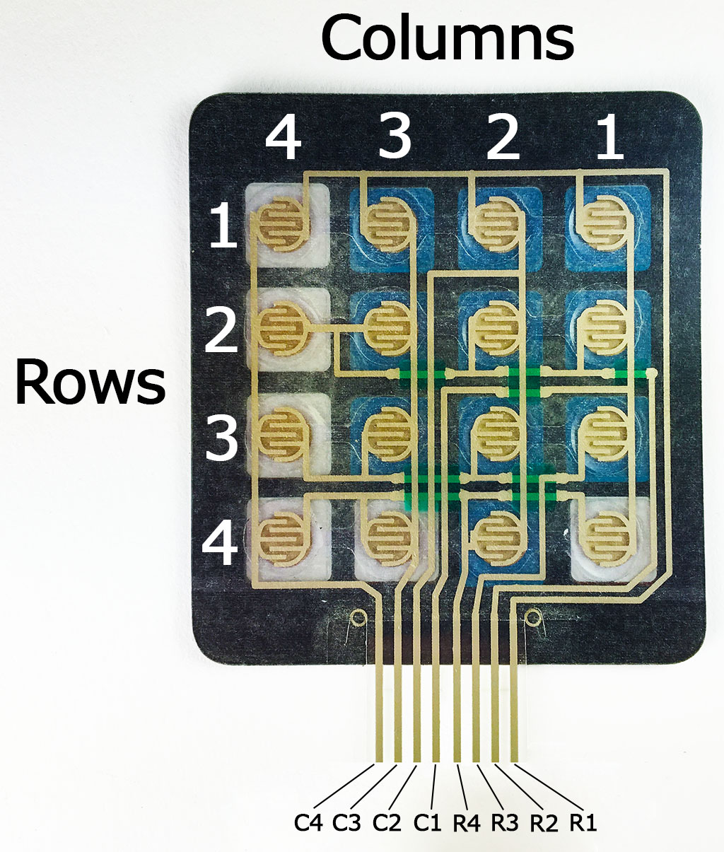

Slide 4
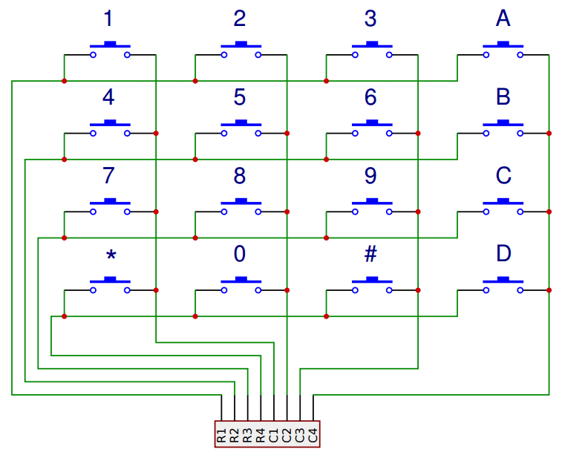
Pressing a button closes the switch between a column and a row trace, allowing current to flow between a column pin and a row pin.
The schematic for a 4X4 keypad shows how the rows and columns are connected

Slide 5
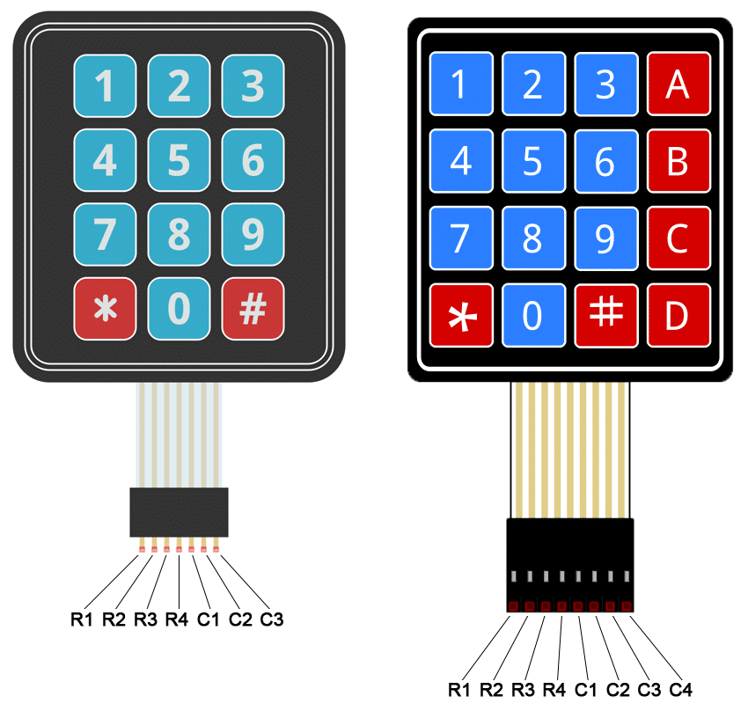
Connect the keypad to the PIC16F877A
The pin layout for most membrane keypads will look like this:

Slide 6
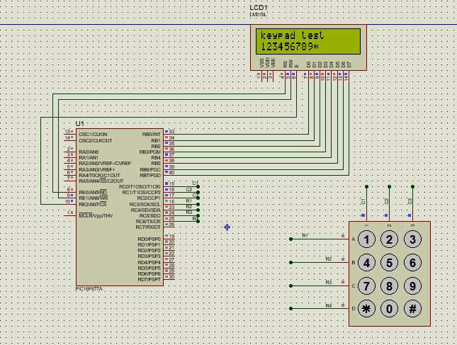
Interfacing lcd and keypad

Slide 7
Program for 3x4 keypad
#include <pic.h>
#define _XTAL_FREQ 4000000
#define RS RE0
#define RW RE1
#define EN RE2
#define COL1 RC0
#define COL2 RC1
#define COL3 RC2
#define ROW1 RC3
#define ROW2 RC4
#define ROW3 RC5
#define ROW4 RC6
char keypad();
void delay()
{
unsigned char i;
for( i=0;i<255;i++);
}

Slide 8
void cmd(unsigned char cmd)
{
RS=0;//command mode
RW=0;//wrte mode
PORTB=cmd; //command tranfer to LCD display
EN=1; //Enable to send cmd
delay();
EN=0; //disable
}
void display_char(unsigned char data)
{
RS=1;//data mode
RW=0;//wrte mode
PORTB=data; //command tranfer to LCD display
EN=1; //Enable to send data
delay();
EN=0; //disable display data showing
}
void display_string(unsigned char *data)
{
while(*data)
{
display_char(*data++);
}
}

Slide 9
void lcd_init()
{
ADCON1=0x06;//to enable PORTE as digital pins
TRISB=0x00;
TRISE=0x00;
PORTB=0x00;
PORTE=0x00;
cmd(0x0c);//LCD ON
cmd(0x38);//ENABLE 2nd ROW access
cmd(0x80);//set Display to 1st Row
}
void main()
{
char array[16] = "keypad test";
TRISC = 0xF8;
PORTC = 0x00;
lcd_init();
cmd(0x80);//set Display to 1st Row
display_string(&array);
char num;
while(1)
{
num = keypad();
if (num != 't')
{display_char(num);
}
}

Slide 10
char keypad()
{
COL1 = 1;COL2=0;COL3=0;
if(ROW1) {while(ROW1);return '1'; }
else if(ROW2) {while(ROW2);return '4';}
else if(ROW3) {while(ROW3);return '7';}
else if(ROW4) {while(ROW4);return '*';}
COL1 = 0;COL2=1;COL3=0;
if(ROW1) {while(ROW1);return '2';}
else if(ROW2) {while(ROW2);return '5';}
else if(ROW3) {while(ROW3);return '8';}
else if(ROW4) {while(ROW4);return '0';}
COL1 = 0;COL2=0;COL3=1;
if(ROW1){while(ROW1);return '3';}
else if(ROW2){while(ROW2);return '6';}
else if(ROW3){while(ROW3);return '9';}
else if(ROW4){while(ROW4);return '#';}
return 't';
}

Slide 11
Heading
contens

