Slide 1

Capture /Compare / PWM

Slide 2
Introduction
The Capture/Compare/PWM module is a peripheral that allows the user to time and control different events, and to generate Pulse-Width Modulation (PWM) signals.
The Compare mode allows the user to trigger an external event when a predetermined amount of time has expired
The PIC16F877A has 2 CCP Modules
PORT RC1 and RC2 are the CCP1 and CCP2 channels
Each CCP (Capture/Compare/PWM) module contains a 16-bit register which can operate as a 16-bit capture register, as a 16-bit compare register or as a 10-bit PWM master/slave Duty Cycle register. Each CCP module has 3 registers.

Slide 3
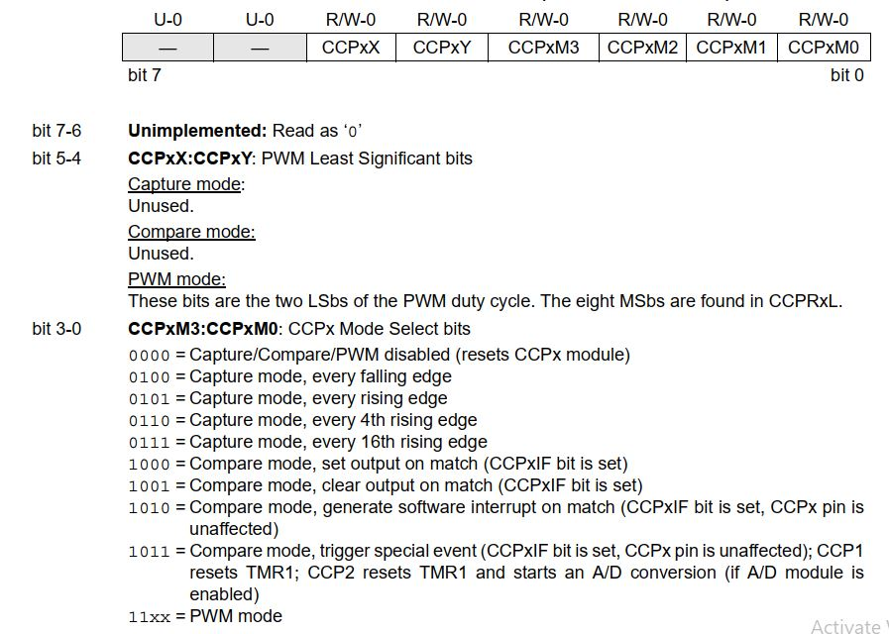

Slide 4
Capture Mode
In Capture mode, CCPR1H:CCPR1L captures the 16-bit value of the TMR1 register when an event occurs on pin RC2/CCP1.
An event is defined as one of the following:
• Every falling edge
• Every rising edge
• Every 4th rising edge
• Every 16th rising edge

Slide 5
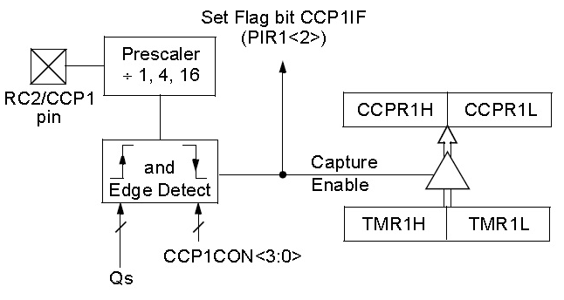
The type of event is configured by control bits, CCP1M3:CCP1M0 (CCPxCON<3:0>).
When a capture is made, the interrupt request flag bit, CCP1IF (PIR1<2>), is set.
The interrupt flag must be cleared in software.
If another capture occurs before the value in register CCPR1 is read, the old captured value is overwritten by the new value.
The block diagram of capture mode is shown below.

Slide 6
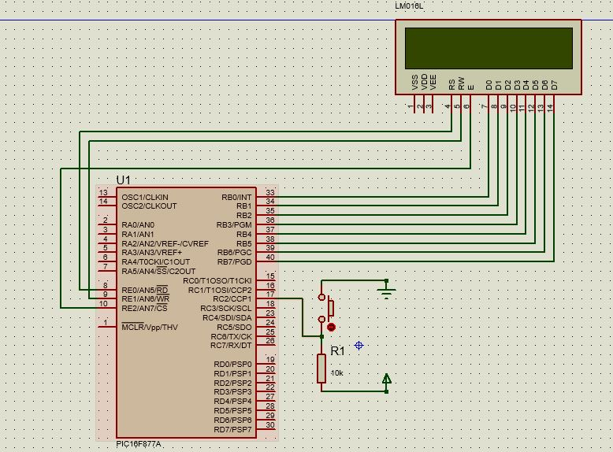
Capture Mode Circuit

Slide 7
Heading
#include<pic.h>
#include<stdio.h>
#define _XTAL_FREQ 4000000
#define RS RE0
#define RW RE1
#define EN RE2
void delay()
{
unsigned char i;
for( i=0;i<255;i++);
}
void cmd(unsigned char cmd)
{
RS=0;//command mode
RW=0;//wrte mode
PORTB=cmd; //command tranfer to LCD display
EN=1; //Enable to send cmd
delay();
EN=0; //disable
}

Slide 8
void display_char(unsigned char data)
{
RS=1;//data mode
RW=0;//wrte mode
PORTB=data; //command tranfer to LCD display
EN=1; //Enable to send data
delay();
EN=0; //disable display data showing
}
void display_string(unsigned char *data)
{while(*data)
{
display_char(*data++);
}
}
void lcd_init()
{
ADCON1=0x06;//to enable PORTE as digital pins
TRISB=0x00;
TRISE=0x00;
PORTB=0x00;
PORTE=0x00;
cmd(0x0c);//LCD ON
cmd(0x38);//ENABLE 2nd ROW access
cmd(0x80);//set Display to 1st Row
}

Slide 9
unsigned short int find_length(unsigned short int temp)
{ unsigned short int length=0;
while(temp)
{
temp=temp/10;
length++;
}
return length;}
void number_to_string(char *data,unsigned short int value)//65535
{
unsigned short int i=0,j=0,divider=1,z=0;
unsigned short int temp=value;
i=find_length(temp);
for(z=0;z<i-1;z++)
{
divider*=10;
}
while(i)
{
data[j++]=((temp/divider)+48);
temp=temp%divider;
divider/=10;
i--;}
}

Slide 10
void main()
{
lcd_init();
char arr[10];
CCP1CON = 0x05;//Capture mode, every rising edge
TRISC |= (1<<2);//INPUT CONFIG
T1CON = 0x09;//TIMER ENABLE
int val1,val2;
while(1)
{cmd(0x80);//set Display to 1st Row
while(!CCP1IF);
CCP1IF = 0;//
val1 = CCPR1H;
val2 = CCPR1L | (val1<<8);//
number_to_string(arr,val2);
display_string(arr);
// display_char(((val2/100))+48);
// display_char(((val2%100)/10));
// display_char((val2/10)+48);
}
}

Slide 11
Compare Mode
In Compare mode, the 16-bit CCPR1 register value is constantly compared against the TMR1 register pair value. When a match occurs, the RC2/CCP1 pin is:
• Driven high
• Driven low
• Remains unchanged
The action on the pin is based on the value of control bits, CCP1M3:CCP1M0 (CCP1CON<3:0>).
At the same time, interrupt flag bit CCP1IF is set.
The user must configure the CCPx pin as an output by clearing the appropriate TRIS bit.
Selecting the compare output mode, forces the state of the CCP pin to the state that is opposite of the match state.
So if the Compare mode is selected to force the output pin low on match , then the output will be forced high until the match occurs (or the mode is changed).
When generate Software Interrupt mode is chosen, the CCPx pin is not affected. Only a CCP interrupt is generated (if enabled).

Slide 12
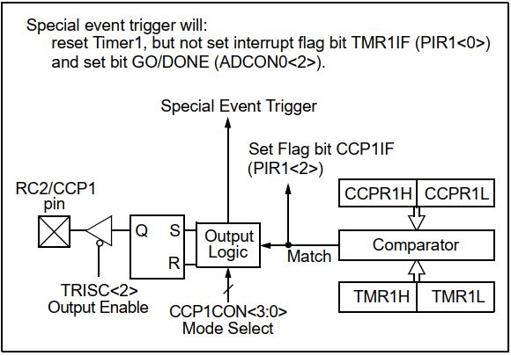
Compare mode operation block diagram

Slide 13
Special Event Trigger
In this mode, an internal hardware trigger is generated which may be used to initiate an action.
The special event trigger output of CCPx resets the TMR1 register pair.
This allows the CCPRx register to effectively be a 16-bit programmable period register for Timer1.
For some devices, the special trigger output of the CCP module resets the TMR1 register pair, and starts an A/D conversion (if the A/D module is enabled).
The special event trigger will not set the Timer1 interrupt flag bit, TMR1IF.

Slide 14
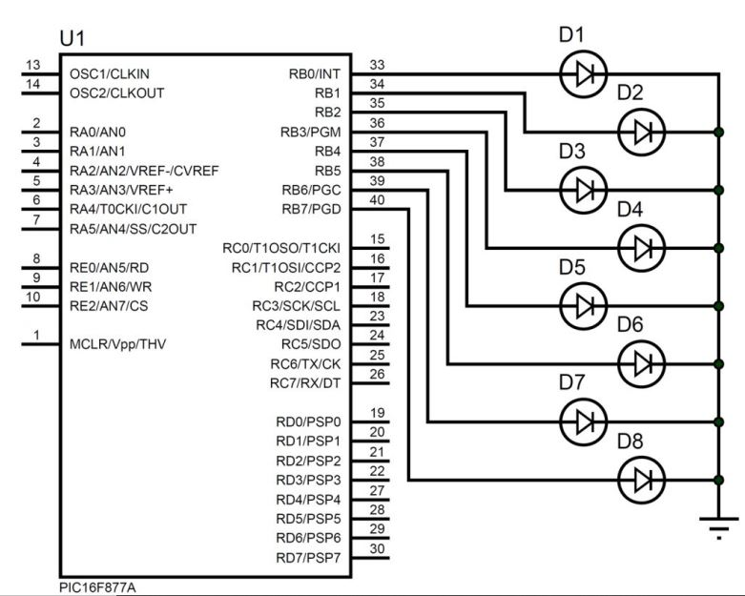
Circuit Diagram

Slide 15
Compare Mode Program
#include<pic.h>
void main()
{
TRISB=0x00;
PORTB=0xFF;
CCP1CON=0x08;
T1CON=0x31;
CCPR1L=0XFF;
CCPR1H=0XFF;
while(1)
{
while(!CCP1IF==1);
CCP1IF=0;
PORTB=~PORTB;
}
}

Slide 16
PULSE WITH MODULATION

Slide 17
What is Modulation
Modulation is the process of converting data into electrical signals optimized for transmission.
Modulation is the process of changing the parameters of the carrier signal, in accordance with the instantaneous values of the modulating signal.

Slide 18
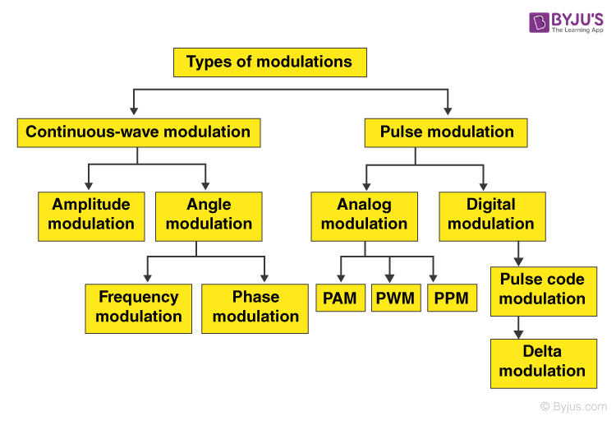
Modulation Types

Slide 19
Pulse Width Modulation
Pulse Width Modulation(PWM) is a digital technology that uses the amount of power delivered to a device that can be changed. It generates analogue signals by using a digital source.
The duty cycle and frequency of a PWM signal determine its behavior.
Application –brightness control, volume control, motor speed control ,acceleration

Slide 20
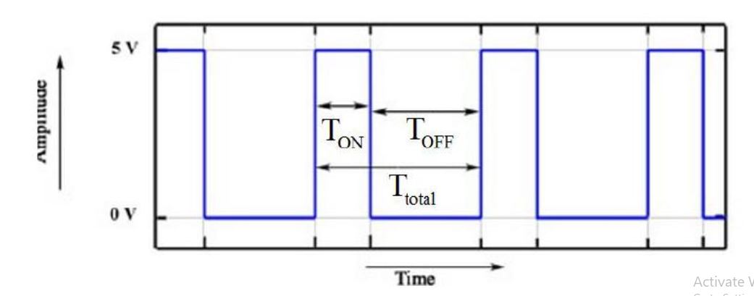
Duty cycle = T_{ON}
T_{ON} + T_{OFF}

Slide 21
PWM In PIC16F877A
PIC16F877A microcontroller has two independent CCP(Capture/Compare/PWM) modules, named as CCP1 and CCP2. Each CCP module has two 8-bit registers(CCPxH, CCPxL) that can be use as:
16 bit Capture Register
16 bit Compare Register
10-bit PWM Register.

Slide 22
Registers Used For PWM
PR2 - Period Register
The Period value will be added to the PR2 register
CCP1CON
This register is used to Configure the CCP module for Capture/Compare/PWM operation.
CCPRxL
This register holds the 8-Msb bits of PWM, lower 2-bits will be part of CCPxCON register. It will be stored in CCPxX & CCPxY.
TMR2
Free running counter which will be compared with CCPR1L and PR2 for generating the PWM output.

Slide 23
Steps to Configure PWM
Configure the CCP1 module for PWM operation.
Set the PWM period by writing to the PR2 register.
Set the PWM duty cycle by writing to the CCPR1L register and CCP1CON<5:4> bits.
Make the CCP1 pin an output by clearing the TRISC<2> bit.
Set the TMR2 Prescale value and enable Timer2 by writing to T2CON.

Slide 24
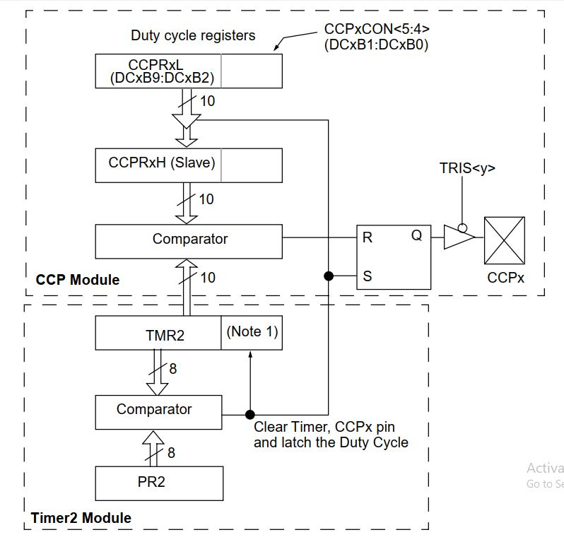
PWM block diagram

Slide 25
PR2 - Period Register
PWM Period = [(PR2) + 1] x 4 x Tosc x (TMR2 Prescale Value)
Duty Cycle
PWM Duty Cycle =(CCPR1L:CCP1CON<5:4>) x Tosc x (TMR2 Prescale Value)

Slide 26
PR2 - Calculaion
PWM period = [(PR2) + 1] * 4 * TOSC * (TMR2 prescaler)
PWM frequency = 1/ PWM period
PWM frequency = FOSC / (4 * TMR2 pre * (PR2+1) ) (simplified form)
TOSC = 1/FOSC
Duty Cycle
PWM Duty Cycle =(CCPR1L:CCP1CON<5:4>) x Tosc x (TMR2 Prescale Value)

Slide 27
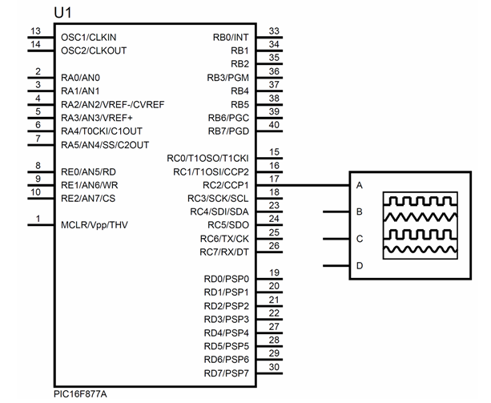
PWM with MCU

Slide 28
PWM program
#include<pic.h>
void pwm_init()
{
CCP1CON = 0x0C;//pwm mode on
TRISC = 0x00;//C AS OUTPUT
T2CON = 0X04;//Timer 2 enable & set PSC = 4
}
void main()
{
pwm_init();
while(1)
{
PR2 = 9;// PERIOD REG
CCPR1L = 5;// DUTY FOR 50%
}
}

Slide 29
Heading
contents

Slide 30
Heading
contents

Slide 31
Heading
contents

