Slide 1

Seven segment Display Interfacing Exercise

Slide 2
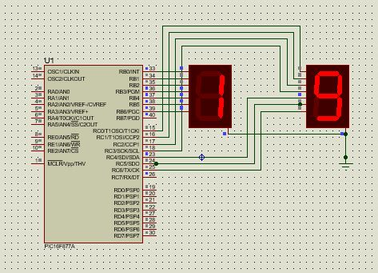
Auto Increment the value 0 to 99

Slide 3
Program for increment 0 to 99
#include<pic.h>
void delay()
{
int i;
for(i=0;i<10000;i++);
}
void main()
{
TRISB = 0x00;
TRISC = 0x00;
PORTB = 0x00;
PORTC = 0x00;
unsigned char numbers[10]= {0x3F,0x06,0x5B,0x4F,0x66,0x6D,0x7D,0x07,0x7F,0x6F};
int i,j;
for(i=0;i<10;i++)
{
PORTB = numbers[i];
for(j=0;j<10;j++)
{
PORTC= numbers[j];
delay();
}
}
}

Slide 4
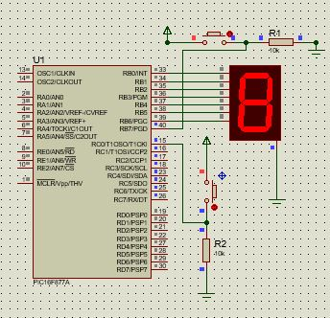
Increment and decrement the value 0 to 9 using switch

Slide 5
Program :
#include<pic.h>
void delay()
{
int i;
for (i=0;i<20000;i++);
for (i=0;i<20000;i++);
}
void main()
{
TRISB = 0x80;
TRISC = 0x01;
PORTB = 0x00;
PORTC = 0x00;
char numbers[10]=
{0x3F,0x06,0x5B,0x4F,0x66,0x6D,0x7D,0x07,0x7F,0x6F};
int i;
while(1)
{
if (PORTB & (1<<7 ))
{
if(i<10)
{
PORTB = numbers[i];
delay();

Slide 6
i++;
}
else
{
i=0;
}
}
else if (PORTC & (1<<0))
{
if(i>0)
{
PORTB = numbers[i-1];
delay();
i--;
}
else
{
i=10;
}
}
}
}

Slide 7
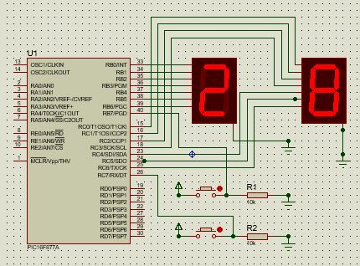
Increment and decrement the value 0 to 99 using switch

Slide 8
#include<pic.h>
#define _XTAL_FREQ 4000000
void delay()
{
int i;
for (i=0;i<10000;i++);
}
void main()
{
TRISB = 0x80;
TRISC = 0x80;
PORTB = 0x00;
PORTC = 0x00;
char numbers[10]={0x3F,0x06,0x5B,0x4F,0x66,0x6D,0x7D,0x07,0x7F,0x6F};
unsigned int i,x=0,y,z;
while(1)
{
// int j=0;
//
if (PORTB & (1<<7 ))
{
if(x>=0 && x<=99)
{
x++;
delay();

Slide 9
}
else
{
x=0;
}
}
else if (PORTC & (1<<7))
{
if(x>=0 && x<=99)
{
x--;
delay();
}
else
{
x=99;
}
}
y=x/10;
z=x%10;
PORTB = numbers[y];
PORTC = numbers[z];
}
}

