Slide 1

Seven segment Display Interfacing in PIC16F877A

Slide 2
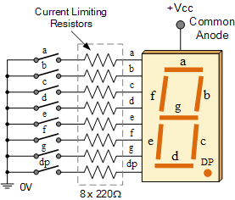
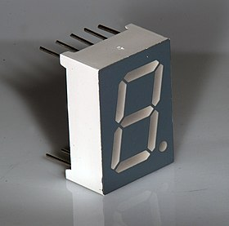
Seven Segment Display
The name 7 segments imply there are 7 LED segments arranged as shown in figure.
After LEDs, these are the easiest interfaces to a microcontroller.
There is also a decimal point or dp. It is used when decimal digits like 5.1 etc are displayed.
Seven segments are widely used in applications where digits[0-9] are required to be displayed.
Although they also display letters A to F .
This is a very simple and convenient way to display numbers in a bright fashion.

Slide 3
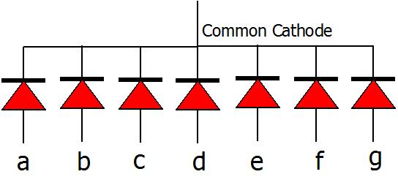
Common Cathode
Common Cathode: In this type of segments all the cathode terminals are made common and tied to GND.
Thus the segments a to g needs a logic High signal(5v) in order to glow.

Slide 4
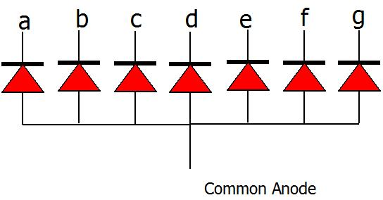
Common Anode
Common Anode: In this type of segments all the anodes terminals are made common and tied to VCC(5v).
Thus the segments a to g needs a logic LOW signal(GND) in order to glow.

Slide 5
Common Cathode Hex values
Below table shows the binary/hex values for displaying the digits on Common cathode seven segment display.
Digit | h | g | f | e | d | c | b | a | Hex Value
0 | 0 | 0 | 1 | 1 | 1 | 1 | 1 | 1 | 0x3f
1 | 0 | 0 | 0 | 0 | 0 | 1 | 1 | 0 | 0x06
2 | 0 | 1 | 0 | 1 | 1 | 0 | 1 | 1 | 0x5b
3 | 0 | 1 | 0 | 0 | 0 | 1 | 1 | 0 | 0x4f
4 | 0 | 1 | 1 | 0 | 0 | 1 | 1 | 0 | 0x66
5 | 0 | 1 | 1 | 0 | 1 | 1 | 0 | 1 | 0x6d
6 | 0 | 1 | 1 | 1 | 1 | 1 | 0 | 1 | 0x7d
7 | 0 | 0 | 0 | 0 | 0 | 1 | 1 | 1 | 0x07
8 | 0 | 1 | 1 | 1 | 1 | 1 | 1 | 1 | 0x7f
9 | 0 | 1 | 1 | 0 | 1 | 1 | 1 | 1 | 0x6f

Slide 6
Common Anode Hex values
Below table shows the binary/hex values for displaying the digits on CommonAnode seven segment display.
Digit | h | g | f | e | d | c | b | a | Hex Value
0 | 1 | 1 | 0 | 0 | 0 | 0 | 0 | 0 | 0xC0
1 | 1 | 1 | 1 | 1 | 1 | 0 | 0 | 1 | 0xF9
2 | 1 | 0 | 1 | 0 | 0 | 1 | 0 | 0 | 0xA4
3 | 1 | 0 | 1 | 1 | 0 | 0 | 0 | 0 | 0xB0
4 | 1 | 0 | 0 | 1 | 1 | 0 | 0 | 1 | 0x99
5 | 1 | 0 | 0 | 1 | 0 | 0 | 1 | 0 | 0x92
6 | 1 | 0 | 0 | 0 | 0 | 0 | 1 | 0 | 0x82
7 | 1 | 1 | 1 | 1 | 1 | 0 | 0 | 0 | 0xF8
8 | 1 | 0 | 0 | 0 | 0 | 0 | 0 | 0 | 0x80
9 | 1 | 0 | 0 | 1 | 0 | 0 | 0 | 0 | 0x90

Slide 7
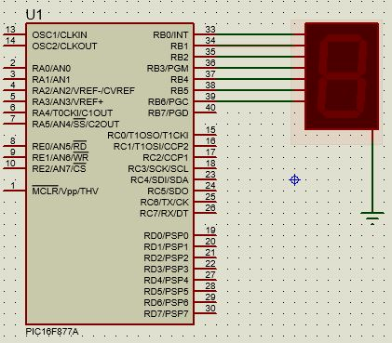
Common Cathode mode of 7-segment interfacing

Slide 8
Print 0-9
#include<pic.h>
void delay()
{
int i;
for(i=0;i<20000;i++);
for(i=0;i<20000;i++);
}
void main()
{
TRISB = 0x00;
PORTB = 0x00;
Char numbers[10]=
{0x3F,0x06,0x5B,0x4F,0x66,0x6D,0x7D,0x07,0x7F,0x6F};
int i;
for (i=0;i<10;i++)
{
PORTB = numbers[i];
delay();
}
}

