Slide 1

16x2 LCD Exercises

Slide 2
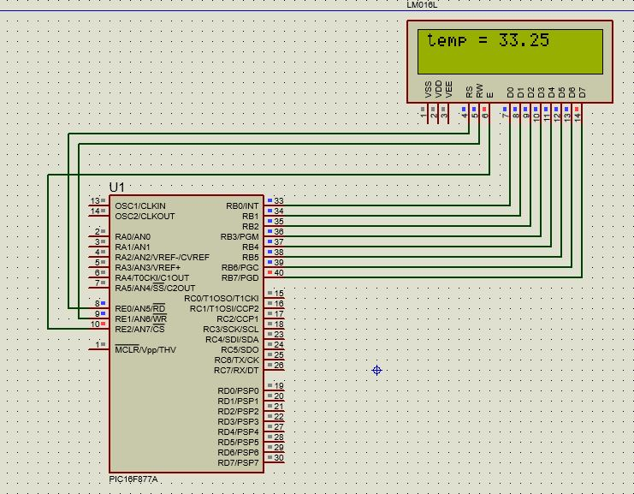
Display float and integer values

Slide 3
LCD UNIT
#include <pic.h>
#define _XTAL_FREQ 4000000
#define RS RE0
#define RW RE1
#define EN RE2
void delay()
{
unsigned char i;
for( i=0;i<255;i++);
}
void cmd(unsigned char cmd)
{
RS=0;//command mode
RW=0;//wrte mode
PORTB=cmd; //command tranfer to LCD display
EN=1; //Enable to send cmd
delay();
EN=0; //disable
}

Slide 4
void display_char(unsigned char data)
{
RS=1;//data mode
RW=0;//wrte mode
PORTB=data; //command tranfer to LCD display
EN=1; //Enable to send data
delay();
EN=0; //disable display data showing
}
void display_string(unsigned char *data)
{
while(*data)
{
display_char(*data++);
}
}
void lcd_init()
{
ADCON1=0x06;//to enable PORTE as digital pins
TRISB=0x00;
TRISE=0x00;
PORTB=0x00;
PORTE=0x00;
cmd(0x0c);//LCD ON
cmd(0x38);//ENABLE 2nd ROW access
cmd(0x80);//set Display to 1st Row}

Slide 5
void main()
{
lcd_init();
float a = 33.25*100;
int b = (int)a;
unsigned int value= b;
unsigned int mod;
cmd(0x80);//set Display to 1st Row
display_string("temp = ");
mod = value%1000;
value = value / 1000;
display_char(value+48);
mod = mod%1000;
value = mod/100;
display_char(value+48);
display_char('.');
mod = mod%100;
value = mod/10;
display_char(value+48);
mod = mod%10;
value = mod/1;
display_char(value+48);
}

Slide 6
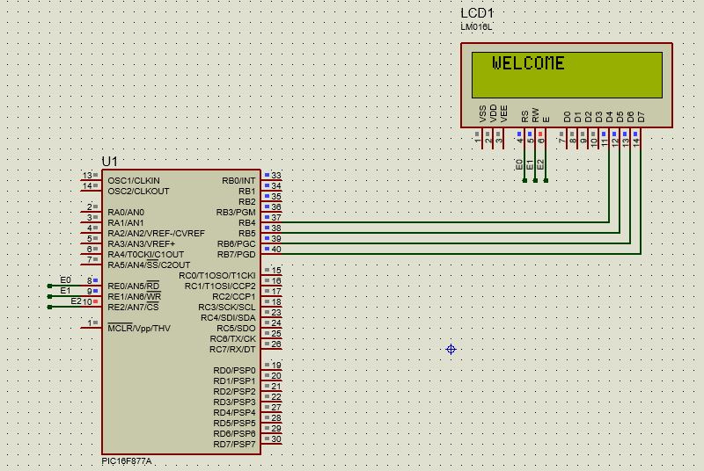
4 – bit mode

Slide 7
Program for 8 bit mode
#include <pic.h>
#define _XTAL_FREQ 4000000
#define RS RE0
#define RW RE1
#define EN RE2
#define cmd 0
#define data 1
void delay()
{
unsigned char i;
for( i=0;i<255;i++);
}
void display(unsigned char a,unsigned int b)
{
RS=b;//data mode
RW=0;//wrte mode
PORTB= a; //command tranfer to LCD display
EN=1; //Enable to send data
delay();
EN=0; //disable display data showing

Slide 8
RS=b;//data mode
RW=0;//wrte mode
PORTB= a <<4; //command tranfer to LCD display
EN=1; //Enable to send data
delay();
EN=0; //disable display data showing
}
void display_string(unsigned char *dat)
{
while(*dat)
{
display(*dat++,data);
}
}
void switch_to_4bit(unsigned char c)
{
RS=0;//data mode
RW=0;//wrte mode
PORTB= c; //command tranfer to LCD display
EN=1; //Enable to send data
delay();
EN=0; //disable display data showing
}

Slide 9
void lcd_init()
{
ADCON1=0x06;//to enable PORTE as digital pins
TRISB=0x00;
TRISE=0x00;
PORTB=0x00;
PORTE=0x00;
switch_to_4bit(0x20);
delay();
display(0x38,cmd);//ENABLE 2nd ROW access
display(0x80,cmd);//set Display to 1st Row
display(0x02,cmd);
display(0x01,cmd);
display(0x0c,cmd);//LCD ON
}
void main()
{
lcd_init();
while(1)
{
display(0x80,cmd);//set Display to 1st Row
display_string(" WELCOME ");
}
}

