Slide 1

Interfacing LCD with PIC16F877A

Slide 2
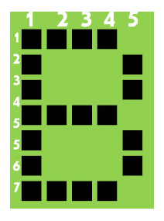
8-bit mode
As per the name the 2x16 has 2 lines with 16 chars on each lines.
It supports all the ascii chars and is basically used for displaying the alpha numeric characters.
Here each character is displayed in a matrix of 5x7 pixels.
Apart from alpha numeric chars it also provides the provision to display the custom characters by creating the pattern.

Slide 3
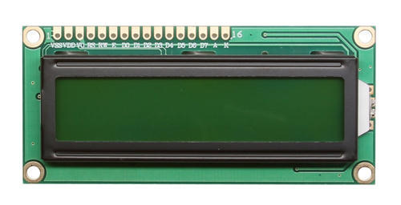
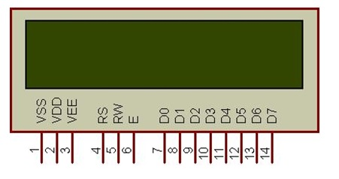
LCD UNIT
Let us look at a pin diagram of a commercially available LCD like LM016L which uses a HD44780 controller and then describe its operation.

Slide 4
Pin Diagram
Pin Number | Symbol | Pin Function
1 | VSS | Ground
2 | VCC | +5v
3 | VEE | Contrast adjustment (VO)
4 | RS | Register Select. 0:Command, 1: Data
5 | R/W | Read/Write, R/W=0: Write & R/W=1: Read
6 | EN | Enable. Falling edge triggered
7 | D0 | Data Bit 0
8 | D1 | Data Bit 1
9 | D2 | Data Bit 2
10 | D3 | Data Bit 3
11 | D4 | Data Bit 4
12 | D5 | Data Bit 5
13 | D6 | Data Bit 6
14 | D7 | Data Bit 7/Busy Flag

Slide 5
Data Bus
As shown in the above figure and table, an alpha numeric lcd has a 8-bit data bus referenced as D0-D7.
As it is a 8-bit data bus, we can send the data/cmd to LCD in bytes.
It also provides the provision to send the the data/cmd in chunks of 4-bit, which is used when there are limited number of GPIO lines on the microcontroller.
Register Select(RS)
The LCD has two register namely a Data register and Command register. Any data that needs to be displayed on the LCD has to be written to the data register of LCD. Command can be issued to LCD by writing it to Command register of LCD. This signal is used to differentiate the data/cmd received by the LCD.
If the RS signal is LOW then the LCD interprets the 8-bit info as Command and writes it Command register and performs the action as per the command.
If the RS signal is HIGH then the LCD interprets the 8-bit info as data and copies it to data register. After that the LCD decodes the data for generating the 5x7 pattern and finally displays on the LCD.

Slide 6
Read/Write(RW)
This signal is used to write the data/cmd to LCD and reads the busy flag of LCD. For write operation the RW should be LOW and for read operation the R/W should be HIGH.
Enable(EN)
This pin is used to send the enable trigger to LCD. After sending the data/cmd, Selecting the data/cmd register, Selecting the Write operation.
A HIGH-to-LOW pulse has to be send on this enable pin which will latch the info into the LCD register and triggers the LCD to act accordingly.

Slide 7
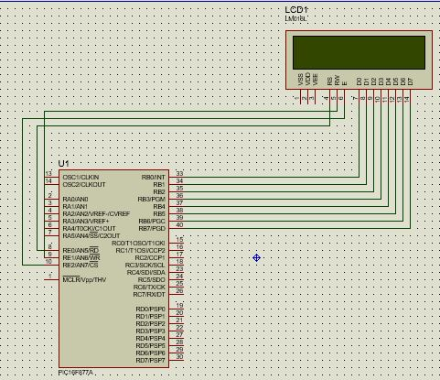
Circuit Diagram

Slide 8
Program for 8 bit mode
#include <pic.h>
#define _XTAL_FREQ 4000000
#define RS RE0
#define RW RE1
#define EN RE2
void delay()
{
unsigned char i;
for( i=0;i<255;i++);
}
void cmd(unsigned char cmd)
{
RS=0;//command mode
RW=0;//wrte mode
PORTB=cmd; //command tranfer to LCD display
EN=1; //Enable to send cmd
delay();
EN=0; //disable
}

Slide 9
void display_char(unsigned char data)
{
RS=1;//data mode
RW=0;//wrte mode
PORTB=data; //command tranfer to LCD display
EN=1; //Enable to send data
delay();
EN=0; //disable display data showing
}
void display_string(unsigned char *data)
{
while(*data)
{
display_char(*data++);
}

Slide 10
void lcd_init()
{
ADCON1=0x06;//to enable PORTE as digital pins
TRISB=0x00;
TRISE=0x00;
PORTB=0x00;
PORTE=0x00;
cmd(0x0c);//LCD ON
cmd(0x38);//ENABLE 2nd ROW access
cmd(0x80);//set Display to 1st Row
}
void main()
{
lcd_init();
unsigned int value=12345;
unsigned int mod;
cmd(0x80);//set Display to 1st Row
display_string("WELCOME");
}

