Slide 1

Timers in PIC16F877A

Slide 2
What is timers ?
The Timer is used to measure the time or generate an accurate time delay.
It is an important application in an embedded system. It maintains the timing of operation in sync with a system clock or an external clock.
The timer is used to count cycles and perform a particular action at a specified moment or optionally start an interrupt cycle.
The digital cycles counted by the timer can be supplied internally through the peripheral clock or externally through a crystal.
Physically, timer is a register whose value is continually increasing to 255, and then it starts all over again: 0, 1, 2, 3, 4...255....0, 1, 2, 3......etc.

Slide 3
Timers In PIC16F877A
The PIC16F877A PIC MCU has three Timer Modules.
They are names as :
Timer0
Timer1
Timer2
The Timer 0 and Timer 2 are 8-bit Timers and Timer 1 is a 16-bit Timer.

Slide 4
Timer0
The Timer0 module timer/counter has the following features:
8-bit timer/counter
Readable and writable
8-bit software programmable prescaler
Internal or external clock select
Interrupt on overflow from FFh to 00h
Edge select for external clock
To start using a timer we should understand some of the fancy terms like 8-bit/16-bit timer, Prescaler, Timer interrupts and Focs.
Now, let us see what each one really means. As said earlier there are both the 8-bit and 16-bit Timers in our PIC MCU, the main difference between them is that the 16-bit Timer has much better Resolution that the 8-bit Timer.

Slide 5
Prescaler
Prescaler is a name for the part of a microcontroller which divides oscillator clock before it will reach logic that increases timer status.
The range of the prescaler is from 1 to 256 and the value of the Prescaler can be set using the OPTION Register.
For example if the value of prescaler is 64, then for every 64th pulse the Timer will be incremented by 1
The Prescaler value is set by PS0 to PS2 bit in OPTION Register and the values are

Slide 6
Fosc
The Fosc stands for Frequency of the Oscillator, it is the frequency of the Crystal used.
The time taken for the Timer register depends on the value of Prescaler and the value of the Fosc.
Timer Interrupt
As the timer increments and when it reaches to its maximum value of 255, it will trigger an interrupt and initialize itself to 0 back again.
This interrupt is called as the Timer Interrupt. This interrupt informs the MCU that this particular time has lapped.

Slide 7
Timer 0 Registers
Register | Description
OPTION_REG | This registers is used to configure the TIMER0 Prescalar, Clock Source etc
TMR0 | This register will hold the count value.When this register overflows (FF to 00) then an interrupt will be generated.

Slide 8
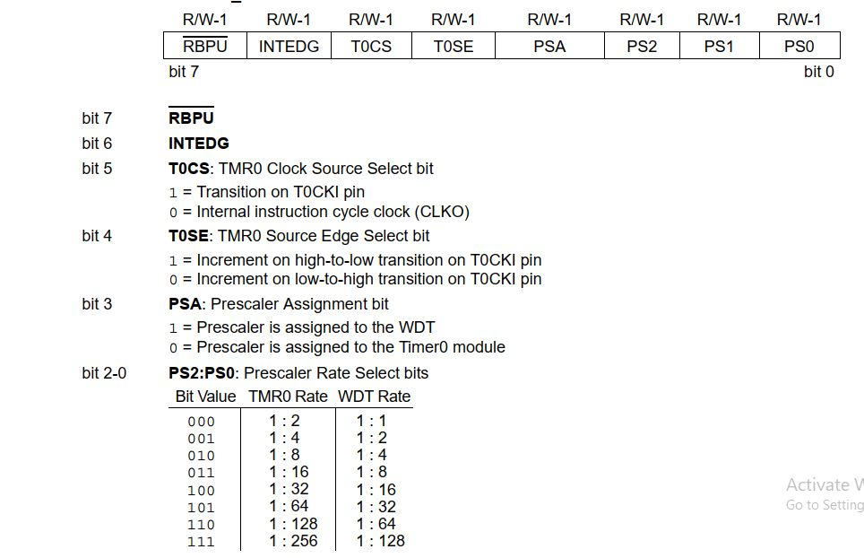
OPTION_REG

Slide 9
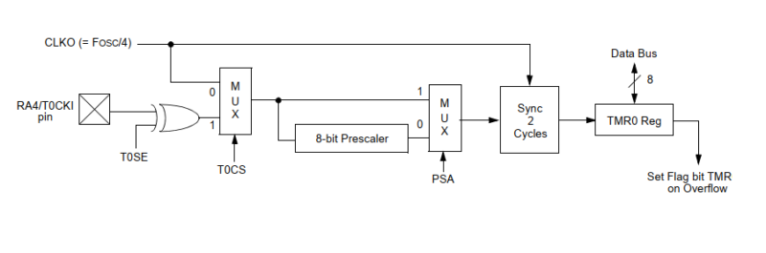
Work Flow of TIMER 0

Slide 10
Timer 0 can be operated both as a timer and counter.
The Timer 0 stores the value TMR0 registers
All the parts to the left are the clock source circuits.
T0CON (Timer 0 Control) register is used to program the timer and includes the bits shown in figure (T0CS, PSA etc.)
The clock source can be internal or external and is controlled by T0CS bit.
In some cases, the clock coming from the oscillator could be too fast for our applications: we can lower it by using the frequency prescaler.
The prescaler is a circuit that divides the signal frequency by 2, 4, 8, 16, …, 256.
The prescaler is activated by bit PSA. Prescaler value is written to TMR0 register.

Slide 11
Delay Calculation
This OPTION register is for configuring the timer. The time needed for the particular application should be defined by the user for defining the time the following formula is used
F_{out =} F_{clk}
_{4*Prescaler*(256-TMR0)*Count}
T_{out =} t / f_{out}
If we want 1 sec delay in our program the following calculation is to be performed to attain the desired 1 secs.
F_{out =} F_{clk} = 1 Hz
_{4*Prescaler*(256-TMR0)*Count}
T_{out =} t / f_{out} = 1 / 1Hz = 1 sec

Slide 12
_{Count =} F_{clk} = 4 mhz = 15.25
4*Prescaler*(256-TMR0)*F out 4*256*(256-0)*1 hz
_{count = 15}

Slide 13
Program to create exact 1sec delay using Timer0
#include<pic.h>
void timer0_sec(unsigned int delay);
void timer0_init()
{
OPTION_REG = 0X87;
TMR0 = 0x00;
}
unsigned int count=0;
void main()
{
timer0_init();
TRISB = 0x00;
PORTB =0x00;
while(1)
{
PORTB=~PORTB;
timer0_sec(2);
}
}

Slide 14
void timer0_sec(unsigned int delay)
{
while(1)
{
if(TMR0IF)
{
TMR0IF=0;
count++;
if(count==(15*delay))
{
count=0;break;
}
}
}
}

Slide 15
Timer1
The main features of Timer 1 is given below:
16-bit timer/counter. It consists of two 8 bit (8+8) registers (TMR1H, TMR1L)
Readable and writable
Internal or External clock select.
1,2,4,8 programmable Prescaler
External can be syn. or asyn.
Interrupt on overflow from FFFFh to 0000h
Second Crystal Permitted

Slide 16
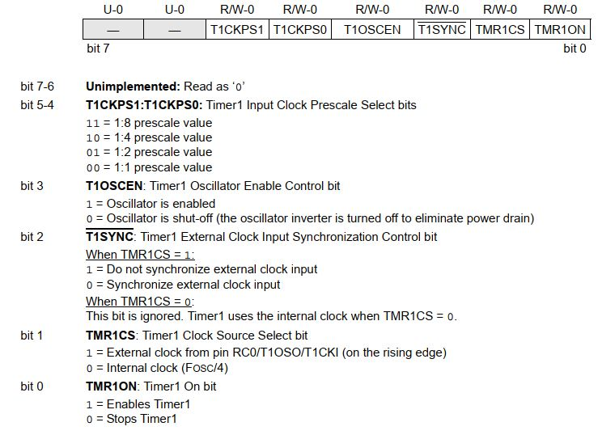
T1CON: Timer1 Control Register

Slide 17
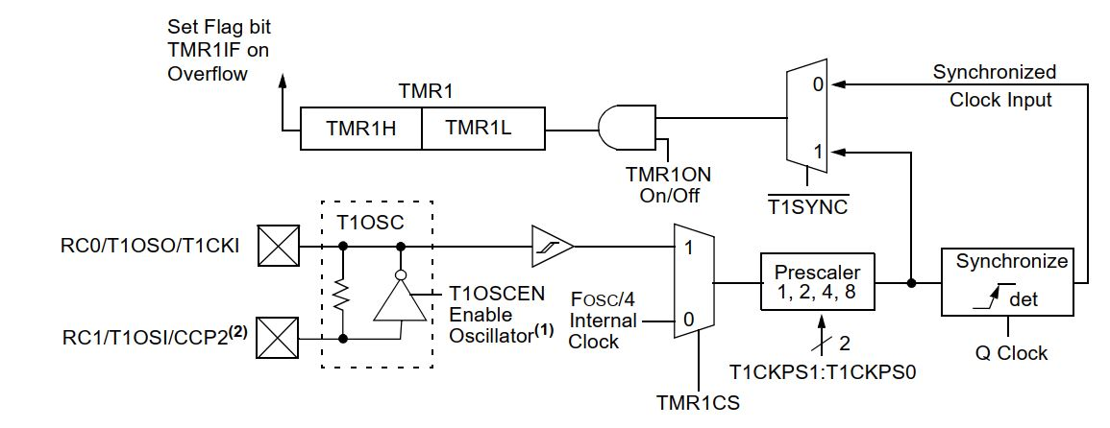
Work Flow of Timer 1

Slide 18
Timer 1 clock source(TMR1CS) bit is used to select the clock source.
If TMR1CS becomes 0, then the internal clock is given to the input of the timer peripheral. If we programmed on to 1, it will get the clock source from the external source. That external source can be T1CKI or a crystal oscillator.
When it can be a crystal oscillator, then T1OSC is logic one if it is enabled it will get the clock pulse from the crystal oscillator. If it is disabled it will get the clock pulse directly from the T1CKI pin.
Prescaler bit is used to divide the incoming clock any one of the factors(1,2,4,8)
T1SYNC bit is logic 1 it will not be synchronized. The external clock will not be synchronized with the internal oscillator clock. If TISYNC is 0, it will be synchronized and it will be given to the AND gate.
Another bit of the AND gate is TMR1 ON bit. If TMRI becomes 1 then the clock moves to the TMR1 register and it will become 0 the AND gate also becomes 0(TMR1 will not counting).

Slide 19
Delay Calculation
TIMER1 is also having the formula for calculating the value for obtain the desired time for the particular operation.
F_{out =} F_{clk}
_{4*Prescaler*(65536-TMR1)*Count}
T_{out =} t / f_{out}
If we want 2 sec delay in our program the following calculation is to be performed to attain the desired 2 secs.
F_{out =} F_{clk} = 0.5 Hz
_{4*Prescaler*(65536-TMR1)*Count}
T_{out =} t / f_{out} = 1 / 0.5Hz = 2 sec

Slide 20
_{Count =} F_{clk} = 4 mhz = 30.51
4*Prescaler*(65536-TMR1)*F out 4*1*(65536-0)*1 hz
_{count = 30}

Slide 21
Blinking LED using Timer1
#include<pic.h> //Using Timer1
int count=0;
void main()
{
TRISB=0X00;
PORTB=0X00;
TMR1L=0x00;
TMR1H=0x00;
T1CON=0X01;
while(1)
{
while(!TMR1IF);
TMR1IF=0;
count++;
if(count==30)
{
PORTB=~PORTB;
count=0;
}
}
}

Slide 22
Timer 2
The main features of Timer 0 is given below:
Two 8-bit registers (TMR2 and PR2)
Readable and Writable
A Prescaler and a Postscaler
Connected only to an internal clock – 4 MHz crystal
Interrupt on overflow

Slide 23
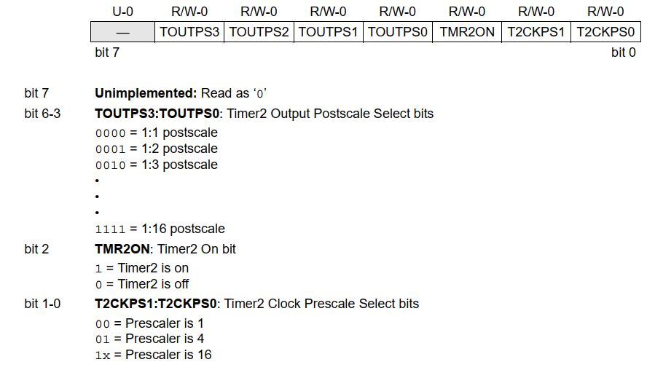
T2CON: Timer2 Control Register

Slide 24
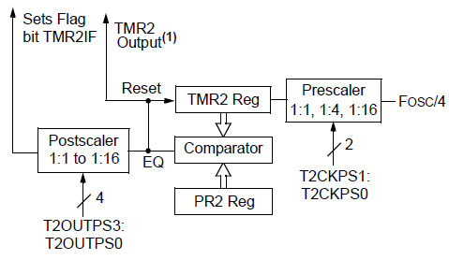
Work Flow of Timer 2

Slide 25
Get the clock from the FOSC/4 and then going to the Prescaler. The Prescaler divides the incoming clock frequency from some factors(it maybe 1,4,16)
Then this clock frequency is given to the TMR2 register, it will count the incoming clock pulse.
As it is counting the incoming clock pulses the value present in the TMR2 register is also compared with PR2 register.
If TMR2 and PR2 register are equal, the output of the comparator will reset the TMR2 register.
Then this equal output is given to the input of the Postscaler. It is not generated an interrupt immediately.
When the Postscaler bit obtains any of the value, it will generate some delay and TMR2 Interrupt Flag bit set.

Slide 26
Delay Calculation
TIMER2 is also having the formula for calculating the value for obtain the desired time for the particular operation.
F_{out =} F_{clk}
4*Prescaler*(PR2-TMR2)*Postscaler*Count
T_{out =} t / f_{out}
If we want 1 sec delay in our program using Timer2, the following calculation is to be performed to the value of count. Let us assume that the frequency division by prescaler will be 1:1 and postscaler will be 1:16, Set the TMR1=0 and PR2=255.
F_{out =} F_{clk} = 1 Hz
4*Prescaler*(PR2-TMR2)*Postscaler*Count
T_{out =} t / f_{out} = 1 / 1Hz = 1 sec

Slide 27
_{Count =} F_{clk} = 4 mhz = 244.1
4*Prescaler*(PR2-TMR1)*Postscaler*F out 4*1*(256-1)*1 hz
_{count = 244}

Slide 28
Heading
#include<pic.h>
int Count=0;
void main(void)
{
T2CON=0b01111100; //T2CON Initiation
TMR2=0; //Start value=0
PR2=0XFF; //Stop value=255
while(1)
{
while(!TMR2IF); //Program stay here till TMR2IF goes to "1"
TMR2IF=0; //after TMR2IF goes to "1" - reset it
Count++; //increase count by 1
if(Count==224)
{
Count=0; //if count reaches 244 - reset it
}
}
}

Slide 29
Heading
contents

Slide 30
Heading
contents

Slide 31
Heading
contents

Slide 32
Heading
contents

