Slide 1
ARUL PRAKASH N
Final Project
3/21/2024 Annual Review

Slide 2
PROJECT TITLE
Stock Market Analysis
3/21/2024 Annual Review

Slide 3


AGENDA
Problem Statement
Project Overview
Who are the end users?
Solutions and value of propositions
WOW factor in the solution
Modelling
Results
3/21/2024 Annual Review

Slide 4

PROBLEM STATEMENT
Given historical stock market data for a specific stock (e.g., AAPL), the task is to develop a predictive model that can classify whether the closing price of the stock will increase or decrease compared to the previous day. The dataset includes features such as
opening price, highest price, lowest price, and
trading volume. Additionally, we aim to incorporate
natural language processing (NLP) techniques to
analyze textual data related to the stock, such
as news articles or social media sentiment.
3/21/2024 Annual Review

Slide 5

PROJECT OVERVIEW
The stock market is influenced by various factors, including economic indicators, company performance, and market sentiment. Predicting stock price movements is challenging due to the complexity and volatility of financial markets. This project aims to develop a predictive modeling solution that leverages historical stock market data and natural language processing (NLP) techniques to forecast whether the closing price of a stock will increase or decrease compared to the previous day.
3/21/2024 Annual Review

Slide 6

WHO ARE THE END USERS?
Investors:
Individual investors who buy and sell stocks for their personal investment portfolios.
Traders:
Day traders and swing traders who engage in short-term buying and selling of stocks to capitalize on price movements.
Financial Analysts:
Financial analysts who provide research and insights on specific stocks or sectors to investors and clients.
Financial Advisors:
Financial advisors who offer investment advice and portfolio management services to individual clients or organizations.
Risk Managers:
Risk managers within financial institutions who assess and manage the risks associated with investment portfolios and trading activities.
Regulators:
Regulatory agencies responsible for overseeing financial markets and ensuring compliance with rules and regulations.
Researchers:
Academic researchers and scholars who study financial markets, trading strategies, and the impact of technology on investment practices.
3/21/2024 Annual Review

Slide 7

YOUR SOLUTION AND ITS VALUE PROPOSITION
The solution provided offers a comprehensive approach to stock market analysis by combining numerical data analysis with natural language processing (NLP) techniques. Here's the value proposition of the solution:
Predictive Modeling: The solution utilizes machine learning algorithms, specifically Random Forest Classifier, to predict whether the closing price of a stock will increase or decrease compared to the previous day
Incorporation of NLP: The solution goes beyond traditional numerical analysis by incorporating NLP techniques to analyze textual data related to the stock, such as news articles or social media sentiment.
Actionable Insights: By visualizing stock price trends, feature importance, sentiment analysis results, and topic distributions, the solution provides actionable insights to investors, traders, and financial analysts.
Robust Performance: The solution's performance is evaluated using classification metrics such as accuracy, precision, recall, and F1-score. Through techniques like cross-validation, the model's robustness and generalization capabilities are ensured, providing users with reliable predictions even in dynamic market conditions.
User-Friendly Interface: The solution can be deployed in a user-friendly
interface where users can interact with the predictive model, visualize
results, and interpret insights in a clear and intuitive manner.
3/21/2024 Annual Review

Slide 8

THE WOW IN YOUR SOLUTION
The "wow" factor in the solution lies in its comprehensive approach to integrating both numerical data analysis and natural language processing (NLP) techniques to provide actionable insights for stock market analysis. Here are some aspects that contribute to the "wow" factor:
Integration of Numerical and Textual Data: The solution combines numerical features from historical stock market data with textual data from news articles, social media, or other sources. By incorporating NLP techniques, the model gains a deeper understanding of market sentiment and key themes impacting stock prices.
Predictive Modeling for Stock Price Movement: The development of a predictive model using machine learning techniques, such as RandomForestClassifier, enables the classification of whether the stock price will increase or decrease. This empowers users to make informed decisions about buying or selling stocks based on predicted price movements.
Visualization and Interpretation: The solution includes visualizations of stock price trends over time, feature importance analysis, sentiment analysis results, and topic distributions. These visualizations help users to interpret the model's predictions, understand market dynamics, and identify actionable insights.
Customization and Adaptability: The solution can be customized and adapted to meet the specific needs of different end users, whether they are individual investors, institutional traders, financial analysts, or regulators. It provides flexibility in incorporating additional features, refining algorithms, and adjusting parameters to optimize performance and relevance.
Real-time Deployment and Monitoring: The solution can be deployed in a real-time environment, allowing users to access up-to-date predictions and insights for timely decision-making. Continuous monitoring ensures that the model remains accurate and effective in capturing changing market conditions.
3/21/2024 Annual Review
8

Slide 9
MODELLING
Data Preparation:
Load historical stock market data.
Generate binary labels indicating price increase or decrease compared to the previous day.
Feature Engineering:
Extract relevant features from the data (e.g., moving averages, technical indicators).
Optionally, incorporate sentiment analysis features from textual data.
Model Selection:
Choose a classification algorithm (e.g., Random Forest, Logistic Regression).
Model Training:
Train the selected model on the prepared data.
Model Evaluation:
Evaluate the model's performance using metrics like accuracy, precision, recall.
Fine-Tuning:
Tune hyperparameters and experiment with feature combinations to optimize performance.
Interpretation and Validation:
Interpret model predictions and assess feature importance.
Validate performance using out-of-sample data or backtesting.
Deployment and Monitoring:
Deploy the trained model for real-time predictions.
Monitor performance and update as needed.
3/21/2024 Annual Review
9

Slide 10
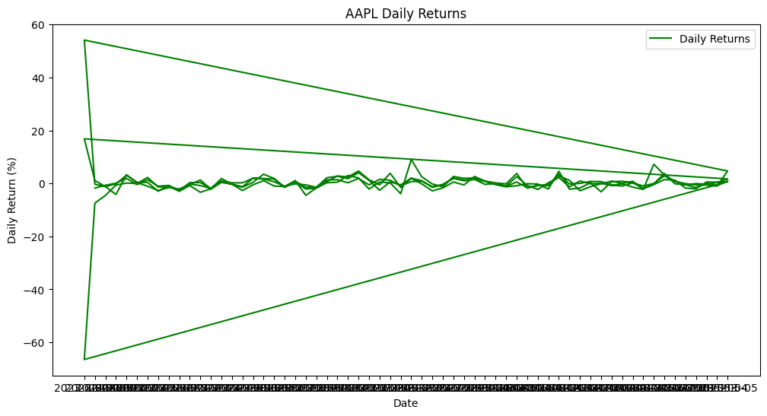
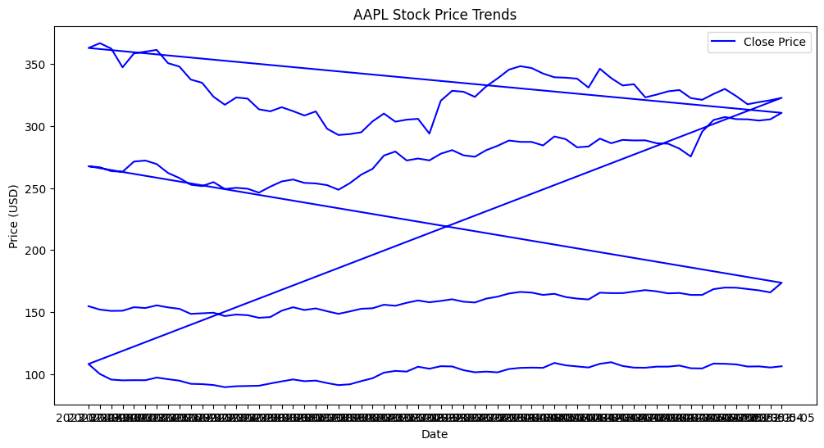
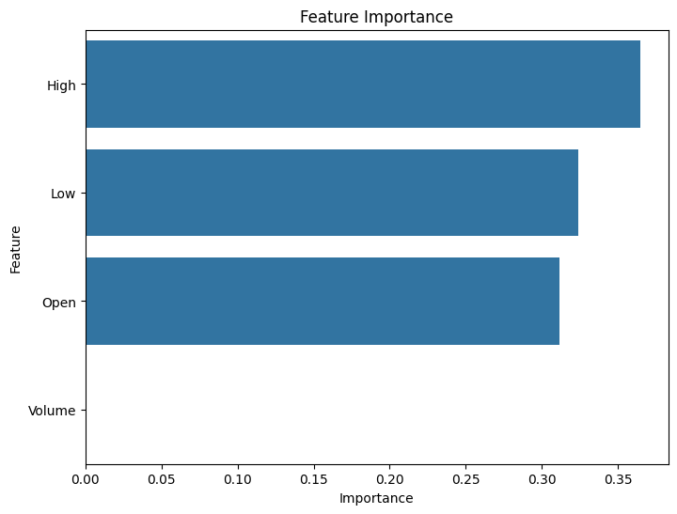
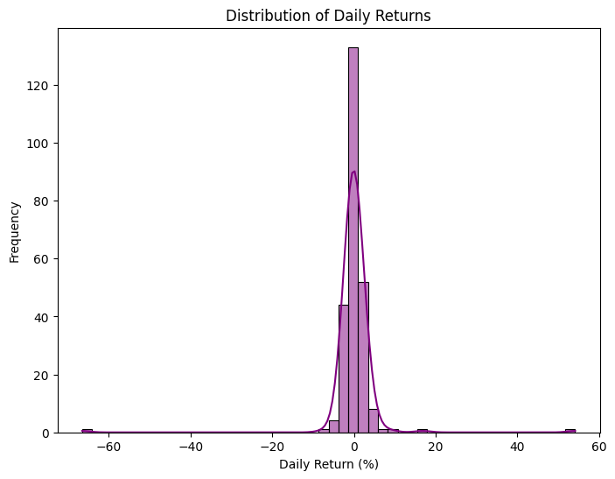
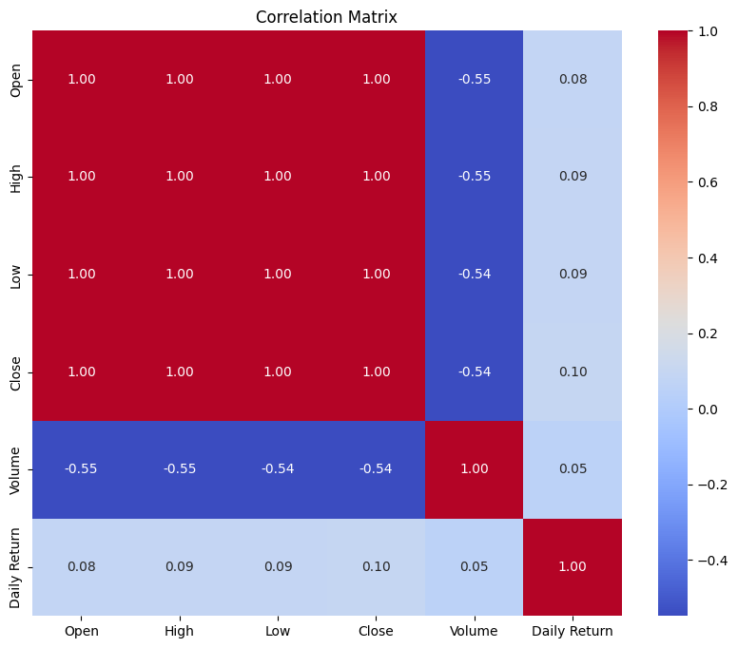
RESULTS
Demo Link
https://colab.research.google.com/drive/1NrPYJkNjVtFsLbWUicXsraTWHoQHYDGW?usp=sharing
3/21/2024 Annual Review
10

