Slide 1
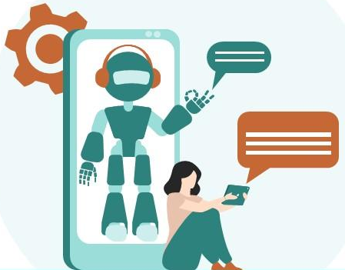
CHAT BOT
GUIDED BY
PROF.SONA MAM
TEAM MEMBERS
S.SHUNMUGA RAJESHWARAN
RAMASAMY
KAMESH
ARUL RAJAVEL

Slide 2
INTRODUCTION:
A chatbot is a computer program that uses artificial intelligence (AI) and natural language processing (NLP) to understand customer questions and automate responses to them, simulating human conversation.Chatbots can make it easy for users to find the information they need by responding to their questions and requests—through text input, audio input, or both—without the need for human intervention.
WHAT IS A CHATBOT?

Slide 3
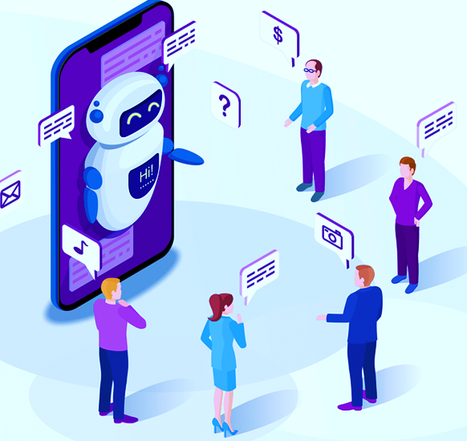


ABSTRACT:
Chatbot is an application where the computer talks with the user like an human. The software can understand the discussion it is having with the user and respond accordingly. Chatbot uses the concepts of Natural Language Processing (NLP) and Artificial Intelligence to achieve this task . They utilize Machine
Learning and Artificial Intelligence technologies like voice
recognition, speech-to-text conversion algorithms, etc to
interpret the user’s sentiments.

Slide 4
NLP FOR CHATBOT
NLP is an applied artificial intelligence (AI) program that helps your chatbot analyze and understand the natural human language communicated with your customers. With NLP, your chatbot will be able to streamline more tailored, unique responses, interpret and answer new questions or commands, and improve the customer’s experience according to their needs. Using NLP technology, you can help a machine understand human speech and spoken words. NLP combines computational linguistics that is the rule-based modelling of the human spoken language with intelligent algorithms such as statistical, machine, and deep learning algorithms.

