Slide 1

CHAT BOT
GUIDED BY
PROF.SONA MAM
TEAM MEMBERS
S.SHUNMUGA RAJESHWARAN
A.RAMASAMY
R.KAMESH
ARUL RAJAVEL

Slide 2
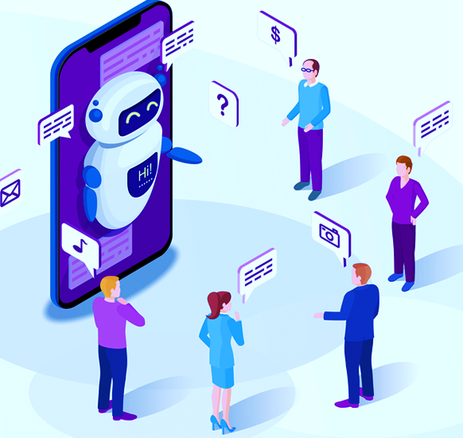
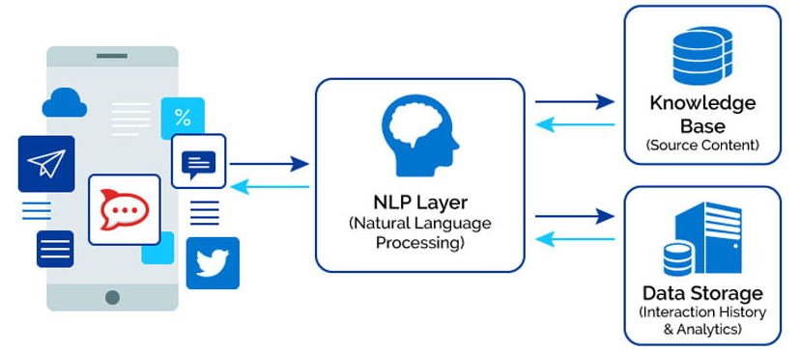
ABSTRACT:
In the project, we have focused on designing a textual communication application namely chatbot for our college website. The proposed chatbot assists in answering questions provided by the users.
The Chatbot software can understand the discussion it is having with the user and respond accordingly. It uses the concepts of Natural Language Processing (NLP) and Artificial Intelligence to achieve this task .

Slide 3
INTRODUCTION
A chatbot can be defined as an AI based computer program that simulates human conversations. They are also known as digital assistants that understand human capabilities. Bots interpret the user intent, process their requests, and give prompt relevant answers. Chatbots work by analyzing and identifying the intent of the user’s request to extract relevant entities, which is the most important task of a chatbot. Once the analysis is done appropriate response is delivered to the user. Chatbots work by adopting three classification methods.
Pattern matching Natural language understanding (NLU) Natural language processing (NLP)

Slide 4
PROBLEM STATEMENT
If a certain person has a question that he needs to enquire, he/she would need to visit varied departments gathering segments of the solution to the question he had. As we see, whenever admission days are nearer all college members strive their best to guide parents and students to induce into course they want. Our Chatbot will reduce half the work by giving students brief information concerning admission, courses, fees and lots of additional. All the queries by students will be answered through the chatbot.
OBJECTIVES
The main objective of "Chatbot" is to minimize the time required to solve the queries of an user , reduce the work load on the college’s office staff , save the time and strength of an user of visiting and contacting the administration office often , keep the user fully updated about the ongoing and upcoming events of college , etc.

Slide 5
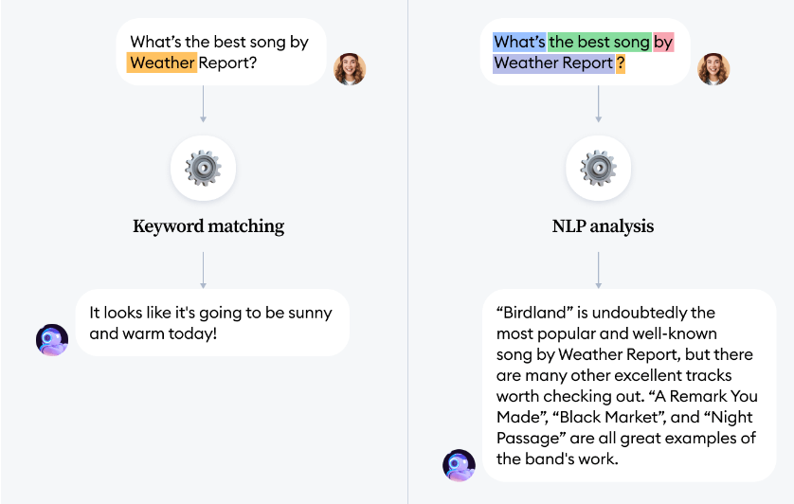
NLP FOR CHATBOT
NLP is an applied artificial intelligence (AI) program that helps your chatbot analyze and understand the natural human language communicated with your customers. With NLP, your chatbot will be able to streamline more tailored, unique responses, interpret and answer new questions or commands, and improve the customer’s experience according to their needs. Using NLP technology, you can help a machine understand human speech and spoken words. NLP combines computational linguistics that is the rule-based modelling of the human spoken language with intelligent algorithms such as statistical, machine, and deep learning algorithms.

Slide 6
LITERATURE SURVEY
AUTHOR(S) | YEAR | TITLE OF PAPER | RESEARCH METHODOLOGY
Yinyin Liu and Xiaolong Wang | 2020 | "A survey on chatbot design techniques in speech conversation systems" | design techniques for chatbots in speech conversation systems, including natural language processing (NLP), dialogue management, and user modeling.
Hua Wei and Qi Yu | 2019 | "A Review of Chatbot Technologies Using Natural Language Processing" | This paper provides an overview of different chatbot technologies, including rule-based systems, retrieval-based models, and generative models.
Saurabh Singhal, Ishan Saxena, and Divya Upadhyay | 2021 | A Review of Natural Language Processing Techniques for Chatbots" | synthesized the findings from the selected papers and discussed the key insights, challenges, and opportunities for natural language processing techniques in chatbots.

Slide 7
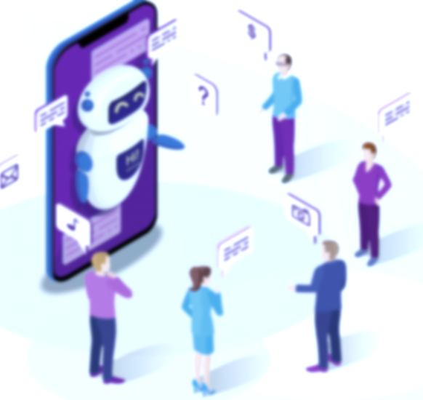




Exisiting system:
Lack of Understanding:
Chatbots may fail to understand user queries due to limitations in their natural language processing algorithms.
Lack of Contextual Understanding:
For example, if a user asks "What is the weather like today?" and the chatbot responds with "I don't know what you mean", it indicates that the chatbot
is unable to comprehend the context of the user query.
Inability to Handle Complex Queries:
Chatbots may struggle to handle complex queries that require multiple steps or pieces of information.
Lack of Emotion and Empathy:
For example, a user may express frustration with a chatbot, and the chatbot may respond with a neutral or irrelevant message, which can further aggravate the user.

Slide 8
PROPOSED SYSTEM:
Implement natural language processing (NLP):NLP is a crucial component of a chatbot , as it enables the chatbot to understand user input and generate appropriate responses. Implement NLP technology such as machine learning algorithms to train the chatbot.
By using advanced NLP algorithms, such as deep learning models, the proposed chatbot system can better understand user queries and generate more accurate responses.
Ensuring that the chatbot responds quickly to user queries can improve user satisfaction and engagement. This can be achieved through optimization of the chatbot's algorithms and infrastructure.
Continuous learning and improvement in chatbots can be achieved through a process called machine learning.

Slide 9

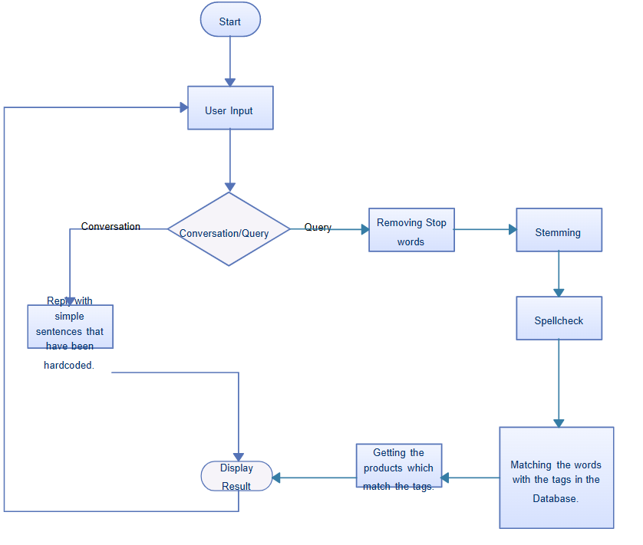
W
O
R
K
Flow:

