Slide 1
Legal Contract Simplification with LLMs

Slide 2
Abstract
This project uses Large Language Models (LLMs) to simplify complex legal contract language into easy-to-understand text, aiming to improve accessibility and comprehension of legal content.

Slide 3
Objective
To develop an AI-powered tool that simplifies legal contract clauses into plain English.
Reduce legal complexity
Assist non-lawyers in understanding legal terms
Use LLMs like GPT or T5

Slide 4
Problem Statement
Legal contracts are difficult to understand due to complex language and terminology.
Legalese creates confusion
Inaccessibility for laypeople
Need for readable contracts

Slide 5
Scope
Focuses on clause-level simplification using AI and is applicable in multiple domains.
Simplifies legal text, not replaces legal advice
Useful for HR, finance, startups
Supports English legal documents

Slide 6
Dataset
A dataset containing legal clauses and their simplified counterparts was used.
Format: txt Files

Slide 7
Methodology
The process involves model selection, training, and inference.
LLM used: t5-base or GPT
Pipeline: Text-to-Text Generation
Evaluation using BLEU and readability

Slide 8
System Architecture
The simplification system follows this flow:
Input: Legal Clause
Preprocessing → LLM → Output
Output: Simplified Text

Slide 9
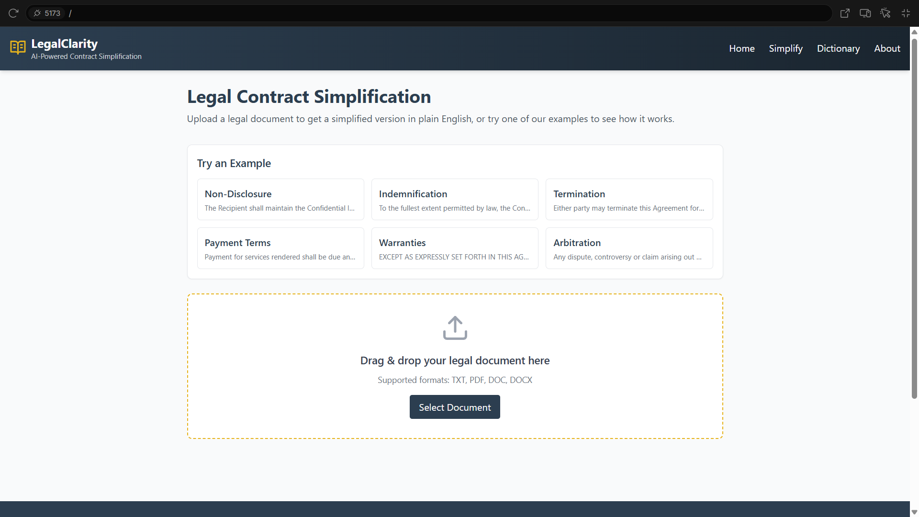
Execution

Slide 10
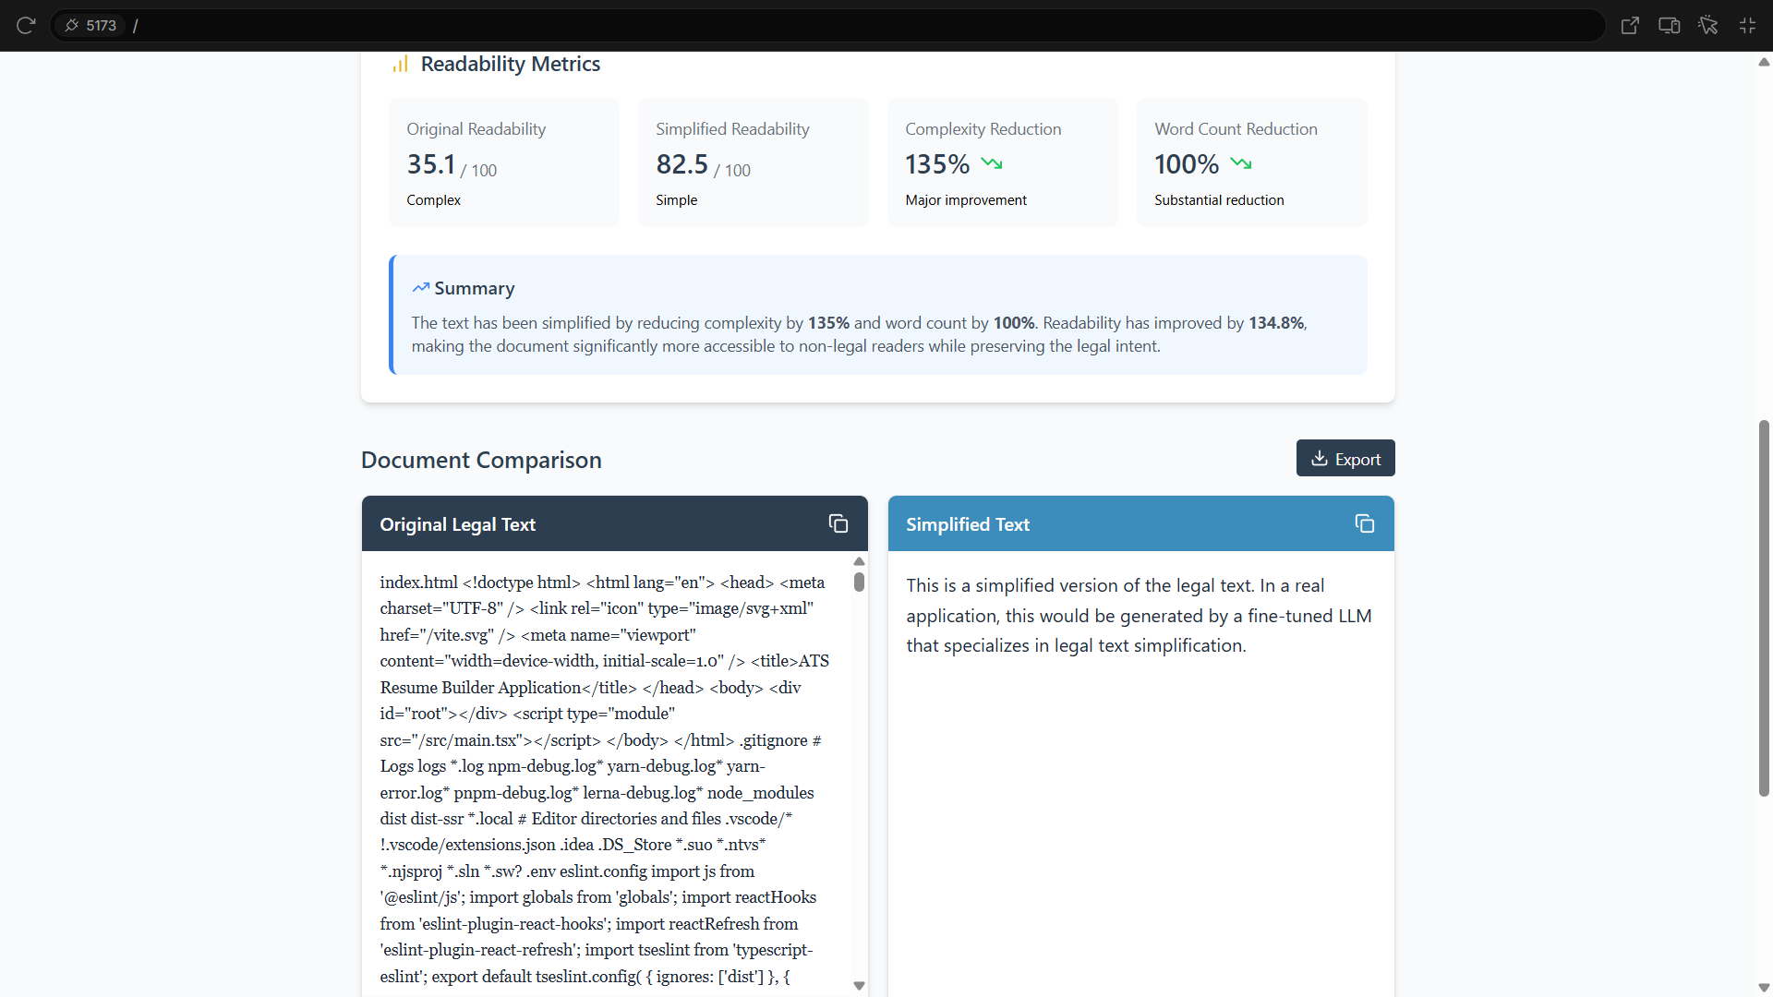
Result of Simplified Text

Slide 11
Conclusion
LLMs can significantly improve legal document accessibility.
Effective simplification achieved
Future: support more languages
Add context-aware understanding

