Slide 1
AngularJS
By Arul

Slide 2
Day 1
Introduction
SPA Overview
About AngularJS and Features
Setting up the Environment
First AngularJS Program
Comparing AngularJS with JQuery
Bootstrapping AngularJS App
AngularJS Data Binding
Creating Demo App & Setup

Slide 3

Introduction

Slide 4
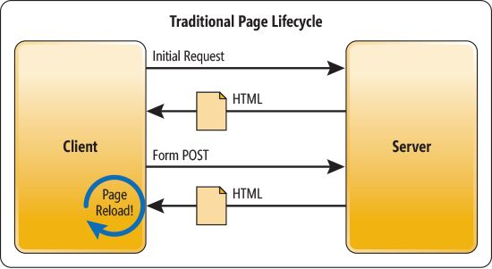
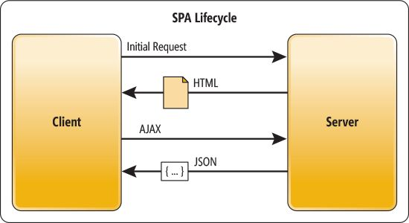
SPA Overview
Traditional site Example: https://www.hcltech.com
SPA Example : https://docs.angularjs.org/guide/i

Slide 5


About AngularJS and Features
What is AngularJS ?
AngularJS is one of the JavaScript based open-source front-end web application framework maintained by Google
Similar to Angular other popular front-end lib/framework :

Slide 6
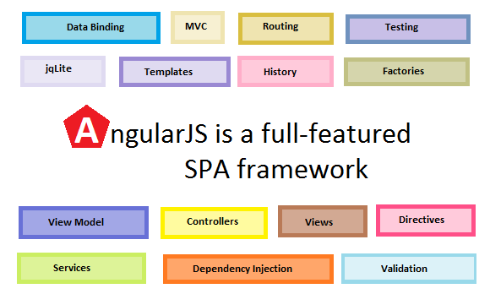

Slide 7
Concept | Description
Template | HTML with additional markup
Directives | extend HTML with custom attributes and elements
Model | the data shown to the user in the view and with which the user interacts
Scope | context where the model is stored so that controllers, directives and expressions can access it
Expressions | access variables and functions from the scope
Compiler | parses the template and instantiates directives and expressions
Filter | formats the value of an expression for display to the user
View | what the user sees (the DOM)

Slide 8
Data Binding | sync data between the model and the view
Controller | the business logic behind views
Dependency Injection | Creates and wires objects and functions
Injector | dependency injection container
Module | a container for the different parts of an app including controllers, services, filters, directives which configures the Injector
Service | reusable business logic independent of views

Slide 9
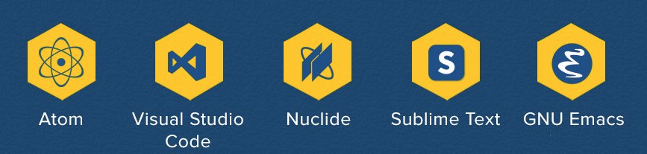


Setting up the Environment

Slide 10
First AngularJS Program
<html ng-app>
<head>
<script src="js/angular.js"></script>
</head>
<body ng-init="name='everyone'">
<input type="text" ng-model="user"/>
<h1>Hello {{user}} </h1>
</body>
</html>

Slide 11


Comparing With JQuery

Slide 12
Bootstrapping
Angular initializes / bootstraps automatically upon DOMContentLoaded event or when the angular.js script is downloaded to the browser and the document.readyState is set to complete. At this point AngularJS looks for the ng-app directive. When the ng-app directive is found then Angular will:
Load the module associated with the directive.
Create the application injector.
Compile the DOM starting from the ng-app root element.
This process is called auto-bootstrapping.

Slide 13
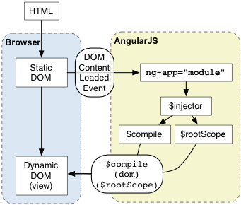

Slide 14
Auto Bootstrapping
<html ng-app>
<head>
<script src="https://ajax.googleapis.com/ajax/libs/angularjs/1.6.7/angular.js"></script>
</head>
<body>
<input type="text" ng-model="user"/>
<h1> Hello {{user}} </h1>
</body>
</html>

Slide 15
Manual Bootstrapping
You can manually initialized your angular app by using angular.bootstrap() function. This function takes the modules as parameters and should be called within angular.element(document).ready() function. The angular.element(document).ready() function is fired when the DOM is ready for manipulation.

Slide 16
<html>
<head>
<script src="https://ajax.googleapis.com/ajax/libs/angularjs/1.6.7/angular.js"></script>
</head>
<body>
<input type="text" ng-model="user"/>
<h1> Hello {{user}} </h1>
</body>
<script type="text/javascript">
var app = angular.module("myApp",[]);
angular.element(document).ready(function(){
angular.bootstrap(document,["myApp"])
})
</script>
</html>

Slide 17
Data Binding
Data-binding is important feature in AngularJS , this will synchronize data between the model and view.

Slide 18
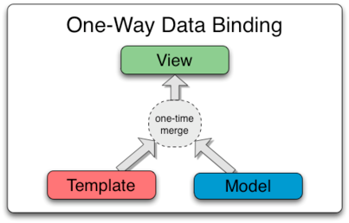
Data binding in Classical System

Slide 19
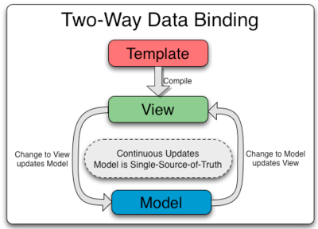
Data Binding in AngularJS
The way that AngularJS implements data-binding lets you treat the model as the single-source-of-truth in your application. The view is a projection of the model at all times. When the model changes, the view reflects the change, and vice versa.

Slide 20
Creating Demo App
We will be creating demo blogging site throughout this entire course and apply all the feature learning

Slide 21
Thank You!

