Slide 1
AngularJs Day 2
Arul

Slide 2
Day 2
Angular Style Guide (Helper to write Clean Code)
MVC Pattern
$scope, view and controller
Angular Directives

Slide 3
Angular Style Guide
https://github.com/johnpapa/angular-styleguide/blob/master/a1/README.md

Slide 4
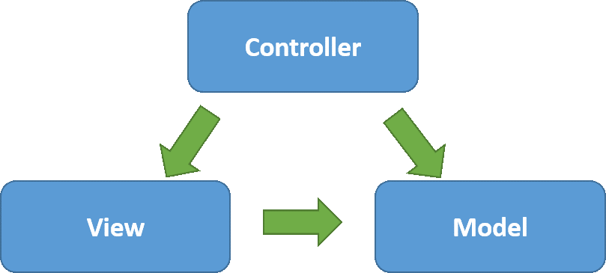
MVC Pattern

Slide 5
$scope
The scope is a JavaScript object with properties and methods, which are available for both the view and the controller.

Slide 6
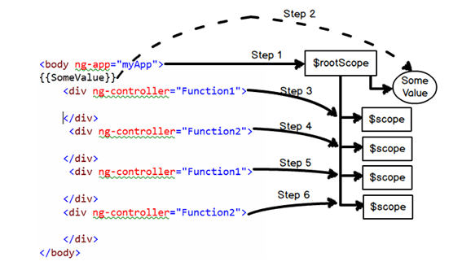
$rootscope
$rootScope” is a parent object of all “$scope” angular objects created in a web page.

Slide 7
JavaScript Object Creation
var student = new Object();
var student = Object.create(null);
var student = {};
var Student = function(name) { this.name = name } var student = new Student("David");
class Student { constructor(name) { this.name = name; } } var student = new Student("David");

Slide 8
Controller
AngularJS controllers are regular JavaScript Objects and control the data between view and model
Connecting Controller to View
Nested Controller
ControllerAs

Slide 9
Connecting Controller to View
<html>
<script type="text/javascript" src="js/angular.js"></script>
<body ng-app="myApp">
<div ng-controller="myController">
<h1>{{greeting}}</h1>
</div>
</body>
<script type="text/javascript">
var app = angular.module("myApp",[]);
app.controller("myController",function($scope){
$scope.greeting = "Hello Everyone!"
});
</script>
</html>

Slide 10
Nested Controller
It is a good practice to make controllers single purpose in their work. However, that means that sometimes controllers might need to work with another controller in partnership to generate and work with an entire view in the page

Slide 11
<html>
<script type="text/javascript" src="js/angular.js"></script>
<body ng-app="myApp">
<div ng-controller="mainController">
<h1>{{title}}</h1>
<div ng-controller="secondController">
<h1>{{title}}</h1>
<div ng-controller="thirdController">
<h1>{{title}}</h1>
<h2 style="margin-left:40px">{{$parent.title}}</h2>
<h2 style="margin-left:40px">{{$parent.$parent.title}}</h2>
</div>
</div>
</div>
</body>
<script type="text/javascript">
var app = angular.module("myApp",[]);
app.controller("mainController",function($scope){
$scope.title = "Main Controller";
});
app.controller("secondController",function($scope){
$scope.title = "Second Controller";
});
app.controller("thirdController",function($scope){
$scope.title = "Third Controller";
});
</script>
</html>

Slide 12
Controller As
<html>
<script type="text/javascript" src="js/angular.js"></script>
<body ng-app="myApp">
<div ng-controller="myController as model">
<h1>{{model.greeting}}</h1>
</div>
</body>
<script type="text/javascript">
var app = angular.module("myApp",[]);
app.controller("myController",function(){
var vm = this;
vm.title = "Hello Everyone!"
});
</script>
</html>

Slide 13
Directive
AngularJS help us to extend HTML with new attributes called Directives.
At a high level, directives are markers on a DOM element (such as an attribute, element name, comment or CSS class) that tell AngularJS's compiler to attach a specified behavior to that DOM element (e.g. via event listeners), or even to transform the DOM element and its children.

Slide 14
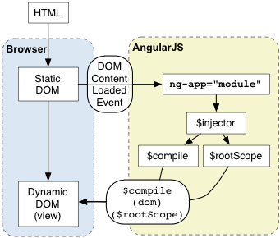
How Angular Finding/Matching Directive
$compile can match directives based on element names (E), attributes (A), class names (C), and comments (M).
<input ng-model="name">
<input data-ng-model="foo">
<person>{{name}}</person>

Slide 15
Normalization
AngularJS normalizes an element's tag and attribute name to determine which elements match which directives,
We typically refer to directives by their case-sensitive camelCase in javascript (e.g. ngModel)
However, since HTML is case-insensitive, we refer to directives in the DOM by lower-case forms, typically using dash-delimited attributes on DOM elements (e.g. ng-model).
The normalization process is as follows:
Strip x- and data- from the front of the element/attributes.
Convert the :, -, or _-delimited name to camelCase.

Slide 16
Normalization
<div ng-controller="Controller"> Hello <input ng-model='name'> <hr/> <span ng-bind="name"></span> <br/> <span ng:bind="name"></span> <br/> <span ng_bind="name"></span> <br/> <span data-ng-bind="name"></span> <br/> <span x-ng-bind="name"></span> <br/> </div>
Best Practice: Prefer using the dash-delimited format (e.g. ng-bind for ngBind). If you want to use an HTML validating tool, you can instead use the data-prefixed version (e.g. data-ng-bind for ngBind).

Slide 17
AngularJS Inbuilt Directives

Slide 18
Interpolation/ng-bind Directive
<h1>{{greeting}}</h1>
<h1 ng-bind="greeting"></h1>

Slide 19
Conditional Directives
ng-show/hide
ng-if
ng-switch

Slide 20
ng-show/ng-hide
The ngShow/ngHide directive shows or hides the given HTML element based on the expression provided to the ngShow attribute.
<div ng-show="showPosts && !showSinglePost">
<div ng-hide="showPosts">

Slide 21
ng-if
The ngIf directive removes or recreates a portion of the DOM tree based on an {expression}

Slide 22
ng-switch
<div ng-switch on="selectedPostId">
<div ng-switch-when="1">{{posts[0].title}}</div>
<div ng-switch-when="2">{{posts[1].title}}</div>
<div ng-switch-default="3">Nothing to display</div>
</div>

Slide 23
ng-repeat
<div ng-repeat="post in posts">
<h1>{{post.title}}</h1>
</div>

Slide 24
Some Event Listener Directives
ng-click
ng-dbl-click
ng-mousedown
ng-mouseup
ng-mouseenter
ng-mouseleave
ng-mousemove
ng-mouseover
ng-keydown
ng-keyup
ng-keypress
ng-change

Slide 25
Reference
For More InBuilt Directives:
https://docs.angularjs.org/api/ng/directive

Slide 26
Thank You!

