Slide 1
IPWGML
Dataset

Slide 2
SPR Dataset
Satellite Precipitation Retrieval
Surface precipitation rates derived from ground-based precipitation radars
The Dataset consists of two subsets:
CONUS overpasses of the GPM Microwave Imager (GMI) sensor
Overpasses of the Advanced Technology Microwave Sounder (ATMS)

Slide 3
Dataset structure

Slide 4
spr └── gmi ├── evaluation ├── gridded │ ├── ancillary │ ├── geo │ ├── geo_ir │ ├── gmi │ └── target └── on_swath ├── ancillary ├── geo ├── geo_ir ├── gmi └── target

Slide 5
├── testing ├── gridded ├── spatial │ ├── ancillary │ ├── geo │ ├── geo_ir │ ├── gmi │ └── target └── tabular ├── ancillary ├── geo ├── geo_ir ├── gmi └── target
── on_swath ├── spatial │ ├── ancillary │ ├── geo │ ├── geo_ir │ ├── gmi │ └── target └── tabular ├── ancillary ├── geo ├── geo_ir ├── gmi └── target

Slide 6
├── training ├── gridded ├── spatial │ ├── ancillary │ ├── geo │ ├── geo_ir │ ├── gmi │ └── target └── tabular ├── ancillary ├── geo ├── geo_ir ├── gmi └── target
── on_swath ├── spatial │ ├── ancillary │ ├── geo │ ├── geo_ir │ ├── gmi │ └── target └── tabular ├── ancillary ├── geo ├── geo_ir ├── gmi └── target

Slide 7
├── validation ├── gridded ├── spatial │ ├── ancillary │ ├── geo │ ├── geo_ir │ ├── gmi │ └── target └── tabular ├── ancillary ├── geo ├── geo_ir ├── gmi └── target
── on_swath ├── spatial │ ├── ancillary │ ├── geo │ ├── geo_ir │ ├── pwm │ └── target └── tabular ├── ancillary ├── geo ├── geo_ir ├── gmi └── target

Slide 8
File size
Evaluation:
Target: 1000 – 2000 kb
gmi: 300 - 400 kb
Testing:
Ancillary: ~100 mb [tabular]
gmi: 300 kb [spatial] | ~30 mb [tabular]
Geo: 300-600 mb [tabular]
Geo_ir: 50-150 mb [tabular]
Target: ~100 mb [tabular]

Slide 9
File size
Training:
Geo: 3000 – 4000 kb [spatial] | ~2.5 Gb [tabular]
Ancillary: ~1 Gb [tabular]
gmi: 200 - 400 kb [tabular]
Geo_ir: ~500 mb [tabular]
Target: 300-500 mb [tabular]
Validation:
Ancillary: ~1 Gb [tabular]
Geo: 3 – 5 mb [spatial] | ~2.5 Gb [tabular]
gmi: 300 - 500 kb[spatial] | ~500 mb[tabular]
Geo_ir: ~500 mb [tabular]
Target: ~300 mb [tabular]

Slide 10
gmi
Attributes:
Satellite : GPM
Sensor : GMI
Preprocessor : 2305c
Scan_start
Scan_end
Gpm_input_file
Lower_left_row
Lower_left_column
Pixel_start
Pixel_end
Data variables:
Earth_incidence_angle
Notes:
Data variables:
earth_incidence_angle refers to the angle at which incoming solar radiation strikes the surface of the Earth. The incidence angle affects the quality and accuracy of the data collected. A higher incidence angle can lead to increased distortion and variations in surface reflectance, especially over rough terrain.
Attributes:
Satellite: GPM:
The Global Precipitation Measurement mission is a joint project of NASA and JAXA (Japan Aerospace Exploration Agency) aimed at measuring global precipitation.
Sensor: GMI:
The GPM Microwave Imager (GMI) is one of the primary instruments aboard the GPM satellite. It measures precipitation, including rain, snow, and other forms of water.
Preprocessor: 2305c:
This likely refers to a specific preprocessing algorithm or method used to prepare the raw GPM data for analysis. The identifier 2305c denotes a version or type of preprocessing applied.
Scan_start:
The timestamp indicating when the satellite began scanning a specific area of interest.
Scan_end:
The timestamp indicating when the scanning was completed for that specific area.
Gpm_input_file:
This refers to the input file containing GPM data, which includes various variables related to precipitation, such as surface precipitation rate, radar quality index, and others.
Pixel_start:
The starting pixel index for processing, likely used to indicate the beginning of a subset of data from the grid.
Pixel_end:
The ending pixel index for processing, marking the end of the subset of data to analyze.

Slide 11
Target
Attributes:
Lower_left_row
Lower_left_column
mrms_input_files:
['PrecipRate' , 'RadarQualityIndex' , 'PrecipFlag', 'RadarOnly_QPE' , 'MultiSensor_QPE']
Data variables:
surface_precip
radar_quality_index
gauge_correction_factor
valid_fraction
precip_fraction
snow_fraction
hail_fraction
convective_fraction
stratiform_fraction
time
scan_index
pixel_index
Notes:
Data variables:
surface_precip (latitude, longitude) [float64]: Surface precipitation values.
radar_quality_index (latitude, longitude) [float64]: A quality index for the radar data, possibly representing the reliability or accuracy of radar measurements.
gauge_correction_factor (latitude, longitude) [float32]: A factor to correct precipitation data using ground-based gauges.
valid_fraction (latitude, longitude) [float64]: Fraction of valid data points for a given location.
precip_fraction (latitude, longitude) [float64]: Fraction of precipitation observed over a particular area.
snow_fraction (latitude, longitude) [float64]: Fraction of snow precipitation.
hail_fraction (latitude, longitude) [float64]: Fraction of hail precipitation.
convective_fraction (latitude, longitude) [float64]: Fraction of convective precipitation (related to thunderstorms or strong vertical air movement).
stratiform_fraction (latitude, longitude) [float64]: Fraction of stratiform precipitation (related to larger, widespread precipitation systems).
time (latitude, longitude) [datetime64[ns]]: Timestamp for each observation point.
scan_index (latitude, longitude) [int16]: Index of the radar scan.
pixel_index (latitude, longitude) [int16]: Index of the pixel in the radar image.
Attributes:
'PrecipRate': Refers to the precipitation rate at a specific time, from satellite data.
'RadarQualityIndex': Quality index for radar data, indicating the accuracy or reliability of the radar's observations.
'PrecipFlag': Could be a flag indicating whether precipitation is present and what type (rain, snow, hail).
'RadarOnly_QPE': Radar-only Quantitative Precipitation Estimate (QPE) data, estimating the precipitation accumulation over a certain time period based only on radar observations.
'MultiSensor_QPE': Multi-sensor QPE data that integrates information from radar, rain gauges, and potentially other sources to improve the accuracy of precipitation estimates.

Slide 12
Ancillary
Data variables:
wet_bulb_temperature
two_meter_temperature
lapse_rate
total_column_water_vapor
surface_temperature
moisture_convergence
leaf_area_index
snow_depth
orographic_wind
10m_wind
surface_type
mountain_type
land_fraction
ice_fraction
quality_flag
sunglint_angle
airlifting_index
Latitude
longitude
Notes:
Data variables:
wet_bulb_temperature (samples) [float64]: The temperature of air when it is saturated with moisture, useful for understanding humidity and cooling processes.
two_meter_temperature (samples) [float64]: The temperature measured at two meters above the ground, often used in weather forecasts.
lapse_rate (samples) [float64]: The rate at which temperature decreases with an increase in altitude, important for understanding atmospheric stability.
total_column_water_vapor (samples) [float64]: The total amount of water vapor present in a vertical column of the atmosphere, which is crucial for predicting precipitation and humidity levels.
surface_temperature (samples) [float64]: The temperature of the Earth’s surface, relevant for various environmental and weather studies.
moisture_convergence (samples) [float32]: The net increase of moisture in a region, which can indicate potential areas for precipitation.
leaf_area_index (samples) [float32]: A measure of the total leaf area relative to the ground area, important for understanding vegetation and its impact on the environment.
snow_depth (samples) [float32]: The depth of snow cover, which is significant for hydrology and weather forecasting.
orographic_wind (samples) [float32]: Wind patterns influenced by mountainous terrain, important for understanding localized weather phenomena.
10m_wind (samples) [float32]: Wind speed and direction measured at a height of 10 meters above the ground.
surface_type (samples) [uint8]: Categorical data indicating the type of surface (e.g., forest, water, urban).
mountain_type (samples) [uint8]: Categorical data specifying the type of mountain (e.g., range, hill).
land_fraction (samples) [uint8]: The fraction of the area that is land.
ice_fraction (samples) [uint8]: The fraction of the area covered by ice, important for climate studies.
quality_flag (samples) [uint8]: A flag indicating the quality of the data, useful for data validation.
sunglint_angle (samples) [float32]: The angle at which sunlight reflects off the water surface, affecting measurements from satellites.
airlifting_index (samples) [uint8]: An index used to indicate potential for air uplift, relevant for storm development.
latitude (samples) [float32]: Latitude of the samples, indicating geographic location.
longitude (samples) [float32]: Longitude of the samples, also indicating geographic location.

Slide 13
GEo & geo_ir
Data variables:
nearest_time_step: (geo)
Interpolating or matching time
Aligning observations
nearest_ind(geo_ir)
Notes:
nearest_time_step:
When we have a desired timestamp, this function will find the scan time closest to our requested timestamp. This is useful for syncing data with other sources.
When we have multiple data sources observations in time can be aligned minimizing time discrepancies.
nearest_ind:
It helps us in finding the index of the time point closest to a specific desired time.

Slide 14
Cnn model

Slide 15
CNN model
Surface precipitation (surface precip) was chosen as a feature for a CNN model.
Labels:
radar_quality_index
gauge_correction_factor
valid_fraction
precip_fraction
snow_fraction
hail_fraction
convective_fraction
stratiform_fraction
time
scan_index
pixel_index
Notes:
nearest_time_step:
When we have a desired timestamp, this function will find the scan time closest to our requested timestamp. This is useful for syncing data with other sources.
When we have multiple data sources observations in time can be aligned minimizing time discrepancies.
nearest_ind:
It helps us in finding the index of the time point closest to a specific desired time.

Slide 16
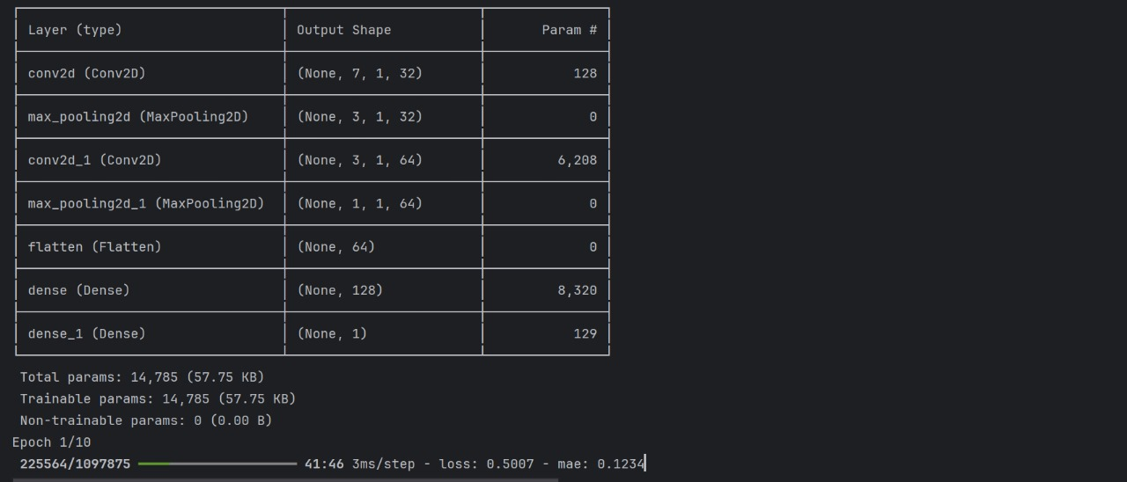

Slide 17
Scatter plot

Slide 18
