Slide 1

Delivering Managed Content to Your Native Apps
Anthony Rumsey (@planetrumsey) | February 2015
Notes:
Hi there! My name is Anthony Rumsey and have been a developer at Adobe for over 15 years. In that time I have been actively integrating web technologies into Adobe’s enterprise products. Most recently I have been building out mobile solutions for Adobe Experience Manager.

Slide 2

COMPROMISE
Notes:
Today I am going to talk about compromise.
As a parent and developer I am constantly making compromises. Take for example, last summer when my family decided to head to the local park to have some photos taken. It was a great place for photos except for the shiny new park my daughters would rather run to rather than having some silly pictures taken. Anyway, as usual we we able to make a compromise where if they managed to sit still for a few pictures they could then have extra time to play at the park.

Slide 3





Mobile App Development
Objective-C
Swift
iOS SDK
XCode
Java
Android SDK
Eclipse
Android Studio
C#
Visual Basic
.NET SDK
Visual Studio
JavaScript
HTML
CSS
Brackets
Text Editor
JavaScript
Titanium SDK
Titanium Studio
Native
Hybrid
Notes:
Mobile app development today can be either be done natively using each platform’s chosen programming language, tools and SDKs or by using a Hybrid solution like PhoneGap or Appcelerator. The hybrid solutions still have their own set of languages, tools and SDKs but they are common across platforms.
The focus of PhoneGap in particular is to allow web development skills to be leveraged as part of mobile app development while still providing access to native device APIs via a JavaScript bridge layer.
While the trend is changing the majority of mobile app development is being done natively.
What I am going to explore today however is finding a sweet spot where native and hybrid can happily co-exist in the same app.

Slide 4
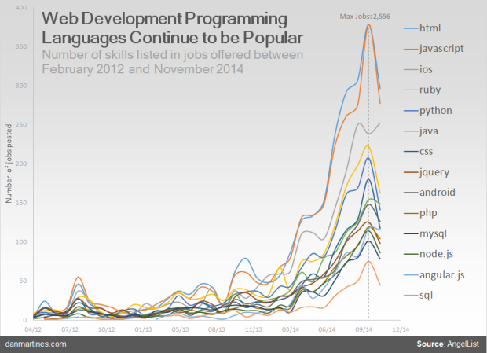


Embrace the Web
With enterprises under extreme pressure from management and employees to develop and deploy mobile applications to accommodate mobile work styles and increase customer engagement, Gartner, Inc. predicts that more than 50 percent of mobile apps deployed by 2016 will be hybrid.
- Gartner

Slide 5
Hybrid Sweet Spot
“So in classic disruption theory, the hybrid model is eating its way up through the complexity chain. I’d argue that the majority of information-based apps today can be successfully implemented through this approach with varying levels of the native/HTML split.”
David Heinemeier Hansson - Founder & CTO at Basecamp
(May 8, 2014 https://signalvnoise.com/posts/3743)

Slide 6





Adobe Experience Manager (AEM)
Mobile Apps Made Easy!
+
Proven open source foundation
Existing tools for authoring web sites
Apps Command Center
Over-the-air content updates
Mobile services integration
PhoneGap build integration
Notes:
Adobe Experience Manager is already a leader in web content management.

Slide 7
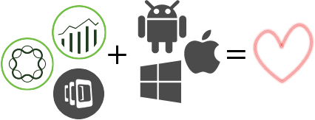
Compromise
Web
Information views
Updates
Native
Navigation
Some views
Notes:
This brings me back to my point about compromise. With all this new knowledge I can be better equipped to make a compromise when it comes to my mobile development. For example one possible compromise to achieve my hybrid sweet spot would be to leave all the navigation on the native size and some specialized views. All the remaining information views however will be handled by the web side which will then also enable easier updates to occur. The result will be one sweet mobile app!

Slide 8
Demo
Notes:
Next, let look at actually implementing such a compromise. First, let me show you the fully native app I would like to integrate managed content into.

Slide 9



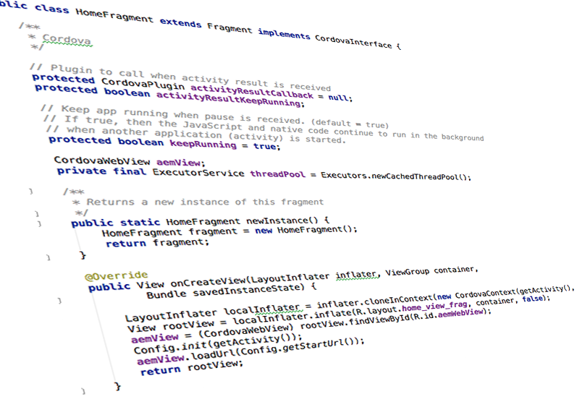
//TODO:
1.
Create AEM Content
2.
Augment Android App
3.
Plugins!
4.
Integrate Native & Web
Notes:
In order to actually get some managed content into my native app then, I have come up with the following four tasks.

Slide 10
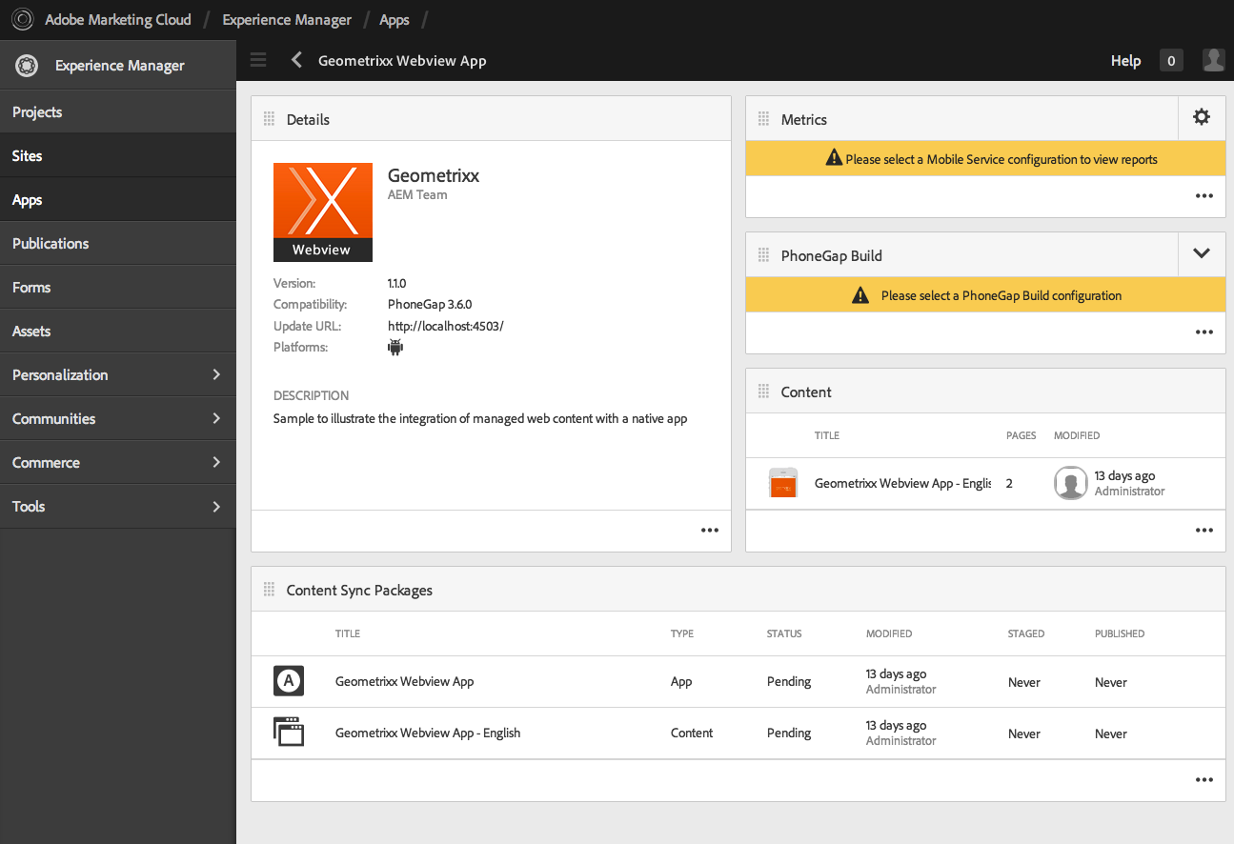
Create Content
Design
Components
splash page
home page
custom
Content Sync
Content

Slide 11
Augment Android
Create a new view layout
Add a reference to org.apache.cordova.CordovaWebView
<org.apache.cordova.CordovaWebView
android:layout_width="fill_parent"
android:layout_height="fill_parent"
android:id="@+id/aemWebView"/>

Slide 12
Augment Android
Update existing Fragment
Implement CordovaInterface
Add webview layout
Load web content URL
public class HomeFragment extends Fragment implements CordovaInterface {
CordovaWebView aemView;
@Override
public View onCreateView(LayoutInflater inflater, ViewGroup container,
Bundle savedInstanceState) {
LayoutInflater localInflater = inflater.cloneInContext(new CordovaContext(getActivity(), this));
View rootView = localInflater.inflate(R.layout.home_view_frag, container, false);
aemView = (CordovaWebView) rootView.findViewById(R.id.aemWebView);
Config.init(getActivity());
aemView.loadUrl(Config.getStartUrl());
return rootView;
}
}

Slide 13
Plugins
Allow we content to communicate with native app
Create class that extends CordovaPlugin
Override execute method
public class Navigation extends CordovaPlugin {
@Override
public boolean execute(String action, CordovaArgs args,
final CallbackContext callbackContext) throws JSONException {
if ("navigate".equals(action)) {
this.cordova.getActivity().runOnUiThread(new Runnable() {
public void run() {
navigateSync(args, callbackContext);
}
});
return true;
}
return false;
}
}

Slide 14
Integration
Download Content Package
phonegap build android
Copy Source
Copy Resources
Copy Assets

Slide 15
{Code Time;}

Slide 17


Slide 18
References
Android + PhoneGap sample with AEM
Embedding a Cordova WebView into an Android fragment
Mixing Cordova/PhoneGap Components with Native iOS
Who’s Winning, iOS or Android? All the Numbers, All in One Place
Hybrid Sweet Spot
Developing PhoneGap Apps in AEM
Four Ways To Build A Mobile Application
Gartner Recommends a Hybrid Approach for Business-to-Employee Mobile Apps

