Slide 1


SEMESTER -05
ENGINEERING CLINICS
PROJECT FALLSEM 2022-23 REVIEW - 01

Slide 2
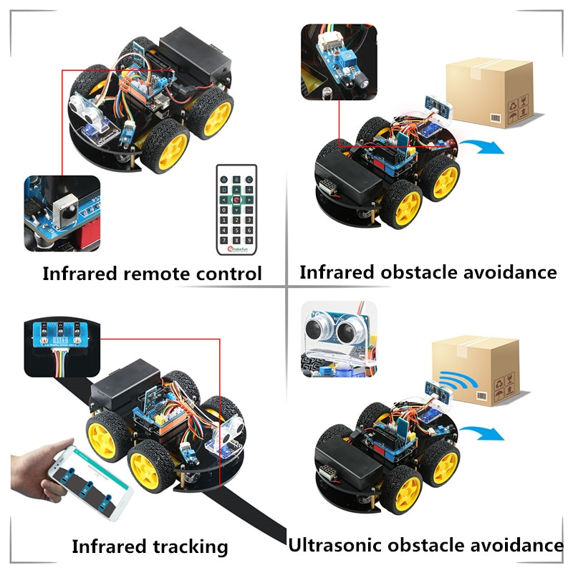

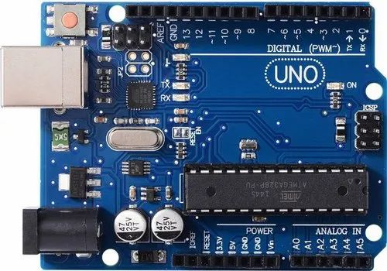
SMART ROBOT CAR USING ARDUINO
Android based smart robot control car

Slide 3



GUIDE NAME
PROF. NEERAJ KUMER MISRA
TEAM MEMBERS
ARUMULLA YASWANTH REDDY -20BES7010
DAMARLA BHUVAN SRI SAI -20BCD7096
KAKUMANU SRIMANI -20BCD7133
NUTHALAPATI JASHVIKA-20BCD7115
CHANDINI KOLLATI -20BCE7379
KANDUKURI PRANAVI-20BCR7104

Slide 4
Required components
Arduino BLE-UNO Mother board
Arduino extension board
Infrared line tracking module
Infrared obstacle avoidance module
L298N motor drive board
RGB ultrasound module
Power indicator digital tube
65mm wheel
DC geared motor
18650 battery charger
SG90 servo
18650 li-battery

Slide 5

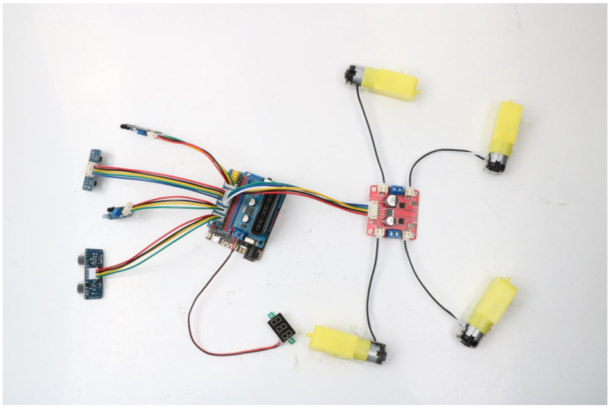

Schematic diagram of overall connection
DC geared motor
Infrared obstacle avoidance module
DC geared motor
Infrared line tracking module
Infrared obstacle avoidance module
L298N motor drive board
Arduino extension board
RGB ultrasound module
DC geared motor
DC geared motor

Slide 6
Approximate Budget
S.NO | REQUIRED COMPONENT | APPOX.COST
01 | Arduino BLE-UNO Mother board | 700
02 | Arduino extension board | 300
03 | Infrared line tracking module | 70
04 | Infrared obstacle avoidance module | 50
05 | L298N motor drive board | 90
06 | RGB ultrasound module | 70
07 | Power indicator digital tube | 60
08 | 65mm wheel | 60
09 | DC geared motor | (70*4)=280
10 | 18650 battery charger | 50
11 | SG90 servo | 120
12 | 18650 li-battery | (50*2)=100
 | TOTAL COST | 1,950

Slide 7
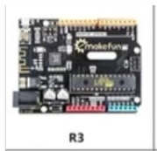
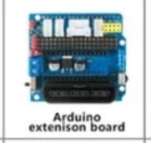
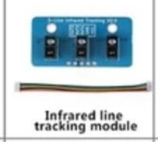
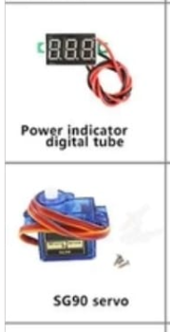
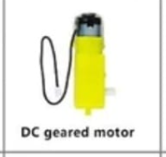
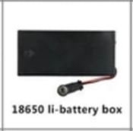
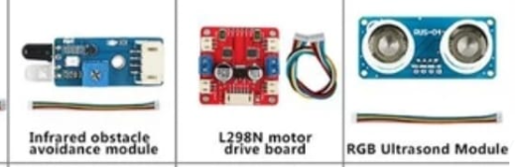
EQUIPMENTS

Slide 8




REFERENCE
https://www.scribd.com/books
https://www.scribd.com/document/449237250/Hummer-Bot-4-0-Instruction-Manual-V-1-5
https://create.arduino.cc/projecthub/samanfern/bluetooth-controlled-car-d5d9ca

Slide 9

THANK YOU

