Slide 1
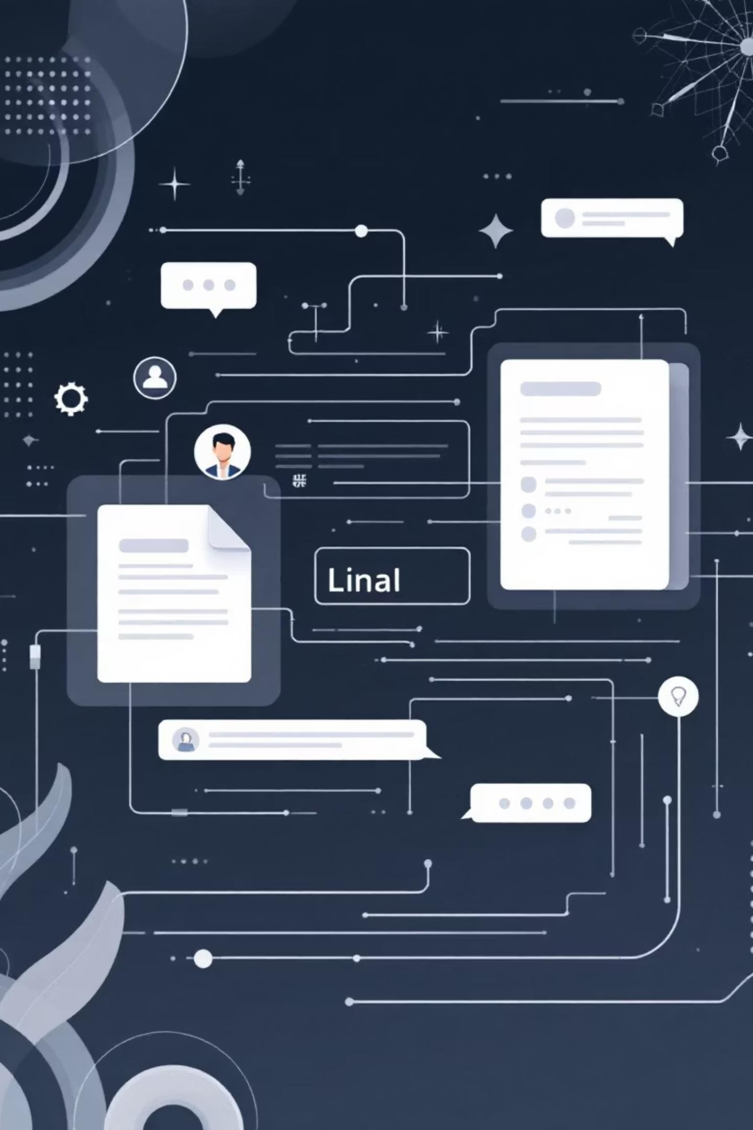
Agentic RAG Chatbot for Multi-Format Document QA Using Model Context Protocol (MCP)
Coding Test Submission
By Arun Chinthalapally

Slide 2
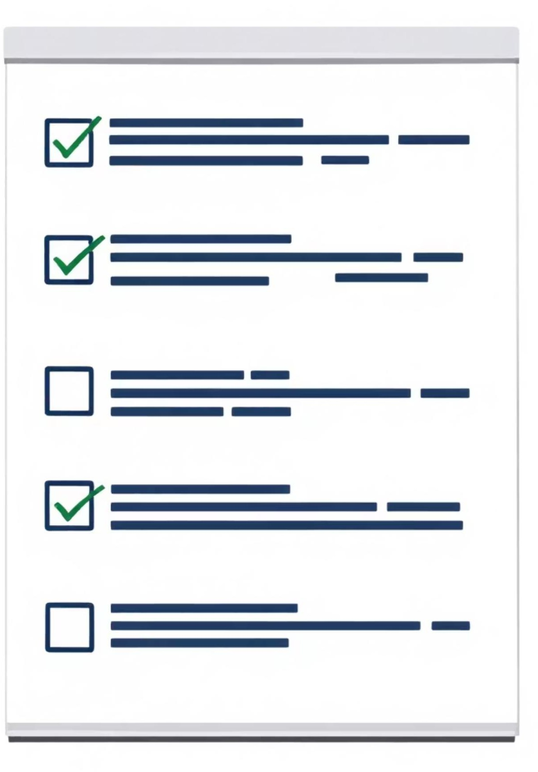
Problem Statement & Technical Compliance
Goal: Build an agent-based Retrieval-Augmented Generation (RAG) chatbot with
MCP for structured message passing between agents.
Agentic Architecture
IngestionAgent → parses and preprocesses
documents
RetrievalAgent → embeddings + FAISS semantic
search
LLMResponseAgent → generates answers using
retrieved context
(CoordinatorAgent orchestrates overall flow)
Multi-Format Support
PDF, PPTX, DOCX, CSV, TXT
processing with robust parsing capabilities
Smart Retrieval
FAISS vector store + HuggingFace embeddings
Streamlit chatbot interface for uploads, queries, and responses
Stub mode (regex-based answers) when API key not provided

Slide 3





Agent-Based Architecture Overview
CoordinatorAgent
Orchestrates the entire pipeline, manages workflow coordination and ensures proper message routing between agents
IngestionAgent
Handles multi-format document parsing and preprocessing, extracting text content from various file types
RetrievalAgent
Performs FAISS semantic retrieval using vector embeddings for accurate document search and matching
LLMResponseAgent
Generates contextual answers using retrieved content, providing intelligent responses to user queries

Slide 4



MCP Message Protocol Flow
USER_QUERY
Initial user question triggers the workflow through Streamlit interface
DOCUMENT_PARSED
IngestionAgent processes files and sends structured content to pipeline
RETRIEVAL_RESULT
RetrievalAgent performs semantic search and returns relevant chunks
FINAL_RESPONSE
LLMResponseAgent generates contextual answer with source citations
Sample MCP JSON: {"message_type": "RETRIEVAL_RESULT", "trace_id": "abc123", "content": "relevant_chunks", "metadata": {"similarity_score": 0.87}}

Slide 5
System Workflow & Processing Pipeline
01
02
03
Document Upload
Users upload multi-format documents through intuitive Streamlit interface with drag-and-drop functionality
Orchestration
CoordinatorAgent initializes workflow and manages inter-agent communication through MCP protocol
Content Processing
IngestionAgent parses documents and sends DOCUMENT_PARSED messages with extracted content
04
05
Vector Indexing
RetrievalAgent creates FAISS embeddings and sends RETRIEVAL_RESULT with semantic matches
Answer Generation
LLMResponseAgent produces FINAL_RESPONSE with contextual answers and source citations

Slide 6

Technical Stack & Implementation
Core Technologies
Document Processing
Python 3.8+ - Primary language
Streamlit - Interactive UI framework
FAISS - Vector database for semantic search
HuggingFace - SentenceTransformers embedding
PyMuPDF - PDF text extraction
python-docx - Word document parsing
python-pptx - PowerPoint processing
pandas - CSV data handling
API Integration: Groq API with intelligent regex-based stub mode for testing without API keys. Custom MCP protocol uses in-memory JSON messages with trace_id tracking.

Slide 7

Key Implementation Features
Multi-Format Parsing
Robust document processing handles edge cases across PDF, DOCX, PPTX, CSV, and TXT formats with error handling
Smart Chunking
Fixed-size content chunking with preserved metadata enables efficient semantic retrieval and context preservation
Real-Time Tracing
MCP message logging in Streamlit sidebar provides transparent workflow visibility and debugging capabilities
Session Management
Multi-turn chat sessions with intelligent stub answers using regex extraction for revenue, NPS, and CAC queries

Slide 8
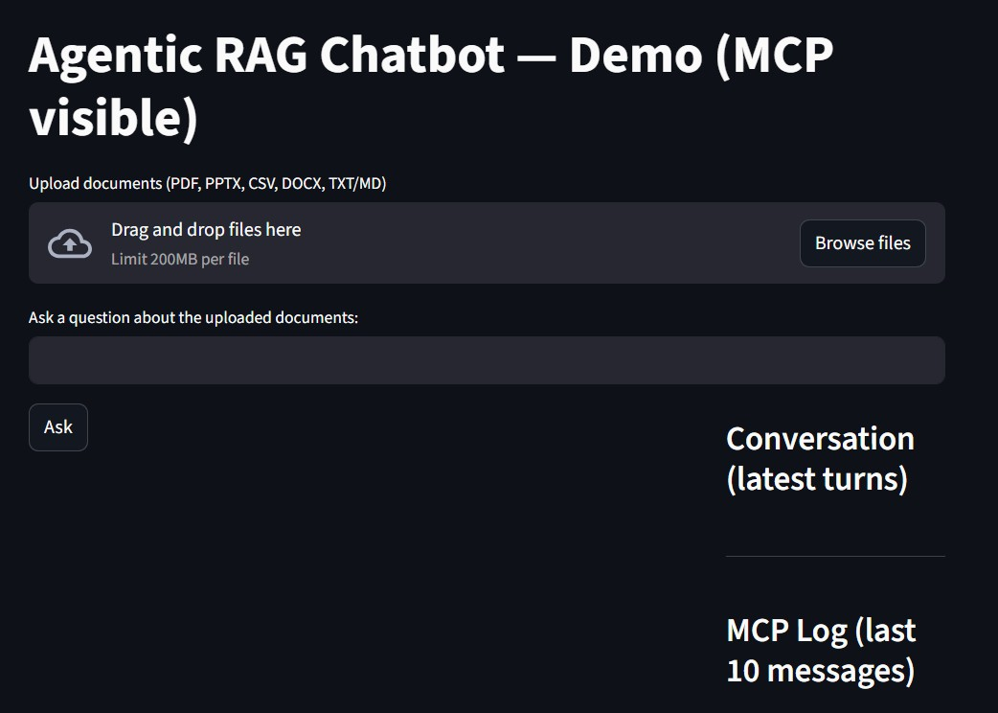
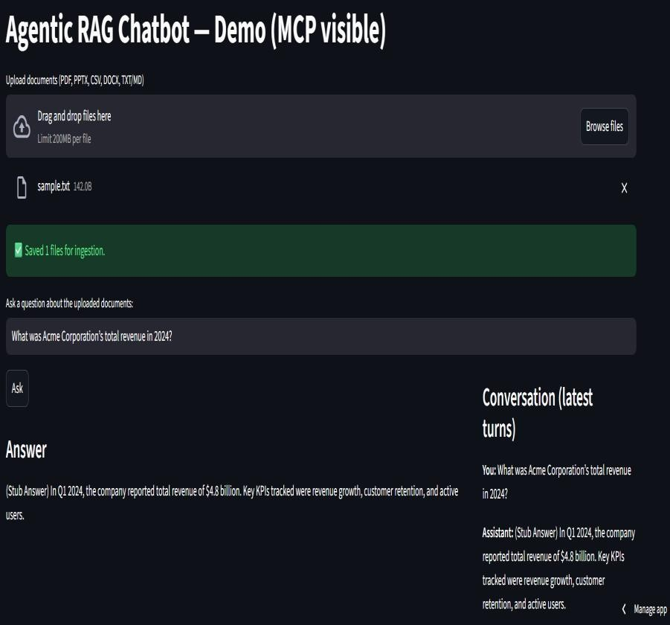
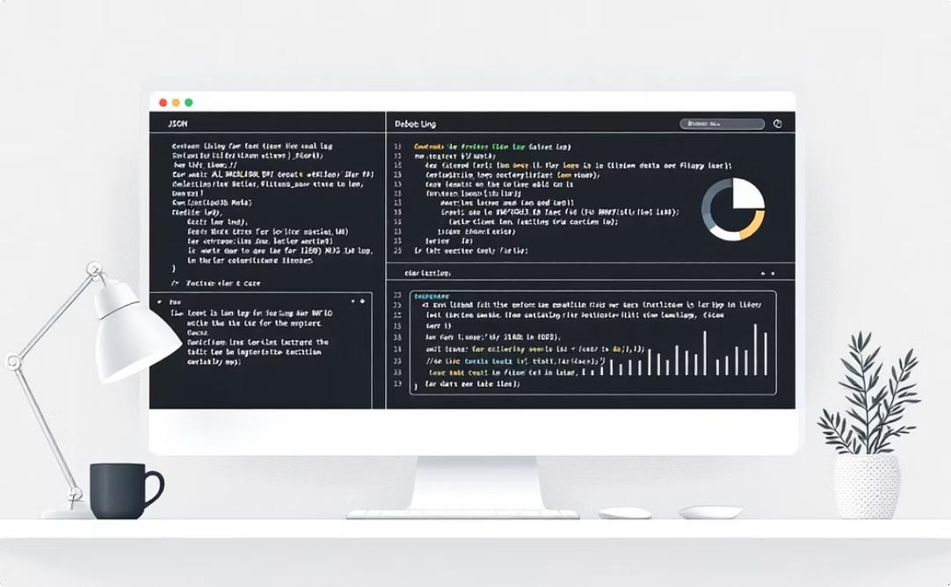
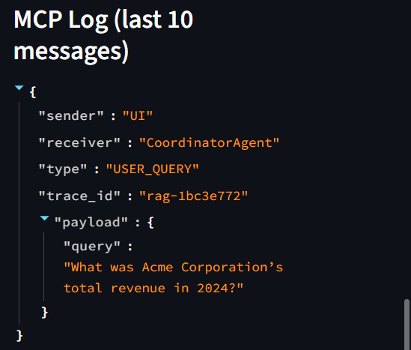
System Demo & User Interface
Document Upload Interface
Intuitive Streamlit file uploader supporting
multiple formats with progress indicators
Interactive Chat Window
Real-time Q&A interface with source
citations and conversation history
MCP Message Tracing
Sidebar displaying real-time JSON message logs for system transparency
Example Query: "What was Acme's revenue in 2024?"Stub Response: "(Stub Answer) Revenue in 2024 was $4.8 billion based on
document analysis"

Slide 9
Development Challenges & Solutions
Technical Challenges
Future Enhancements
Multi-format parsing edge
cases and encoding issues
Designing structured MCP protocol for agent communication
Creating intelligent stub answers without API dependencies
Optimizing FAISS similarity scoring and retrieval accuracy
Smarter semantic chunking
with overlapping windows
Persistent database for
conversation history
Multi-modal support for images and audio processing
Enterprise features including user management and analytics

Slide 10

Project Completion & Assessment Ready
Fully Implemented
All requirements met with robust multi- format document processing and agentic architecture
Production Ready
Comprehensive error handling, user- friendly interface, and fallback stub mode functionality
Well Documented
Fully commented codebase with clear architecture documentation and submission compliance
Conclusion: The Agentic RAG Chatbot successfully demonstrates advanced AI engineering principles with MCP protocol implementation, making it assessment-ready for technical evaluation.
Submission Status: Project completed, fully compliant with requirements & ready for evaluation.

