Slide 1
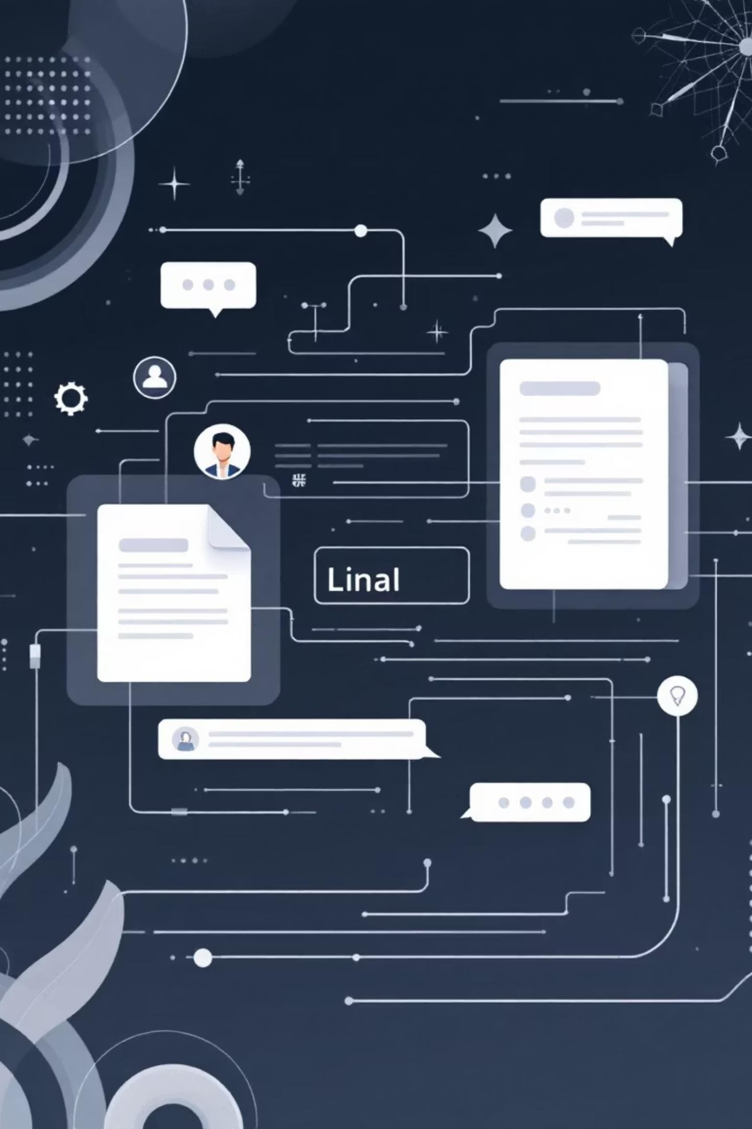
Agentic RAG Chatbot for Multi-Format Document QA Using Model Context Protocol (MCP)
Coding Test Submission
By Arun Chinthalapally

Slide 2
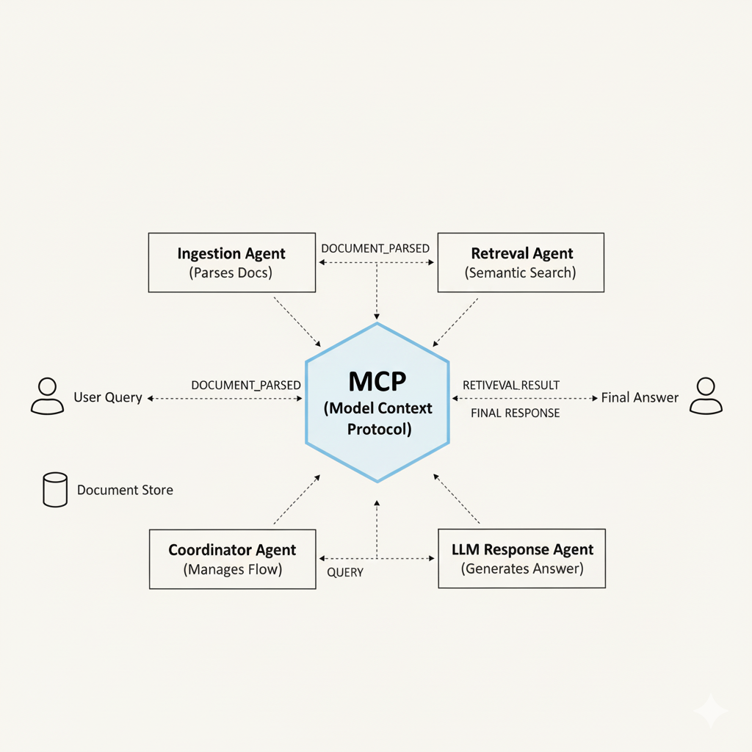
Agent-Based Architecture with MCP integration
User Question Initiation → The process starts when the user inputs a question in the Streamlit UI.
CoordinatorAgent → The workflow router that receives the input and directs the initial QUERY message to the correct agent.
IngestionAgent → The data parsing layer that processes diverse file formats and outputs the structured DOCUMENT_PARSED message.
RetrievalAgent→ The semantic search engine that looks up context with FAISS/embeddings and sends the result as the RETRIEVAL_RESULT message.
LLMResponseAgent → The answer synthesis agent that uses the LLM to generate the final, contextual answer and produces the FINAL_RESPONSE message.
MCP (Model Context Protocol) → The Communication Standard which is the central secure hub managing the exchange of all structured JSON messages between agents.
Final Delivery → The FINAL_RESPONSE message is extracted and presented back to the user via the Streamlit UI.

Slide 3
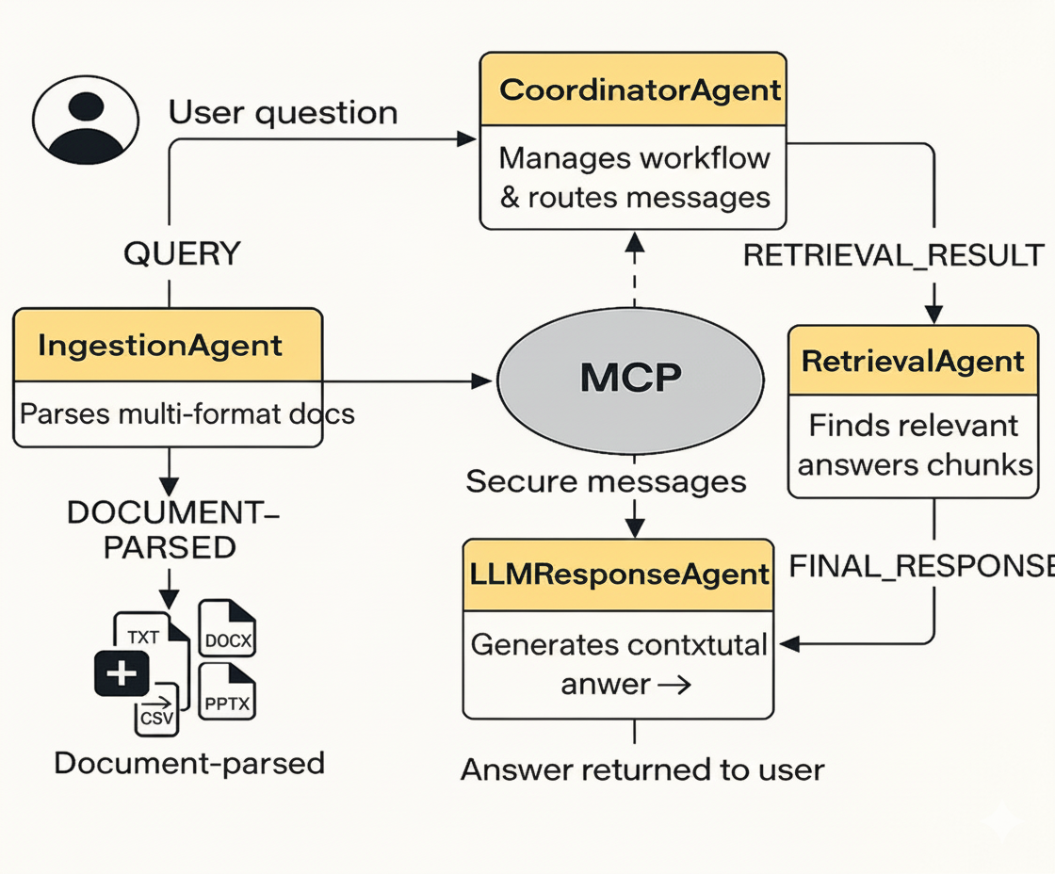
System flow diagram (with Message Passing)
User Query → User's question entered via the Streamlit UI to start the process.
CoordinatorAgent → The manager that directs the workflow and routes all MCP messages.
IngestionAgent → Parses multi-format documents (PDF, DOCX, etc.) to create DOCUMENT_PARSED data.
RetrievalAgent → Performs semantic search using FAISS/embeddings to find document chunks (RETRIEVAL_RESULT).
LLMResponseAgent → Uses an LLM to generate the final, contextual FINAL_RESPONSE from the retrieval results.
MCP → The communication standard that enables traceable, modular communication via structured JSON messages.

Slide 4

Technical Stack & Implementation
Core Technologies
Document Processing
Python 3.8+ - Primary language
Streamlit - Interactive UI framework
FAISS - Vector database for semantic search
HuggingFace - SentenceTransformers embedding
PyMuPDF - PDF text extraction
python-docx - Word document parsing
python-pptx - PowerPoint processing
pandas - CSV data handling
API Integration: Groq API with intelligent regex-based stub mode for testing without API keys. Custom MCP protocol uses in-memory JSON messages with trace_id tracking.

Slide 5

Key Implementation Features
Multi-Format Parsing
Robust document processing handles edge cases across PDF, DOCX, PPTX, CSV, and TXT formats with error handling
Smart Chunking
Fixed-size content chunking with preserved metadata enables efficient semantic retrieval and context preservation
Real-Time Tracing
MCP message logging in Streamlit sidebar provides transparent workflow visibility and debugging capabilities
Session Management
Multi-turn chat sessions with intelligent stub answers using regex extraction for revenue, NPS, and CAC queries

Slide 6
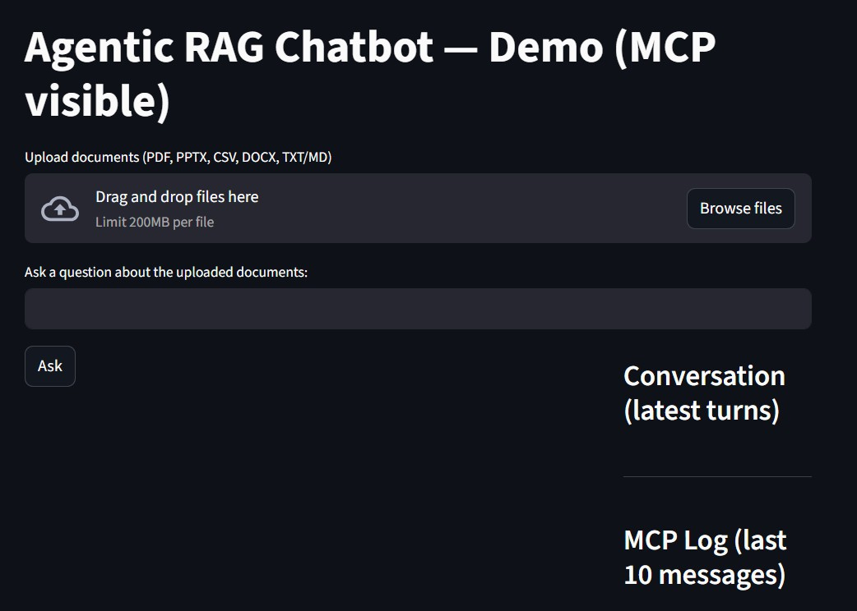
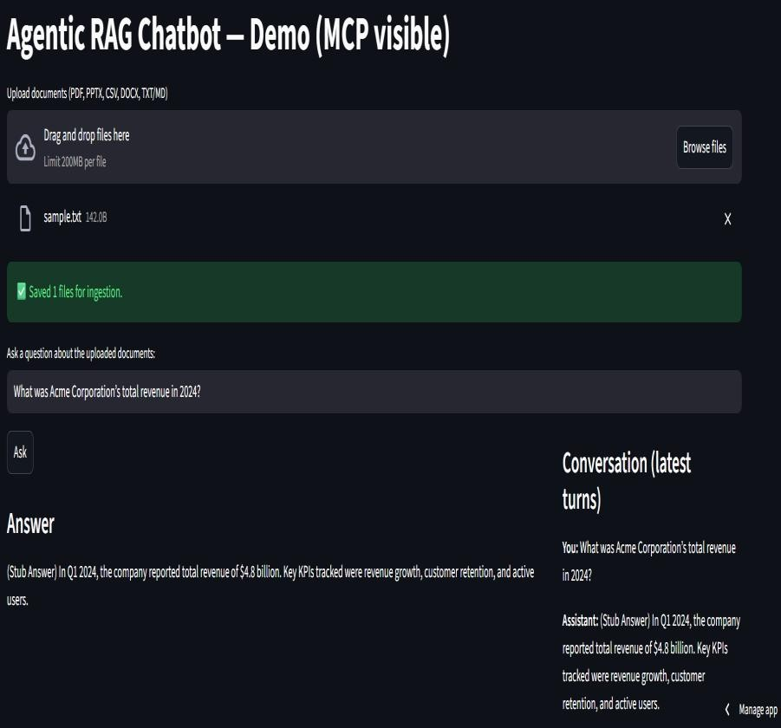
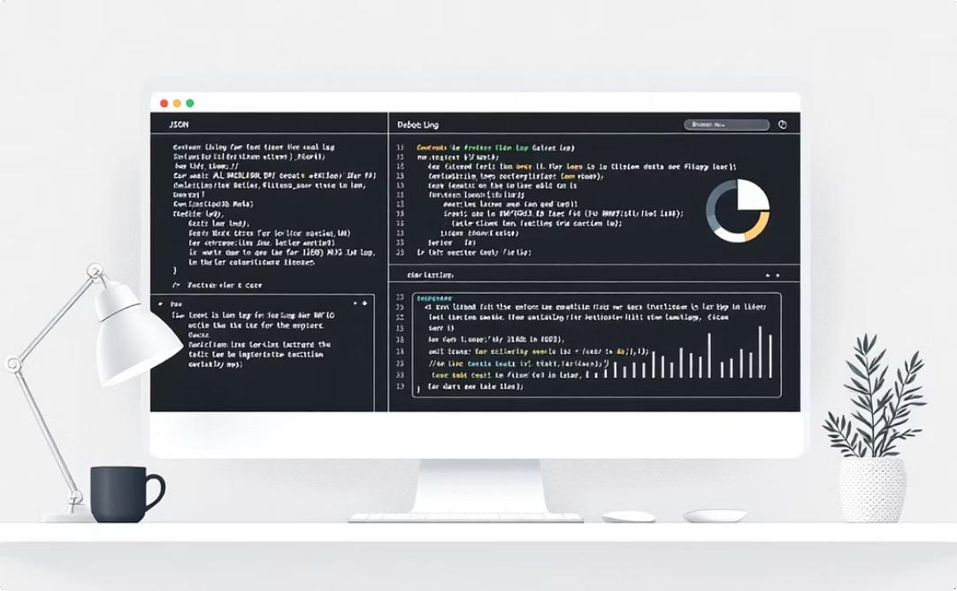
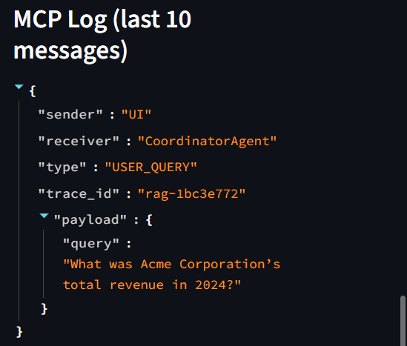
System Demo & User Interface
Document Upload Interface
Intuitive Streamlit file uploader supporting
multiple formats with progress indicators
Interactive Chat Window
Real-time Q&A interface with source
citations and conversation history
MCP Message Tracing
Sidebar displaying real-time JSON message logs for system transparency
Example Query: "What was Acme's revenue in 2024?"Stub Response: "(Stub Answer) Revenue in 2024 was $4.8 billion based on
document analysis"

Slide 7
Development Challenges & Solutions
Technical Challenges
Future Enhancements
Ensuring scalable architecture while coordinating multiple agents in real time.
Managing large document sizes without exceeding memory or processing limits.
Maintaining traceability of queries using unique trace_id across MCP messages.
Designing a responsive Streamlit UI that handles file uploads and multi-turn chats smoothly.
Cloud deployment with containerization (Docker/Kubernetes) for production scaling
Integration with vector databases (Pinecone, Weaviate, Milvus) instead of local FAISS
Support for collaborative multi-user sessions with secure role-based access control
Adding real-time monitoring & logging for system performance and agent behavior

Slide 8

Project Completion & Key Takeaways
End-to-End Solution → Built a fully functional Agentic RAG Chatbot supporting PDFs, PPTX, DOCX, CSV, and TXT
Advanced Engineering → Multi-agent orchestration via MCP (Model Context Protocol) with traceable JSON messages
Smart Retrieval → FAISS-based semantic search + embeddings ensures accurate and context-rich answers
Production-Ready Design → User-friendly Streamlit UI, stub fallback mode, error handling, modular architecture
Excellence in Delivery → Cleanly documented, interview-ready codebase that aligns with real-world AI engineering practices
Fully ImplementedAll requirements met with robus multi- format document processing and agentic architecture
Production Ready
Comprehensive error handling, user- friendly interface, and fallback stub mode functionality
Conclusion:
This project demonstrates a complete, agent-based RAG chatbot with MCP integration, meeting all requirements with clarity and robustness.
Thank you for the opportunity to design and present this solution
— I look forward to your evaluation.
.

