Slide 1

data_science_assignment
05-07-2026
E-COMMERCE SALES DATA
ANALYSIS
Submitted By -Arun Anjana

Slide 2
Title: Sales Data Analysis using Python
Tools Used
Python
Pandas
NumPy
Matplotlib
Jupyter Notebook
Introduction
The objective of this project is to analyze a real-world sales dataset and identify meaningful business insights using Python. The analysis focuses on customer segments, sales trends, product categories, shipping methods, and yearly sales performance. The results help businesses make better decisions related to marketing, inventory, and customer management.

Slide 3
Dataset Description
The dataset contains information such as:
Order ID
Customer Name
Category
Sub Category
Sales
Profit
Ship Mode
State
Region
Order Date

Slide 4
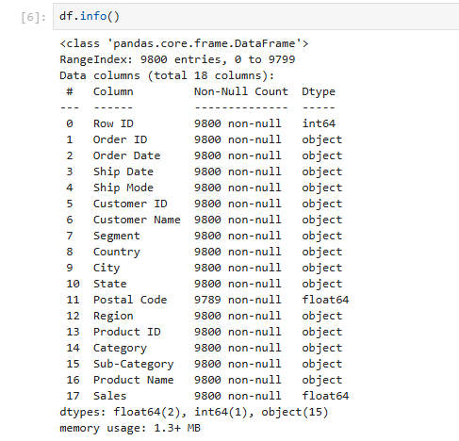
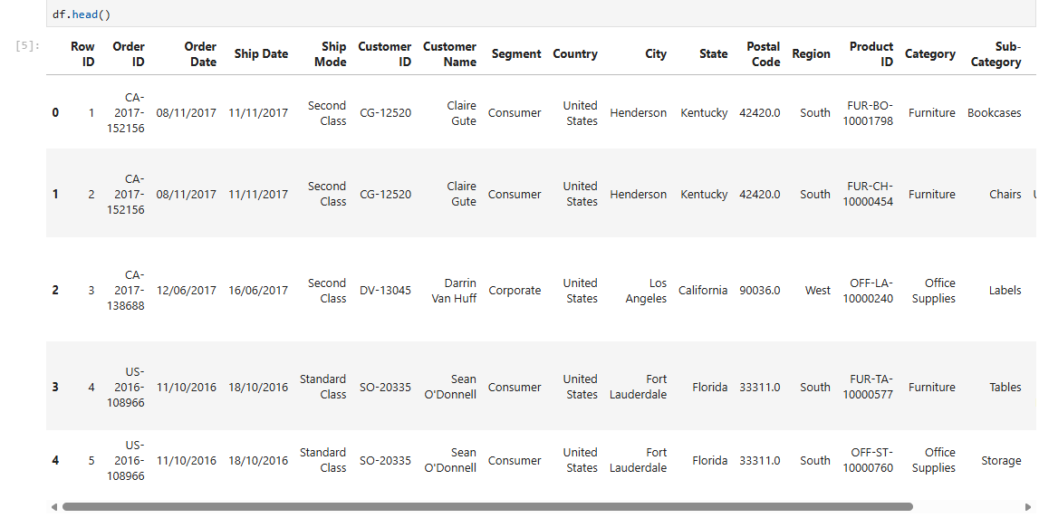
Objectives
Clean the dataset
Handle missing values
Perform Exploratory Data Analysis
Analyze sales trends
Discover customer behavior
Generate business insights
Provide recommendations

Slide 5
Data Cleaning
The following preprocessing steps were performed before analysis:
Imported the dataset into Jupyter Notebook
Examined the dataset structure
Identified missing values
Filled missing values where necessary
Checked duplicate records
Verified data types
Prepared the dataset for analysis

Slide 6
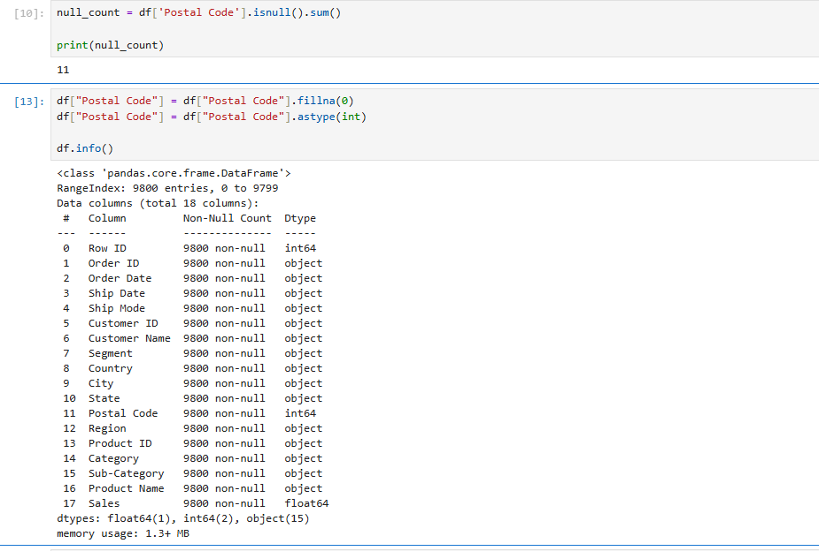
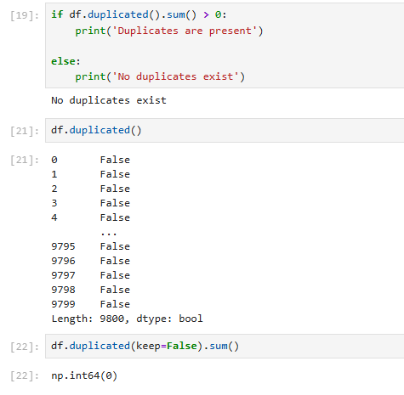

Slide 7
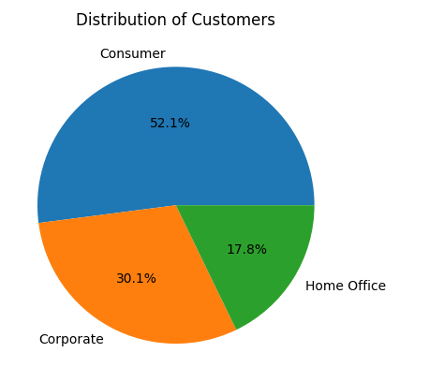
Customer Segment Analysis
Objective
Understand the distribution of customers across different market segments.
Observation
The Consumer segment contributes the largest portion of customers and overall sales.

Slide 8
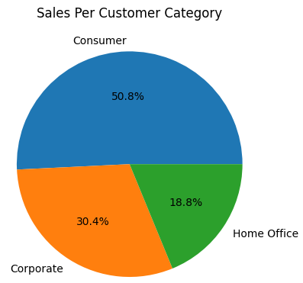
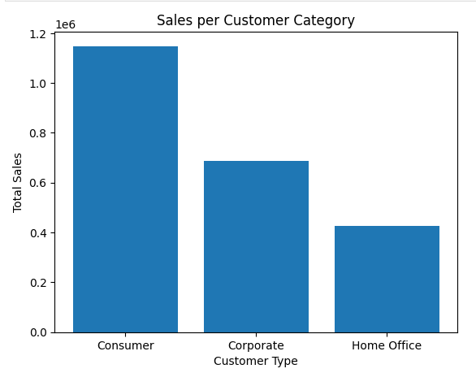
Sales by Category
Objective
Identify which product category generates the highest revenue.
Observation
Technology products contribute the highest sales followed by Furniture and Office Supplies.

Slide 9
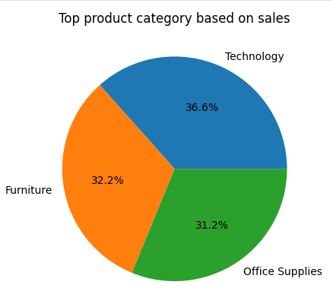
Shipping Mode Analysis
Objective
Analyze the preferred shipping method.
Observation
Standard Class is the most frequently used shipping mode.

Slide 10
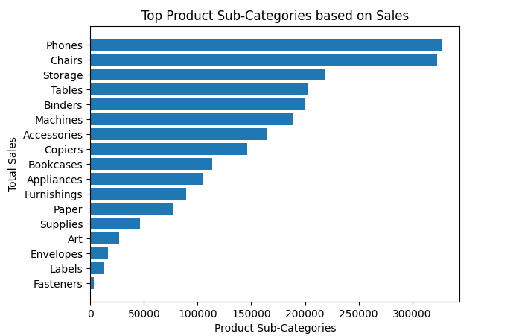
Sub-Category Analysis
Objective
Find the best-performing product sub-categories.
Observation
Phones, Chairs, and Storage contribute significantly to total sales.

Slide 11
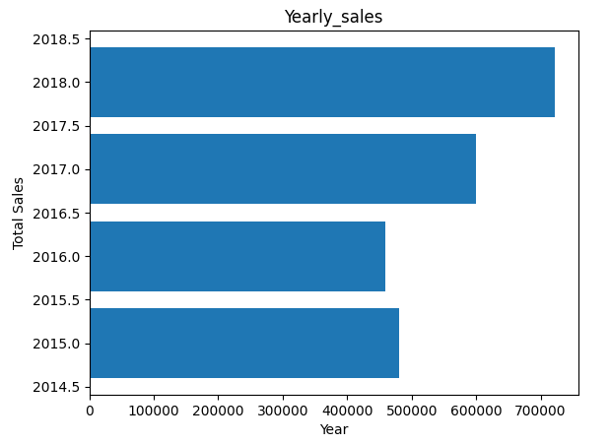
Yearly Sales Trend
Objective - Study yearly growth in sales.
Observation - Sales increased steadily over the years with the highest revenue recorded in the latest year.

Slide 12
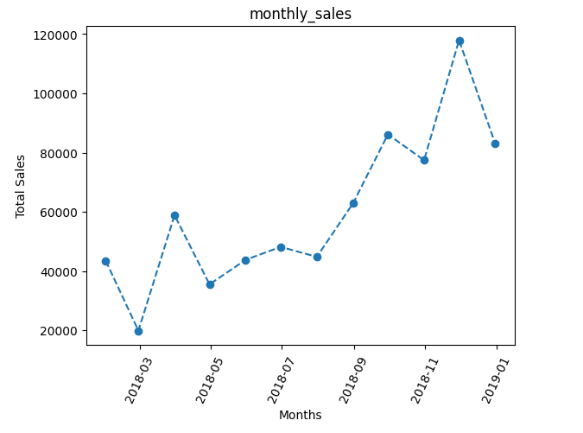
Monthly Sales Trend
Objective - Understand monthly sales patterns.
Observation - Certain months consistently generate higher sales, indicating seasonal demand.

Slide 13
Major Insights
Consumer customers generate the highest revenue.
Technology is the best-performing category.
Standard Class shipping is the most preferred.
California and New York contribute maximum sales.
Phones are among the top-selling products.
Overall sales show positive growth year by year.
Recommendations
Increase investment in Technology products.
Improve inventory planning for high-demand products.
Focus marketing on top-performing customer segments.
Optimize shipping operations.
Reduce unnecessary discounts to improve profitability.

Slide 14
Conclusion
This project demonstrates how Python can be used to transform raw business data into meaningful insights through data cleaning, visualization, and exploratory data analysis. The findings support data-driven business decisions and provide valuable recommendations for improving sales performance. This project demonstrates practical skills in data analysis, visualization, and business intelligence using Python.

Slide 15
Sales Forecasting Dataset (Kaggle)
Kaggle Dataset: https://www.kaggle.com/datasets/rohitsahoo/sales-forecasting
Sales Forecasting Dataset (Kaggle)
Kaggle Dataset: https://github.com/arun-anjana/e-commerce.git

Slide 16


