Slide 1


PANIMALAR ENGINEERING COLLEGE
Computer Science and Engineering
Project Review III , 16-06-21
THIRD GENERATION ATM MACHINE USING ADVANCED COMPUTER VISION TECHNIQUES
DOMAIN NAME: MACHINE LEARNING
TEAM MEMBERS: Arun.L.K
(2017peccs365)
Aakash.S
(2017peccs353)
Alagupandi.J
(2017peccs359)

Slide 2
Abstract:
ATM Security has always been one of the most prominent issues concerning the daily users and the not so frequent ones as well on. This situation is hypothetical, yet very possible scenario of an individual's ATM card falling into the wrong hands, and the PIN number being cracked by a theft perpetrating entity. Our proposed model uses certain factors which would be monitored right from the initiation, to the end of the respective transaction. With the help of these factors, we would declare the status of the transaction before proceeding with cash withdrawal. Such monitoring would assist the transaction with a secure approach to bank upon

Slide 3
Technology stack:
Open CV
Python programming

Slide 4
Existing system:
In existing system magnetic strips card is used as ATM card, IR sensor in order to sense the presence of the card holders and to turn on Fan and Light, if ATM is tampered then SMS is sent to two main stations via GSM.

Slide 5
Proposed system :
The study is focused on Design and Implementation of Face Detection based ATM Security System using Embedded Linux Platform.
The system is implemented on the credit card size Raspberry Pi board with extended capability of open source Computer Vision (Open CV) software which is used for Image processing operation.
High level security mechanism is provided by the consecutive actions such as initially system captures the human face and check whether the human face is detected properly or not. If the face is not detected properly, it warns the user to adjust him/her properly to detect the face.

Slide 6
Functionalities:
If the some one wants to access the account it first detects their face .
If the face matches to account holder face in the database its authenticates the user to access the account the use of ATM cards..
If not it wants the user to use ATM cards or account number if this happen the it send message the user when he is accessing it. If he blocks it means he cant access the account.
If the account holder allows them to access means they can access or they can’t

Slide 7
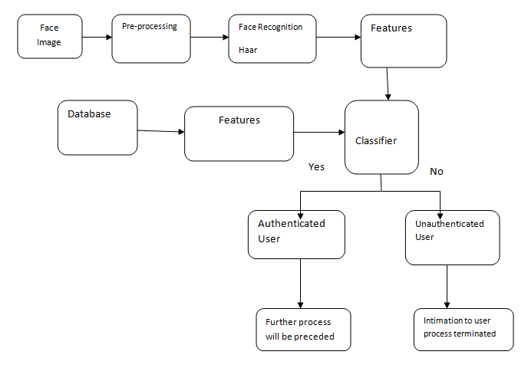
Block diagram :

Slide 8
Modules :
Pre-processing
GLCM feature extraction
Training
Testing
Neural network Classification

Slide 9
Pre processing :
Image pre-processing is the term for operations on images at the lowest level of abstraction.
These operations do not increase image information content but they decrease it if entropy is an information measure.
The aim of pre-processing is an improvement of the image data that suppresses undesired distortions or enhances some image features relevant for further processing and analysis task.

Slide 10
DRLBP :
At feature extraction stage, Discriminative Robust Local binary pattern descriptors is used to describe local primitives including different types of curves, corners and junctions.
DRLBP computes the edge response values in all eight directions at each pixel position and generates a code from the relative strength magnitude.
DRLBP uses kirsch templates for each local block in all eight orientations to determine edge details and it is converted into binary codes to generate the directional pattern.
The binary codes are determined by find difference between centre and neighboring pixels and label ‘1’ to difference pixel values which are greater than or equal to 0 and label ‘0’ to remaining.

Slide 11
GLCM :
A GLCM is a histogram of co-occurring grayscale values at a given offset over an image
texture features are extracted using Gray Level Co-occurrence Matrix (GLCM)
Texture features calculated using GLCM are Contrast, Correlation, Entropy, Energy

Slide 12
Texture features :
Energy : It is a measure the homogeneousness of the image and can be calculated from the normalized COM. It is a suitable measure for detection of disorder in texture image.
Entropy : Entropy gives a measure of complexity of the image. Complex textures tend to have higher entropy

Slide 13
Continue :
Contrast : Measures the local variations and texture of shadow depth in the gray level co-occurrence matrix.
Correlation Coefficient : Measures the joint probability occurrence of the specified pixel pairs.
sum(sum((x- μx)(y-μy)p(x , y)/σ_{x}σ_{y}))
Homogeneity : Measures the closeness of the distribution of elements in the GLCM to the GLCM diagonal.
sum(sum(p(x , y)/(1 + [x-y])))

Slide 14
Neural network :
A neural network is a series of algorithms that endeavors to recognize underlying relationships in a set of data through a process that mimics the way the human brain operates.
In this sense, neural networks refer to systems of neurons, either organic or artificial in nature. Neural networks can adapt to changing input; so the network generates the best possible result without needing to redesign the output criteria.
The concept of neural networks, which has its roots in artificial intelligence, is swiftly gaining popularity in the development of trading systems

Slide 15
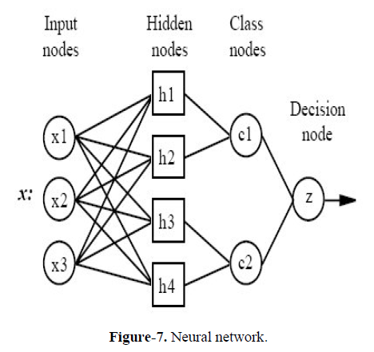
Neural network :

Slide 16
CNN description:
Input Layer: This layer holds the raw input of image with width 32, height 32 and depth 3.
Convolution Layer: This layer computes the output volume by computing dot product between all filters and image patch. Suppose we use total 12 filters for this layer we’ll get output volume of dimension 32 x 32 x 12.
Activation Function Layer: This layer will apply element wise activation function to the output of convolution layer. Some common activation functions are RELU: max(0, x), Sigmoid: 1/(1+e^-x), Leaky RELU, etc. The volume remains unchanged hence output volume will have dimension 32 x 32 x 12.

Slide 17
Continue :
Pool Layer: This layer is periodically inserted in the cornets and its main function is to reduce the size of volume which makes the computation fast reduces memory and also prevents from over fitting. Two common types of pooling layers are max pooling and average pooling. If we use a max pool with 2 x 2 filters and stride 2, the resultant volume will be of dimension 16x16x12.
Fully-Connected Layer: This layer is regular neural network layer which takes input from the previous layer and computes the class scores and outputs the 1-D array of size equal to the number of classes

Slide 18
Advantages:
Increasing security to the ATM machines
Illegal transactions can be reduced

Slide 19
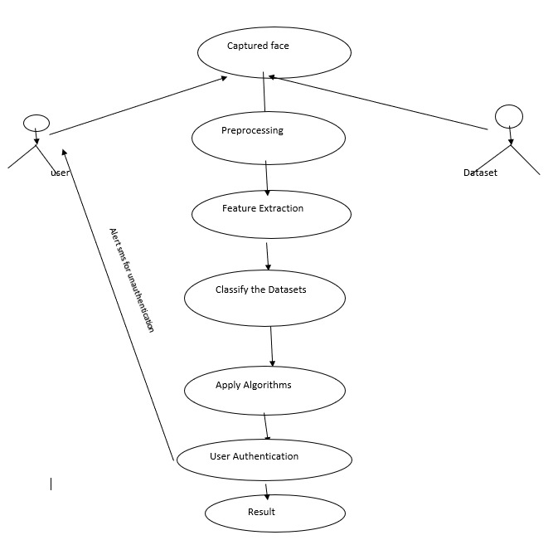
Use case diagram :

Slide 20
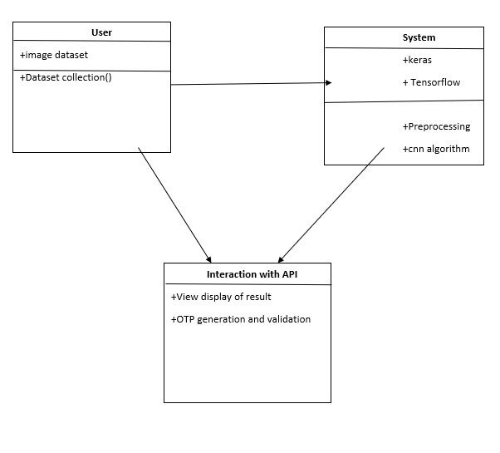
Class diagram :

Slide 21
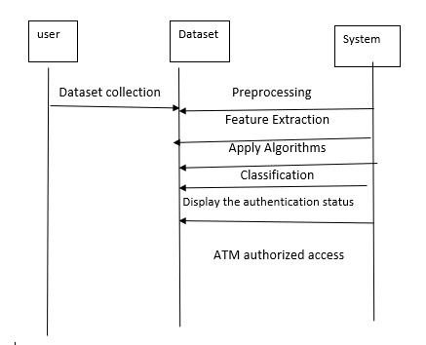
Interaction diagram :

Slide 22
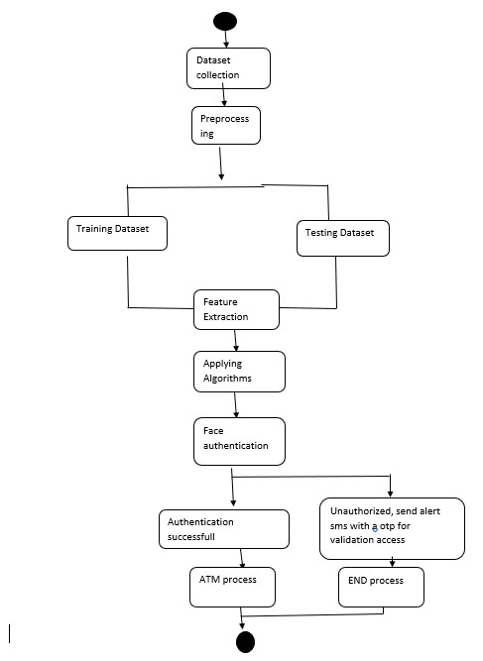
Activity diagram :

Slide 23
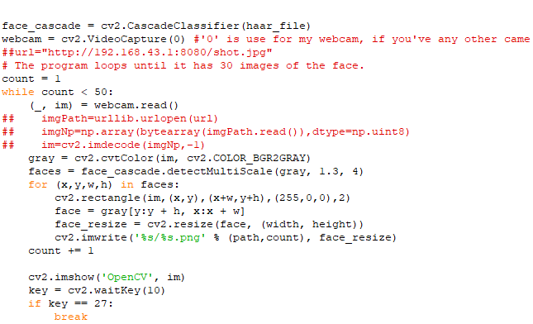
Creating database :

Slide 24
References :
V. V. Jog, D. Jain, R. Arora and B. Bhat, "Theft prevention ATM model using dormant monitoring for transactions," 2013 IEEE Conference on Information & Communication Technologies, Thuckalay, India, 2013, pp. 1156-1159, doi: 10.1109/CICT.2013.6558274.
V. Jotsov and V. Sgurev, "Applications of Puzzle methods for intrusion detection in ATMs," 2012 6th IEEE International Conference Intelligent Systems, Sofia, Bulgaria, 2012, pp. 481-488, doi: 10.1109/IS.2012.6335180.
A. T. Siddiqui, "Biometrics to Control ATM scams: A study," 2014 International Conference on Circuits, Power and Computing Technologies [ICCPCT-2014], Nagercoil, India, 2014, pp. 1598-1602, doi: 10.1109/ICCPCT.2014.7054755.
M. M. E. Raj and A. Julian, "Design and implementation of anti-theft ATM machine using embedded systems," 2015 International Conference on Circuits, Power and Computing Technologies [ICCPCT-2015], Nagercoil, India, 2015, pp. 1-5, doi: 10.1109/ICCPCT.2015.7159316

