Slide 1
Media Streaming
CMPE 277 Final Project
Submitted by:
Jon Guan
Arun Malik
Pravin Agrawal
Matilda Bernard

Slide 2
What is our app all about?
View lectures remotely:
Record and stream
broadcast
Store
Browse / play

Slide 3
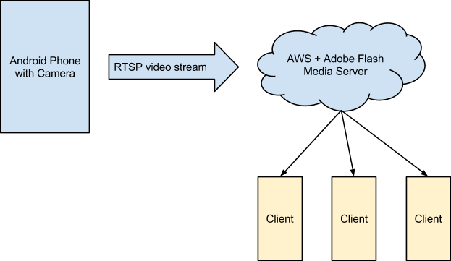
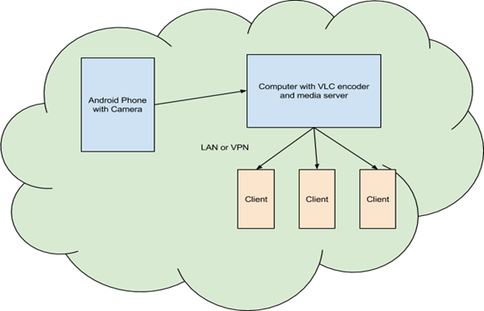
App (continued)
Various configurations that we came up with:
Web Stream and Save
Computer Stream and Save

Slide 4
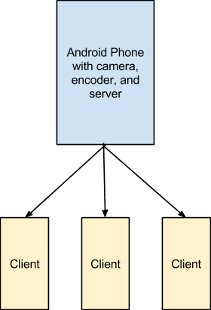
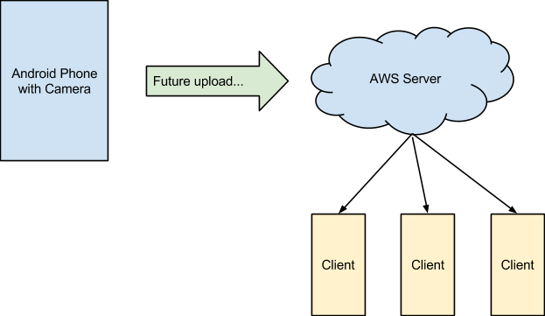
App (continued)
Other configurations:
Local Phone Save
Phone Stream and Save

Slide 5
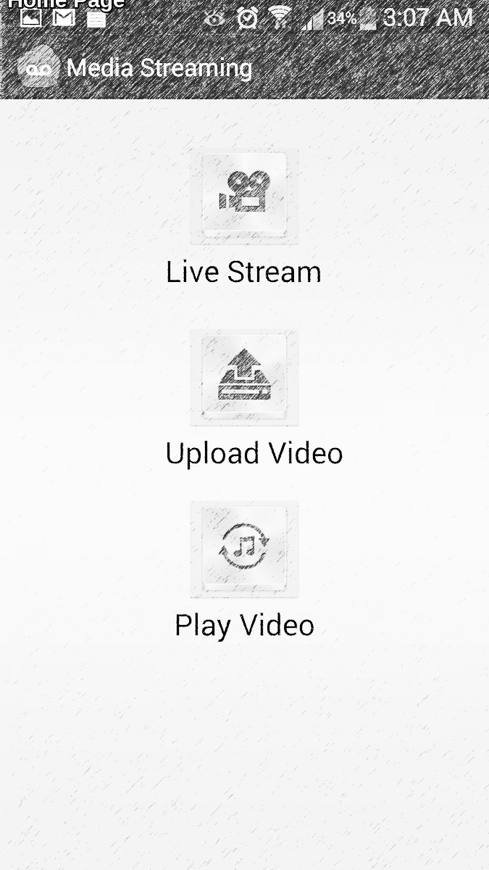
App (continued)
First option allows live streaming – visible on VLC player
Second option let’s user upload videos to the EC2 instance from:
Google Drive
DropBox
Photos
Gallery
Third option let’s users browse videos and play them.

Slide 6
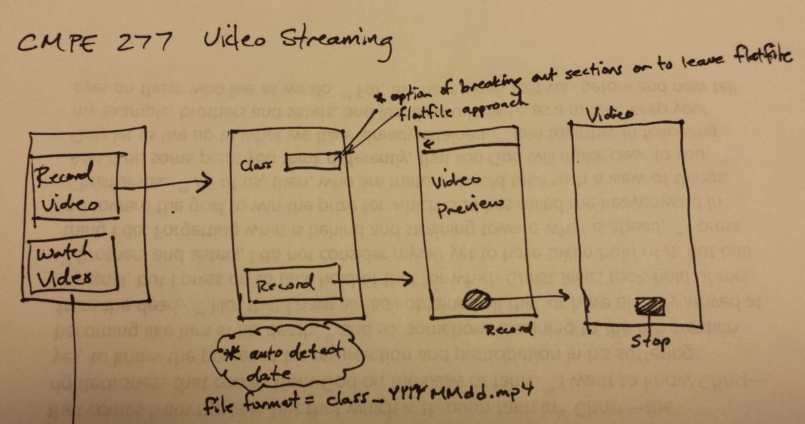
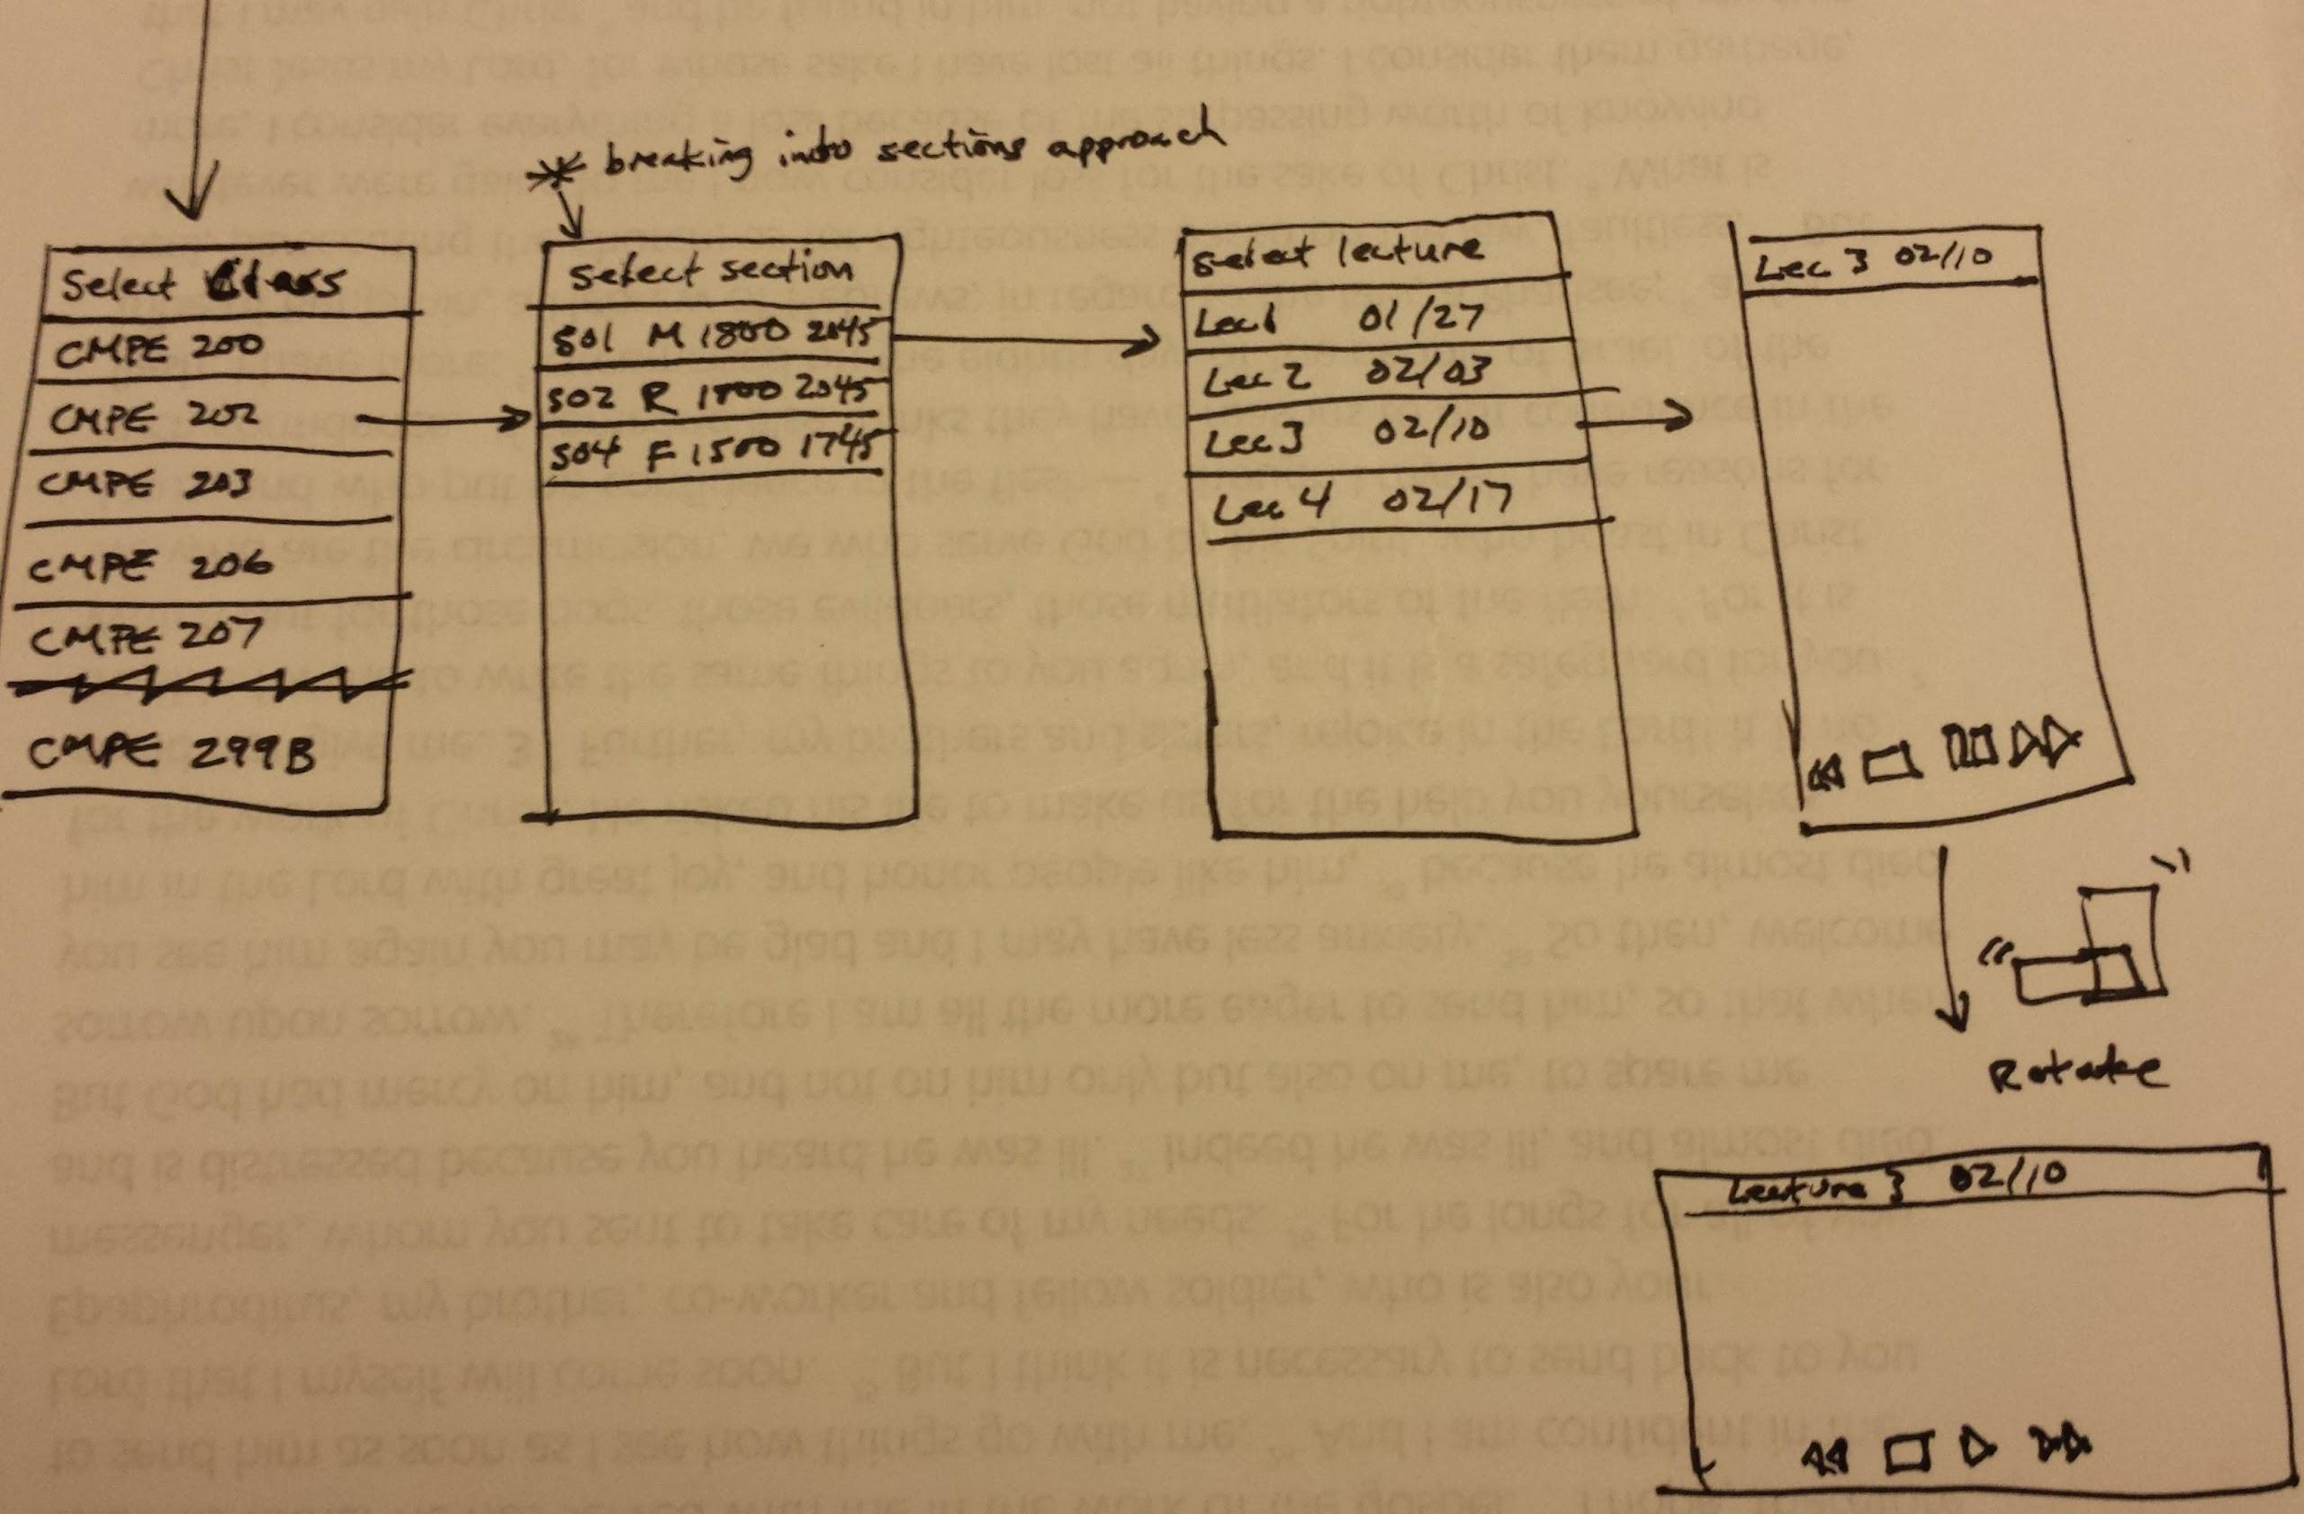
Storyboards

Slide 7
Requirements
System Requirements
Android phone, minimum os version 2.3 Gingerbread (API level 9)
Must have built-in camera
SD Card storage bay recommended, but to required.
Amazon Web Service (AWS) instance (Configuration 1 and 4)
Adobe Flash Media Server (Configuration 1)
VLC player on a Windows PC or Mac (Configuration 2)
Web server
Internet connectivity during time of live stream to enable streaming capability.
Internet connectivity for file upload if not present during time of live stream.

Slide 8
High Level Architecture

Slide 9
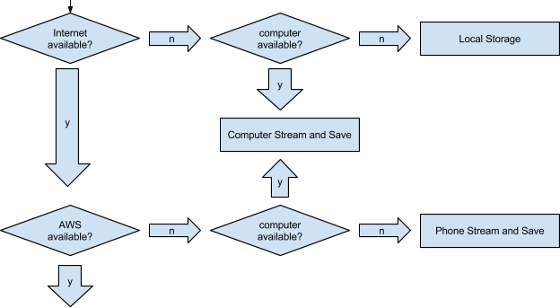
Workflow

Slide 10
Mobile and Cloud Technologies used
Cloud
Amazon EC2 : Flash Media Server and VLC live media streaming is configured on the EC2 instance
Mobile
Async Task
Bound Service
Surface Holder
Toast messages

Slide 11
Testing
UI Testing
Navigating between activities
Touch and click behavior
Phone orientation and change behavior
Multiple selects, long touch and hard button press
Smoke Testing
Check if app installs and loads main activity properly.
Check if all buttons work on the UI screen
Live stream works as expected.
Files are uploaded to media Server
User is able to browse and playback uploaded video files

Slide 12
Testing (Continued)
Integration Testing
The media server API to upload recorded video works as expected with the recording module
Live streaming video from the app are viewable on media players.
Uploaded files to the server are available on the web server and can be play backed.
Operational Test
It includes code analysis, installation testing, load testing and performance testing

Slide 13
Thank you

