Slide 1
Mesher2D
Simple Expandable Mesh Generator

Slide 2
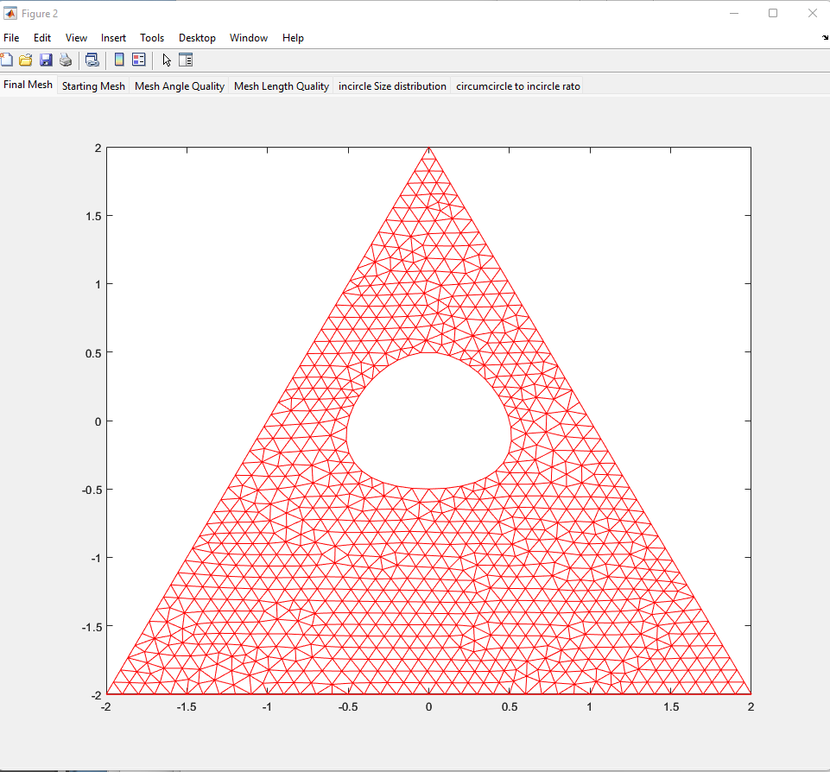
Usage
1. Create input text file
2. Open Mesher2D script and run it. And choose the text file that you want to run
If everything works, you will see the figure on the right
3. Enter output file when prompted. It is set to print nodal coordinates and element connectivity list as files

Slide 3
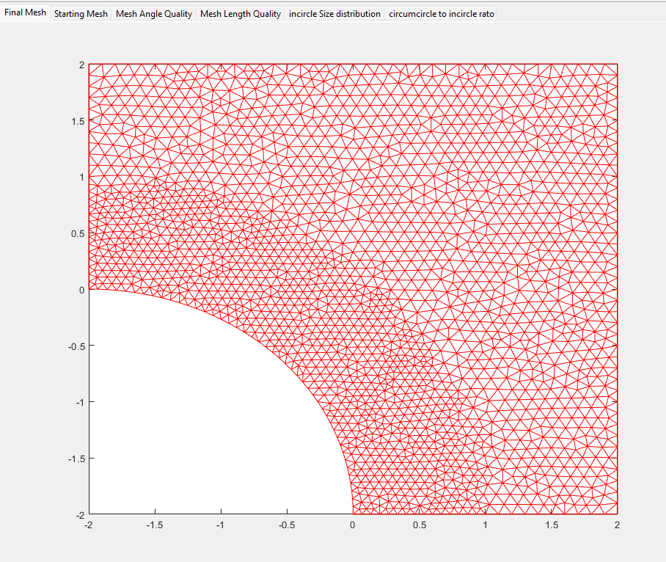
Input text file
Open polyline
You can create 3 types of curves: polylines, circular arcs and splines .
Circular arch
Closed spline
Closed polyline

Slide 4
Boundary Descriptions
Each contiguous boundary is one Loop
<-2,2>
<2,2>
*LOOP
POLYLINE, 0,-2, 0.07, 1,-2, 0.1, 2,-2, 0.1, 2, 2, 0.1, -2,2, 0.1, -2,1, 0.07, -2,0
CIRCLE, 0.07, -2,-2, 2, 90,0
<-2,1>
Refined region
<-2,0>
Circlular arc with center at -2, -2 and of radius 2, going from vertical (90) to horizontal (0)
<1,-2>
<0,-2>
<2,-2>
Note the cooridnates and the ccw order for outer loops
Note that the spacng (0.07) is closer in the denser region
Numbers in red are the point spacing along the boundaries
This controls the density of nodes.

Slide 5
Boundary description
*LOOP
POLYLINE, -2,-2, 0.1, 2,-2, 0.1, 0, 2, 0.1, -2,-2
Last point is the same as the first so it is a closed polygon
Points go CCW to indicate outer boundary
*LOOP
SPLINE,40, 0, -0.5, -0.5, 0, 0, 0.5, 0.5,0, 0,-0.5
*LOOP
SPLINE,40, 0, -0.5, -0.5, 0, 0, 0.5, 0.5,0, 0,-0.5
*LOOP
SPLINE,40, 0, -0.5, - 0.5, 0, 0, 0.5, 0.5, 0, 0,-0.5
Spline with 40 points on the boundary
5 knot points with the last beint the same as the first to indicate closed loop
Knot points specified CW to indicate inner boundary

Slide 6
Refinement region description: region subsets
Level 1 (bounding box)
Each contiguous boundary is one Loop
<-2,2>
*REFINEMENT_REGIONS
POLYLINE, 1, -2.1,-2.1, 0.1, 2.1,-2.1, 0.1, 2.1, 2.1, 0.1, -2.1,2.1
CIRCLE, 2, 0.07, -2,-2,3, 0,360
<2,2>
<-2,1>
Level 2(subset
<-2,0>
Refined region
Level 1 is a bounding box with the grid size set to 0 .1
<1,-2>
Level 2 is the refined circle of radius 3 (subset of level 1 ) that has a grid size of 0.07
<0,-2>
<2,-2>
See the initial point cloud distribution in next page

Slide 7
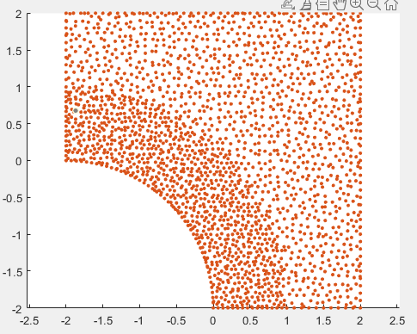

Slide 8
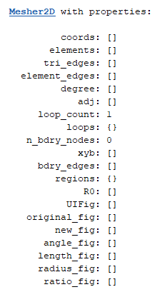
Mesher2Dscript
The object has the following attributes
The suare bracket items are all matrices and you can print any of them. (see DATA folder files for examples)
The program is run through the script file
It needs the Mesher2D object
List of unique edges
List of edge numbers for each element
Adjacency matrix

