Slide 1
Introduction to OOP with C++
Slides Adapted from
1. Programming Language Concepts, Manuel E. Bermúdez, Ph.D., Associate Professor, University of Florida
2. CSE332, Washington University, St. Louis
Slides for private educational use only. Public posting is forbidden.
Associate Professor
University of Florida
Associate Professor
University of Florida

Slide 2

Object Oriented Programming
Over time, data abstraction has become essential as programs became complicated.
Benefits:
1. Reduce conceptual load (minimum detail).
2. Fault containment.
3. Independent program components.
(difficult in practice).
Code reuse possible by extending and refining abstractions.

Slide 3
Object Oriented Programming
A methodology of programming
Four (Five ?) major principles:
Data Abstraction.
Encapsulation.
Information hiding.
Polymorphism (dynamic binding).
Inheritance

Slide 4
The C++ language
An object-oriented, general-purpose programming language, derived from C (C++ = C plus classes + more...).
C++ adds the following to C:
Inlining and overloading of functions.
Default argument values.
Argument pass-by-reference.
Free store operators new and delete, instead of malloc() and free().
Support for object-oriented programming, through classes, information hiding, public interfaces, operator overloading, inheritance, and templates.

Slide 5
Design Objectives in C++
Compatibility. Existing code in C can be used. Even existing, pre-compiled libraries can be linked with new C++ code.
Efficiency. No additional cost for using C++. Overhead of function calls is eliminated where possible.
Strict type checking. Aids debugging, allows generation of efficient code.
C++ designed by Bjarne Stroustrup of Bell Labs (now at TAMU).
Standardization: ANSI, ISO. Latest standard C++ 2017

Slide 6
Non Object-Oriented Extensions to C
Major improvements over C.
Stream I/O.
Strong typing.
Parameter passing by reference.
Default argument values.
Inlining.

Slide 7
Stream I/O in C++
Input and output in C++ is handled by streams.
The directive #include <iostream> declares 2 streams: cin and cout.
cin is associated with standard input. Extraction: operator>>.
cout is associated with standard output. Insertion: operator<<.
In C++, input is line buffered, i.e. the user must press <RTN> before any characters are processed.

Slide 8
Example of Stream I/O in C++
A function that returns the sum of
the numbers in the file Number.in
int fileSum();
{
ifstream infile("Number.in");
int sum = 0;
int value;
//read until non-integer or <eof>
while(infile >> value)
sum = sum + value;
return sum;
}

Slide 9
Example of Stream I/O in C++
Example 2: A function to copy myfile into copy.myfile
void copyfile()
{
ifstream source("myfile");
ofstream destin("copy.myfile");
char ch;
while (source.get(ch))
destin<<ch;
}

Slide 10
Line-by-line textfile concatenation
int ch;
// Name1, Name2, Name3 are strings
ifstream f1 (Name1);
ifstream f2 (Name2);
ofstream f3 (Name3);
while ((ch = f1.get())!=-1 )
if (ch =='\n')
while ((ch = f2.get())!=-1) {
f3.put(ch);
if (ch == '\n') break;
}
else f3.put(ch);
}

Slide 11
Why use I/O streams ?
Streams are type safe -- the type of object being I/O'd is known statically by the compiler rather than via dynamically tested '%' fields.
Streams are less error prone:
Difficult to make robust code using printf.
Streams are faster: printf interprets the language of '%' specs, and chooses (at runtime) the proper low-level routine. C++ picks these routines statically based on the actual types of the arguments.

Slide 12
Why use I/O streams ? (cont’d)
Streams are extensible -- the C++ I/O mechanism is extensible to new user-defined data types.
Streams are subclassable -- ostream and istream (C++ replacements for FILE*) are real classes, and hence subclassable. Can define types that look and act like streams, yet operate on other objects. Examples:
A stream that writes to a memory area.
A stream that listens to external port.

Slide 13
C++ Strong Typing
There are 6 principal situations in which C++ has stronger typing than C.
The empty list of formal parameters means "no arguments" in C++.
In C, it means "zero or more arguments", with no type checking at all. Example:
char * malloc();

Slide 14
C++ Strong Typing (cont’d)
In C, it's OK to use an undefined function; no type checking will be performed. In C++, undefined functions are not allowed.
Example:
main()
f( 3.1415 );
// C++: error, f not defined
// C: OK, taken to mean int f()

Slide 15
C++ Strong Typing (cont’d)
A C function, declared to be value-returning, can fail to return a value. Not in C++. Example:
double foo() {
/* ... */
return;
}
main() {
if ( foo() ) { ... }
...
}
// C : OK
// C++: error, no return value.

Slide 16
C++ Strong Typing (cont’d)
In C, assigning a pointer of type void* to a pointer of another type is OK. Not in C++. Example:
int i = 1024;
void *pv = &i;
// C++: error,
// explicit cast required.
// C : OK.
char *pc = pv;
int len = strlen(pc);

Slide 17
C++ Strong Typing (cont’d)
C++ is more careful about initializing arrays: Example:
char A[2]="hi";
// C++: error,
// not enough space for '\0'
// C : OK, but no '\0' is stored.
It's best to stick with char A[] = "hi“;

Slide 18
C++ Strong Typing (cont’d)
Free store (heap) management. In C++, we use new and delete, instead of malloc and free.
malloc() doesn't call constructors, and free doesn't call destructors.
new and delete are type safe.

Slide 19
Object-Oriented Programming
Object-oriented programming is a programming
methodology characterized by the following concepts:
Data Abstraction: problem solving via the formulation of abstract data types (ADT's).
Encapsulation: the proximity of data definitions and operation definitions.
Information hiding: the ability to selectively hide implementation details of a given ADT.
Polymorphism: the ability to manipulate different kinds of objects, with only one operation.
Inheritance: the ability of objects of one data type, to inherit operations and data from another data type. Embodies the "is a" notion: a horse is a mammal, a mammal is a vertebrate, a vertebrate is a lifeform.

Slide 20
O-O Principles and C++ Constructs
O-O Concept C++ Construct(s)
Abstraction Classes
Encapsulation Classes
Information Hiding Public and Private Members
Polymorphism Operator overloading,
templates, virtual functions
Inheritance Derived Classes

Slide 21
O-O is a different Paradigm
Central questions when programming.
Imperative Paradigm:
What to do next ?
Object-Oriented Programming
What does the object do ? (vs. how)
Central activity of programming:
Imperative Paradigm:
Get the computer to do something.
Object-Oriented Programming
Get the object to do something.

Slide 22
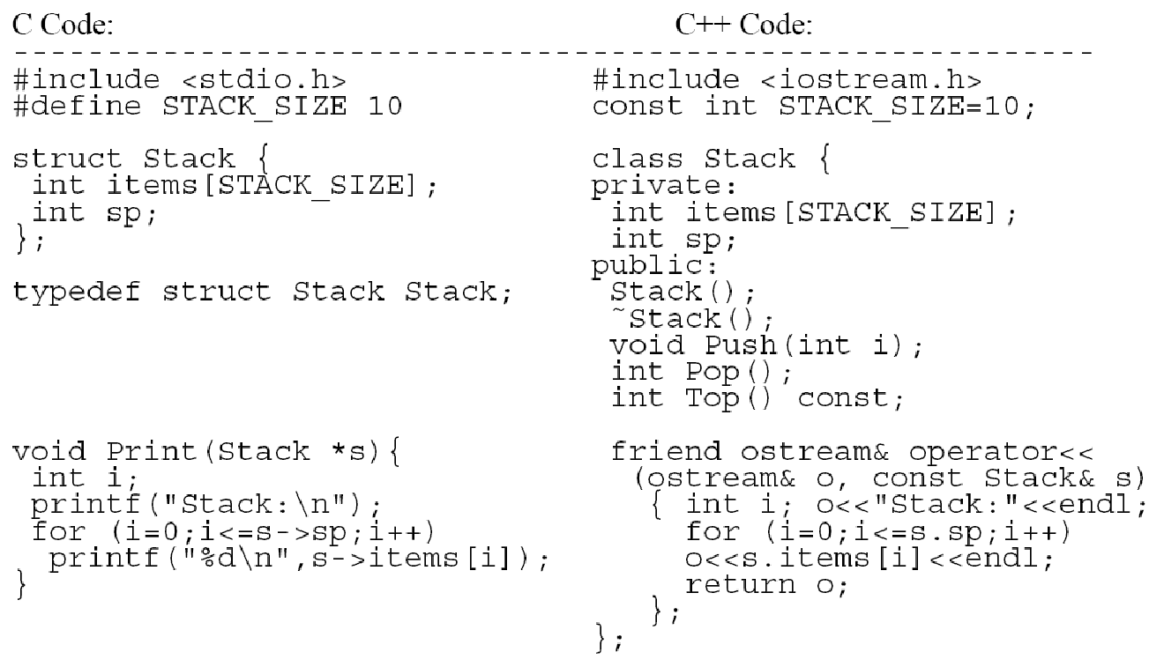
C vs. C++, side-by-side

Slide 23
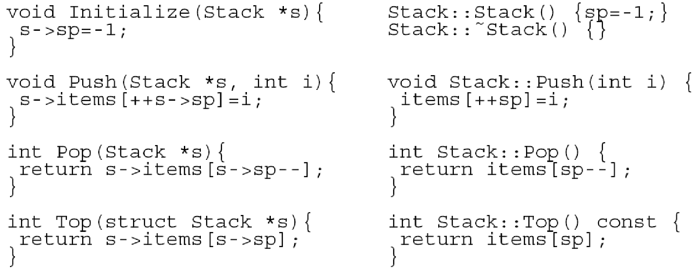
C vs. C++, side-by-side (cont’d)
In C++, methods can appear inside the class definition (better encapsulation)

Slide 24
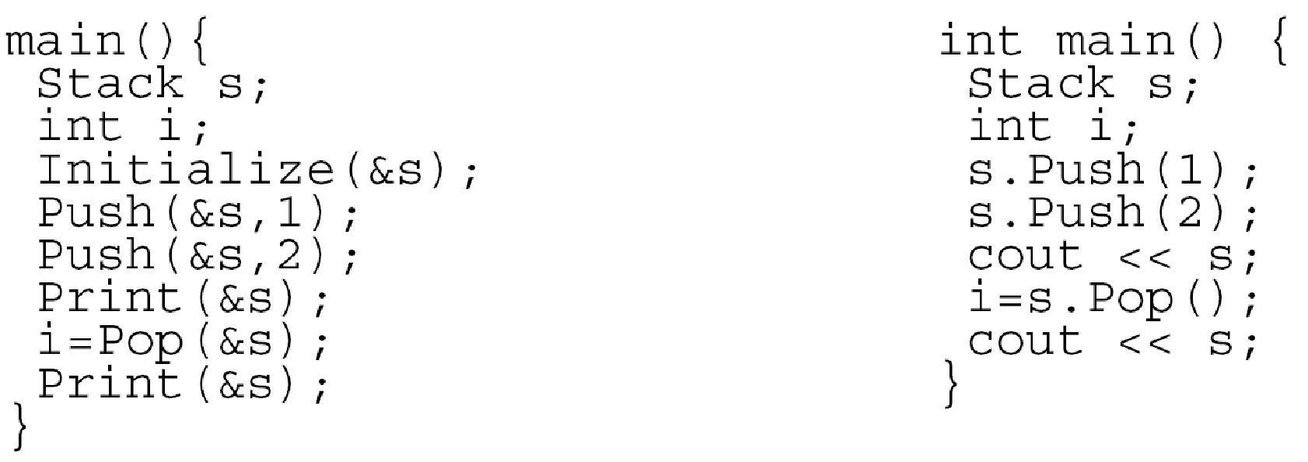
C vs. C++, side-by-side (cont’d)
In C++, no explicit referencing.
Could have overloaded <<, >> for Stacks:
s << 1; s >> i;

Slide 25
Structures and Classes in C++
Structures in C++ differ from those in C in that members can be functions.
A special member function is the “constructor”, whose name is the same as the structure. It is used to initialize the object:
struct buffer {
buffer()
{size=MAXBUF+1; front=rear=0;}
char buf[MAXBUF+1];
int size, front, rear;
}

Slide 26
Structures and Classes in C++
The idea is to add some operations on objects
of type buffer:
struct buffer {
buffer() {size=MAXBUF+1;front=rear=0;}
char buf[MAXBUF+1];
int size, front, rear;
int succ(int i) {return (i+1)%size;}
int enter(char);
char leave();
}

Slide 27
Structures and Classes in C++
The definition (body) of a member function can be
included in the structure's declaration, or may
appear later. If so, use the name resolution
operator (::)
int buffer::enter(char x) {
// body of enter }
char buffer::leave() {
// body of leave }

Slide 28
Public and Private Members
Structures and classes are closely related in C++:
struct x { <member-dclns> };
is equivalent to
class x { public: <member-dclns>};
Difference: by default, members of a structure are
public; members of a class are private. So,
class x { <member-dclns> };
is the same as
struct x { private: <member-dclns> };

Slide 29
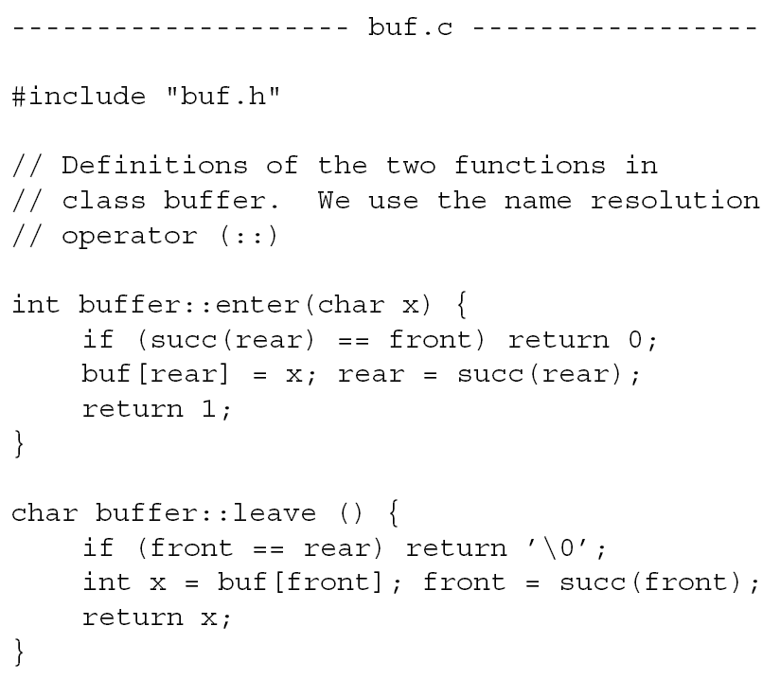
Header File Partitioning (cont’d)

Slide 30
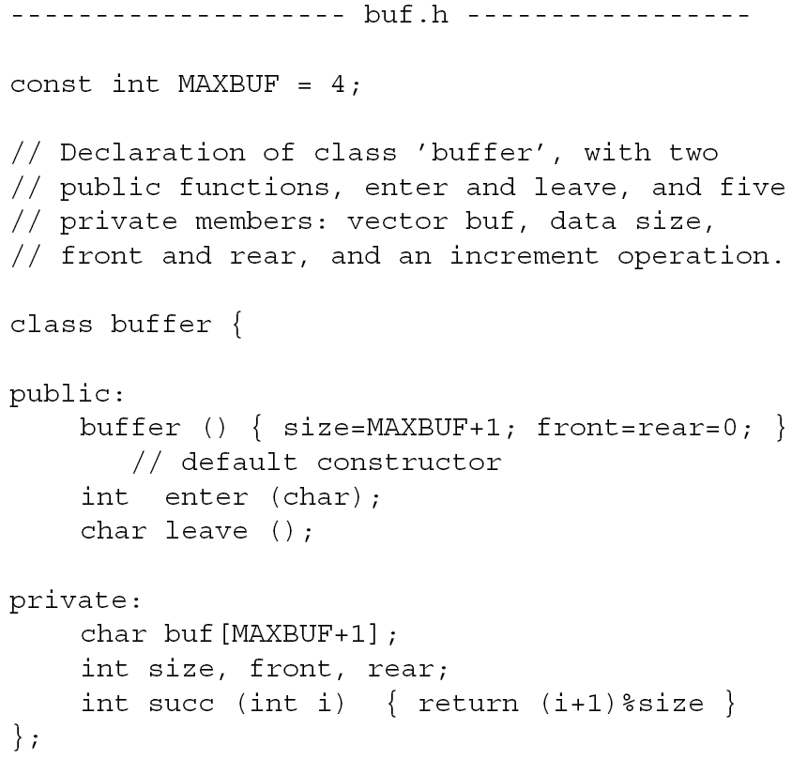
Header File Partitioning

Slide 31
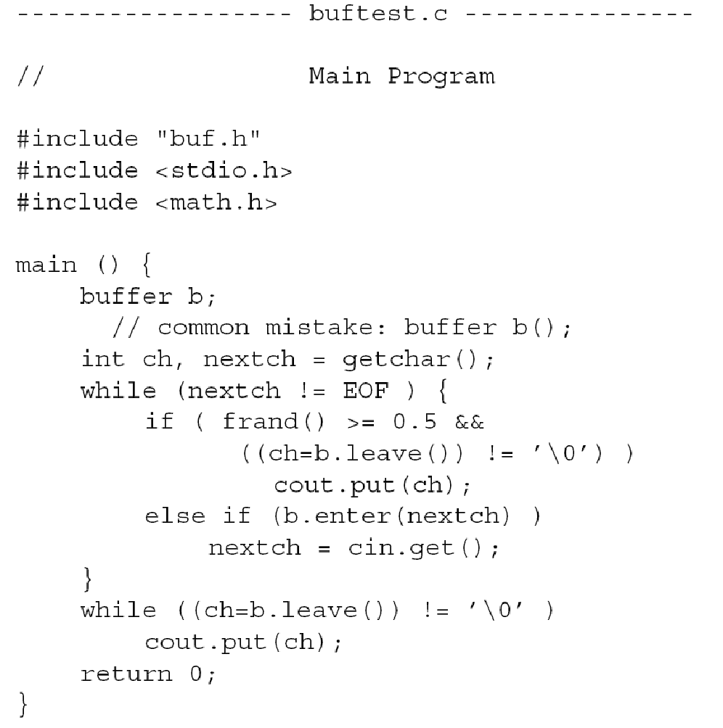
Header File Partitioning (cont’d)

Slide 32
The this Pointer
To invoke a class member function, use the ''dot'' operator (structure field selection):
<object name> . <member function name>
The this pointer: an implicit parameter to each class member function, of type (Object *).
Its value is the address of the “current” object, through which the member function has been invoked.
It can be used inside member functions. Examples coming up.

Slide 33
The const Qualifier
Three places where the const qualifier can be used
in a member function declaration:
class A {
...
const X& f(const Y& y) const {
// 1. Can't assign to object returned
// 2. Can't change parameter y
// 3. Can't change this.
}
}

Slide 34
The const Qualifier (cont’d)
A a;
...
a.f(y)
// f is a member of class A.
// a is an object of class A.
// a.f(y) can't be assigned a value.
// a.f(y) cannot change y.
// a.f(y) cannot change a.

Slide 35

Constructors
class cell {
cell(int i, cell *n) {info=i; next=n;}
int info;
cell *next;
};
cell a(1,0);
//declare a and call cell(1,0)
cell b(2,&a);
//declare b and call cell(2,&a)
These don’t just declare a and b of type cell.
They also call the constructor function cell.

Slide 36

Overloading Constructors
class cell {
cell (int i) {info=i; next=this;}
cell (int i, cell *n) {
info=i; next=n;
}
int info;
cell *next;
};
cell c(7);

Slide 37
Derived Classes
Humans tend to abstract on two dimensions:
A part-of B, (a.k.a. has_a)
A kind-of B, (a.k.a. is_a).
ADT programming focuses on the has_a relation.
OOP also includes the is_a abstraction.
Support for the is_a abstraction implies:
if A is_a B, and B has_a X, then A has_a X.
This is inheritance !!

Slide 38
Derived Classes (cont’d)
In general,
class <derived-class> : public <base-class> {
<member-declarations>
}
All members of <base-class> are also members of <derived-class>.
The <derived-class> may have additional members.
public clause: derived members retain their attributes (public, private, or protected).
private clause: derived members will be private.

Slide 39
The circlist class, revisited
class circlist {
public:
int empty () const { return rear==rear->next;}
int top() const { return rear->next->info; }
// 'inspectors'
protected:
circlist () {rear = new cell(0);};
~circlist();
void push(int);
int pop();
void enter(int); // 'mutators'
private:
cell *rear;
}

Slide 40
The circlist class, revisited
Protected members behave as if they were private, except that:
they are visible to members (and friends) of derived classes.
Some of the circlist functions are now protected so they'll be inherited by the new class queue.

Slide 41
Derived class queue
class queue: private circlist {
public:
queue() { }
~queue() { }
void enqueue (int x) { enter(x); }
int dequeue () { return pop(); }
circlist::empty;
circlist::top;
};

Slide 42
Complete list of members of queue
Public Functions:
queue new constructor
~queue new destructor
enqueue new
dequeue new
empty, top inherited, explicitly made public
Private Functions:
push inherited
pop inherited
enter inherited
Private Variables (accessible to new functions of queue):
none
Private Variables (accessible only by inherited functions):
rear inherited

Slide 43
Another class derived from circlist
class stack: private circlist {
public:
stack () { }
~stack () { }
void push (int x) { circlist::push(x); }
int pop() { return circlist::pop(); }
circlist::empty;
circlist::top;
};

Slide 44
Sample Use of these Classes
main () {
stack s;
queue q;
s.push(1); s.push(2); s.push(3);
q.enqueue(7); q.enqueue(8); q.enqueue(9);
cout << "Stack Top: " << s.top() << endl;
cout << "Queue Top: " << q.top() << endl;
cout << s.pop() << " ";
cout << s.pop() << " ";
cout << s.pop() << endl;
cout << q.dequeue() << " ";
cout << q.dequeue() << " ";
cout << q.dequeue() << endl;
}
Results:
Stack Top: 3
Queue Top: 7
3 2 1
7 8 9

Slide 45
Class Hierarchies
class employee { /* . . . */ };
class manager:
public employee { /* . . . */ };
class director:
public manager { /* . . . */ };
class temporary { /* . . . */ };
class secretary:
public employee { { /* . . . */ };
class tsec:
public temporary, //MULTIPLE INHERITANCE !!
public secretary { /* . . . */ };
class consultant:
public temporary,
public manager { /* . . . */ };

Slide 46
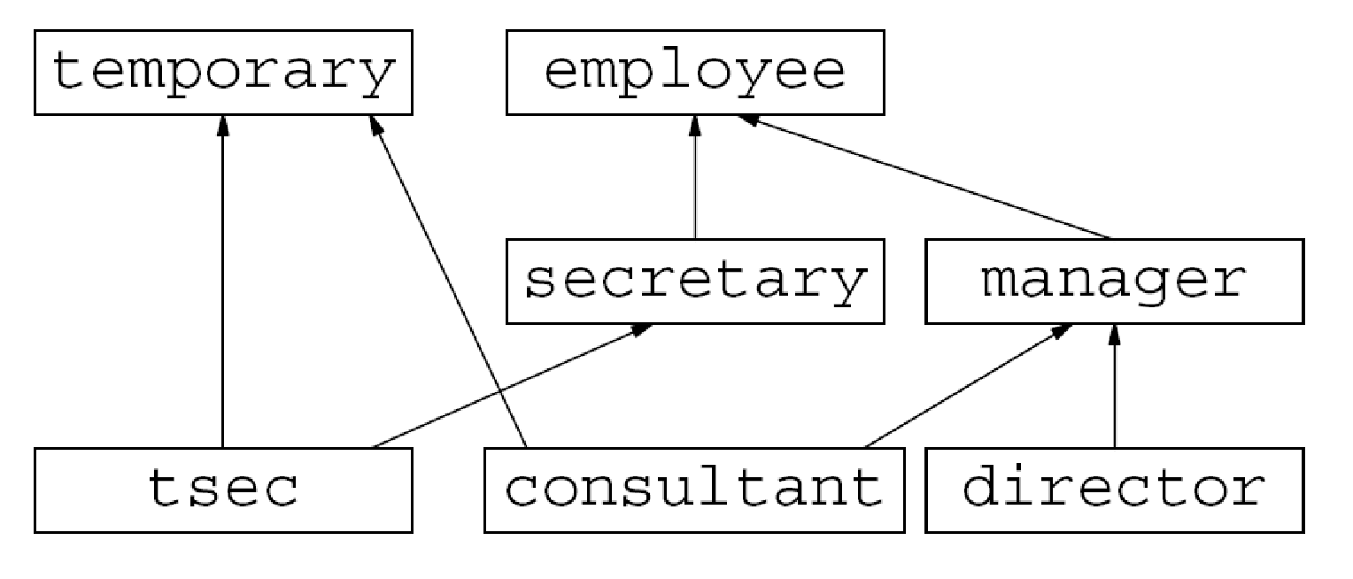
Class Hierarchy is a DAG

Slide 47
Type Identification
In our example, given a pointer of type employee*, it can point to:
employee, secretary, tsec, manager, or director.
Three solutions, in general, to this problem:
Only use pointers to classes that have no derived classes. Sure ...
Use a variable to determine the type of the object. Very easy to forget to check the type variable.
Use virtual functions.

Slide 48
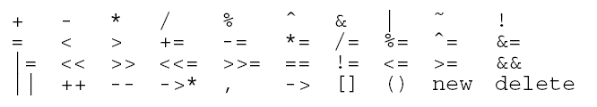

Operator Overloading
Allow intrinsic operators in C++ to be applied to objects of new types.
Overloading is achieved by defining functions named operatorXXX, where XXX is one of:
Can’t overload these:
Can’t change precedence, arity or associativity. Can’t add new operators, either.☹

Slide 49
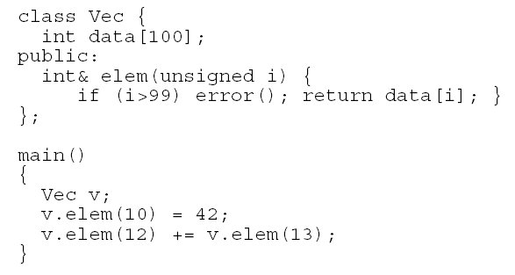
Operator Overloading (cont’d)
Example: the subscript operator, which returns
a reference. First, without operator overloading:

Slide 50
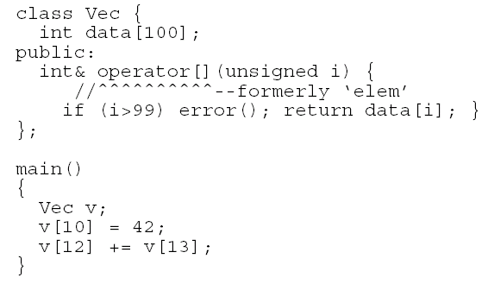
Operator Overloading (cont’d)
Now, simply replace elem with operator[]:

Slide 51
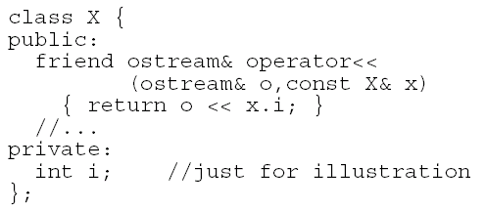
Overloading Operators << and >>
We wish to use << and >> for user-defined objects, the same way they are (normally) used for "built-in" objects (e.g. int, char, etc.).

Slide 52
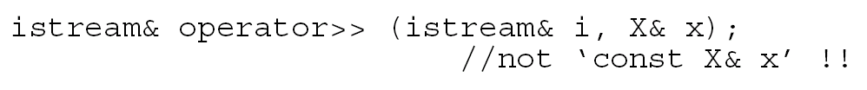
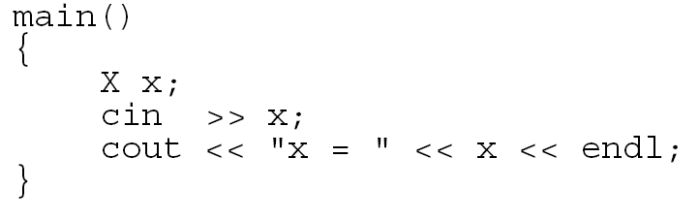
Overloading Operators << and >>
Input is similar. The signature is:
To use them:

Slide 53
The Orthodox Canonical Form
An idiom (pattern). The OCF is characterized
by the presence of:
A default constructor:
X::X()
A copy constructor:
X::X(const X&)
An assignment operator:
X& operator=(const X&)
A destructor:
X::~X()

Slide 54
Overview of C++ Polymorphism
Two main kinds of types in C++: native and user-defined
“User” defined types: declared classes, structs, unions
including types provided by the C++ standard libraries
Native types are “built in” to the C++ language itself: int, long, float, …
A typedef creates a new type name for another type (type aliasing)
Public inheritance creates sub-types
Inheritance only applies to user-defined classes (and structs)
A publicly derived class is-a subtype of its base class
Known as “inheritance polymorphism”
Template parameters also induce a subtype relation
Known as “interface polymorphism”
We’ll cover how this works in depth, in later sessions
Liskov Substitution Principle (for both kinds of polymorphism)
if S is a subtype of T, then wherever you need a T you can use an S

Slide 55
Static vs. Dynamic Type
The type of a variable is known statically (at compile time), based on its declaration
int i; int * p;
Fish f; Mammal m;
Fish * fp = &f;
However, actual types of objects aliased by references & pointers to base classes vary dynamically (at run-time)
Fish f; Mammal m;
Animal * ap = &f;
ap = &m;
Animal & ar = get_animal();
Animal
Fish
Mammal
A base class and its derived classes form a set of types
type(*ap) ∈ {Animal, Fish, Mammal}
typeset(*fp) ⊂ typeset(*ap)
Each type set is open
More subclasses can be added

Slide 56
Class and Member Destruction Order
class A {
public:
A(int i) :m_i(i) {
cout << "A“ << endl;}
~A() {cout<<"~A"<<endl;}
private:
int m_i;
};
class B : public A {
public:
B(int i, int j) :A(i), m_j(j) {
cout << “B” << endl;}
~B() {cout << “~B” << endl;}
private:
int m_j;
};
int main (int, char *[]) {
B b(2,3);
return 0;
};
B destructor called on object b in main
Body of B destructor runs
outputs “~B”
B destructor calls “destructor” of m_j
int is a built-in type, so it’s a no-op
B destructor calls A destructor
Body of A destructor runs
outputs “~A”
A destructor calls “destructor” of m_i
again a no-op
Compare orders of construction and destruction of base, members, body
at the level of each class, order of steps is reversed in constructor vs. destructor
ctor: base class, members, body
dtor: body, members, base class

Slide 57
Virtual Functions
class A {
public:
A () {cout<<" A";}
virtual ~A () {cout<<" ~A";}
virtual f(int);
};
class B : public A {
public:
B () :A() {cout<<" B";}
virtual ~B() {cout<<" ~B";}
virtual f(int) override; //C++11
};
int main (int, char *[]) {
// prints "A B"
A *ap = new B;
// prints "~B ~A" : would only
// print "~A" if non-virtual
delete ap;
return 0;
};
Used to support polymorphism with pointers and references
Declared virtual in a base class
Can override in derived class
Overriding only happens when signatures are the same
Otherwise it just overloads the function or operator name
More about overloading next lecture
Ensures derived class function definition is resolved dynamically
E.g., that destructors farther down the hierarchy get called
Use final (C++11) to prevent overriding of a virtual method
Use override (C++11) in derived class to ensure that the signatures match (error if not)

Slide 58
Virtual Functions
class A {
public:
void x() {cout<<"A::x";};
virtual void y() {cout<<"A::y";};
};
class B : public A {
public:
void x() {cout<<"B::x";};
virtual void y() {cout<<"B::y";};
};
int main () {
B b;
A *ap = &b; B *bp = &b;
b.x (); // prints "B::x"
b.y (); // prints "B::y"
bp->x (); // prints "B::x"
bp->y (); // prints "B::y"
ap->x (); // prints "A::x"
ap->y (); // prints "B::y"
return 0;
};
Only matter with pointer or reference
Calls on object itself resolved statically
E.g., b.y();
Look first at pointer/reference type
If non-virtual there, resolve statically
E.g., ap->x();
If virtual there, resolve dynamically
E.g., ap->y();
Note that virtual keyword need not be repeated in derived classes
But it’s good style to do so
Caller can force static resolution of a virtual function via scope operator
E.g., ap->A::y(); prints “A::y”

Slide 59
Potential Problem: Class Slicing
Catch derived exception types by reference
Also pass derived types by reference
Otherwise a temporary variable is created
Loses original exception’s “dynamic type”
Results in “the class slicing problem” where only the base class parts and not derived class parts copy

Slide 60
Pure Virtual Functions
class A {
public:
virtual void x() = 0;
virtual void y() = 0;
};
class B : public A {
public:
virtual void x();
};
class C : public B {
public:
virtual void y();
};
int main () {
A * ap = new C;
ap->x ();
ap->y ();
delete ap;
return 0;
};
A is an abstract (base) class
Similar to an interface in Java
Declares pure virtual functions (=0)
May also have non-virtual methods, as well as virtual methods that are not pure virtual
Derived classes override pure virtual methods
B overrides x(), C overrides y()
Can’t instantiate an abstract class
class that declares pure virtual functions
or inherits ones that are not overridden
A and B are abstract, can create a C
Can still have a pointer or reference to an abstract class type
Useful for polymorphism

Slide 61
Design with Pure Virtual Functions
Pure virtual functions let us specify interfaces appropriately
But let us defer implementation decisions until later (subclasses)
As the type hierarchy is extended, pure virtual functions are replaced
By virtual functions that fill in (and may override) the implementation details
Key idea: refinement
Animal
move()=0
Fish
Mammal
move()
move()
swim()
walk()
Bird
Sparrow
Penguin
move()
move()
walk()
waddle()
fly()
swim()

Slide 62
Summary: Tips on Inheritance Polymorphism
A key tension
Push common code and variables up into base classes
Make base classes as general as possible
Use abstract base classes to declare interfaces
Use public inheritance to make sets of polymorphic types
Use private or protected inheritance only for encapsulation
Inheritance polymorphism depends on dynamic typing
Use a base-class pointer (or reference) if you want inheritance polymorphism of the objects pointed to (or referenced)
Use virtual member functions for dynamic overriding
Even though you don’t have to, label each inherited virtual (and pure virtual) method “virtual” in derived classes
Use final (C++11) to prevent overriding of a virtual method
Use override (C++11) to make sure signatures match

