Slide 1
OOP Principles and Design Patterns
Arun Ravindran, Ph.D
January 2019
For private educational use only. Not to be shared publicly.

Slide 2
Principles of good software design
Principles to good software design
understandable, flexible, and maintainable
Characteristics of bad software according to Robert Martin (Uncle Bob!)
It is hard to change because every change affects too many other parts of the system (Rigidity)
When you make a change, unexpected parts of the system break. (Fragility)
It is hard to reuse in another application because it cannot be disentangled from the current application. (Immobility)

Slide 3
Reasons for bad software design
Rigidity
Heavy interdependency among modules making cost of change impossible to predict
Managers become reluctant to authorize changes
Fragility
Heavy interdependency among modules making changes in one part causing failures in unrelated parts
Immobilitty
Desired parts are tightly coupled with unneeded parts, making reuse difficult

Slide 4
SOLID Design Principles
SOLID
S - Single responsibility principle
O - Open/closed principle
L - Liskov substitution principle
I - Interface segregation principle
D - Dependency inversion principle
Reference - Design Principles and Design Patterns, by Robert Martin

Slide 5
Design Patterns
Reusable solution to a commonly occurring problem within a specific context
Aids the designer in applying SOLID principles to commonly occurring design situations
Constitutes a common vocabulary among developers
Not to be applied blindly!
First introduced by Gang of Four - Design Patterns: Elements of Reusable Object Oriented Software

Slide 6
SOLID - SRP: Single Responsibility Principle
Every class should have a responsibility for a single functionality
Responsibility can be thought of as a reason to change
If a class has more than one responsibility, the the responsibilities become couple
Change to one, may impair the ability to change the other
For example, consider a Rectangle class with draw() and area() methods
Say, draw() primarily used by a Graphics application, while area() used by Geometry application
If Graphics application causes rectangle to change in some way, it may require rebuilding of the unrelated Geometry application as well!
Important to apply single responsibility principle if change actually happens

Slide 7
SOLID - OCP: Open/Closed Principle
Modules are “Open For Extension”
Behavior of the module can be extended
Modules are “Closed for Modiﬁcation”
No one is allowed to make source code changes to it
Achieved through abstraction
Module can be closed for modiﬁcation since it depends upon an abstraction that is ﬁxed
Behavior of that module can be extended by creating new derivatives of the abstraction

Slide 8
Example C code that violates Open/Close principle
enum ShapeType {circle, square};
struct Shape { ShapeType itsType; };
struct Circle { ShapeType itsType; double itsRadius; Point itsCenter; };
struct Square { ShapeType itsType; double itsSide; Point itsTopLeft; };
// These functions are implemented elsewhere
void DrawSquare(struct Square*);
void DrawCircle(struct Circle*);
typedef struct Shape *ShapePointer;
void DrawAllShapes(ShapePointer list[], int n)
{
int i;
for (i=0; i<n; i++) {
struct Shape* s = list[i];
switch (s->itsType) {
case square:
DrawSquare((struct Square*)s);
break;
case circle:
DrawCircle((struct Circle*)s);
break;
}
}
}
To include triangles, DrawAllShapes() has to be modified

Slide 9
OOP rewrite that satisfies Open/Closed principle
class Shape { public: virtual void Draw() const = 0; };
class Square : public Shape { public: virtual void Draw() const; };
class Circle : public Shape { public: virtual void Draw() const; };
void DrawAllShapes(Set<Shape*>& list){
for (Iterator<Shape*>i(list); i; i++)
(*i)->Draw();
}
To extend the behavior of the DrawAllShapes function to draw a new kind of shape, all we need do is add a new derivative of the Shape class
The DrawAllShapes function does not need to change.

Slide 10
SOLID - LSP: Liskov Substitution Principle
Functions that use pointers or references to base classes must be able to use objects of derived classes without knowing it
If there is a function which does not conform to the LSP, then that function uses a pointer or reference to a base class, but must know about all the derivatives of that base class
Such a function violates the Open-Closed principle because it must be modiﬁed whenever a new derivative of the base class is created

Slide 11
Example violation of Liskov Substitution Principle
class Rectangle {
private:
double itsHeight;
double itsWidth;
public:
virtual void setWidth(double w) {itsWith = w;}
virtual void setHeight(double h) {itsHeight = h;}
double getHeight() const {return itsHeight;}
double getWidth() const {return itsWidth;}
};
class Square : public Rectangle {
public:
virtual void SetWidth(double w) {Rectangle::setWidth(w);}
virtual void SetHeight(double h) {Rectangle::setHeight(h);}
};
void g(Rectangle& r)
{
r.SetWidth(5);
r.SetHeight(4);
assert(r.GetWidth() * r.GetHeight()) == 20);
}
The function works for a Rectangle, but declares an assertion error if passed a Square
Violation of LSP since Square IS NOT A Rectangle!

Slide 12
SOLID - DIP: Dependency Inversion Principle
High level module should not depend on low level modules
Both should depend on abstractions
Abstractions should not depend on details
Details should depend on abstractions
In traditional structured programming, the dependency if of higher level modules depending on lower level modules
Changes in lower level modules propagate upwards
By having the high level layer (policy) and low level layer (mechanism) depending on an abstract interface, the dependency is inverted

Slide 13
SOLID - DIP: Example violation
class Lamp
{
public:
void TurnOn();
void TurnOff();
};
class Lamp;
class Button
{
public:
Button(Lamp& l) : itsLamp(&l) {}
void Detect();
private:
Lamp* itsLamp;
};
void Button::Detect()
{
bool buttonOn = GetPhysicalState(); if (buttonOn)
itsLamp->TurnOn();
else
itsLamp->TurnOff();
}
Button class depends on the lamp class
Button
Lamp

Slide 14
SOLID: DIP - Fix with abstract interfaces
Button
Abstract
Button client
Reusable with any kind of button and kind of device that needs to be controlled
Button Concrete
Lamp

Slide 15
SOLID: DIP - Fix with abstract interfaces
class ButtonClient
{
public:
virtual void TurnOn() = 0;
virtual void TurnOff() = 0;
};
class ButtonClient;
class Button
{
public:
Button(ButtonClient&);
void Detect();
virtual bool GetState() = 0;
private:
ButtonClient* itsClient;
};
Button::Button(ButtonClient& bc)
: itsClient(&bc) {}
void Button::Detect()
{
bool buttonOn = GetState();
if (buttonOn)
itsClient->TurnOn();
else
itsClient->TurnOff();
}
class Lamp : public ButtonClient
{
public:
virtual void TurnOn();
virtual void TurnOff();
};
class ButtonImplementation
: public Button
{
public:
ButtonImplementaton(
ButtonClient&);
virtual bool GetState();
};

Slide 16
SOLID: ISP - Interface segregation principle
Deals with what to include in an interface
Clients should not be forced to depend on interfaces that they do not use
When a client depends upon a class that contains interfaces that the client does not use, but that other clients do use, then that client will be affected by the changes that those other clients force upon the class.
Example, for an ATM application, instead of an a UI interface that common to many different types of transaction (deposit, withdraw, transfer etc.), ISP calls for different UI interfaces for each transaction
Deposit UI Interface, Withdraw UI interface, Transfer UI interface

Slide 17
Design Patterns
Creation - Factory, Abstract Factory, Singleton
Structural - Adapter, Facade, Proxy
Behavioral - Strategy, Decorator, Command, State
Reference - Design Patterns: Elements of Reusable Object-Oriented Software, by Erich Gamma, John Vlisiddes, Ralph Johnson, and Richard Helm (aka Gang of 4)
Reference - Head First Design Patterns - A Brain-Friendly Guide, by Bert Bates, Kathy Sierra, Eric Freeman, Elisabeth Robson

Slide 18
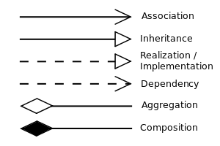
Class Diagrams
Association: Two classes X and Y communicate with each other
eg. instructor, student
Aggregation: A class X “has” other classes Y and Z, each of which exists independently of X
eg: Car is a collection of engine, wheel, chassis etc.
Composition: A class X “has” classes Y and Z, each of which exists only if X exists
eg. Person is composed of head, arms, chest, legs, abdomen, etc.
Inheritance: A class Y “is” a type of class X
eg: Circle is a Shape
Dependency: Changes to class X causes changes to class Y
Realization: Class Y implements class X (interface)

Slide 19
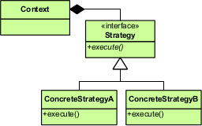
Strategy Pattern
Defines a family of algorithms, encapsulates each one, and makes them interchangable
Strategy lets the algorithm vary independently from the clients that use it
Instead of implementing a single algorithm directly, code receives run-time instructions as to which in a family of algorithms to use.
Context refers to the Strategy interface for implementing the algorithm

Slide 20
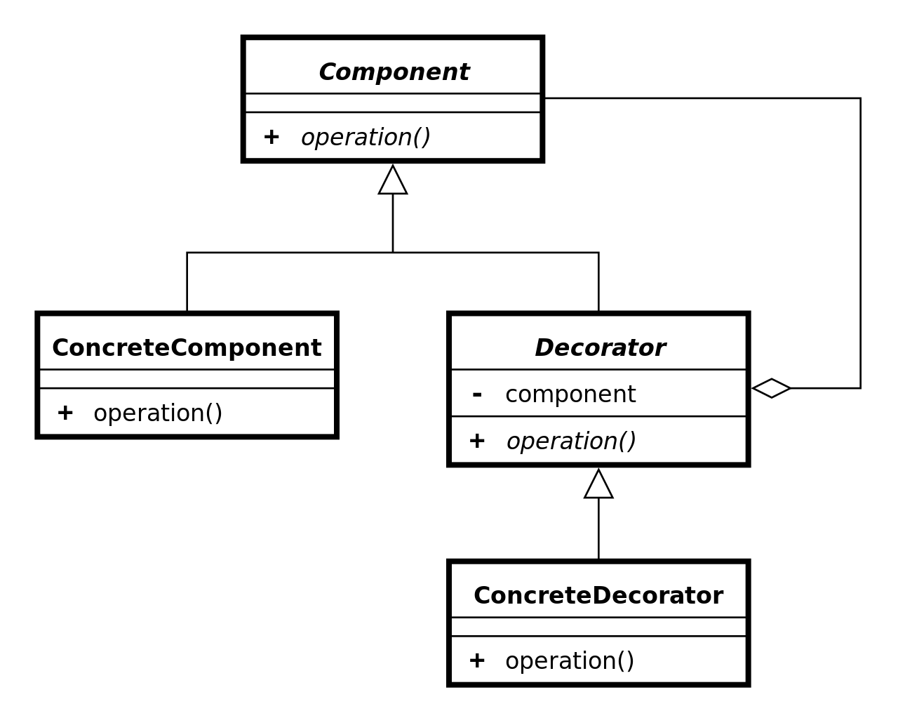
Decorator Pattern
The Decorator Pattern attaches additional responsibilities to an object dynamically by wrapping the original class
Decorators provide a flexible alternative to subclassing for extending functionality

Slide 21
Decorator - steps
Subclass the original Component class into a Decorator class
In the Decorator class, add a Component pointer as a field
In the Decorator class, pass a Component to the Decorator constructor to initialize the Component pointer
In the Decorator class, forward all Component methods to the Component pointer
In the ConcreteDecorator class, override any Component method(s) whose behavior needs to be modified.

Slide 22
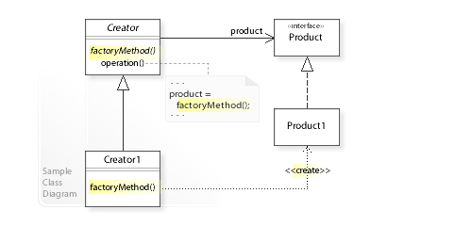
Factory Method Pattern
The Factory method pattern defines an interface for creating an object, but lets subclasses decide which class to instantiate
Creating an object often requires complex processes not appropriate to include within a composing object
Creator refers to a separate factoryMethod() to create a product object, which makes the Creator independent of which concrete class is instantiated
Subclasses of Creator can redefine which class to instantiate.

Slide 23
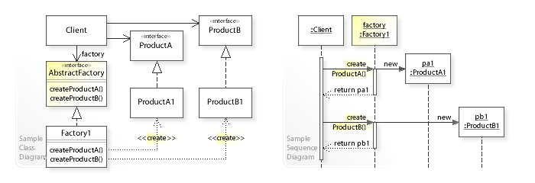
Abstract Factory Pattern
The abstract factory pattern provides an interface for creating families of related or dependent objects without specifying their concrete classes
The Abstract Factory design pattern solves problems like
How can an application be independent of how its objects are created?
How can a class be independent of how the objects it requires are created?
How can families of related or dependent objects be created?

Slide 24
Abstract Factory pattern - steps
Client class that requires ProductA and ProductB objects doesn't instantiate the ProductA1 and ProductB1 classes directly
Instead, the Client refers to the AbstractFactory interface for creating objects, which makes the Client independent of how the objects are created (which concrete classes are instantiated)
The Factory1 class implements the AbstractFactory interface by instantiating the ProductA1 and ProductB1 classes.

Slide 25
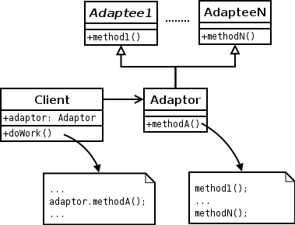
Adapter Pattern
The adapter pattern converts the interface of a class into another interface the clients expect.
Adapter lets classes work together that couldn’t otherwise because of incompatible interfaces
The adapter design pattern solves problems like:[3]
How can a class be reused that does not have an interface that a client requires?
How can classes that have incompatible interfaces work together?
How can an alternative interface be provided for a class?

Slide 26
Command Pattern
The command pattern encapsulates a request as an object, thereby letting your parameterize other objects with different requests, queue or log requests, and support undo operations
Implementing (hard-wiring) a request directly into a class is inflexible because it couples the class to a particular request at compile-time, which makes it impossible to specify a request at run-time
Define separate (command) objects that encapsulate a request.
A class delegates a request to a command object instead of implementing a particular request directly.

Slide 27
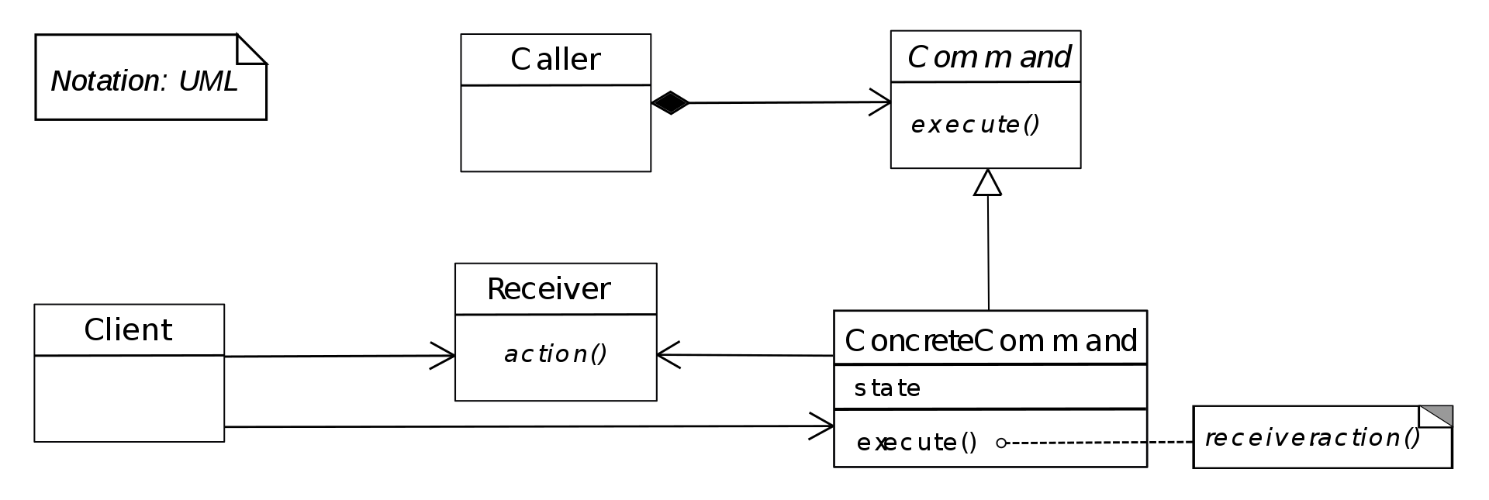
Command Pattern - Steps
Invoker(caller) refers to the Command interface to perform a request (command.execute())
The Invoker is independent of how the request is performed
The ConcreteCommand class implements the Command interface by performing an action on a receiver (receiver.action1())

