Slide 1
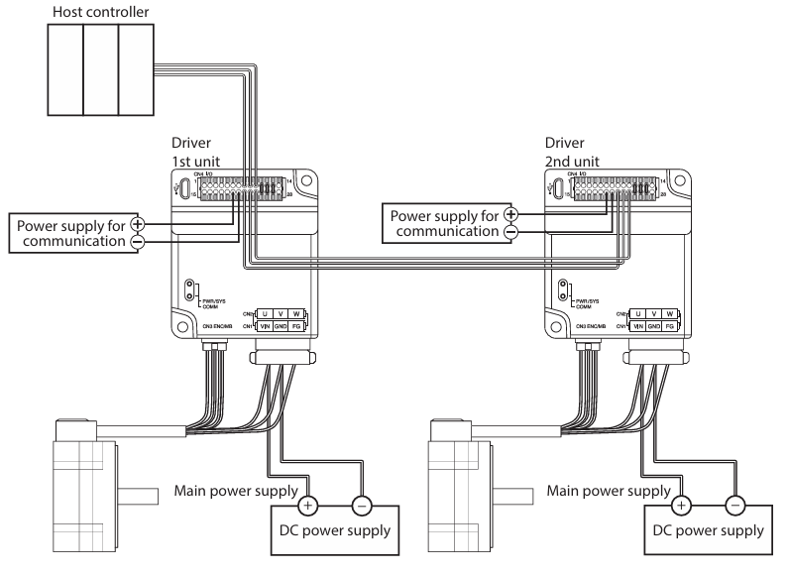
Connection INFO
General connection information

Slide 2
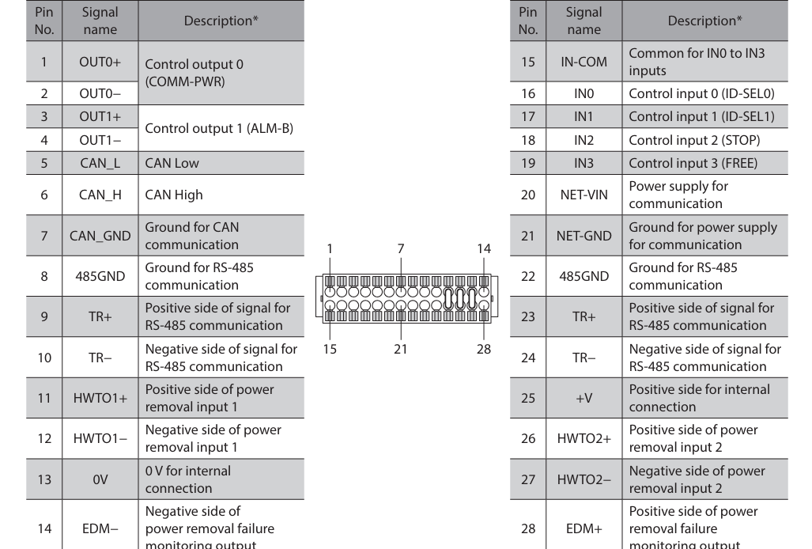
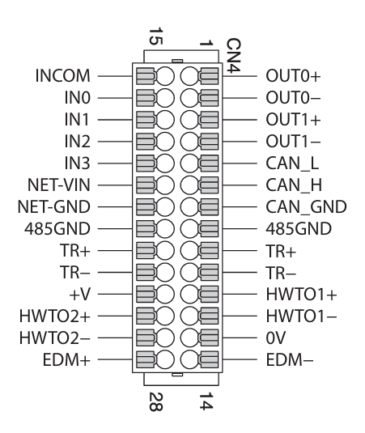

Slide 3
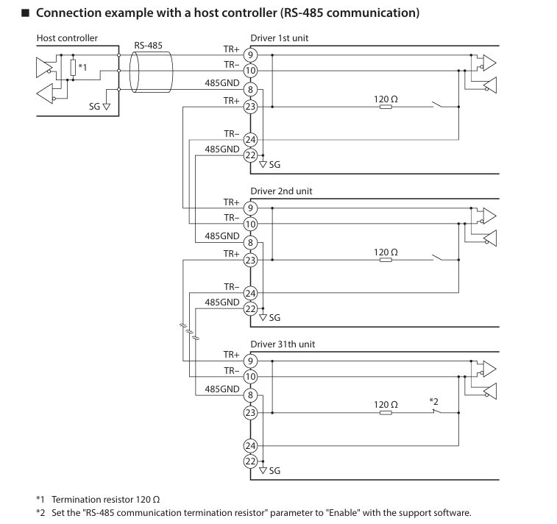

Slide 4
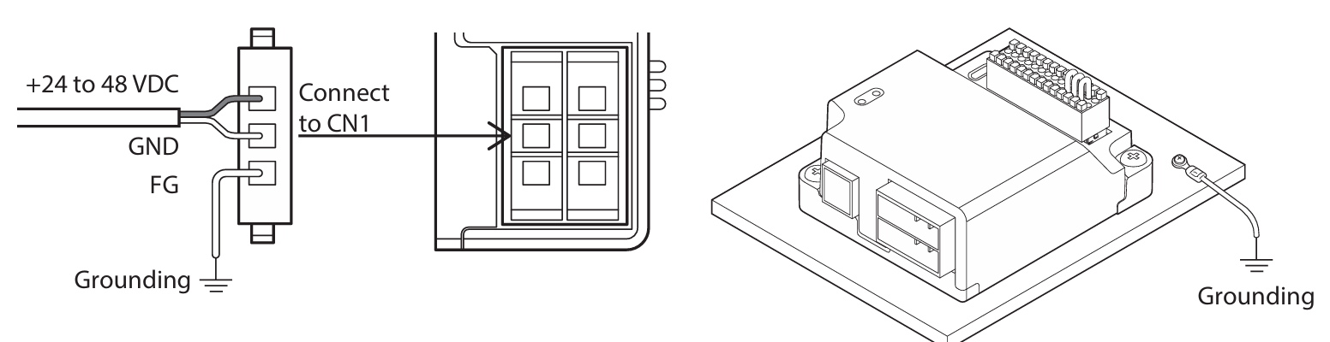

Slide 5
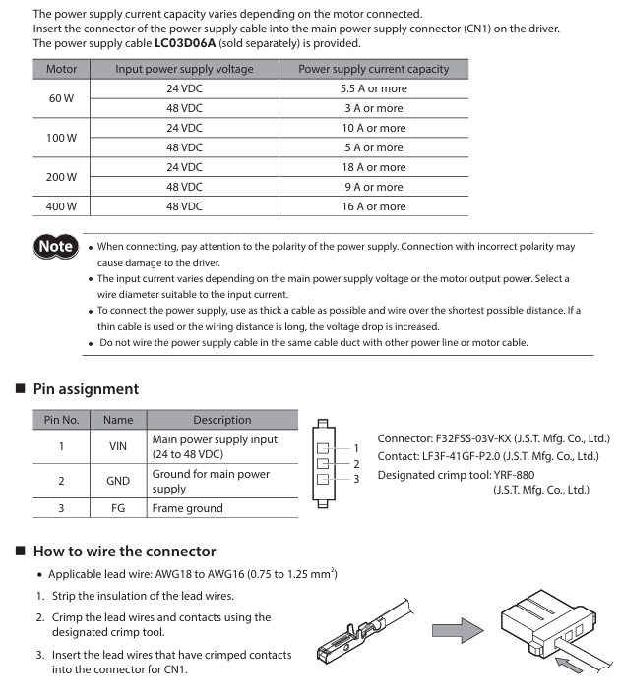

Slide 6
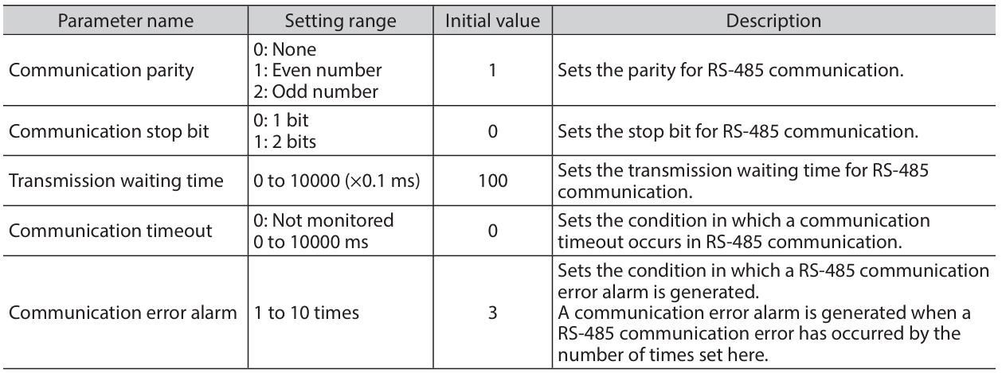
Setting of RS-485 communication
Note: The communication settings are typical for all the RS485 connection establishment
Set parameters required for RS-485 communication first

Slide 7
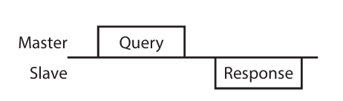
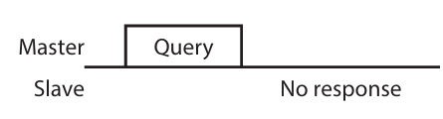
Communication Mode
Modbus protocol communication is based on the single-master/multiple-slave method. Under this protocol, messages are sent in one of two methods.
Unicast mode
The master sends a query to only one slave.
The slave executes the process and returns a response.
Broadcast mode
  If slave address 0 is specified on the master, the master can send a
  query to all slaves. Each slave executes the process, but does not
  return a response.
Note: Enter

Slide 8
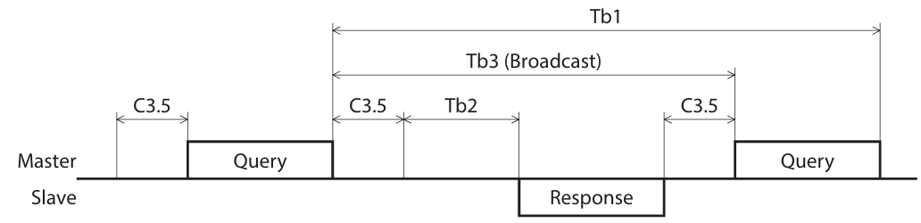
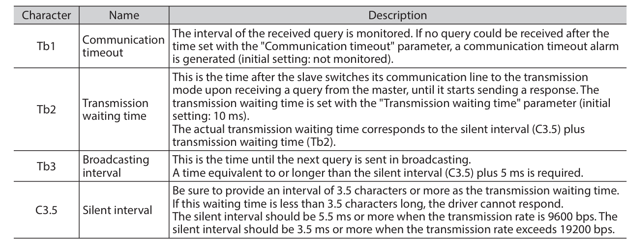
Communication timing
Note: Enter

Slide 9
Modbus Protocol Message Structure ( Mater to Slave and Slave to Master)
1
2
Message Format
Message Types
Master Messages
  Slave Address:
  Unicast: Specific slave
  Broadcast: Address set to 0
  Function Code: Defines the action (e.g., Read, Write)
  Data: Varies based on function
Query
  Structure:
  Slave Address (8b) | Function Code (8b) | Data (32-296b) | CRC-16 (16b)
Response
Types:
      Slave Address
      Function Code
      Data
      Error Check: CRC-16 for integrity
Slave Messages
  Slave Address
  Function Code
  Data
  Error Check: CRC-16 for integrity
  Structure:
  Slave Address | Function Code (+80h) | Exception Code | CRC-16

Slide 10
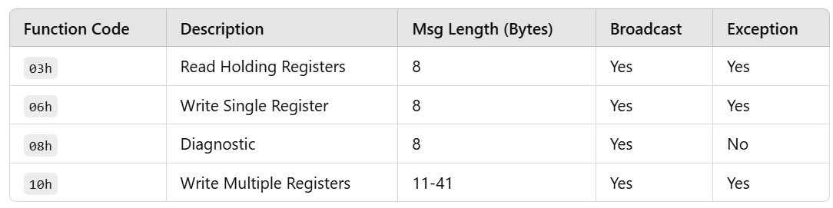
Modbus Protocol Message Structure ( Mater to Slave and Slave to Master)
3
Function Codes (BLV Series Driver)
4
Error Checking: CRC-16
Method:
XOR FFFFh with Slave Address
Right shift until overflow bit is 1, then XOR with A001h
Repeat for all bytes
Purpose: Verify message integrity

Slide 11
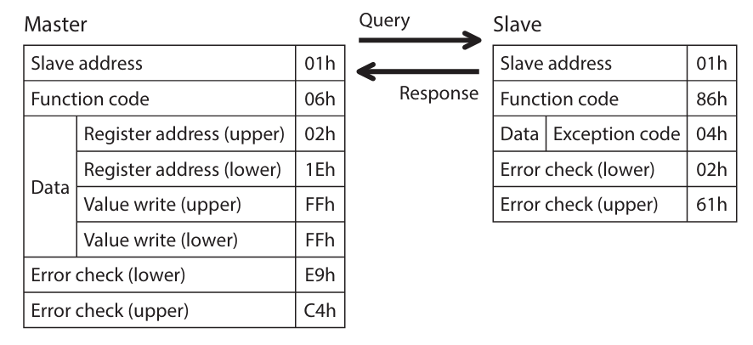
Modbus Protocol Message Structure ( Mater to Slave and Slave to Master)
5
Response Scenarios
6
Exception Responses
Structure:
  Slave Address | Function Code (+80h) | Exception Code | CRC-16
  Normal Response: Successful operation
  No Response:
    Transmission Errors: Framing, parity, CRC mismatches
    Other Causes: Broadcast queries, address mismatches
  Exception Response: Indicates specific error
Common codes:
  01h: Invalid Function
  02h: Invalid Data Address
  04h: Slave Error
  89h: Communication in Progress
  8Ah: NV Memory Processing
  8Ch: Parameter Out of Range
  8Dh: Command Execution Disabled
Example
7
  Query:
  Master → Slave:
  [Address: 01h] [Func: 06h] [Reg Addr: 1Eh] [Data: 02h 61h] [CRC]
  Exception Response:
  Slave → Master:
  [Address: 01h] [Func: 86h] [Exception: 04h] [CRC]

Slide 12
Communication timing

Slide 13
MAIN Motor
Control_1
Start
Stop
Control_2

