Slide 1
MBTA: Who is Unreachable?
Arun Wongprommoon ’23
IAP 2020 11.S188

Slide 2
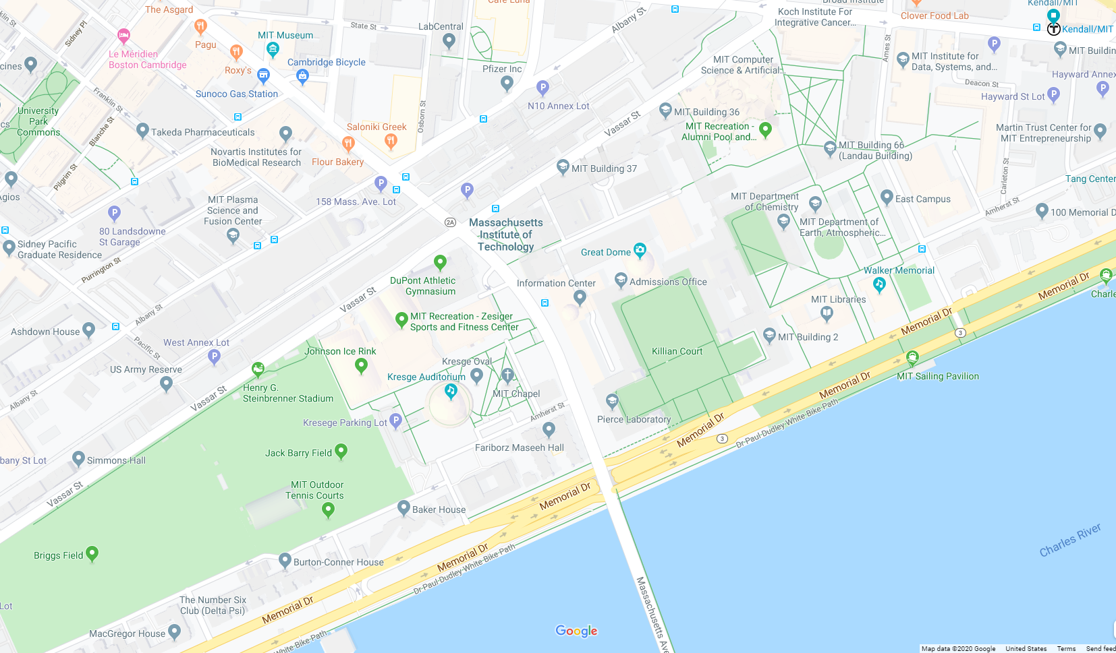
Background
Kendall/MIT
Every 5 mins
77 Mass Ave
Every 8-13 mins
MacGregor House

Slide 3
Tools
Data manipulation: pandas, numpy
API handling: requests, json
Analysis: datetime, geopy

Slide 4
Datasets and Scope
MBTA stops and schedules, January 30, 2020
API data called yesterday
Includes the T, commuter rails and buses (entire MBTA system)
Massachusetts census blocks, 2010
Census block locations
Population within each census blocks

Slide 5
Method
For each stop, calculate average wait until each scheduled departure
For each census block, calculate the optimal stop where
Distance to stop (km) * Average wait time (m)
is minimum

Slide 6
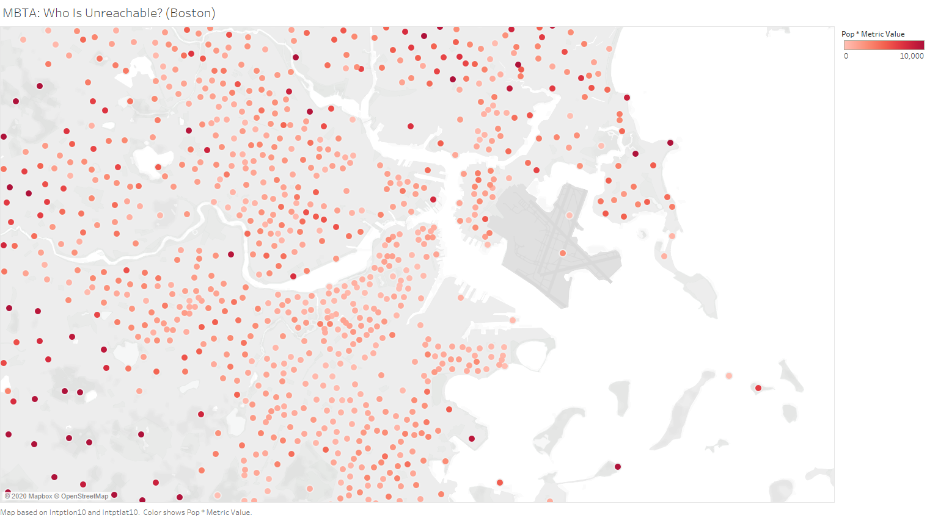
Results

Slide 7
Discussion: Green Line Extension
The Green Line is getting extended soon, let’s see how it matches with the visualization
Application: future transit planning

Slide 8
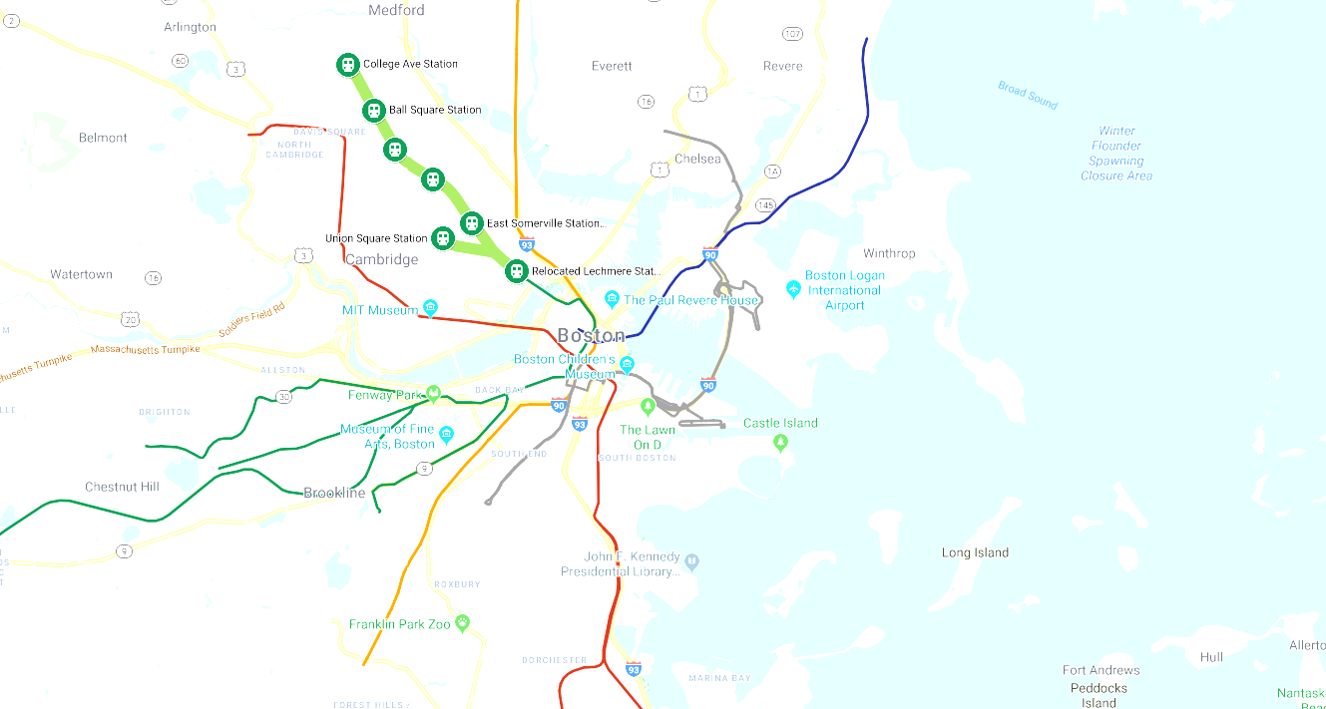
Results

Slide 9
Results

Slide 10
Discussion: Daily Updates
API call to schedule data updates daily, and can be changed to actual departures
Application: “live” affected areas from transit malfunction
Notes:
Currently it takes 2 hours to run for the whole of Mass

Slide 11
Discussion: “Weights”
The formula can be updated to
[Distance to stop (km)]ª * [Average wait time (m)]^{b}
to give unequal weights to each variable
Application: emphasis on stops / emphasis on schedule

Slide 12
Discussion: Assumptions
The total population of a census block
Other public transit options not considered
Other variables at play: income, demographics

