Slide 1
Mushroom classification
Class Prediction (Edible/Poisonous)

Slide 2
Introduction & problem definition
About My Team (Arun & Sandeep)
Data Science Solution Design – We are Data Science enthusiastic professional, passionate to work on data science problem and create solution by using various machine learning and deep learning technique.
Good knowledge of linear regression, logistic regression, LDA, QDA, KNN, Decision Tree, Random Forest, Gradient Boost and K Means. The team have good understanding of deep learning methods for solving problems in image recognition, speech recognition and Natural language processing.
Loan Default Problem – The data have been collected for 11 variants to identify if an applicant could qualify/disqualify for loan.

Slide 3
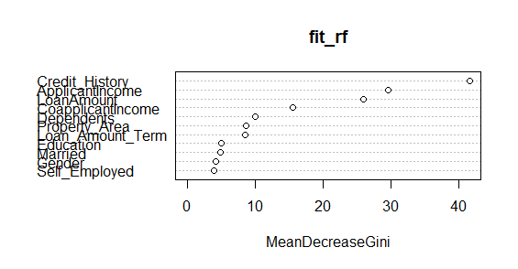
Content and Analysis
Top Variants:
Credit History
Applicant income
Co Applicant income
Dependents
Loan Amount Term

Slide 4
Conclusion
Prediction Matrix (Decision Tree)
 | Yes | No
Predicted | 111 | 43
Actual | 109 | 45
The values are predicted based on decision tree model.

Slide 5

Q & A

