Slide 1


INTERSHIP REPORT (5th Apr to 5th Jun)
Contoso
ARUNKUMAR A
II MSC ADS “A”
RA2232014010056

Slide 2

AGENDA
Company Overview
Purpose Of Internship
Training Period
Project Period
Conclusion

Slide 3

COMPANY OVERVIEW
Skill vertex founded in 2021, it has continually evolved to stay current with the latest advancements in data science and analytics.
Main provide quality education and training in the field of data science, equipping individuals with the skills and knowledge required to excel in data-driven professions
It offers a wide range of products and services, including data science courses, workshops, certifications, and online resources.
Skill vertex's expertise in data science education and training makes it an ideal platform for practical internships, aligning with its mission to prepare individuals for real-world data challenges.

Slide 4

PURPOSE OF INTERNSHIP
The primary purpose of this internship was to gain practical experience in the field of data science and analytics. It aimed to bridge the gap between theoretical knowledge and its application in real-world data scenarios. The overarching objectives included:
Application of Statistical and Hypothesis Testing Methods
Comprehensive Understanding of Data Science Techniques
Improving Data Analytics Skills

Slide 5

TRAINING PERIOD
Training was held for one month
(from 5th April – 5th May)
During the training period they teach about basic fundamentals of machine learning such as,
Collection of data
Data preprocessing
Data visualization
Various Machine Learning algorithms
Statistics behind the algorithm

Slide 6

PROJECT PERIOD
Project period started from 5th of May to 5th June
There are two projects that to be finished during this period
One project is an individual project
Another project is group project
The individual project is loan prediction model using logistic regression

Slide 7
Cont…
During the group project, we done fake currency detection model
This model consists of three main algorithms
Logistic regression
Decision tree
XGBOOST

Slide 8
CONCLUSION
In the course of this internship, I have gained valuable insights and experiences that have significantly enriched my understanding of data science. It has been an incredibly rewarding journey, and I would like to highlight a few key takeaways,
Practical Application: This internship has allowed me to apply the theoretical knowledge
Team Collaboration: Working closely with a diverse team of professionals has not only improved my technical skills.
Data Wrangling: I've learned the importance of data cleaning and preprocessing. It's often the most time-consuming part of any data science project but is critical for accurate analysis and modeling.
Machine Learning: I have had the opportunity to work on various machine learning projects, from classification to regression
Data Visualization: Effective data visualization is crucial for conveying insights. I've honed my skills in creating compelling and informative data visualizations.
Ethical Considerations: This internship has also highlighted the ethical responsibilities of a data scientist, such as ensuring data privacy and using data for positive purposes.

Slide 9
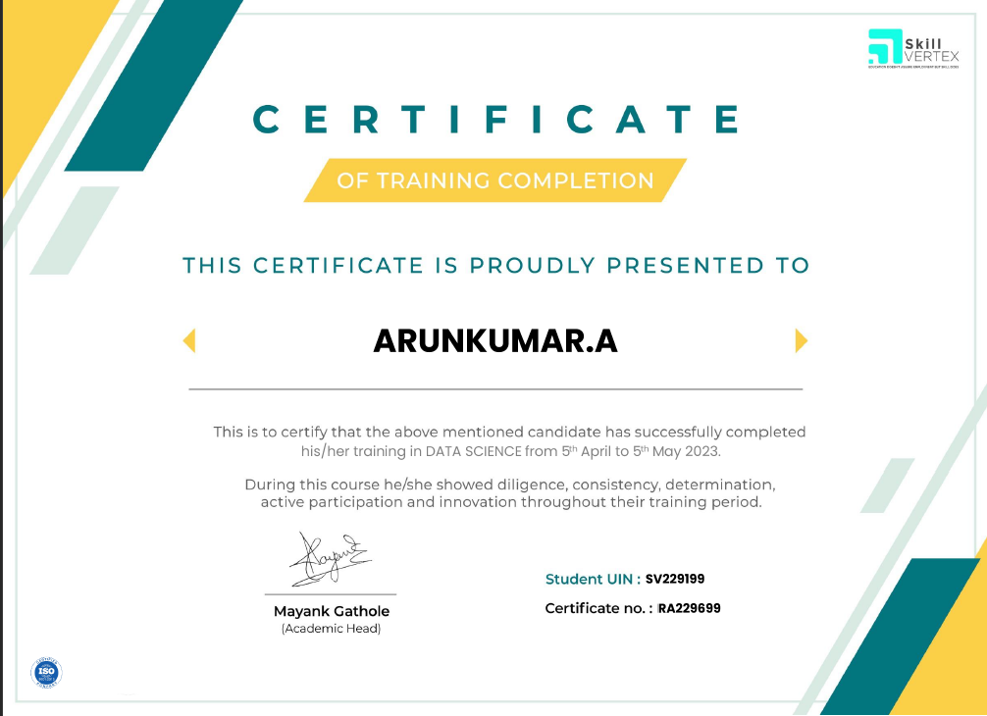
TRAINING CERTIFICATE

Slide 10
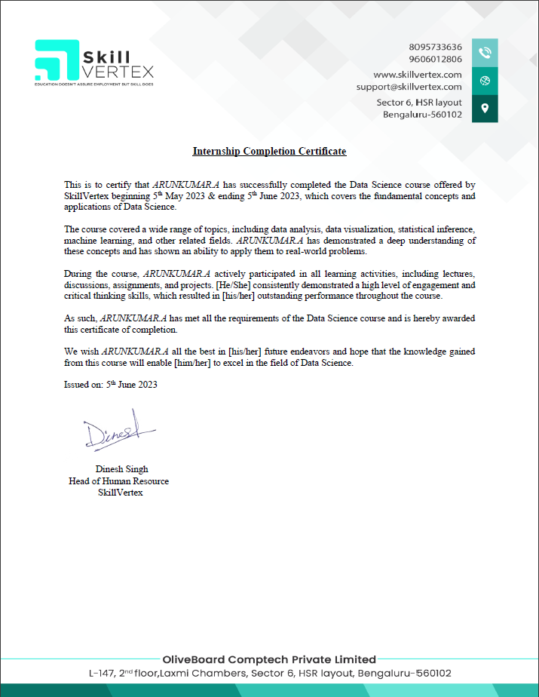
INTERNSHIP CERTIFICATE

Slide 11
THANK YOU!

