Slide 1
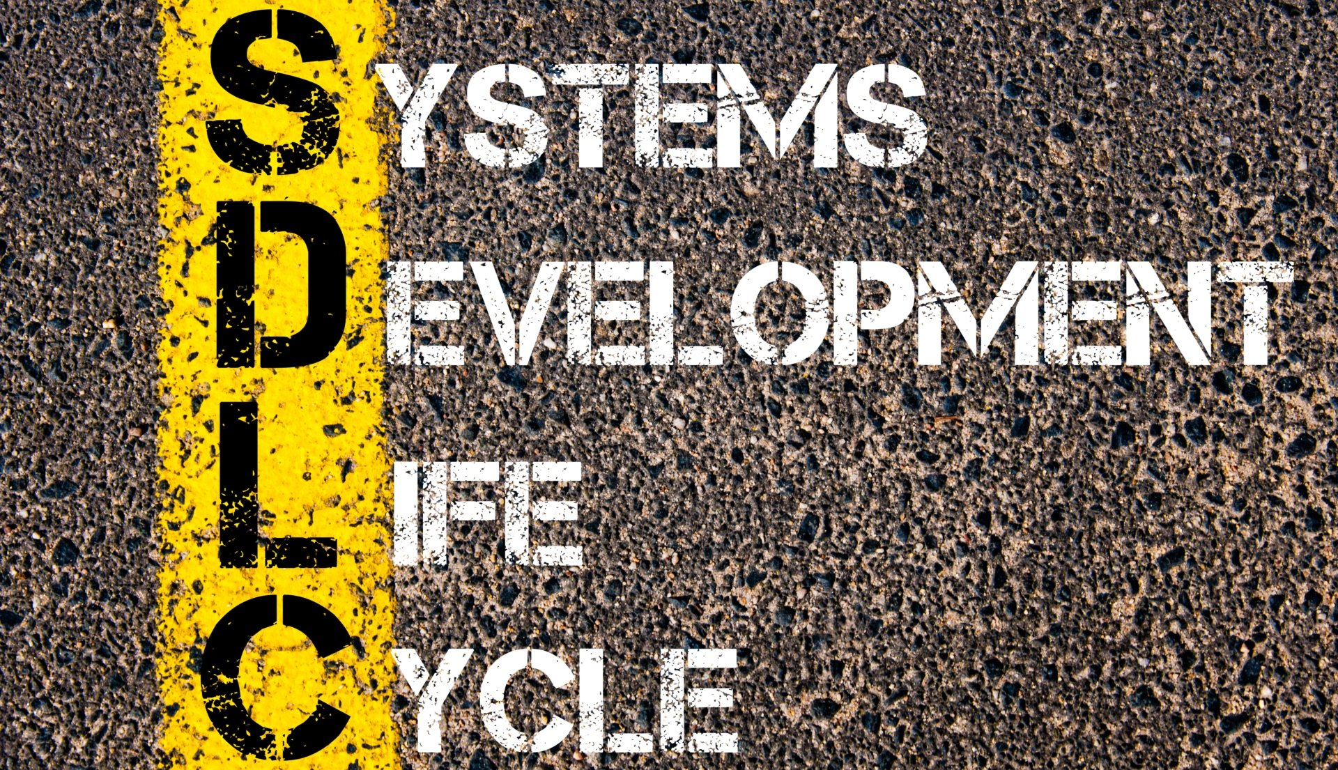
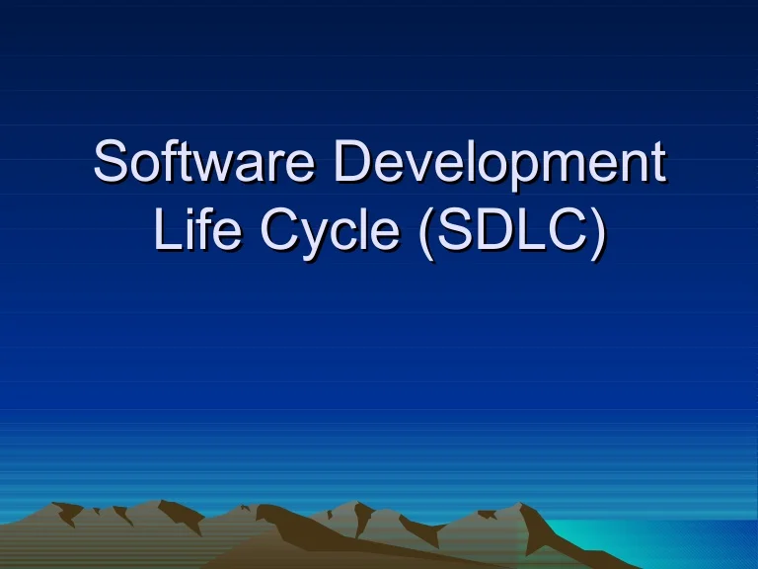

Slide 2
INTRODUCTION
SDLC stand for software development life cycle.
SDLC life cycle model is a key concept of S.E.
It generally consists of series of stages.
SDLC can consists of different stages.

Slide 3
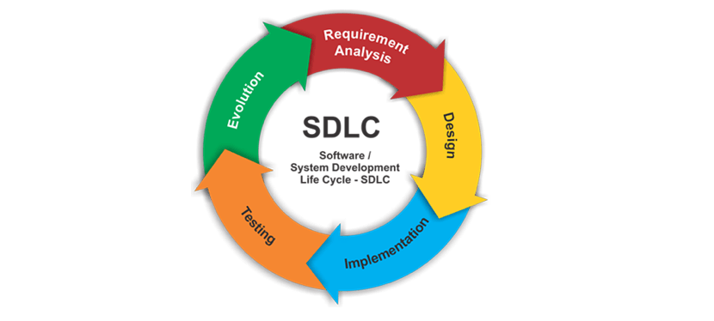

Slide 4
SDLC MODELS
Waterfall model.
Iterative model.
Spiral model.
Agile model.

Slide 5
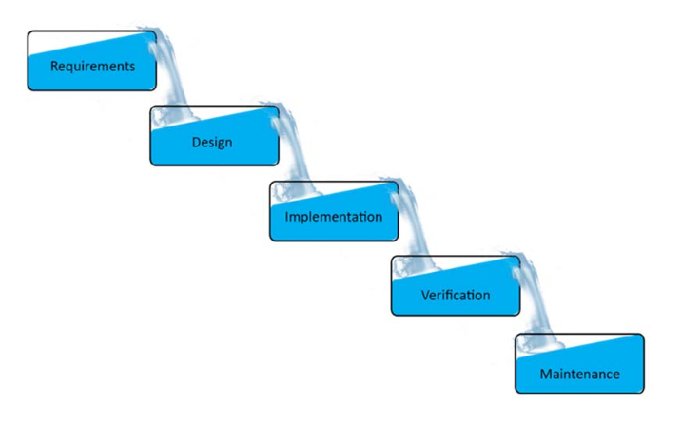
WATERFALL MODEL

Slide 6
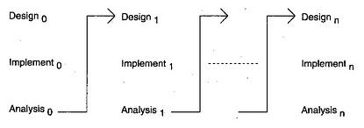
ITERATIVE MODEL

Slide 7
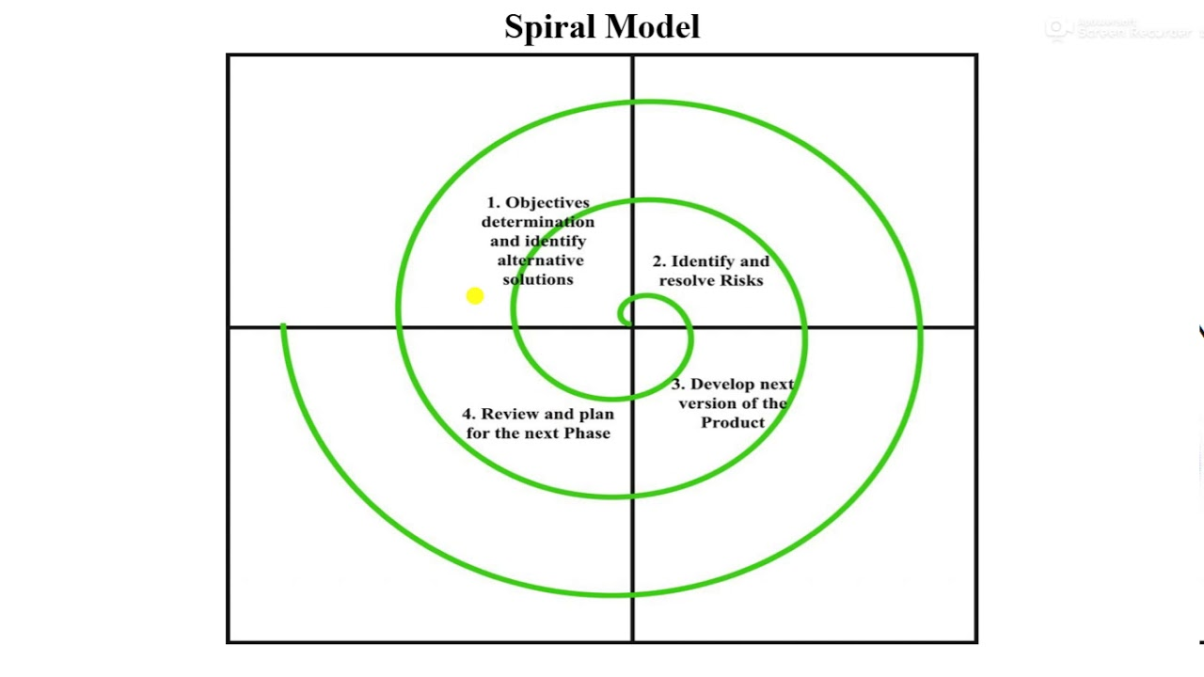
SPIRAL MODEL

Slide 8
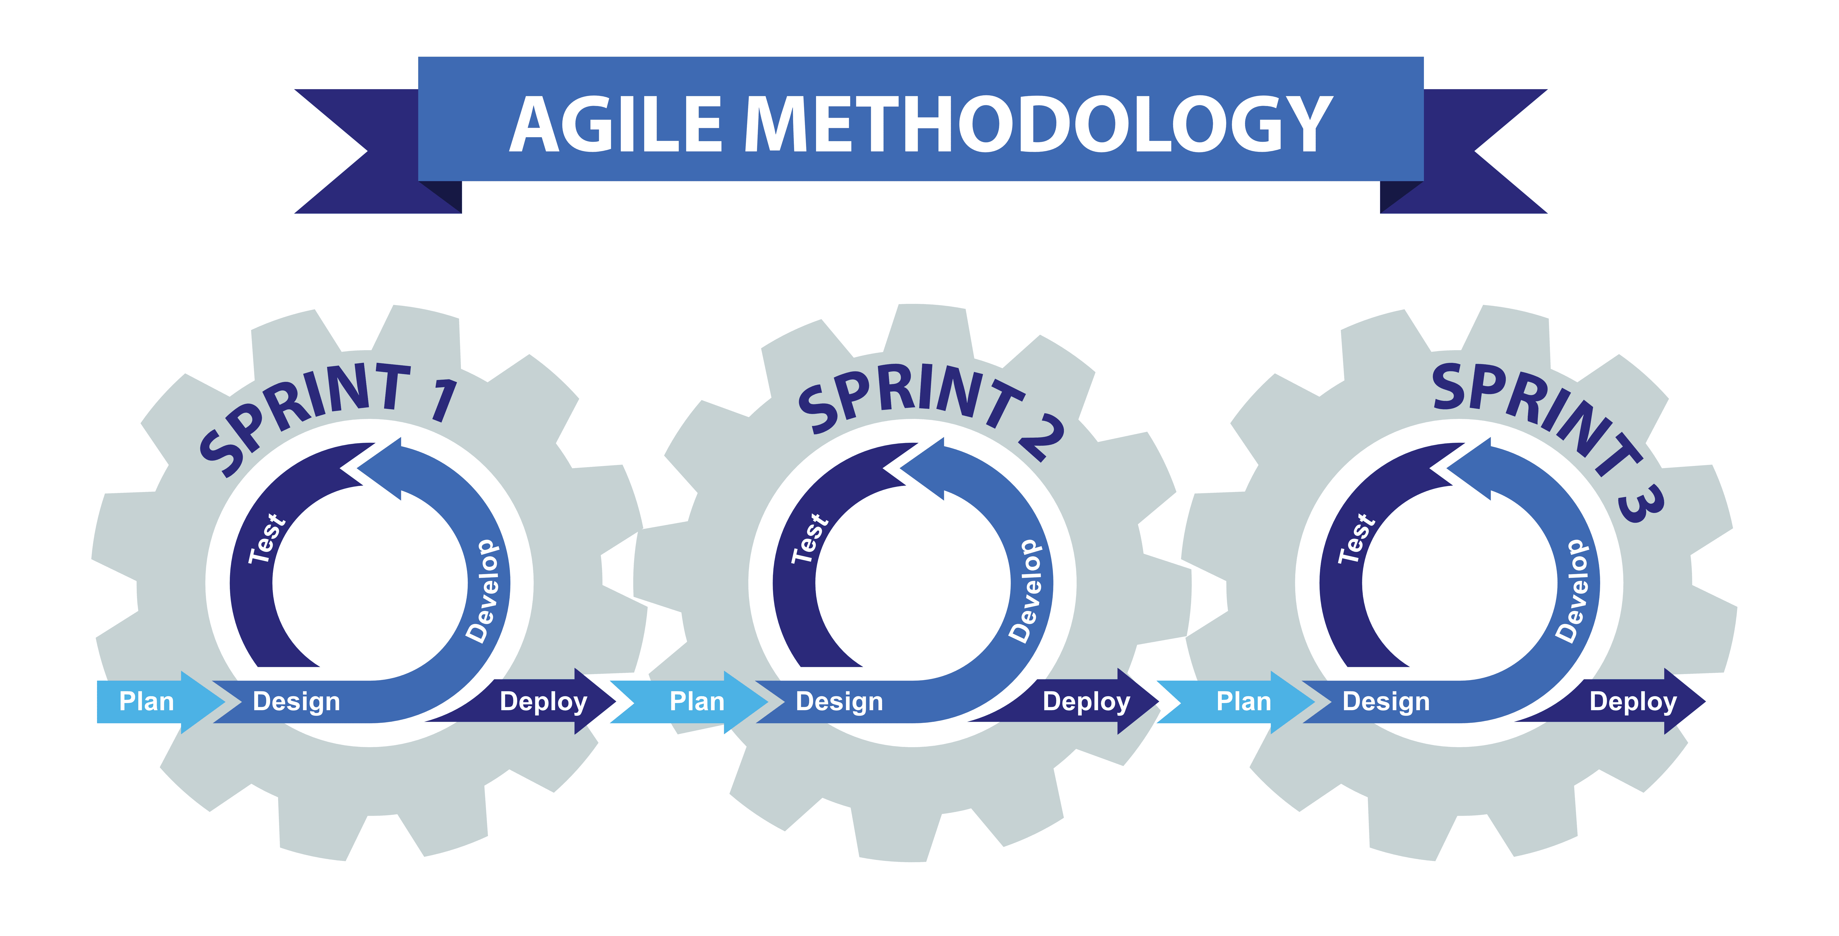
AGILE MODEL

Slide 9


