Slide 1


Slide 2
JIRA
Jira is a project management tool.
Jira tool is developed by Atlassian company.
Mostly Jira tool can be used by agile & kanban.
The use of Jira tool we can track the status of work.
Every day status updates in Jira.

Slide 3
Features of Jira
Issue Tracking
Customization
Agile Project Management
Workflow Automation
Permissions and Security

Slide 4
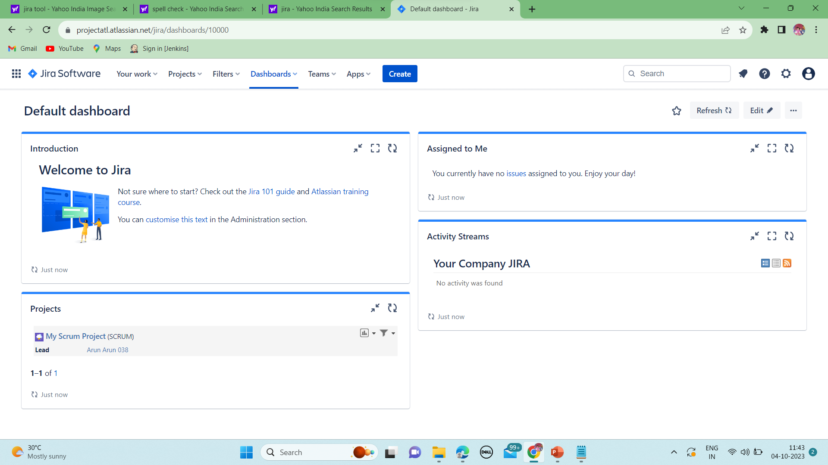
Dashboard Jira: planning in Jira software: 1)Timeline. 2)Backlog. 3)Board.

Slide 5
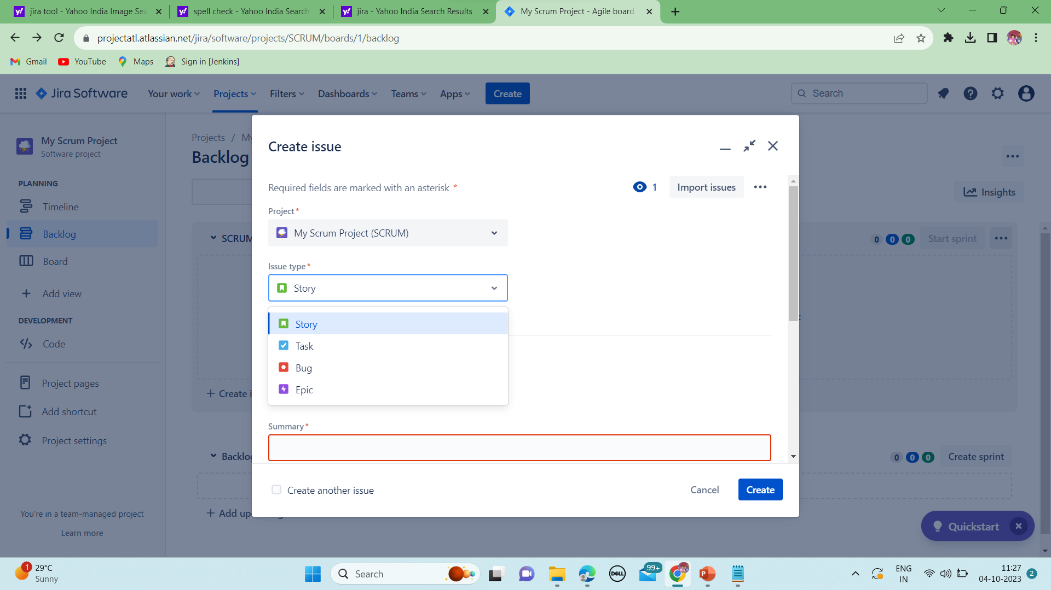
Create issue: In this issue, we can create what type of this issue, whether it’s bug or it is a task or its story.

Slide 6
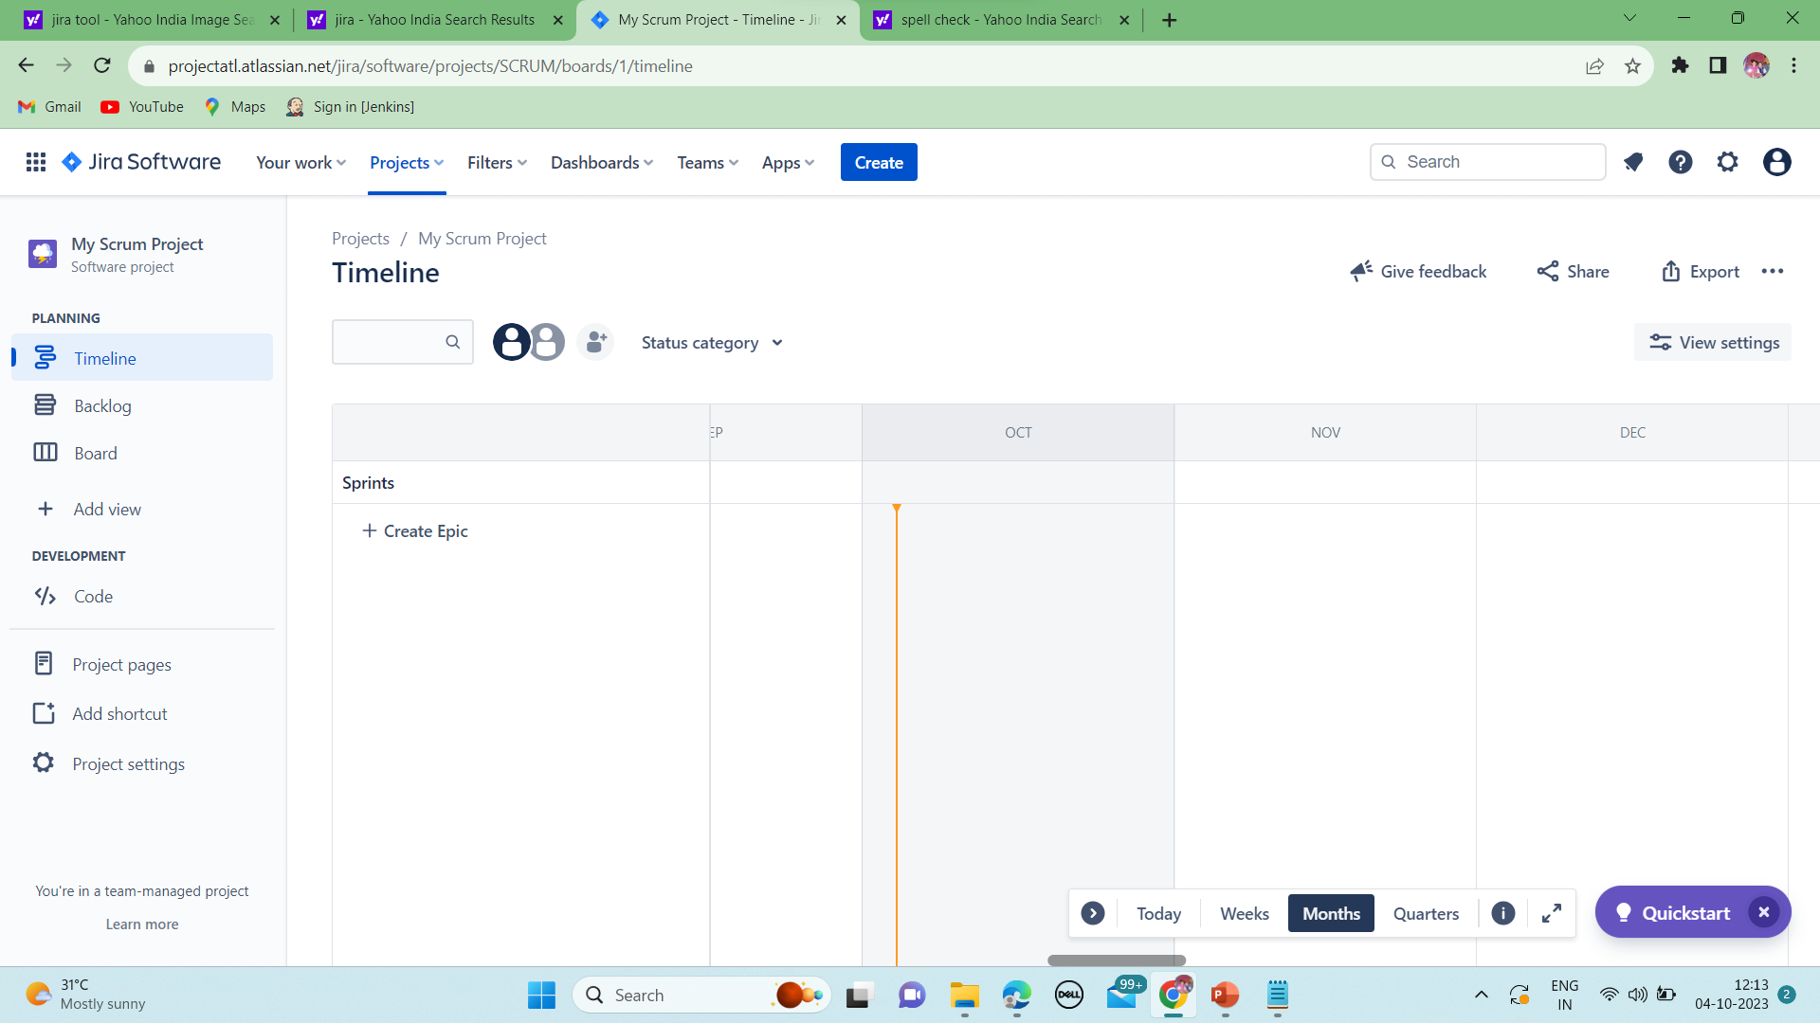
Timeline: what work is going in sprint can be viewed in time line.

Slide 7
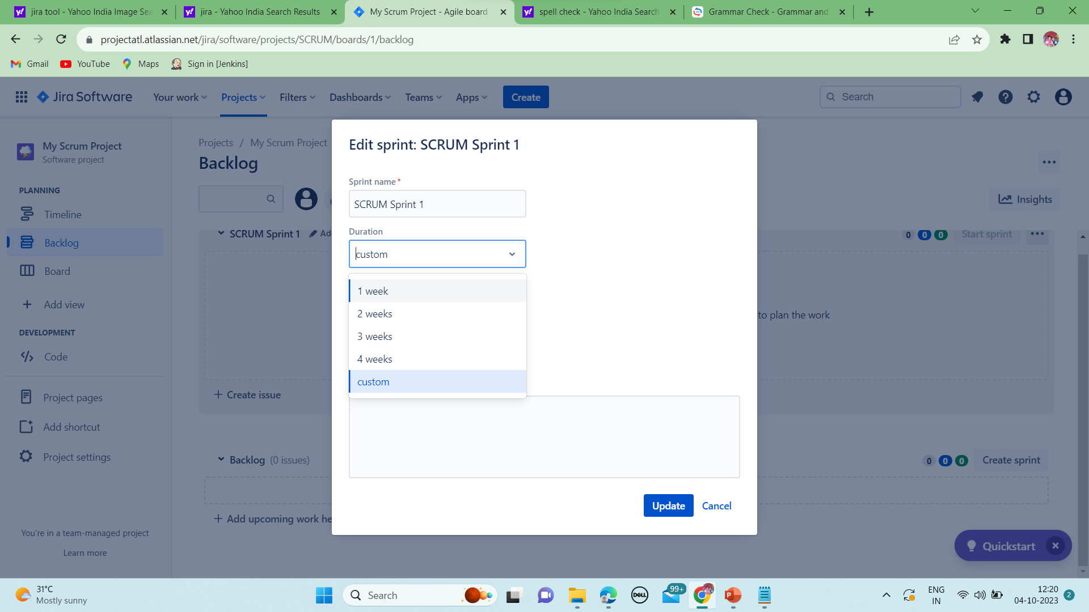
Backlog: In this back log sprint is created.

Slide 8
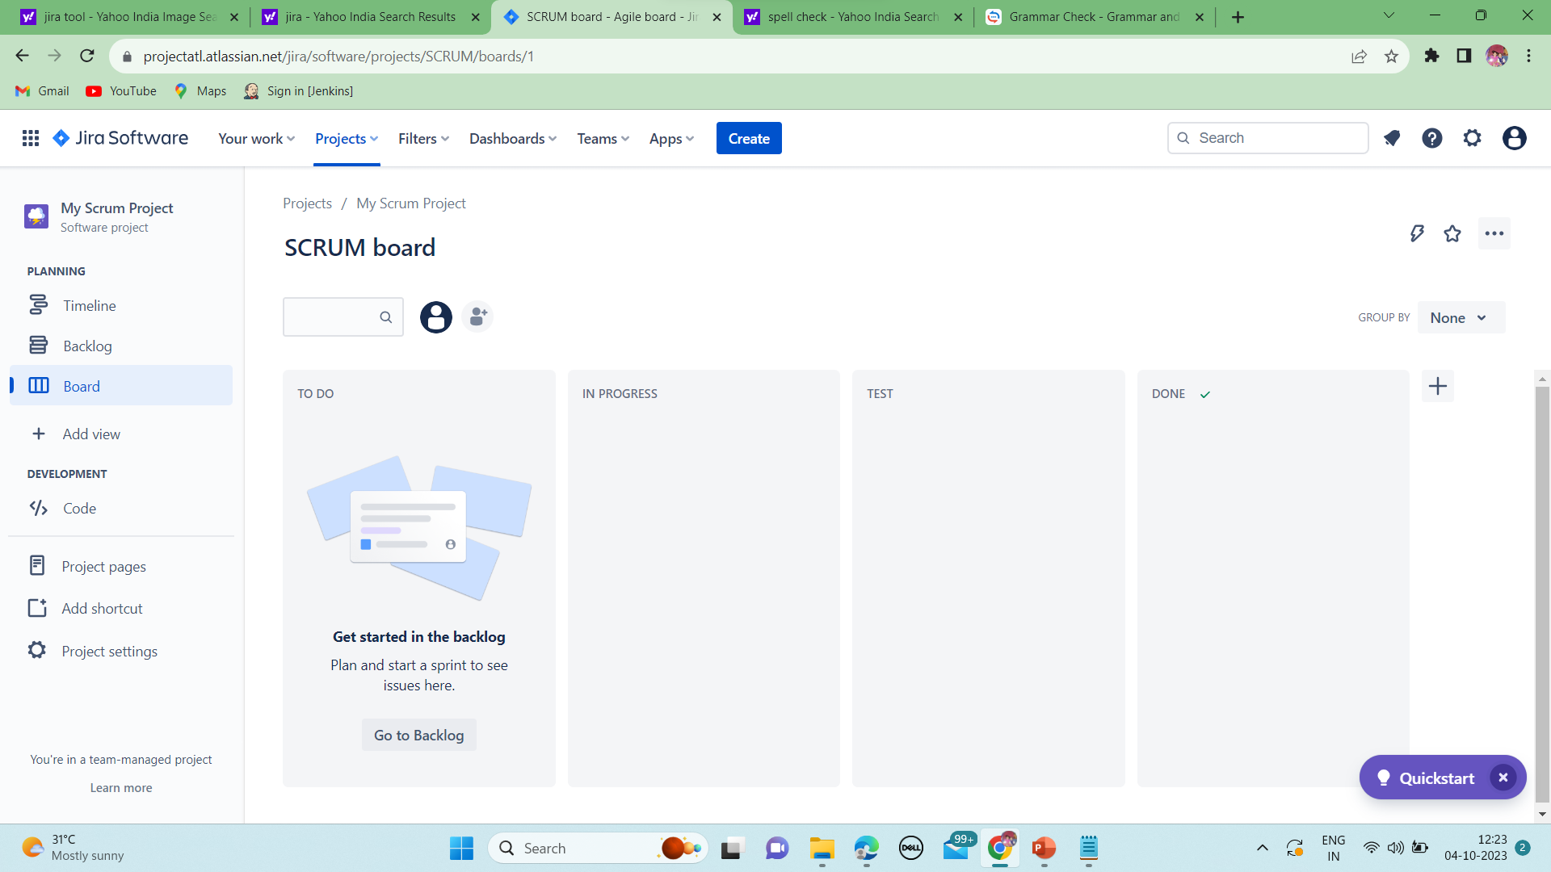
Board: It state that moving ticket from one place to another.

Slide 9
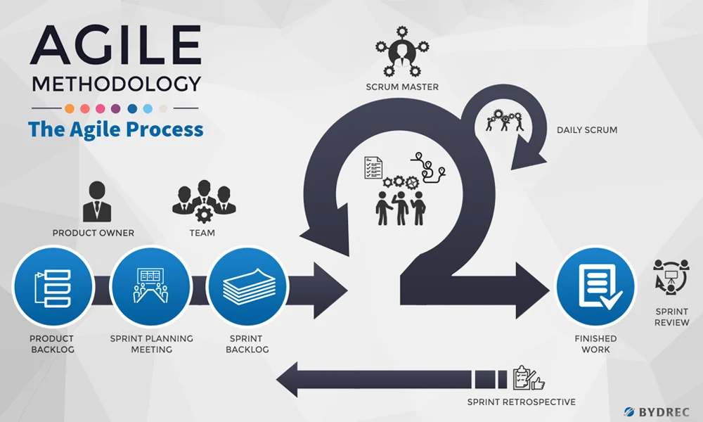
AGILE METHODOLOGY

Slide 10
Agile frameworks:
Scrum
Lean
Kanban

Slide 11
AGILE PRINCIPLES:
Customer satisfaction.
We can accept requirement at any time.
Collaborative work.
Develop, test and release piece of s/w to the customer with few number of features.

Slide 12
AGILE CEREMONIES:
Sprint planning.
Daily standup meetings.
Sprint grooming
Sprint review meeting.
Sprint retrospective meeting.

Slide 13


