Slide 1
AI-Driven Supply Chain Disruption Predictor and Inventory Optimization System

Slide 2
Introduction
Addressing Global Supply Chain Disruptions: The project aims to tackle the increasing unpredictability of supply chains, focusing on risks like geopolitical issues and natural disasters.
AI-Powered Prediction System: Utilizes advanced AI models (OpenAI GPT, Meta LLaMA) and machine learning to predict disruptions and assess risk levels in real-time.
Dynamic Inventory Optimization: Adjusts inventory levels based on real-time disruption predictions, ensuring businesses maintain optimal stock levels.
Real-Time Alerts for Stakeholders: Sends instant notifications via platforms like Discord and Slack to alert stakeholders about potential disruptions and actionable insights.
Proactive Supply Chain Management: By integrating global data monitoring, predictive analytics, and automated alerts, the system helps businesses stay ahead of supply chain risks and maintain operational continuity.

Slide 3
Problem Statement
Unpredictable Supply Chain Risks: Increasing global uncertainties that disrupt supply chains.
Lack of Predictive Analytics: No foresight into potential disruptions, leaving businesses reactive.
Inventory Imbalances: Difficulty maintaining optimal inventory levels during disruptions.
Manual Processes: Current systems rely on manual monitoring, leading to delayed responses.
Operational Downtime: Supply chain disruptions result in unplanned downtime, impacting performance.

Slide 4
Objectives
Develop AI-Powered Risk Analysis: Use NLP and ML models to analyze global wheat data and calculate sentiment and risk factors.
Integrate Real-Time Data: Continuously collect and analyze data on wheat production, transportation, and global events affecting supply chains.
Automate Inventory Adjustments: Dynamically adjust inventory levels based on risk analysis and current stock.
Send Timely Alerts: Set up real-time notifications via Discord and Slack to inform stakeholders of critical disruptions.
Enhance Decision-Making: Provide actionable insights to help decision-makers adjust strategies and mitigate risks.

Slide 5
Why “Wheat”.
Global Consumption: Wheat is a staple commodity consumed globally, affecting billions.
High Risk Factors: Vulnerable to climate, geopolitical issues, and production inefficiencies.
Recent Shortages: Ongoing wheat shortages highlight supply chain risks and vulnerabilities.
Logistics Challenges: Complex supply chain logistics are crucial for wheat production and distribution.
Impact on People: Wheat shortages impact food security and economic stability across regions.

Slide 6
Challenges Faced
Data Quality and Availability
Challenge: Global wheat supply chain data can be fragmented, incomplete, or inconsistent. Accessing accurate and timely data is crucial for predictive modeling.
Solution: Integrate multiple data sources (APIs, news feeds, government reports) and implement data. cleaning techniques to ensure quality
Model Accuracy and Bias
Challenge: Machine learning models (e.g., sentiment analysis, risk scoring) may not always provide highly accurate predictions due to the complexity and volatility of global supply chains.
Solution: Continuously train and fine-tune models with fresh data, and incorporate human expertise to validate the model's predictions.
Sentiment Analysis and Risk Factor Analysis
Prioritizing Risk Factors: Identifying and ranking key risks (Weathers, geopolitical issues) is crucial but challenging for accurate disruption prediction.
Complex Data Interpretation: Analyzing global news and reports demands advanced sentiment analysis to understand subtle language nuances.
Risk Scoring Difficulty: Assigning accurate risk scores for disruptions is complex, requiring deep analysis of various influencing factors

Slide 7
Project Modules
Global Data Monitoring & Analysis Engine
Predictive Disruption Modelling System
ERP Integration & Inventory Adjustment Module
Real-Time Alert & Reporting Dashboard

Slide 8
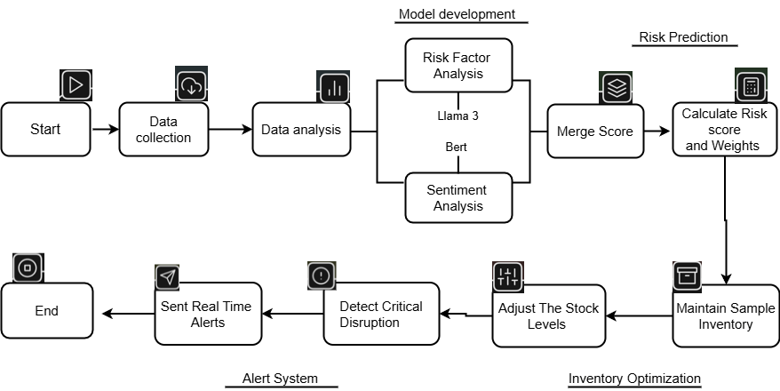
Work Flow

Slide 9
Data Collection Method & Source
Data Collection Method
Used REST API to fetch real-time and historical data.
Extracted structured data in JSON format for easy processing.
Automated data retrieval using Python (requests library) for continuous updates.
Data Source: Event Registry
Website: Event Registry
Purpose: Collected news articles, reports, and global events related to wheat supply chain disruptions.

Slide 10
Data Preprocessing Methods
Text Cleaning:
Lowercasing: Converting all text to lowercase to ensure consistency.
Removing Punctuation and Special Characters: Eliminating characters that don't contribute to the meaning of the text.
Removing Stop Words: Filtering out common words (e.g., "the," "a," "is") that don't carry much information.
Text Transformation:
Tokenization: Breaking down text into individual words or phrases (tokens).
Stemming: Reducing words to their root form (e.g., "running" to "run").
Lemmatization: Reducing words to their dictionary form (lemma) (e.g., "running" to "run").
Encoding: Converting text into numerical representations that can be used in machine learning models. I used a word embeddings.

Slide 11
Technology Stack
Programming & Development
Python – Core language for data processing, model development, and automation.
Machine Learning & AI
BERT (Hugging Face) – Used for sentiment analysis on supply chain news and reports.
Llama-3 (Hugging Face) – Applied for risk factor analysis and disruption prediction.
Scikit-Learn – Data Splitting and model testing.
Data Collection & Processing
REST APIs – Fetching real-time global supply chain data.
Pandas & NumPy – Handling large datasets and performing data analysis.
Real-Time Alerts & Visualization
Discord Webhook – Sending real-time alerts on supply chain disruptions.
Power BI / Matplotlib / Seaborn – Visualizing insights and risk factors.

Slide 12
Future Improvements
Automated Data Pipeline
Develop ETL pipelines for data collection, transformation, and ingestion. And use the NoSql for fast data processing.
Batch & Streaming Data Processing
Combine batch processing for historical data with real-time streaming (Apache Kafka) for live updates. Ensure low-latency insights for quick decision-making
Improve Prediction AI-Optimized Computation
Leverage GPU-accelerated computing (NVIDIA CUDA, TensorFlow) for large-scale model training.
Use transformers and optimized ML pipelines for efficient sentiment and risk analysis.
Accuracy
Train AI models with historical disruption events and industry-specific data. And model testing.
Develop Interactive Dashboards
Utilize Power BI or Tableau for user-friendly data visualization.

Slide 13
Output Samples.
Sentiment & Risk factor analysis output
Supply Chain Disruption Prediction using (sentiment, risk factor score and inventory stocks level )
date | sentiment_score | sentiment_label | risk_score | risk_label
1/10/2025 | 0.998860955 | NEGATIVE | 0.98606354 | neutral
1/10/2025 | 0.993918419 | NEGATIVE | 0.94786662 | neutral
1/10/2025 | 0.995576143 | NEGATIVE | 0.53922772 | neutral
1/10/2025 | 0.99865061 | NEGATIVE | 0.75986046 | contradiction
1/10/2025 | 0.995576143 | NEGATIVE | 0.53922772 | neutral
Column1 | Column2 | Column3
month | reason | action
January | High risk with neutral sentiment - Monitor for price fluctuations. | MONITOR
January | High risk and negative sentiment - Immediately increase stock levels! | ALERT
January | Negative sentiment - Consider buying stock or increasing safety stock | CAUTION
January | High risk with neutral sentiment - Monitor for price fluctuations. | MONITOR
January | High risk with neutral sentiment - Monitor for price fluctuations. | MONITOR

Slide 14
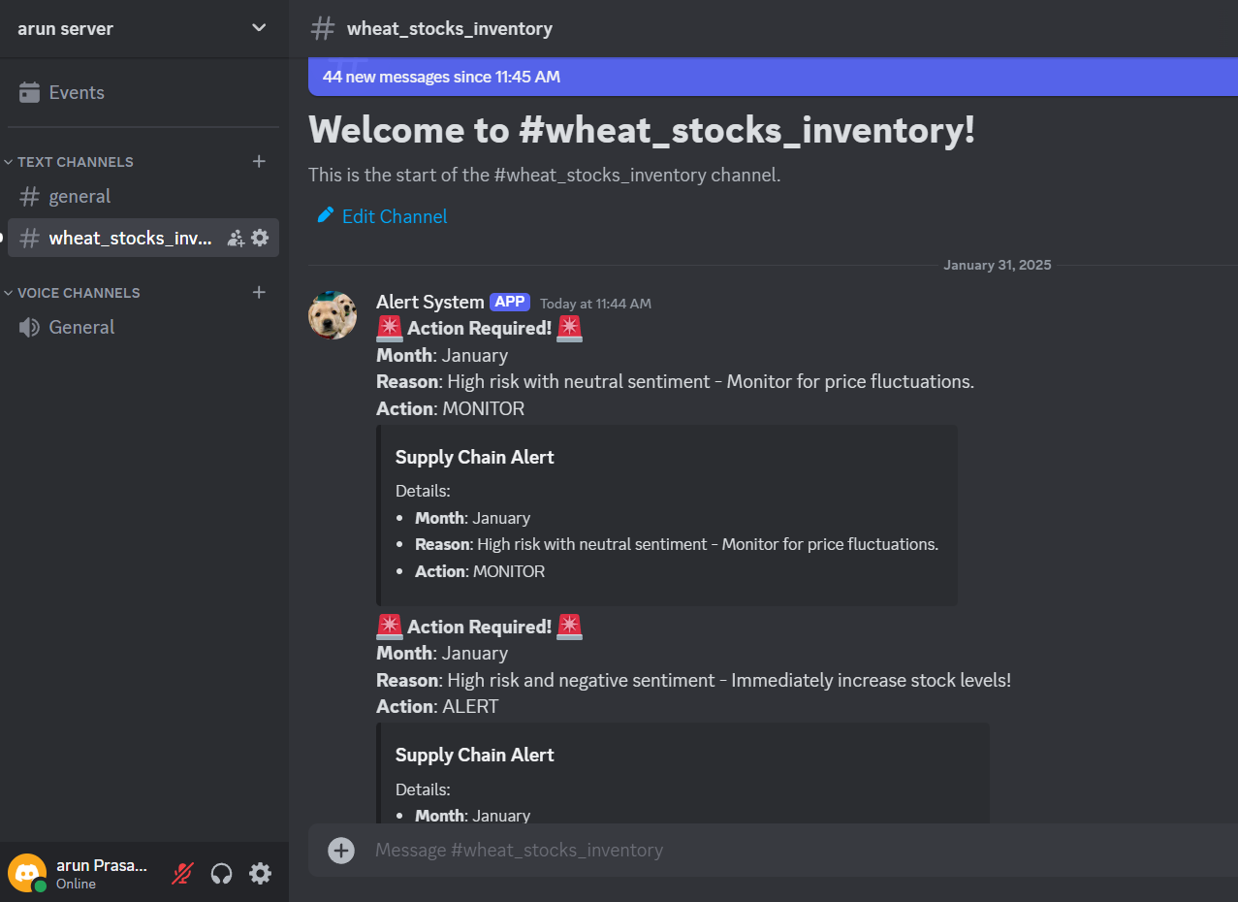
Automated inventory suggestions based on risk levels.(Discard )

Slide 15
Thank You

