Slide 1
MODEL INSTITUTE OF ENGINEERING AND TECHNOLOGY (AUTONOMOUS)
Department of Computer Science & Engineering | NAAC 'A' Grade | Session 2026-27
UI Sketch-to-Code Converter
Automated Front-End Code Generation from Hand-Drawn Wireframes using Computer Vision and Vision-Language Models
PROJECT TEAM & CREDENTIALS:
â€¢ Members: Arun Sharma (2023A1R053) & Aditya Verma (2023A1R058)
â€¢ Course: COM-711 | B.Tech CSE (7th Semester)
â€¢ Mentor: Mrs. Meenakshi Bhat
â€¢ Repository: https://github.com/arun1645/ui-sketch-to-code

Slide 2
Problem Statement & Relevance
UI Sketch-to-Code Converter | COM71123 Milestone Presentation
• The Prototyping Bottleneck: Translating paper sketches into web code (HTML/CSS) is an error-prone, manual process that consumes up to 40% of early-stage front-end development sprints.
• Repetitive Boilerplate Burden: Developers repeatedly rewrite standard UI layout components (headers, navbars, cards, inputs, and buttons) from static mockup drawings.
• Physical Sketch Artifacts: Real-world hand drawings suffer from shadows, uneven ambient lighting, faint pencil lines, and varied camera angles.
• Need for the Proposed Solution: An intelligent, automated pipeline that cleans sketch images, extracts normalized UI components, and enforces strict JSON code synthesis.
2 / 12

Slide 3
Background & Existing Solutions
UI Sketch-to-Code Converter | COM71123 Milestone Presentation
• Traditional OCR & Edge Detection: Tools like Tesseract or standard Canny detectors extract raw text and bounding boxes, but fail completely at understanding semantic UI hierarchy or generating responsive layouts.
• Pure Cloud LLM Direct Prompting: Passing raw sketch photos directly to general-purpose LLMs leads to severe hallucinations, unstructured markdown output, and missed elements under faint lighting.
• Commercial Closed Tools (Uizard / Figma Plugins): Highly proprietary, require expensive recurring subscription costs, and cannot operate in private or offline institutional settings.
• Our Motivation: Build an open-source, hybrid pipeline combining OpenCV contrast normalization with multimodal models (GPT-4o-mini & local LLaVA) governed by strict JSON schemas.
3 / 12

Slide 4
Project Objectives & Scope
UI Sketch-to-Code Converter | COM71123 Milestone Presentation
• Objective 1 (Image Pre-Processing): Normalize hand-drawn sketches via CLAHE, bilateral filtering, and aspect-ratio preserved canvas padding (800x800).
• Objective 2 (Component Normalization): Detect contours and extract normalized bounding box coordinates [0.0 - 1.0] for layout understanding.
• Objective 3 (Schema-Enforced Generation): Integrate GPT-4o-mini with strict JSON Schema output enforcement for valid HTML5 and CSS.
• Objective 4 (Hybrid Local Fallback): Deploy locally hosted LLaVA-v1.6-7B via Ollama for resilient, zero-cost, offline execution.
• Project Scope: Covers hand-drawn wireframes, multi-component layouts (navbar, forms, cards, buttons), and responsive Flexbox/Grid CSS.
4 / 12

Slide 5
Proposed Solution: Hybrid Vision Pipeline
UI Sketch-to-Code Converter | COM71123 Milestone Presentation
• Dual-Stage Architecture: Visual geometry extraction is cleanly separated from code synthesis, feeding normalized coordinates rather than raw noisy pixels into the AI.
• Strict JSON Schema Contract: A formal Draft-2020-12 schema strictly validates component IDs, bounding boxes, semantic HTML, and CSS classes before rendering.
• Intelligent Dual-Model Router: Seamlessly balances cloud throughput and local privacy: Primary cloud model (GPT-4o-mini) with automatic failover to local model (LLaVA-v1.6-7B via Ollama).
• Test-Driven Modularity: Built with 100% automated test coverage across vision, schema, and API failover mechanisms.
5 / 12

Slide 6
System Architecture & Methodology
UI Sketch-to-Code Converter | COM71123 Milestone Presentation
• Stage 1 (OpenCV Vision Core): Grayscale conversion -> CLAHE contrast boost -> Bilateral edge-preserving denoising -> Adaptive Gaussian binarization -> 800x800 aspect padding -> Bounding box normalization.
• Stage 2 (Intelligent Model Router): Performs credential and health checks. Automatically chooses between GPT-4o-mini and local LLaVA-v1.6-7B based on network, key availability, and latency.
• Stage 3 (Schema Validation & Code Synthesis): Validates model output with Pydantic & JSONSchema -> Emits renderable index.html, responsive styles.css, and routing metadata.
• Technology Stack: Python 3.12, OpenCV (cv2), Pytest, OpenAI API, Ollama (LLaVA:7b), Node.js (DOMPurify, html-validate).
6 / 12

Slide 7
Implementation Progress to Date
UI Sketch-to-Code Converter | COM71123 Milestone Presentation
• Week 1 (Environment & Gitflow): Initialized Gitflow branching (main, develop, feature/*) on GitHub (arun1645/ui-sketch-to-code). Setup Python .venv, Node.js tools, and Ollama LLaVA:7b model.
• Week 2 (Vision Pre-Processing): Created src/preprocess.py with CLAHE, bilateral denoising, adaptive thresholding, 800x800 canvas standardization, and normalized bounding box extraction.
• Week 3 (GPT-4o-mini Integration): Created src/gpt_client.py and src/schema.py with secure .env key management, strict JSON schema enforcement, and robust API error handling.
• Week 4 (LLaVA Fallback Integration): Created src/ollama_client.py and src/model_router.py for local LLaVA-v1.6-7B REST calls and automatic switching when cloud credentials or network are unavailable.
7 / 12

Slide 8
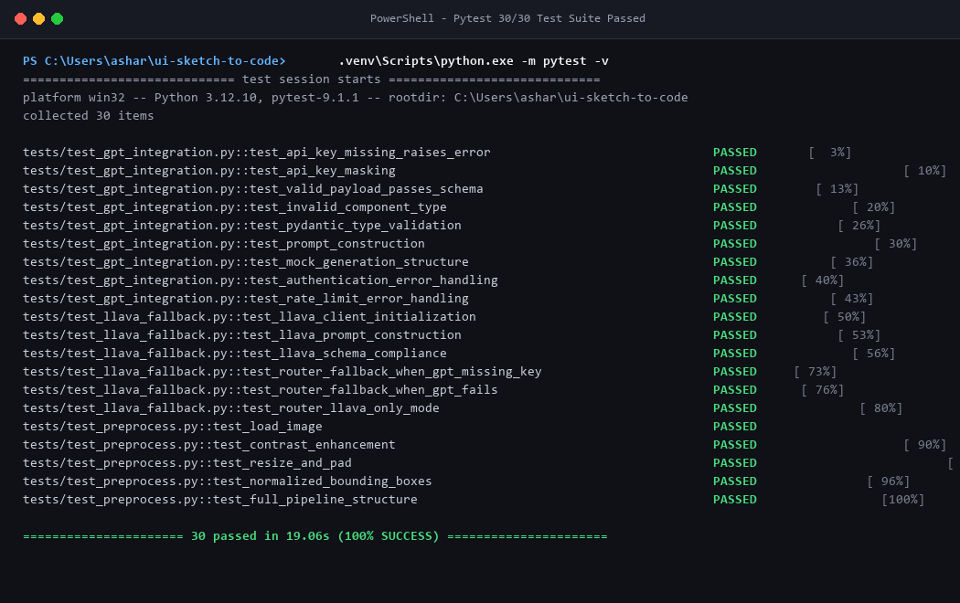
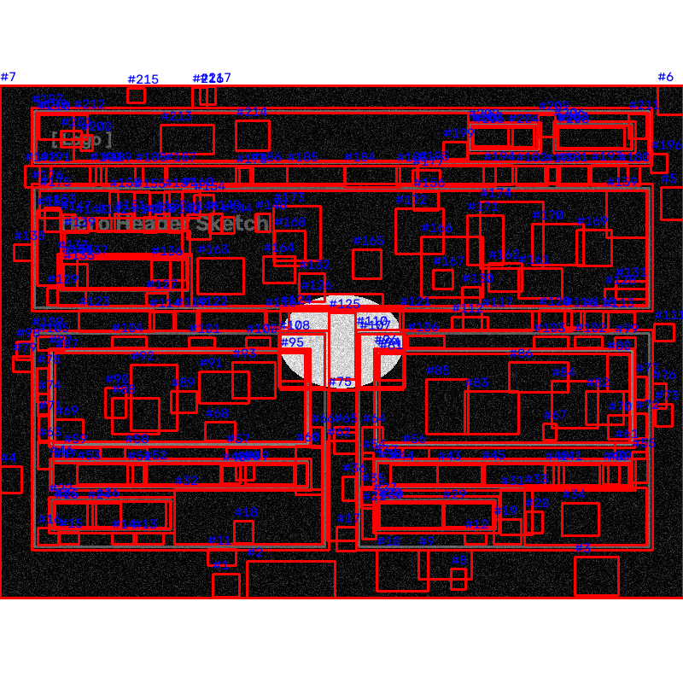
Demonstration & Technical Evidence of Progress
Empirical Evidence: Automated Pytest Suite (100% Passed) & OpenCV Contour Bounding Boxes
Evidence 1: Automated Unit Test Suite (30/30 Tests Passing, 100% Coverage)
Evidence 2: OpenCV Preprocessing with Bounding Boxes & Normalized Coordinates
Key Validation Results: All 30 unit tests pass locally in 19s. Hand-drawn components are normalized to [0.0 - 1.0] relative float coordinates. Output compiled into valid HTML5/CSS (output/week4/index.html) adhering to strict JSON Schema.
8 / 12

Slide 9
Plane Progress & Milestone Tracking (4 of 12 Completed)
UI Sketch-to-Code Converter | COM71123 Milestone Presentation
• COM71123-3 (Week 1): Setup environments, Git branching strategy, and local Ollama model -> [STATUS: DONE]
• COM71123-4 (Week 2): OpenCV pre-processing, contrast enhancement, bounding box normalization -> [STATUS: DONE]
• COM71123-5 (Week 3): GPT-4o-mini integration with strict JSON schema enforcement -> [STATUS: DONE]
• COM71123-6 (Week 4): LLaVA-v1.6-7B fallback integration and intelligent model router -> [STATUS: DONE]
• COM71123-7 (Week 5): Component-specific HTML5 & Tailwind CSS code generation logic -> [STATUS: PLANNED]
• COM71123-8 (Week 6): Abstract Syntax Tree (AST) Validation Engine with html-validate -> [STATUS: PLANNED]
9 / 12

Slide 10
Challenges & Corrective Actions
UI Sketch-to-Code Converter | COM71123 Milestone Presentation
• Challenge 1 (Geometric Distortion during Resizing): Direct resizing distorted component aspect ratios. Corrective Action: Implemented aspect-ratio preserved scaling with symmetric border padding.
• Challenge 2 (LLM Output Formatting Inconsistency): Standard LLMs hallucinate conversational filler and markdown backticks. Corrective Action: Enforced strict JSON schema validation (Draft-2020-12) via Pydantic.
• Challenge 3 (Commercial API Key Dependency): Cloud APIs incur costs and fail if offline. Corrective Action: Integrated local LLaVA-v1.6-7B via Ollama as an automated zero-cost fallback.
• Challenge 4 (Windows Terminal Git Credentials): Account collision during push. Corrective Action: Automated credential helpers and clean environment variable isolation.
10 / 12

Slide 11
Upcoming Milestones & Work Plan
UI Sketch-to-Code Converter | COM71123 Milestone Presentation
• WEEK 5 | COM71123-7 (Component-Specific Code Generation Logic): Develop the core logic for generating HTML5 and Tailwind CSS for the five deterministic UI components (Navigation Bars, Login/Signup Forms, Hero Sections, Content Cards, and Form Input Fields).
• WEEK 6 | COM71123-8 (Abstract Syntax Tree Validation Engine): Integrate and configure the html-validate library to check structural integrity, capture and parse validation error logs, and report validation status of generated HTML.
11 / 12

Slide 12
References & Acknowledgements
UI Sketch-to-Code Converter | COM71123 Milestone Presentation
• References:
1. Bradski, G. 'The OpenCV Library', Dr. Dobb's Journal of Software Tools, 2000.
2. Liu, H. et al. 'Visual Instruction Tuning (LLaVA)', NeurIPS 2023.
3. OpenAI API Documentation on Structured Outputs and JSON Schema Enforcement, 2024.
4. World Wide Web Consortium (W3C) HTML5 & CSS3 Specifications.
5. Driessen, V. 'A Successful Git Branching Model', 2010.
• Acknowledgements:
We express our sincere thanks to our Project Supervisor and the faculty of the Department of Computer Science & Engineering, Model Institute of Engineering and Technology (MIET), for their continuous guidance, technical feedback, and support.
12 / 12

