Slide 1

Media Streaming
Notes:
Media Streaming

Slide 2
Media Streaming Ideas
Create a book trailer
Give a video tour
Celebrate the holidays
Recreate a moment in history
Try stop-motion video
Create a news channel
Create a university promotion video

Slide 3
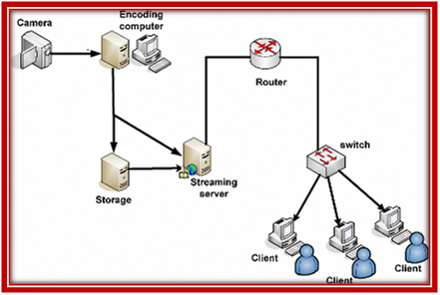
Factors affecting Media Streaming Projects:
Development in streaming servers.
Advances in compression algorithm for audio and video.
Improvements in broadband networks and in cable modems.

Slide 4
Media streaming projects features:
It can benefit from using broadcast and multicast approaches.
It can deliver live content such as a football match, a concert or a political speech.
Allows for streaming tracks to be included in otherwise non-streaming content.
Provides random access to long movies.
It only uses the exact network bandwidth it really needs.
It occupies no space on the user’s hard disk.

