Slide 1
Natural Language Processing (CS5803)
DISASTER TWEET CLASSIFICATION
Arun Kant Dubey (CS20MTECH12008)
Saim Khan (CS20MTECH14008)
Indian Institute of Technology, Hyderabad
<number>
Notes:
<number>
Sukanya

Slide 2
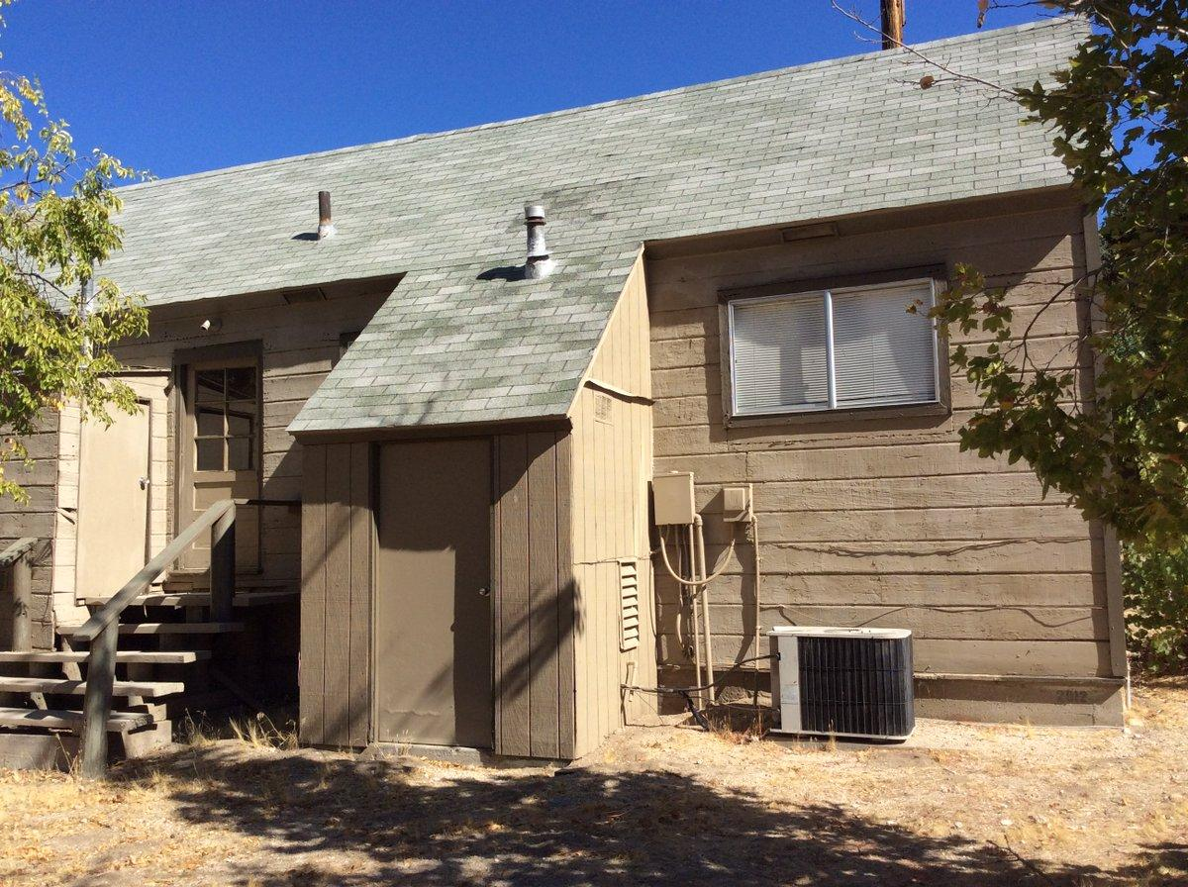
One Example of data
Path of Image
Tweet Label
Text Label
Image Label
Original Text
Original Image
Old Ranger Station building next to the Fire Station in Oak Grove, California. #rangerstation #OakGrove
.
<number>
Notes:
<number>
Sukanya

Slide 3
Problem Statement
Text
BiLSTM / BERT
Tweet
Concat
Output: Final Class
Image
VGG16
Multi-Modal
<number>
Notes:
<number>
Sukanya

Slide 4

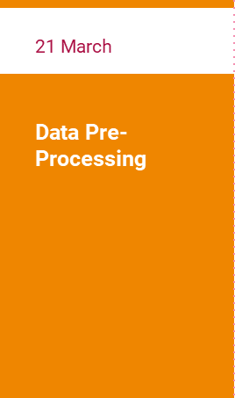
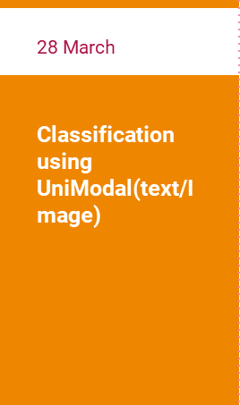

Timeline
<number>
Notes:
<number>
Sukanya

Slide 5
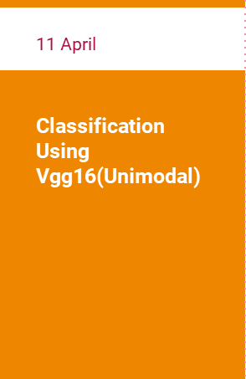
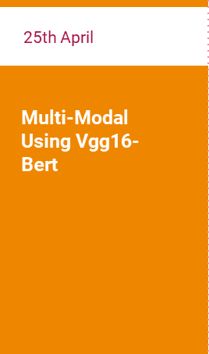

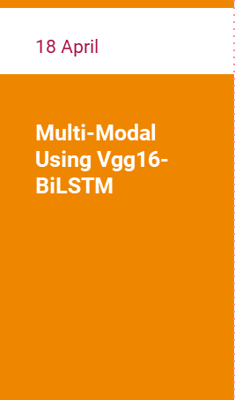
Timeline
<number>
Notes:
<number>
Sukanya

Slide 6
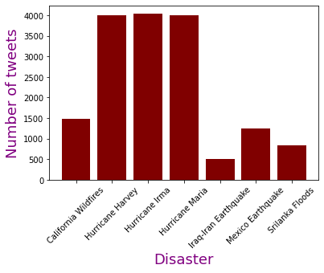
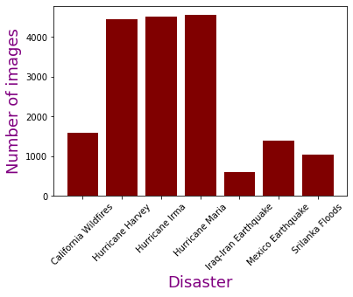
Exploratory Data Analysis
Dataset used is the CrisisMMD dataset[1]
Contains tweets posted during seven disaster events in 2017
Tweet contains text and atleast one image
Tweets were hand-labelled as informative/non-informative
Text and images labelled separately and can be different
<number>
Notes:
<number>
Sukanya

Slide 7
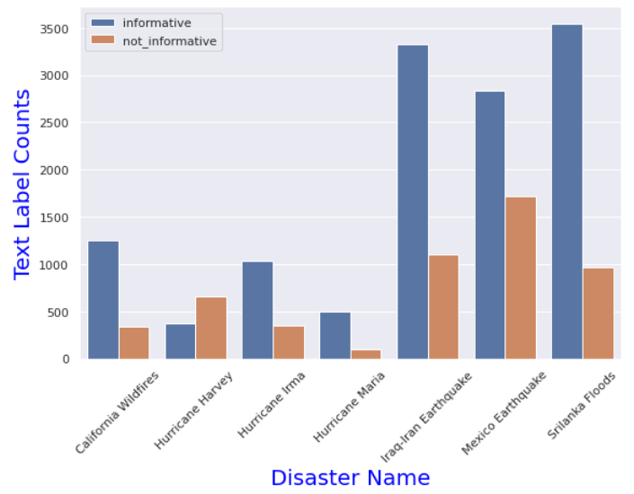
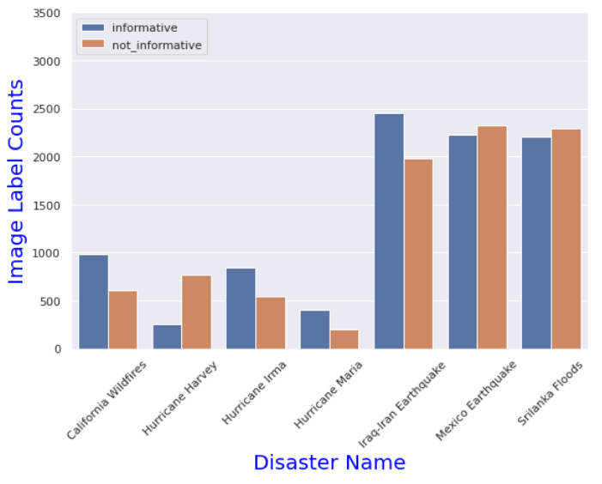
DATA
<number>
Notes:
<number>
Sukanya

Slide 8
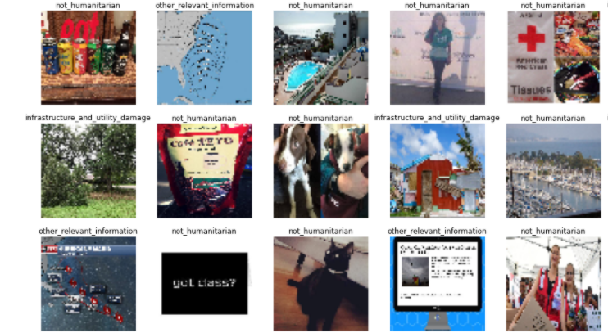
DATA
Tweets also hand-labelled as
Infrastructure and Utility Damage
Rescue Volunteering or Donation Effort
Affected Individuals
Other Relevant Information
Not Humanitarian (Non Informative)
Injured or Dead People
Vehicle Damage
Missing or Found People
<number>
Notes:
<number>
Sukanya

Slide 9
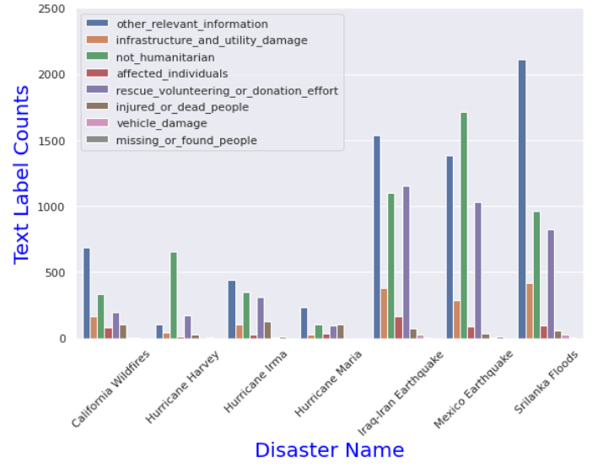
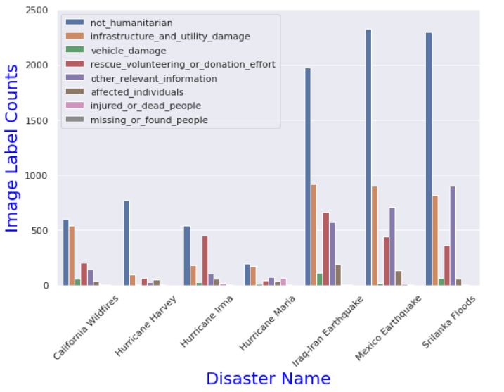
DATA
Infrastructure damage labels are more in image
Donation effort labels are more in text
Inference-Both image and text are sometimes capturing different features.
<number>
Notes:
<number>
Sukanya

Slide 10
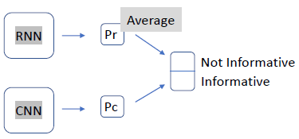
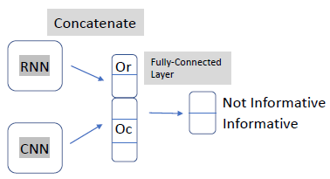
THE MODELS
Multimodal (Text+Image) classification
BERT For Text + VGG16 for Image representation / BiLSTM with Word2Vec embeddings + VGG16 for Image representation
Train Text & Image Models independently and take average Predictions
Concatenate the Text & Image Representations and Co-train the Corresponding Models
<number>
Notes:
<number>
Sukanya

Slide 11
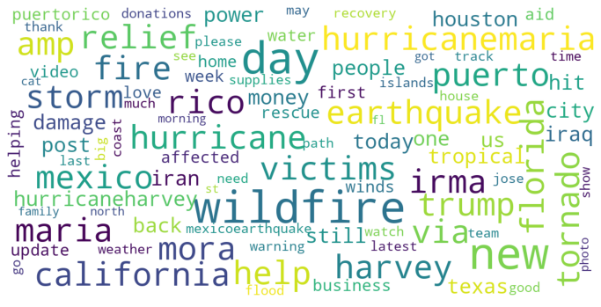
WORK FLOW FOR BILSTM/BERT
Preprocessing
URLs, hashtags, non-ASCII characters, single characters, punctuations & stop words removed
Text converted to lowercase form
Tokenising
BiLSTM: Tokeniser fitted on preprocessed tweet text data
BERT: Pre-fitted tokeniser used
Tweets converted to sequence of tokens
Top 100 most frequent words
<number>
Notes:
<number>
Sukanya

Slide 12
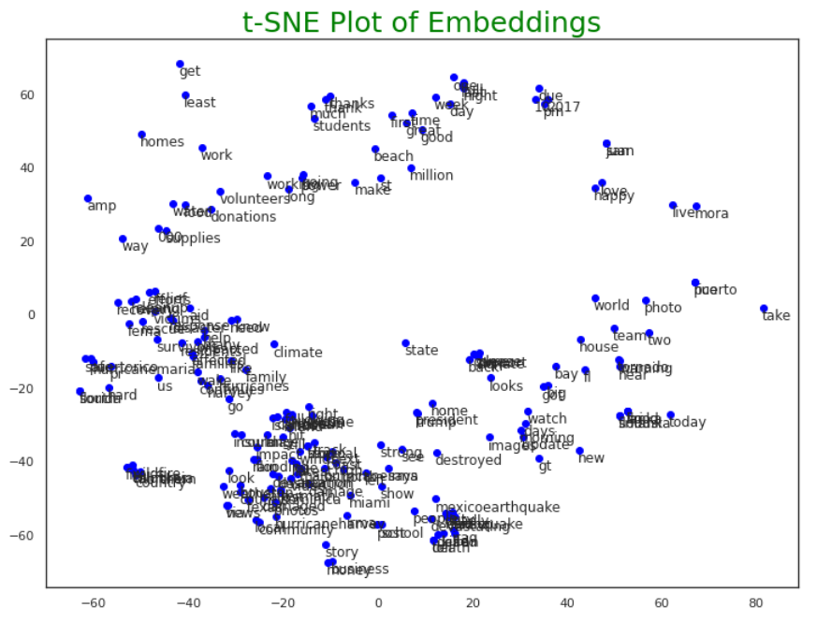
WORK FLOW FOR BILSTM/BERT
Embedding creation
BiLSTM: Word2Vec (size = 300)
BERT: Pre-trained embeddings used
<number>
Notes:
<number>
Sukanya

Slide 13
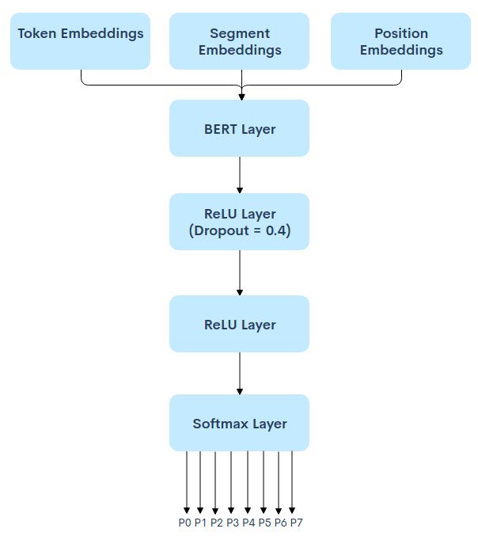
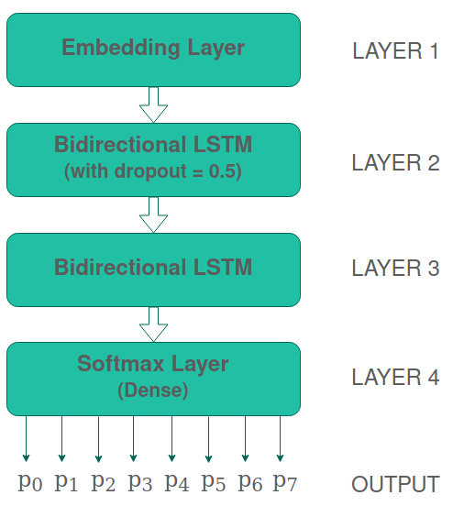
WORK FLOW FOR BILSTM/BERT
Model building
BiLSTM
BERT
<number>
Notes:
<number>
Sukanya

Slide 14
WORK FLOW FOR CNN
Preprocessing
Images are of different sizes so making them all 224*224.
Normalizing all pixels by dividing 255.
VGG16 layers(excluding top)
Flatten Layer
(with Dropout=0.4)
VGG16 -Imagenet pre-trained weights are being used
Fully Connected Layer1
(with Dropout=0.4)
Softmax(Fully Connected)
Output
Notes:
<number>
Sukanya

Slide 15
RESULTS
Results for Uni-modal Classification
Training Mode | Modality | Model Used | Informative / Non-informative |  |  |  | Humanitarian
 |  |  | Accuracy | Precision | Recall | F1-score | Accuracy | Precision | Recall | F1-score
Unimodal (Base) | Text | CNN | 80.80 | 81.00 | 81.00 | 80.90 | 70.40 | 70.00 | 70.00 | 67.70
 | Image | VGG16 | 83.30 | 83.10 | 83.30 | 83.20 | 76.80 | 76.40 | 76.80 | 76.30
Unimodal | Text | BiLSTM | 83.70 | 83.44 | 83.70 | 83.29 | 75.81 | 75.56 | 75.81 | 74.92
 | Image | CNN | 64.42 | 62.33 | 62.12 | 62.40 | 64.22 | 61.48 | 62.15 | 60.24
Unimodal | Text | BERT | 83.96 | 83.86 | 83.96 | 83.90 | 80.31 | 79.26 | 80.31 | 79.57
 | Image | VGG16 | 80.25 | 81.40 | 80.25 | 80.58 | 70.16 | 74.78 | 70.16 | 70.15
<number>
Notes:
<number>
Sukanya

Slide 16
RESULTS
Results for Multi-modal Classification
Training Mode | Modality | Model Used | Informative / Non-informative |  |  |  | Humanitarian
 |  |  | Accuracy | Precision | Recall | F1-score | Accuracy | Precision | Recall | F1-score
Multimodal (Base)[2] | Text + Image | CNN + VGG16 | 84.40 | 84.10 | 84.00 | 84.20 | 78.40 | 78.50 | 78.90 | 78.30
Multimodal | Text + Image | BiLSTM + VGG16 | 84.02 | 86.17 | 84.03 | 82.54 | 82.09 | 82.48 | 80.84 | 80.85
Multimodal (All Data) | Text + Image | BERT + VGG16 | 70.34 | 68.22 | 68.09 | 68.00 | 42.51 | 42.73 | 42.13 | 41.92
Multimodal (All Data) | Text + Image | BiLSTM + VGG16 | 75.10 | 76.12 | 75.10 | 75.03 | 60.97 | 63.19 | 49.98 | 54.91
<number>
Notes:
<number>
Sukanya

Slide 17
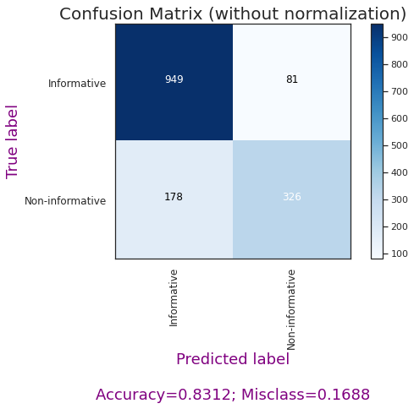
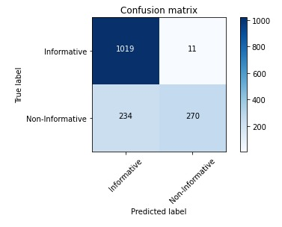
RESULTS
Results for Informative/Non-informative Classification
Accuracy = 83.70
Accuracy = 84.02
BiLSTM
BiLSTM + VGG16
<number>
Notes:
<number>
Sukanya

Slide 18
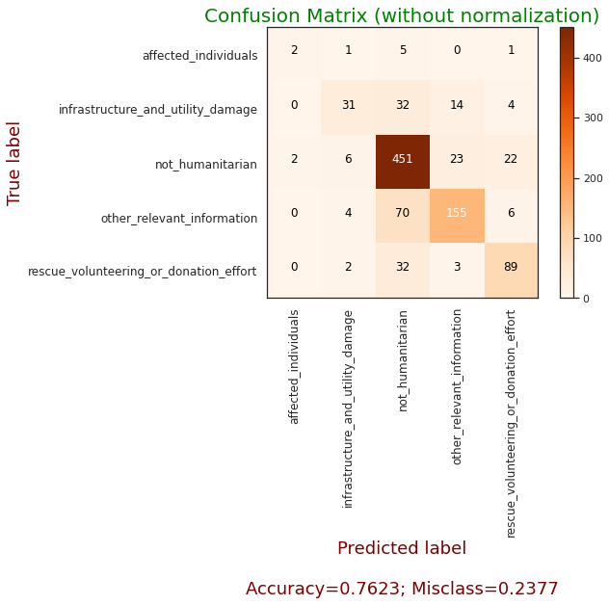
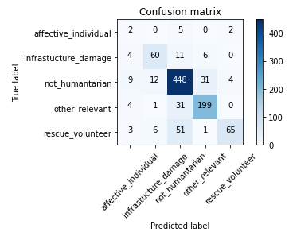
RESULTS
Results for Humanitarian Classification
Accuracy = 75.81
Accuracy = 82.09
BiLSTM
BiLSTM + VGG16
<number>
Notes:
<number>
Sukanya

Slide 19
REFERENCES
[1] https://crisisnlp.qcri.org/crisismmd
[2] Ofli, Ferda and Alam, Firoj and Imran, Muhammad, Analysis of social media data using multimodal deep learning for disaster response, arXiv preprint arXiv:2004.11838 [2020]
[3] Xukun Li and Doina Caragea, Improving Disaster-related Tweet Classification with a Multimodal Approach
[4] https://towardsdatascience.com/how-to-use-a-pre-trained-model-vgg-for-image-classification-8dd7c4a4a517 for Vgg 16 model
<number>

Slide 20
THANK YOU!
<number>

