Slide 1

CAREER COUNSELLOR BOT
HELPS IN CHOOSING THE RIGHT PATH TO ATTAIN YOUR GOAL
DONE BY :
ARUN KARTHIK . K
MANASA . N
COLLEGE : SHIV NADAR UNIVERSITY, CHENNAI

Slide 2

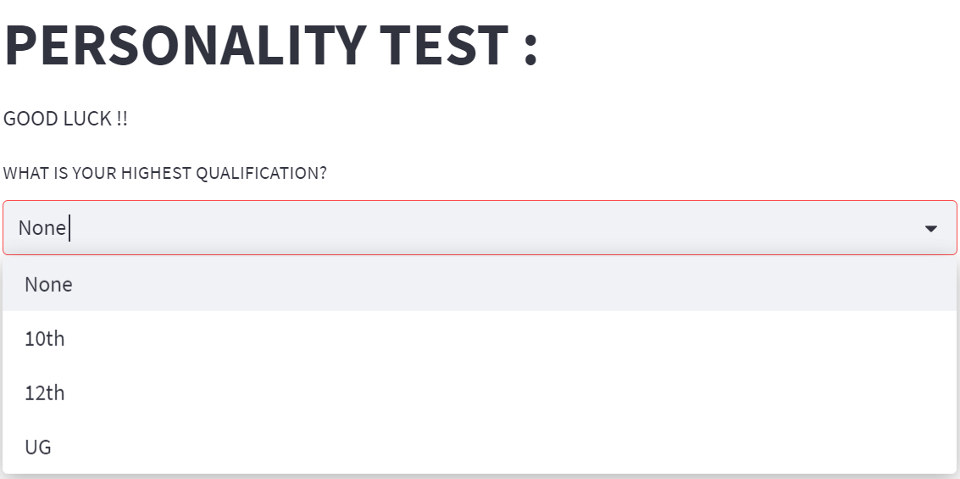
PROBLEM STATEMENT
We generally see a lot of students suffering after selecting career track that they are not interested in. Our career counsellor chatbot is designed to assist users in finding and pursuing their ideal career with a small personality test.

Slide 3
HOW IS CAREER COUNSELLOR CHATBOT USED
First the Chatbot asks the user about their highest qualification
( Among 10th, 12th and UG )
After the user selects the qualification, it then displays the possible subjects that can be pursued or the streams or the jobs available according to the QUALIFICATION
Then a short quiz is conducted in which the user is asked to rate their interest in that field ( starting from – Strongly Disagree, Disagree, Neutral, Agree, Strongly Agree )
And then the score is calculated
Finally, we get the RESULT in the form of a PIE chart that gives us the top 5 fields that we can choose

Slide 4
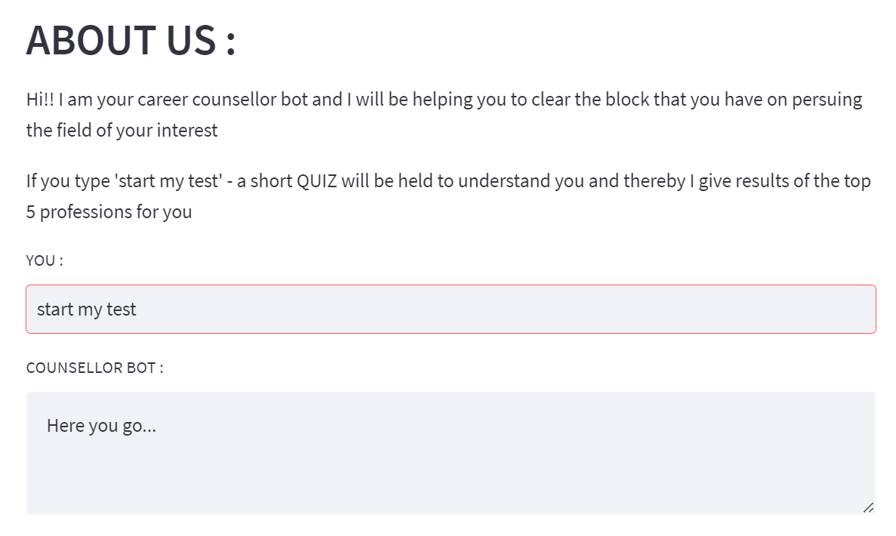
CAREER COUNSELLOR CHATBOT :
At start the chat bot displays a briefing about itself and asks us to enter 'start my test'

Slide 5
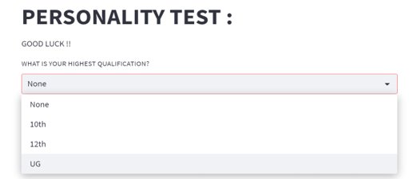
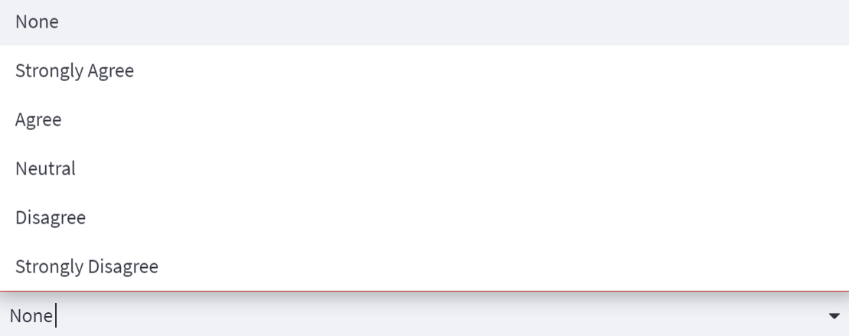
ABOUT THE QUIZ
Initially the bot asks about the user's Qualification then the quiz starts
The Rating of our interest is in the form of a select box – that is we are supposed to select any option among - Strongly Disagree, Disagree, Neutral, Agree, Strongly Agree
The points for this rating are :
Strongly Disagree – 1; Disagree – 2; Neutral – 3; Agree – 4; Strongly Agree – 5

Slide 6
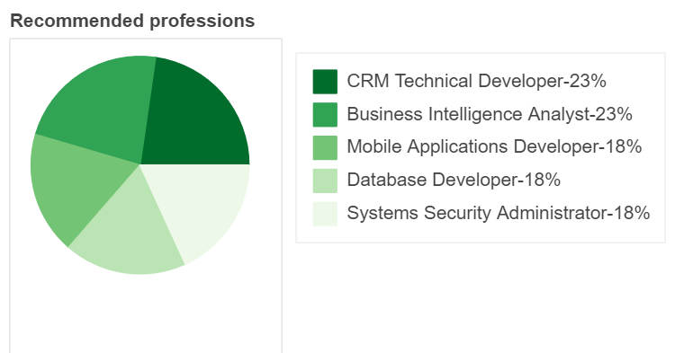
RESULTS :
The Result attained after a short quiz for the user suggests that the top 5 professions according to interest ratings is :
CRM Technical Developer – 23 %
Business Intelligent Analyst – 23 %
Mobile Applications Developer – 18 %
Database Developer – 18 %
Systems Security Administrator - 18 %

