Slide 1

Notes:
_header: **Product Docs**

Slide 2
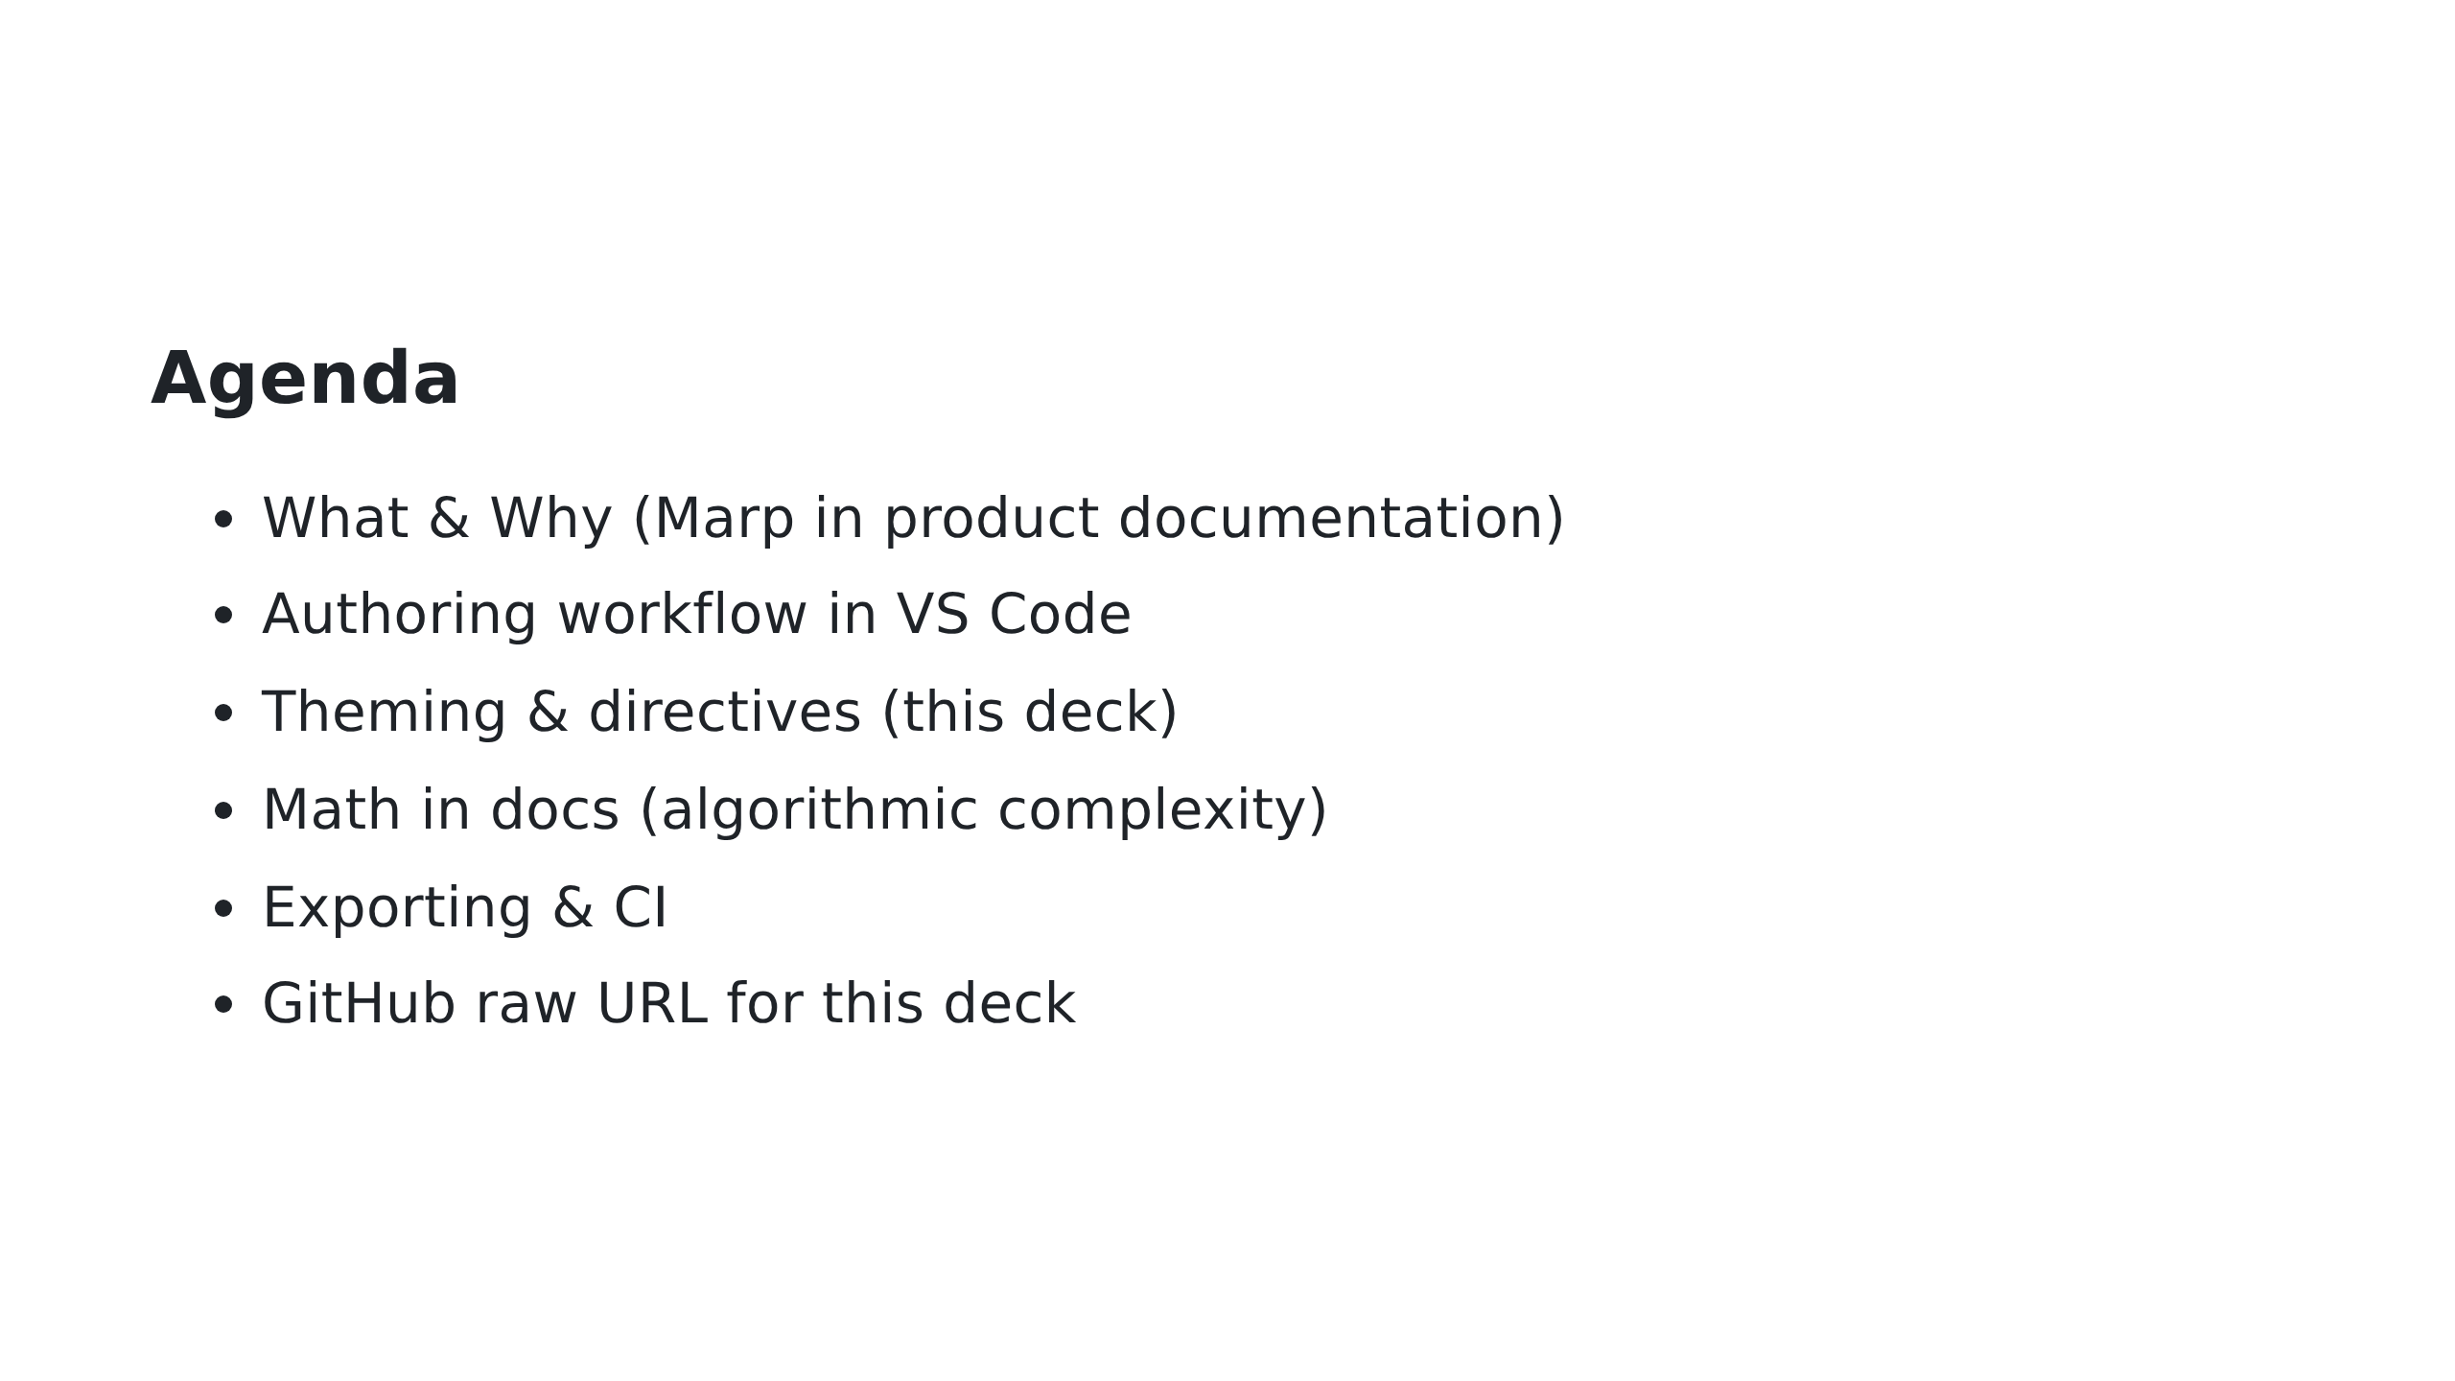

Slide 3
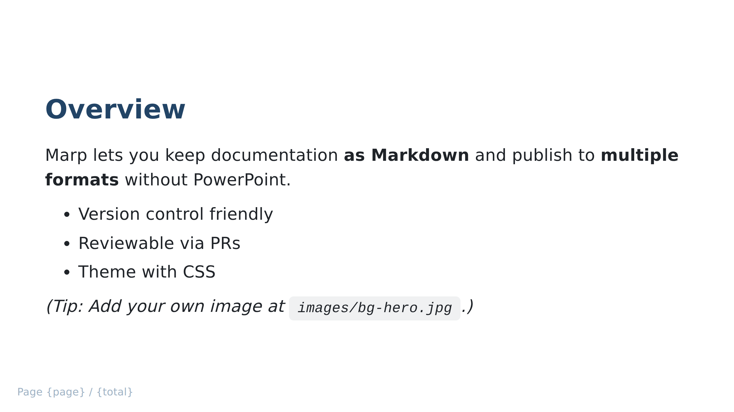
Notes:
Background image demo (place your file at images/bg-hero.jpg) _header: **Product Docs**

Slide 4
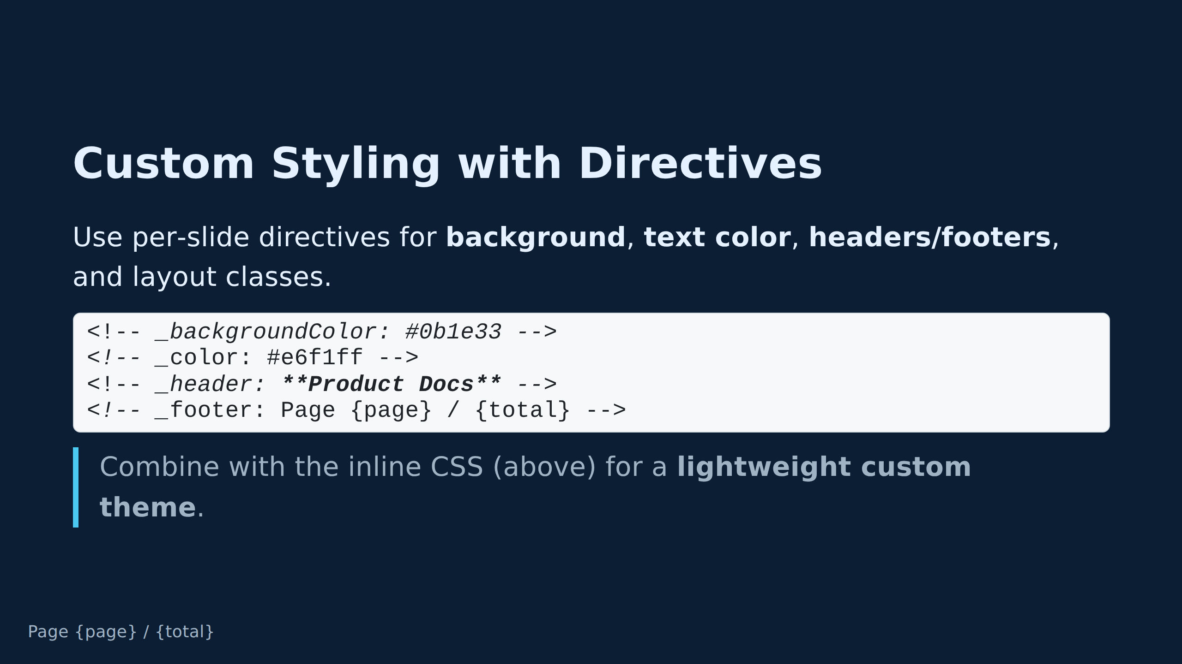
Notes:
Slide with custom colors via directives _header: **Theming & Directives**

Slide 5
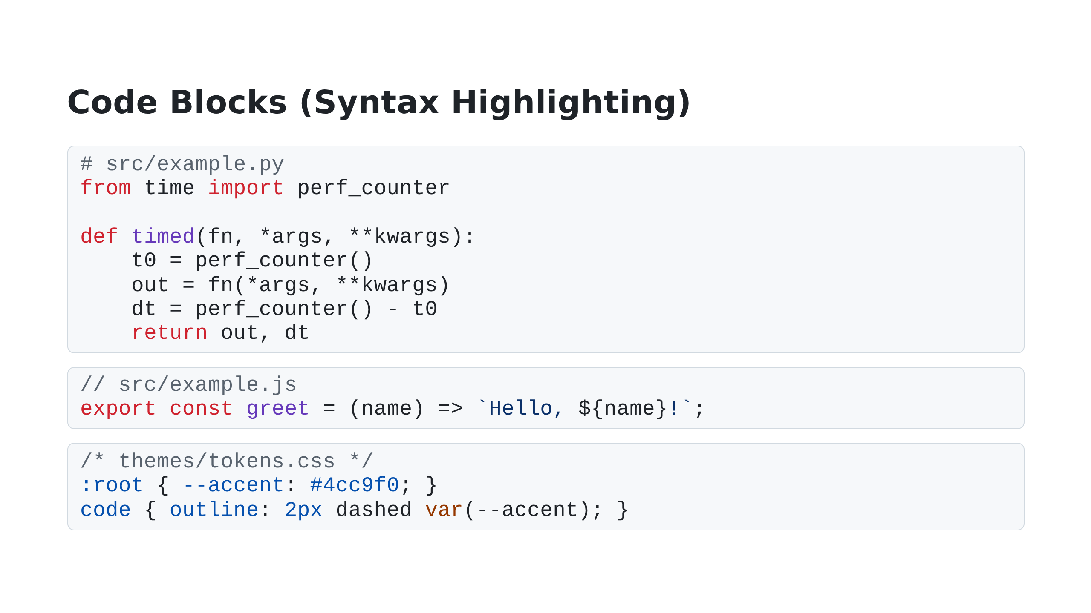

Slide 6


Slide 7
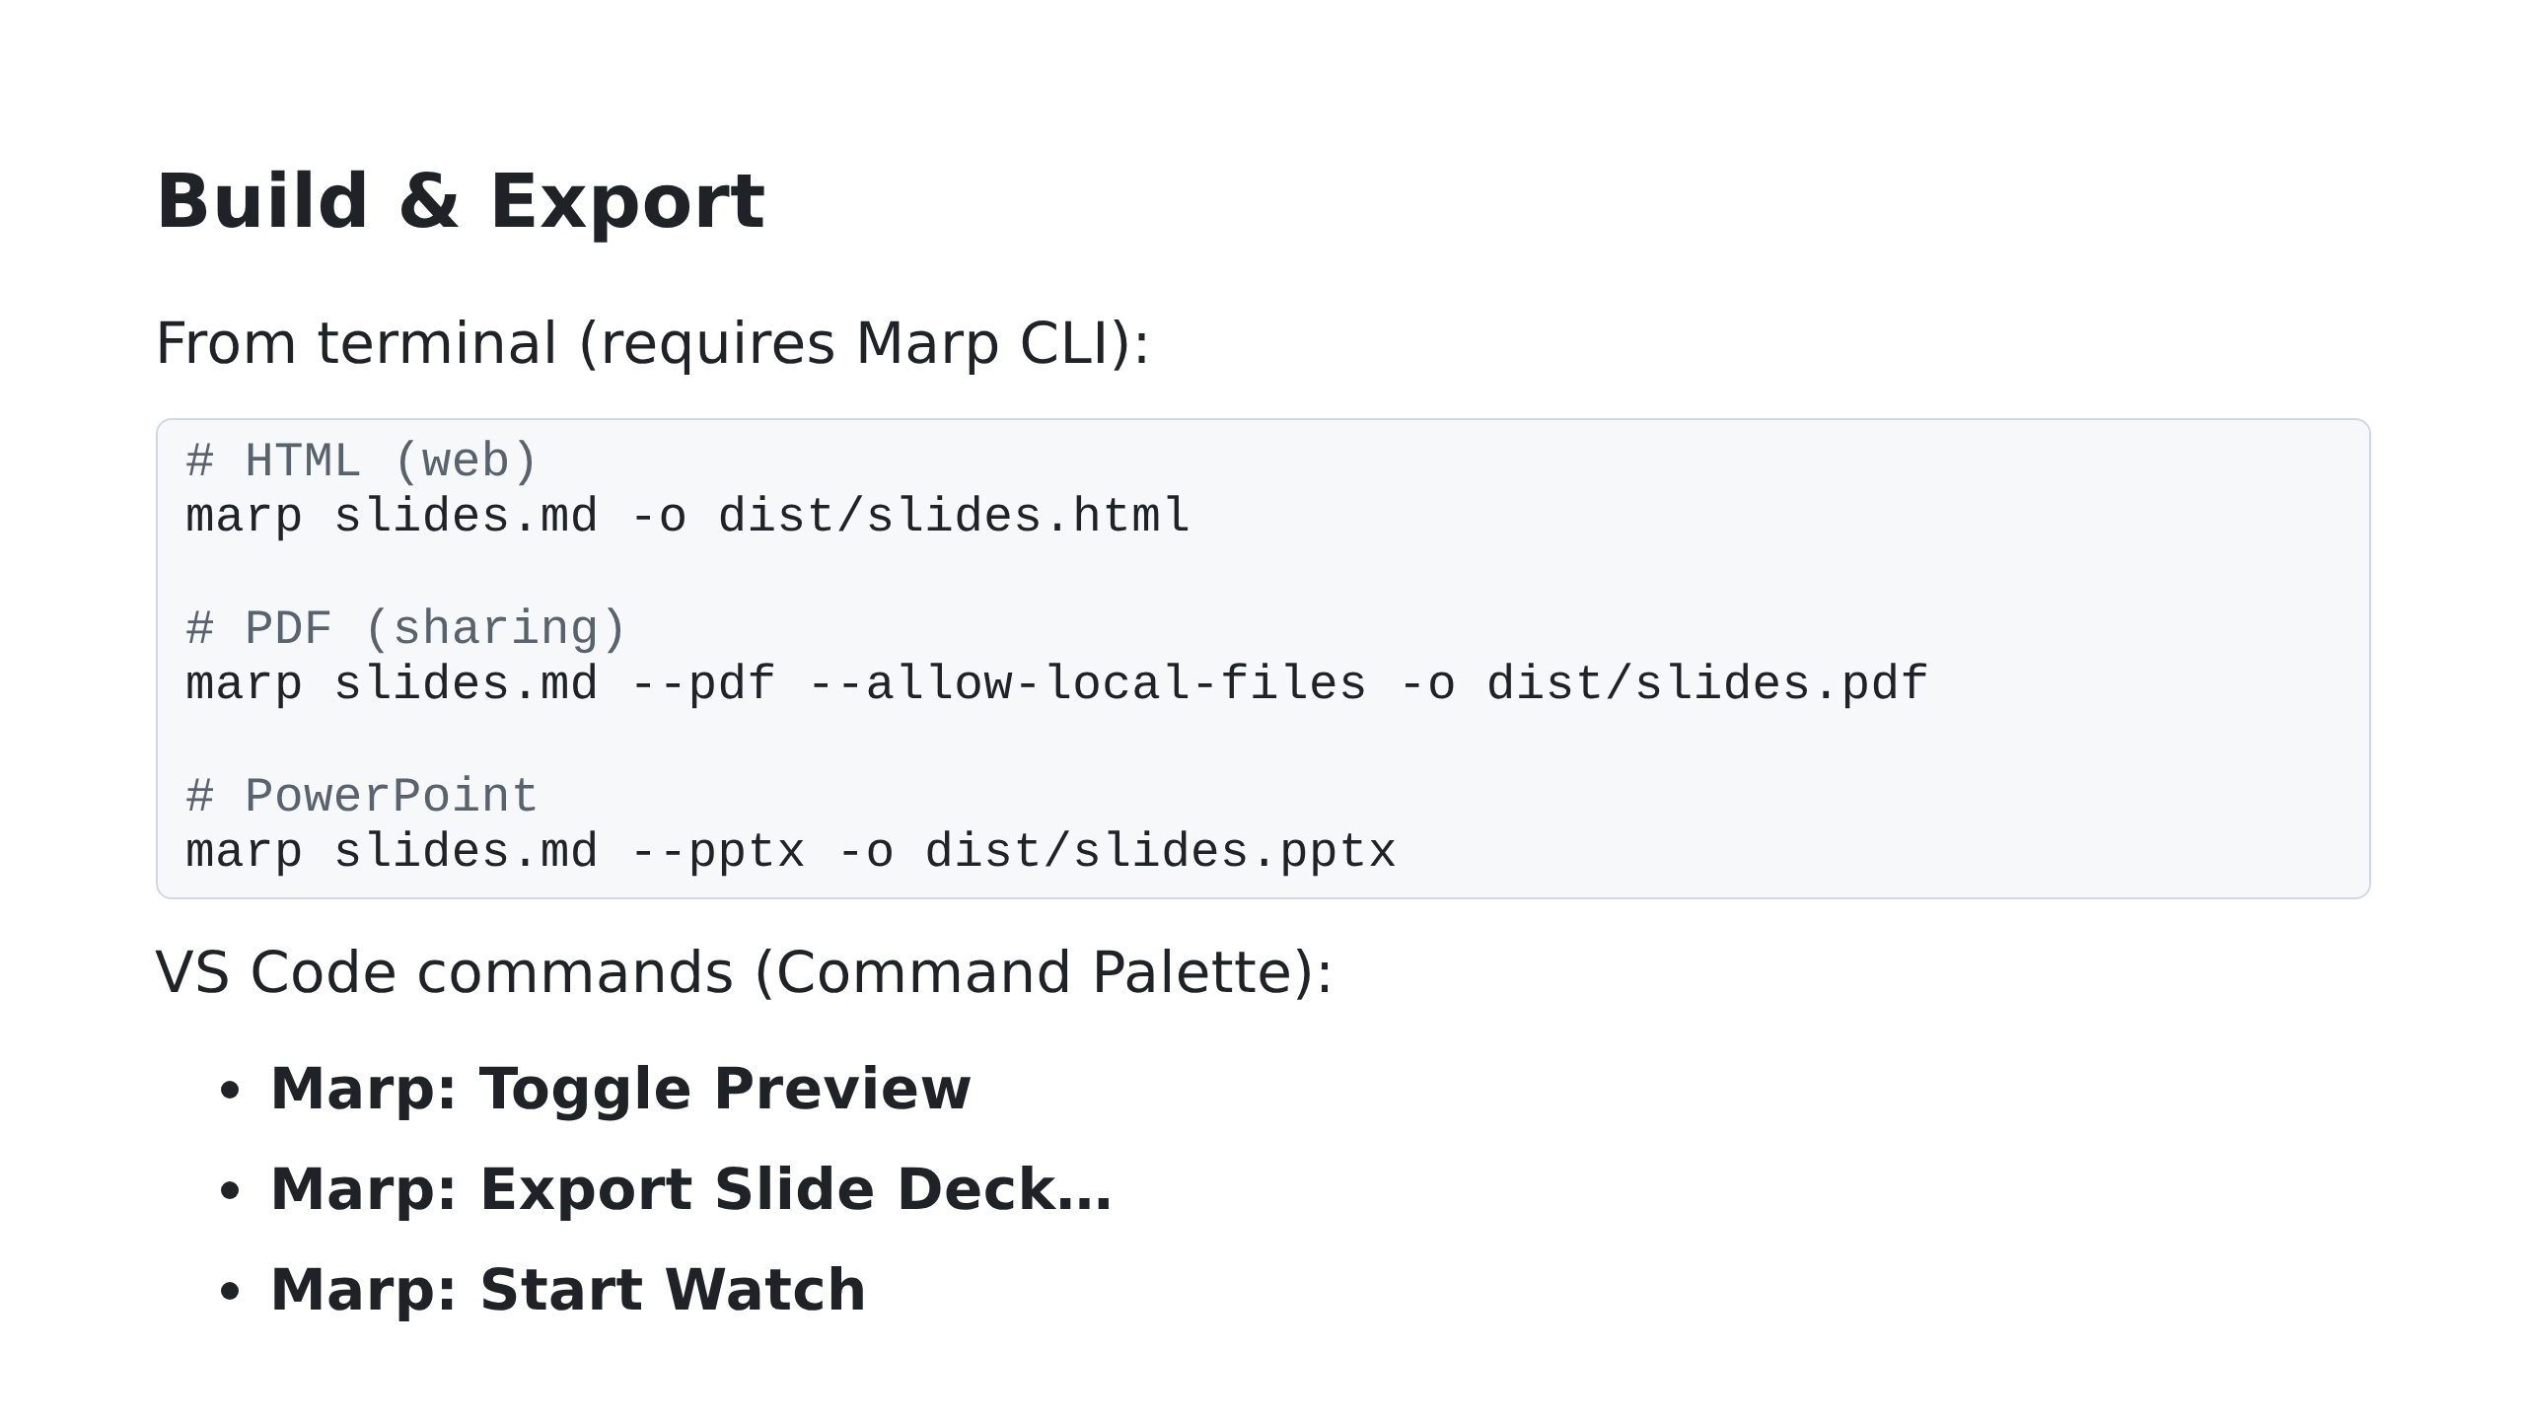

Slide 8
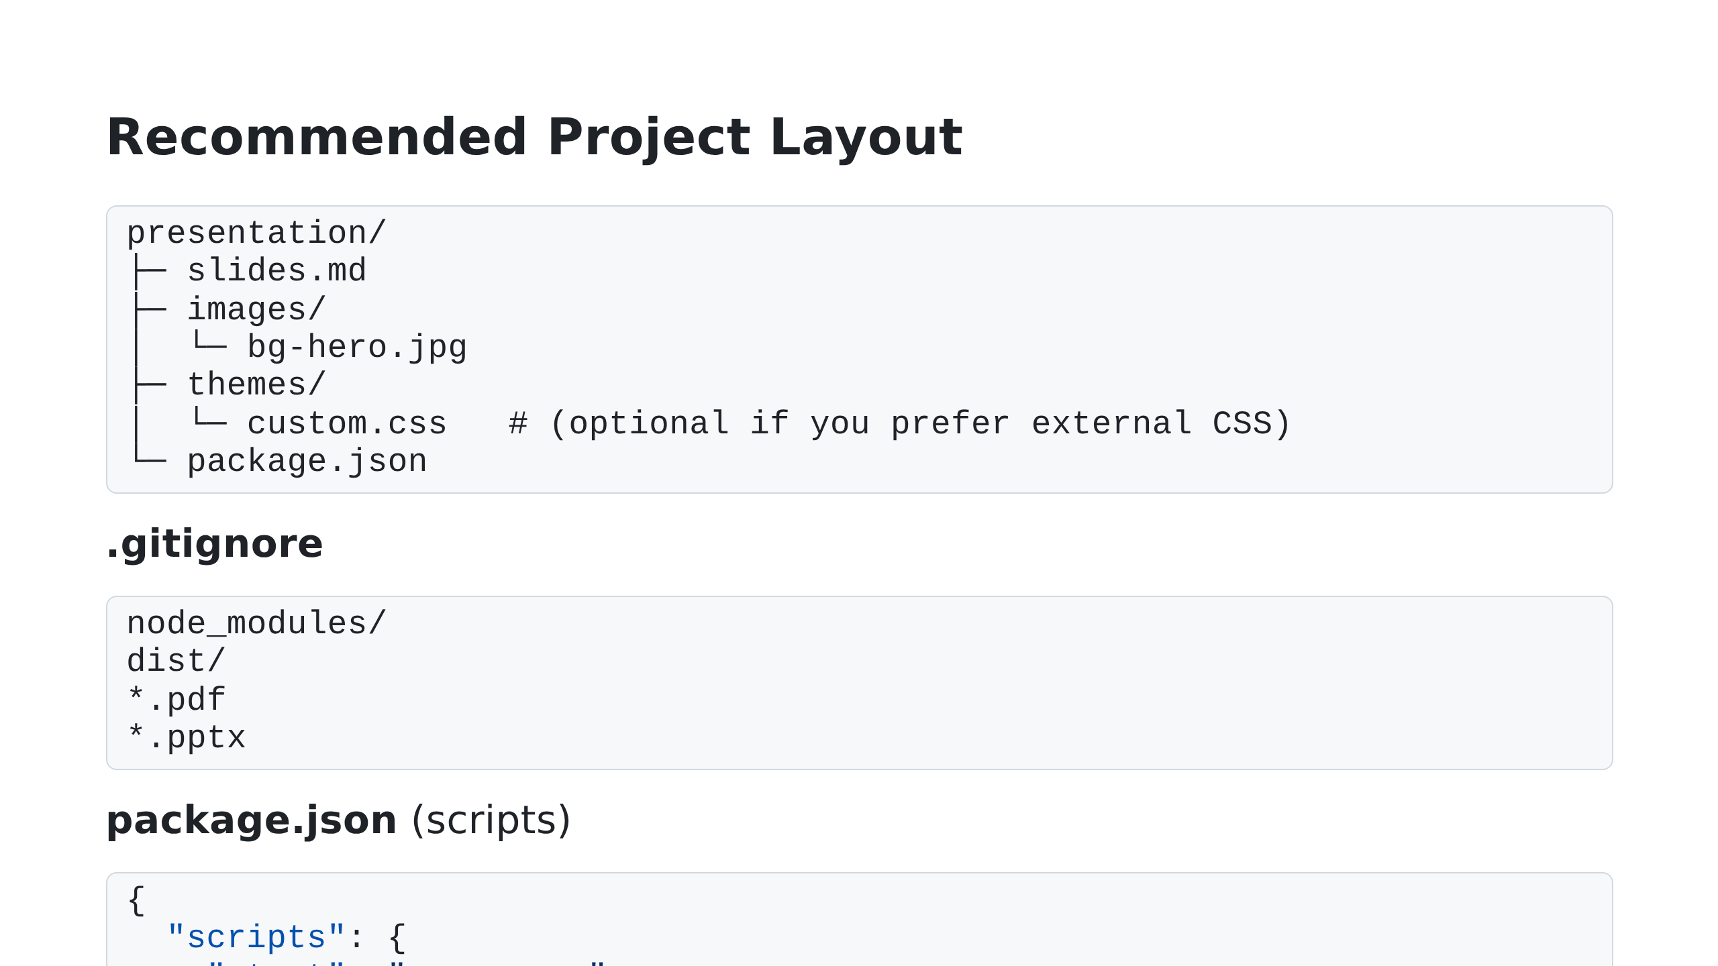

Slide 9
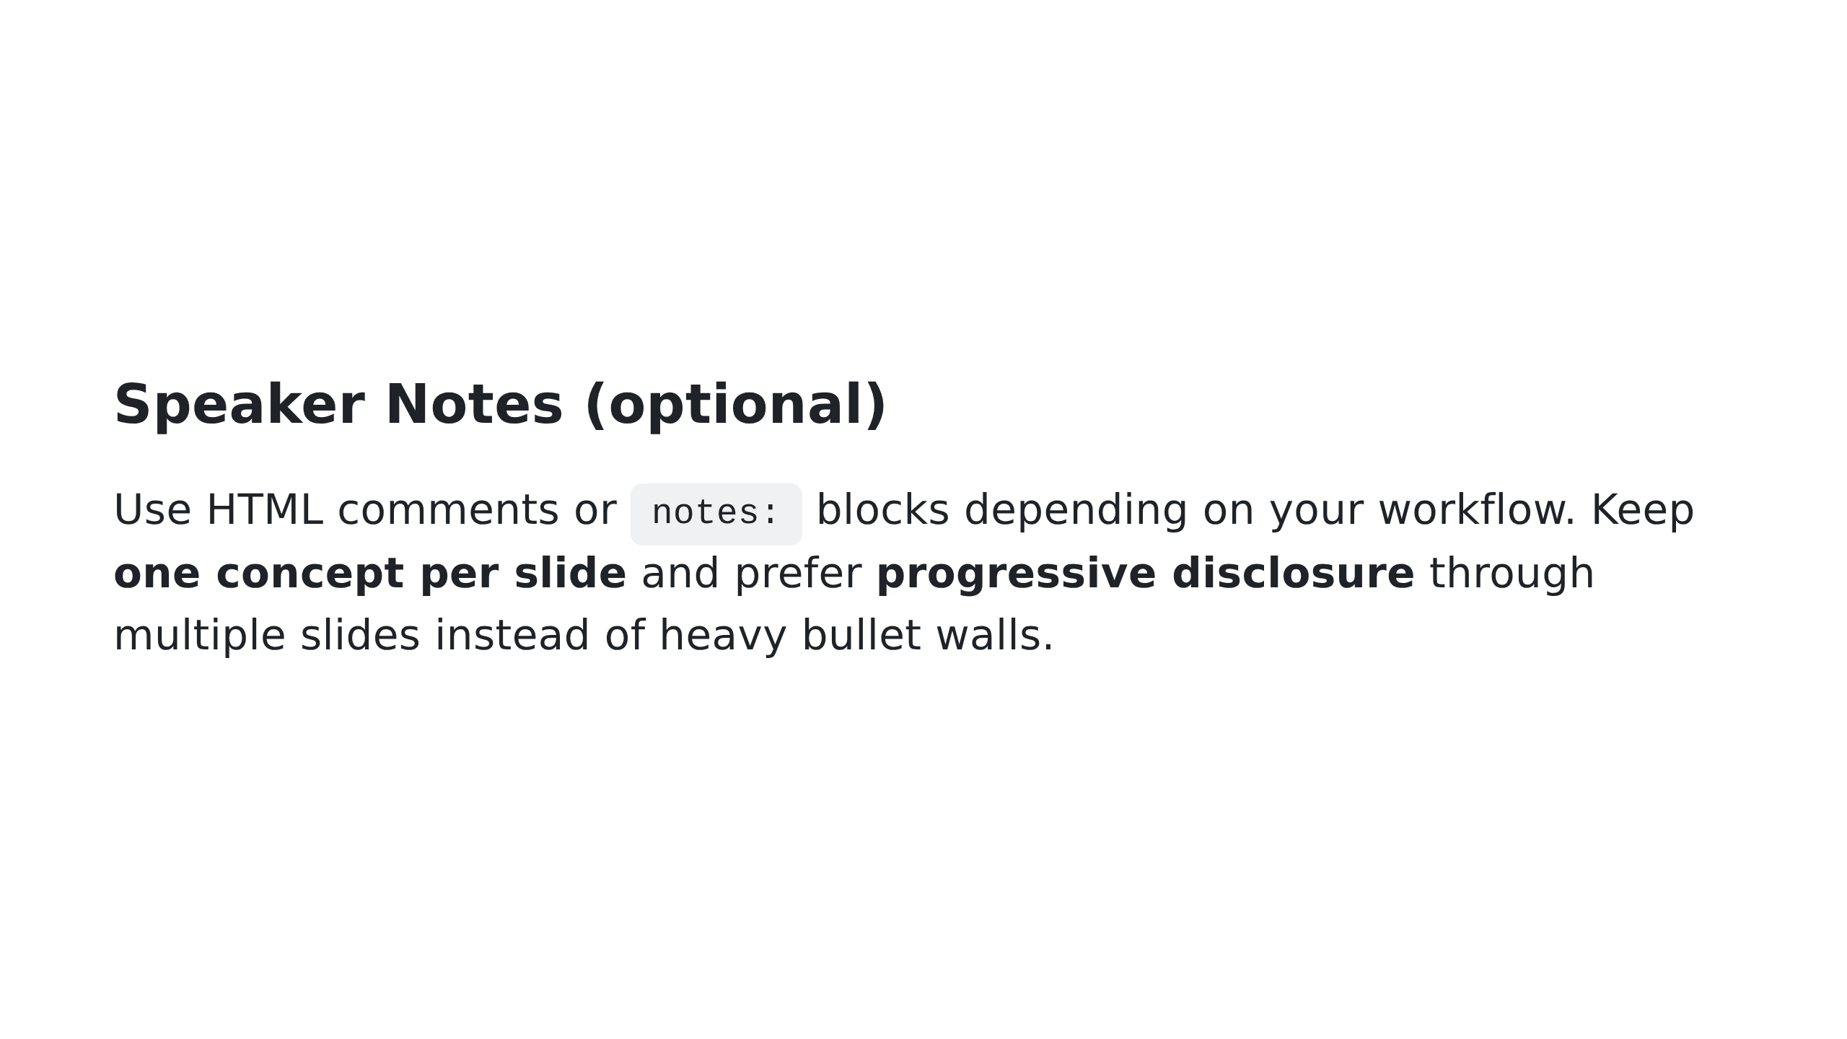

Slide 10
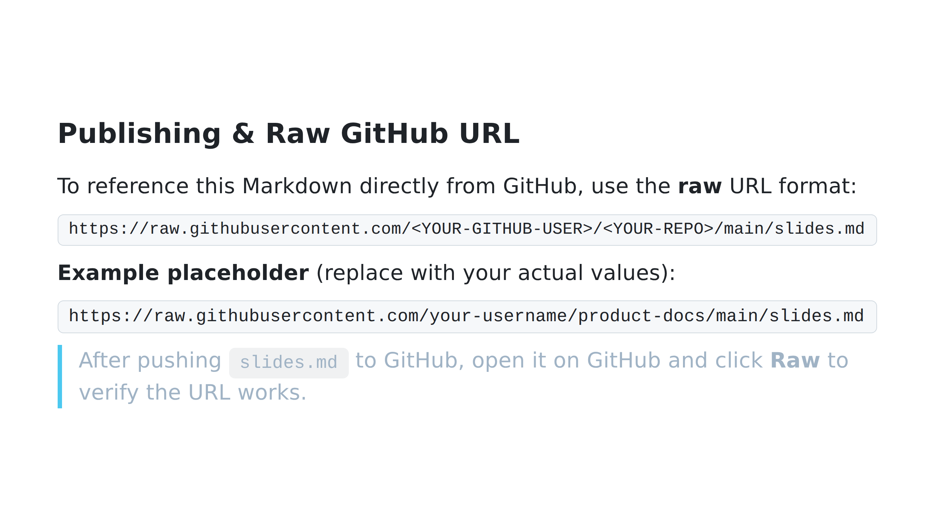

Slide 11
