Slide 1
Fitness buddy
IBM HACKATHON PROJECT
Presented By:
Student name : Arunkumar S
College Name & Department : S. Veerasamy Chettiar College of Engineering and Technology & Electronics and Communication Engineering

Slide 2
OUTLINE
Problem Statement
Technology used
Wow factor
End users
Result
Conclusion
Git-hub Link
Future scope
IBM Certifications

Slide 3
Problem Statement
In today’s busy world, maintaining a healthy lifestyle is challenging due to time limitations, lack of motivation, and expensive fitness programs. Fitness Buddy is a smart, conversational virtual assistant designed to tackle these issues by providing:
Personalized home workout recommendations
Daily motivational tips and inspiration
Simple and nutritious meal suggestions
Guidance for building healthy habits
Built using IBM Cloud Lite services and IBM Granite, Fitness Buddy ensures a cost-effective, intelligent, and always-available health solution tailored to individual needs—making fitness support accessible anytime, anywhere.

Slide 4
Technology used
IBM cloud lite services
Natural Language Processing (NLP)
IBM Granite model

Slide 5
IBM cloud services used
IBM Cloud Watsonx AI Studio
IBM Cloud Watsonx AI runtime
IBM Cloud Agent Lab
IBM Granite foundation model

Slide 6
Wow factors
🤖 AI-Powered Personalization Tailors workouts, meals, and tips to each user’s lifestyle, goals, and preferences.
💬 24/7 Virtual Fitness Coach Always available for instant guidance—no appointments, no waiting.
💸 Zero Cost, Maximum Impact Built on IBM Cloud Lite—leveraging powerful services without subscription fees.
🏋️ No Equipment? No Problem! Recommends home-based workouts using body weight or simple props.
🥗 Smart Meal Suggestions Offers easy, nutritious meal ideas using common kitchen ingredients.
📈 Habit Tracking & Motivation Boosts Encourages daily consistency with reminders, streaks, and motivational quotes.
☁️ Powered by IBM Cloud & Granity Scalable, secure, and intelligent backend support ensures reliable performance.

Slide 7
End users
Busy Professionals Looking for quick, personalized fitness routines and wellness tips.
Students Seeking affordable and flexible ways to stay healthy and active.
Home-makers Interested in simple workouts and healthy meals without the need to visit a gym.
Fitness Beginners Needing guidance, motivation, and easy-to-follow plans to start their fitness journey.
Elderly Individuals Wanting gentle, guided exercises and basic health advice from the comfort of home.
Remote Workers / Freelancers Looking to balance sedentary work with health-focused habits.
People with Budget Constraints Who can't afford gym memberships or personal trainers but still want expert advice.
Health-Conscious Individuals Interested in daily fitness, nutrition guidance, and long-term habit formation.

Slide 8
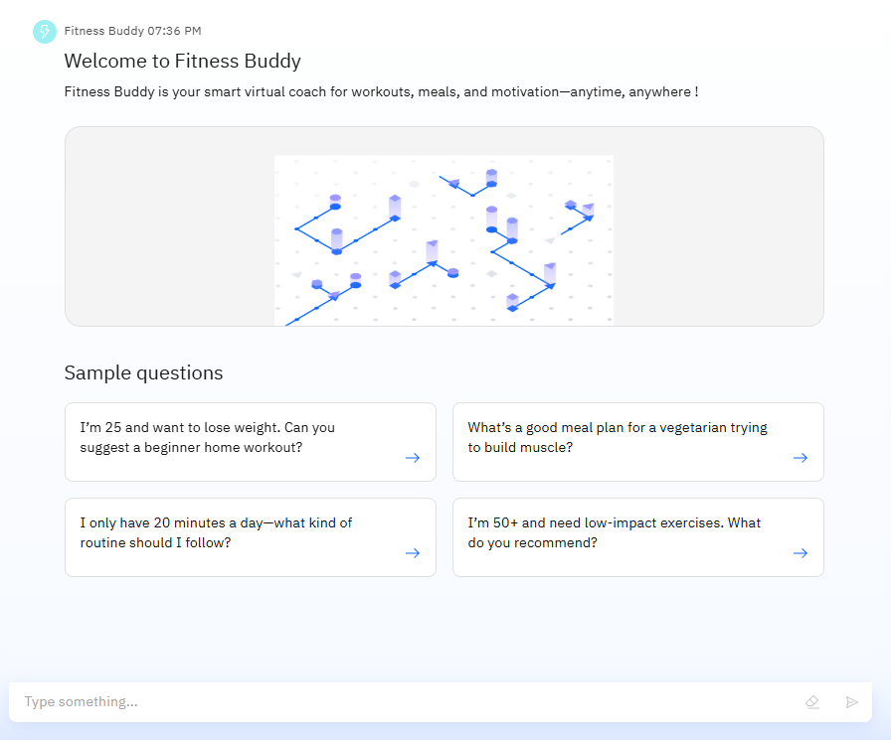
Results

Slide 9
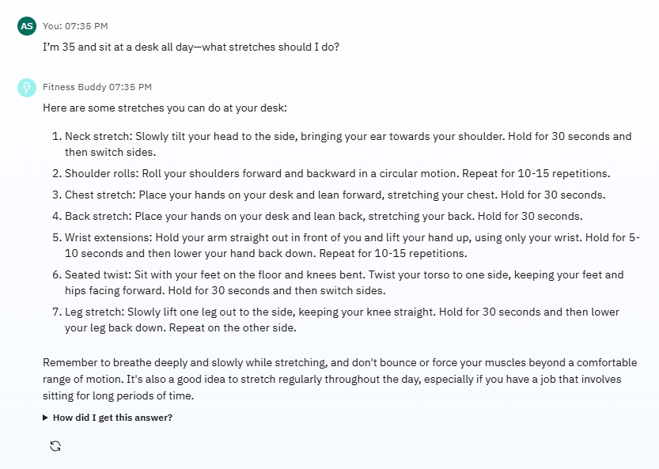
Results

Slide 10
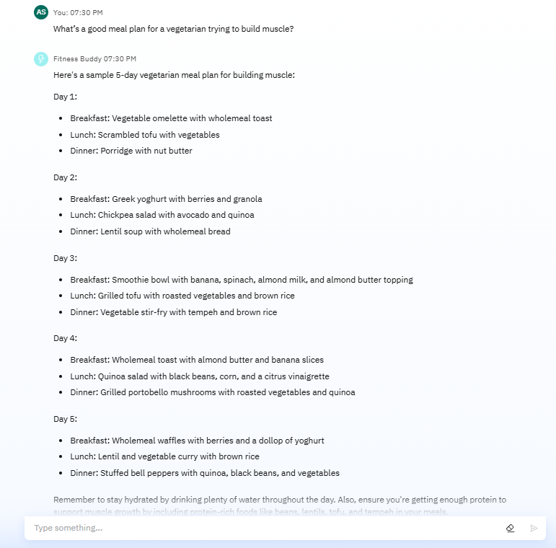
Results

Slide 11
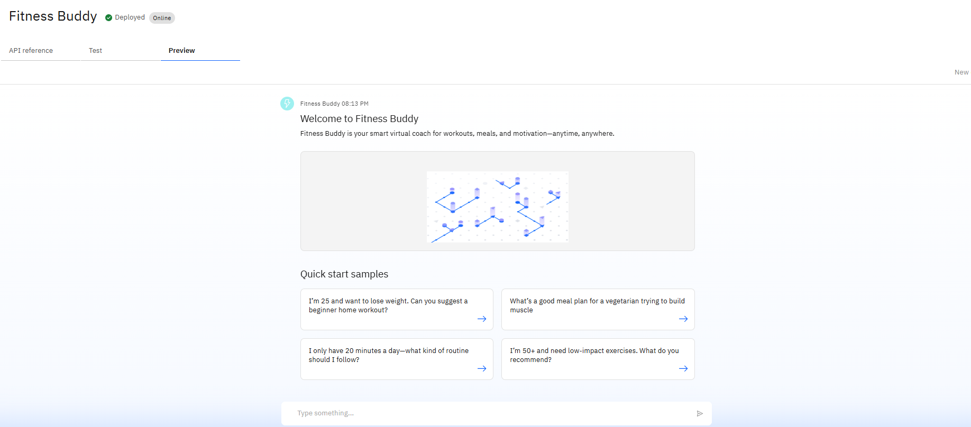
Results
Deployed AI Agent

Slide 12
Conclusion
Personalized Wellness for Everyone Fitness Buddy offers tailored workouts, nutrition tips, and motivation—making healthy living accessible to all.
AI Meets Affordability Leveraging IBM Cloud Lite and Granity, the solution delivers intelligent support without the cost of traditional fitness services.
Empowering Consistency and Healthy Habits By providing on-demand guidance and daily inspiration, Fitness Buddy helps users build long-term, sustainable wellness routines.

Slide 13
GitHub Link
Git-hub Link – View Repository

Slide 14
Future scope
🧠 Integration with Wearables Sync with fitness bands and smartwatches for real-time activity and health tracking.
📊 AI-Driven Progress Analytics Provide visual dashboards with personalized progress reports and fitness insights.
🗣️ Multilingual Support Enable regional language support to reach a wider and more diverse user base.
🤝 Virtual Trainer Collaboration Allow users to connect with certified fitness experts for advanced guidance.
📅 Smart Scheduling Auto-generate daily routines and reminders based on user availability and goals.
🌐 Community & Social Features Introduce user forums, challenges, and leaderboards to boost motivation through peer engagement.

Slide 15
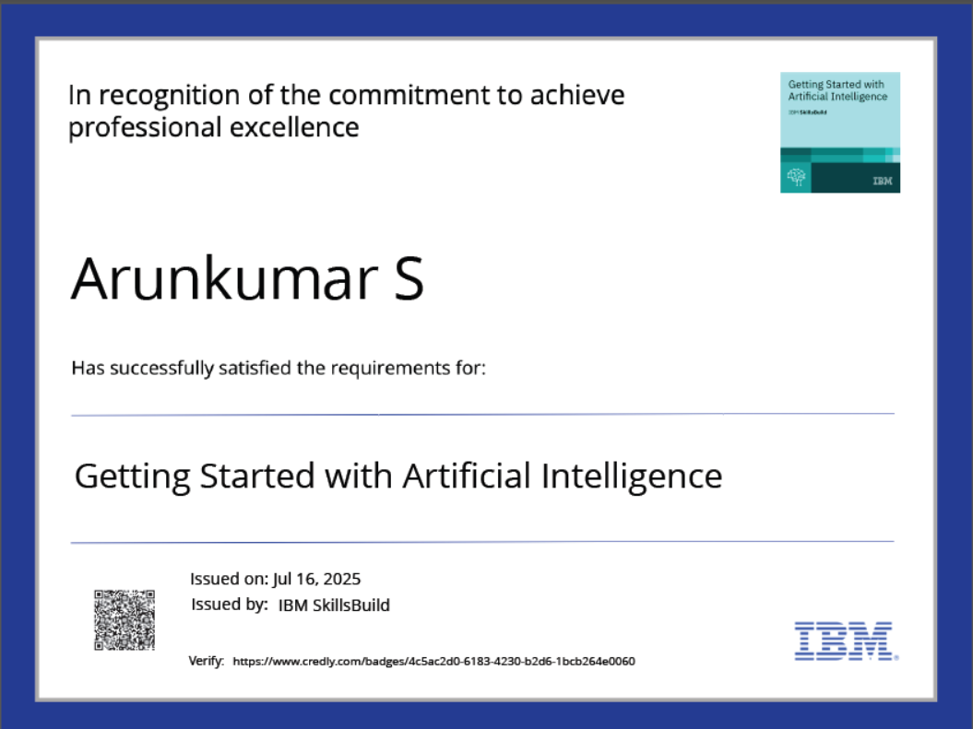
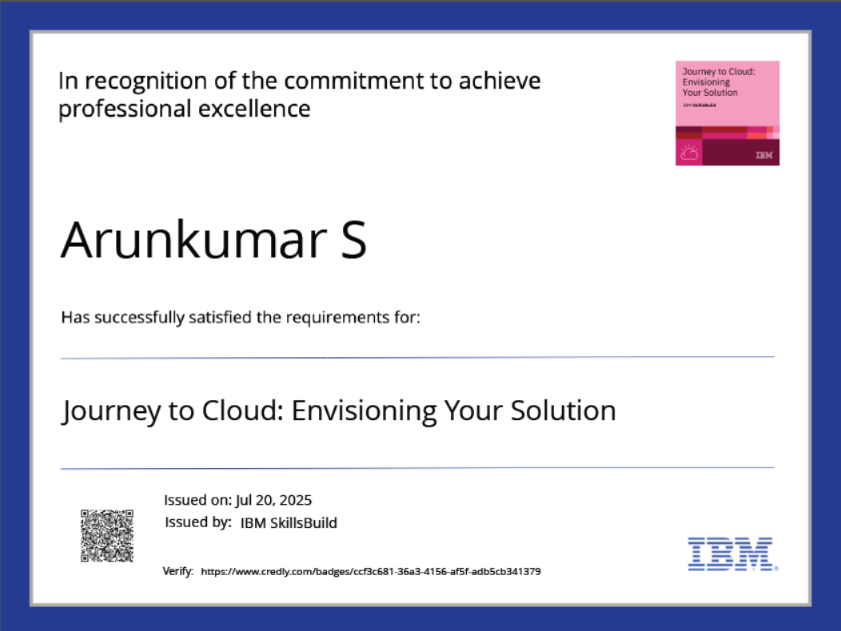
IBM Certifications

Slide 16
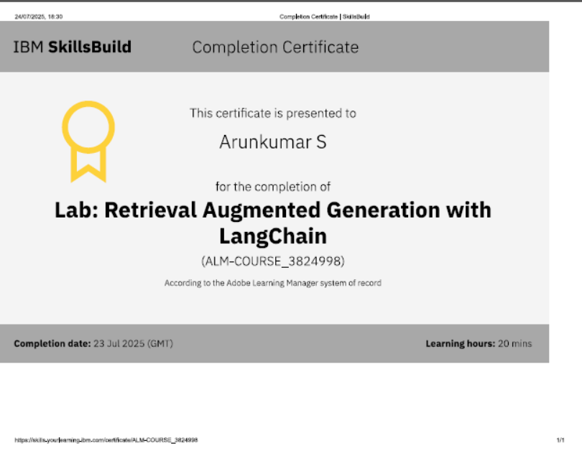

Slide 17
THANK YOU

