Slide 1
JavaScript
TKHTS
Techknow Heights
Notes:
var name = "arun
name = name.split("").sort().join("")

Slide 2
Agenda
TKHTS
Techknow Heights
Introduction to JavaScript
JavaScript Expressions and Operators
Functions and Flow Control
Objects and Arrays (Important)
Document Object Model(Important)
Form Validation The Form Object Model(Important)
Dates and Times in JavaScript(Important)

Slide 3
Introduction
TKHTS
Techknow Heights

Slide 4

JavaScript History
TKHTS
Techknow Heights

Slide 5
Introduction
TKHTS
Techknow Heights
There are three languages of the Web
HTML
CSS
JavaScript
JavaScript is a programming language that is used to add behavior and interactivity to the web pages.
Its syntax was influenced by the language C.
JavaScript copies many names and naming conventions from Java, but the two languages are otherwise unrelated and have very different semantics.
It is an interpreted language.
A JavaScript engine (also known as JavaScript interpreter or JavaScript implementation) is an interpreter that interprets JavaScript source code and executes the script accordingly.
JavaScript code can run locally in a user's browser (rather than on a remote server), enabling the browser to respond quickly to user actions, making an application more responsive.
Furthermore, JavaScript code can detect user actions which HTML alone cannot, such as individual keystrokes using event handling.

Slide 6
JavaScript History
TKHTS
Techknow Heights
JavaScript created by Netscape
JScript created by Microsoft
IE and Netscape renderings were slightly different
Standardized by European Computer Manufacturers Association (ECMA)
http://www.ecma-international.org/ecma-262/6.0/ECMA-262.pdf
Language to look ahead in current times
Lightweight, Interpreted & Scripting language
Loosely based on Java and built into all the major modern browsers
Easy to learn

Slide 7
What is JavaScript?
TKHTS
Techknow Heights
Language more than a browser scripting language
Supports many advanced concepts such as
OOPs
Recursion
Memoization
Closures
Cross-Platform

Slide 8
My first Program - Hello World (The Inline way)
TKHTS
Techknow Heights
The <script> tag
The following example will make “Hello World” pop-up on the browser window.
<!DOCTYPE html>
<html>
<head>
<title>Hello World</title>
</head>
<body>
<script type="text/javascript">
alert("Hello World");
</script>
</body>
</html>
This results in an alert message in the browser window as soon as the html document is browsed .
Write the code in an editor and verify the result

Slide 9
My first Program - Hello World (The external JavaScript)
TKHTS
Techknow Heights
Instead of having the scripting code in the HTML -
Write script in separate file and save them with .js extension
Include the script in the HTML document using the src attribute of the script tag
The same script can be executed using the following code snippets
Helloworld.html
<!DOCTYPE html>
<html>
<head>
<title>Hello World</title>
</head>
<body>
<script type="text/javascript" src="script.js"></script>
</body>
</html>
Script.js
alert("Hello World");

Slide 10
External Vs Inline JavaScript
TKHTS
Techknow Heights
Using an external JavaScript (and not an inline javascript) provides the following advantages.
Increases Performance of the webpages
Promotes Reusability.
Using external files in the real world generally produces faster pages because the JavaScript and CSS files are cached by the browser.
JavaScript and CSS that are inlined in HTML documents get downloaded every time the HTML document is requested. This reduces the number of HTTP requests that are needed, but increases the size of the HTML document.
On the other hand, if the JavaScript and CSS are in external files cached by the browser, the size of the HTML document is reduced without increasing the number of HTTP requests.
If we have external Javascript, the same can be used across different web pages by including that script in the HTML document and specifying the src attribute.

Slide 11
Content Delivery Networks
TKHTS
Techknow Heights
Advantages
Sites like Google usually have better serves
Browsers can download a certain number of assets per web sites
Someone is maintaining these files for us and often can automatically move to latest version
Browser skips recache if the link is same
Disadvantages
Can be disaster if host is having some problem (network, performance)
CDN is out of the business
Should be online
You can not change/modify the files

Slide 12
First JavaScript
TKHTS
Techknow Heights
<body>
<script language="javascript" type="text/javascript">
<!--
document.write("Hello World!") ;
//-->
</script>
</body>
Older Browsers
<body>
<script type="text/javascript"> document.write("Hello World!") ;
</script>
</body>
Modern Browsers
Notes:
JavaScript ignores spaces, tabs, and newlines

Slide 13
Where to place JavaScript
TKHTS
Techknow Heights
The HTTP/1.1 specification suggests that browsers download no more than two components in parallel per hostname. If you serve your images from multiple hostnames, you can get more than two downloads to occur in parallel.
The problem caused by scripts is that they block parallel downloads.
This effectively means, While a script is downloading, the browser won't start any other downloads, even on different hostnames.
So if we place the scripts anywhere in the webpage (except at the bottom) and the script takes a very long time to execute, it will result in the following two scenarios.
Everything below the script won't render until the script is loaded.
All components below the script don't start downloading until the script is done
So placing the script at the bottom of the web page, would effectively remove such scenarios from occurring.

Slide 14
Why before </body>
TKHTS
Techknow Heights
Concat first_name & last_name and display in <h1> tag
Why we should not use document.write();
What is the differences between Java and JavaScript?

Slide 15
Basics
TKHTS
Techknow Heights
JavaScript is a sequence of statements to be executed by the browser.
JavaScript statements are "commands" to the browser which tell the browser what to do.
Semicolon separates JavaScript statements.
JavaScript is case sensitive.
JavaScript ignores extra spaces. You can add white space to your script to make it more readable.

Slide 16
Comments
TKHTS
Techknow Heights
Comments can be added to explain the JavaScript, or to make the code more readable
Comments will not be executed by JavaScript
Single line comments start with //
Multi line comments start with /* and end with */

Slide 17
Quiz
TKHTS
Techknow Heights
Select correct statements on adding comments to JavaScript code.
Comments increase the size of code
Comments reduce the code size
Comments can help to better understand code
Comments significantly reduces the speed of execution the code
Comments significantly increases the speed of execution the code

Slide 18
Variables & Operators
TKHTS
Techknow Heights

Slide 19
Variables
TKHTS
Techknow Heights
Variables are "containers" for storing information.
Variable must be given descriptive names. We use camel case convention to name a variable.
Variables in JavaScript are declared using “var” keyword.
Rules for variable names
Variable names must begin with a letter.
Variable names can also begin with $ and _.
Variable names are case sensitive
Variable names should not be reserved keywords
A variable can store
Numbers
Strings
Arrays
Objects
Booleans

Slide 20
Variables
TKHTS
Techknow Heights
JavaScript is a dynamically typed language
Which means data types are converted automatically as needed during script execution
Variables can be declared in 2 ways
var x = 42;
Later on you do –
x = “hello world”;
var data = 10;
(This syntax is used to declare local and global variables)
data = 10
(Variables declared using this syntax are always global)

Slide 21
Variables
TKHTS
Techknow Heights
Assigning values to variables
Declaring multiple variables in one statement
var numericData = 10.5; // Number
var stringData = "Hello World"; //String
var booleanFlag = false; // Boolean
var lastname=“Sparrow", age=30, job=“Pirate";

Slide 22
???
TKHTS
Techknow Heights
What are not-defined and undefined variables?
‘var’ is mandatory to declare variables in JS. True or False;

Slide 23
Operators
TKHTS
Techknow Heights
Arithmetic Operators
+
-
*
/
%
++
--
Assignment Operators
=
+=
-=
*=
/=
%=
Logical Operators
&&
||
!

Slide 24
Operators
TKHTS
Techknow Heights
Comparison Operators
==
===
!=
!==
>
<
>=
<=
Conditional Operators (Ternary Operator)- ?:
Syntax: var variablename=(condition)?value1:value2
var counter= 5;
var flag = ( counter<10 ) ? True : false;

Slide 25
Conditional Statements
TKHTS
Techknow Heights
If Statement
Syntax
if (condition) { code to be executed if condition is true }
If...else Statement
Syntax
if (condition) { code to be executed if condition is true } else { code to be executed if condition is not true }

Slide 26
Conditional Statements
TKHTS
Techknow Heights
If...else if...else Statement
Syntax
if (condition1) { code to be executed if condition1 is true } else if (condition2) { code to be executed if condition2 is true } else { code to be executed if neither condition1 nor condition2 is true }

Slide 27
Conditional Statements
TKHTS
Techknow Heights
Switch case
Syntax
switch(n) { case 1: execute code block 1 break; case 2: execute code block 2 break; default: code to be executed if n is different from case 1 and 2 }
Based on the value of ‘n’, the code switches to different code blocks
The value of ‘n’ is computed before the switch statement
The various cases denote the possible values that ‘n’ can take
To prevent the code from moving to another case, we use break statement. So, once the code block 1 is executed when the value of ‘n’ is 1, the flow comes out of the switch statement
default is used to specify the condition when there is no matching case available for the given value of ‘n’

Slide 28
Looping Constructs
TKHTS
Techknow Heights
Loops help us in iteration
The basic types of loops are :
for
While
for/in
do/while

Slide 29
Looping Constructs
TKHTS
Techknow Heights
The for loop
Syntax
for (initialization; condition; afterthought) { the code block to be executed }
The initialization declares (and perhaps assigns to) any variables required
The condition check is made and, the loop ends if results is false.
The afterthought is performed exactly once every time the loop ends and then repeats

Slide 30
Looping Constructs
TKHTS
Techknow Heights
The while loop
The while construct consists of a block of code and a condition. The condition is evaluated, and if the condition is true, the code within the block is executed. This repeats until the condition becomes false
Syntax
while (condition) { code block to be executed }

Slide 31
Break
TKHTS
Techknow Heights
While the execution of program, the break statement will terminate the
iteration of block
switch case block
When a break statement is encountered in a loop, the loop is exited and the program continues with the statements immediately following the loop
When the loops are nested, the break will only terminate the corresponding loop body

Slide 32
Continue
TKHTS
Techknow Heights
The continue statement skips the current iteration of a loop
In while and do loops, continue causes the control to go directly to the test-condition and then continue the iteration process
In case of for loop, the increment section of the loop is executed before the test-condition is evaluated

Slide 33
Quiz
TKHTS
Techknow Heights
What will be the result of the following code snippet?
var a = "1";
a = a + 0;
a = a - 1;
a = a + 1;
alert(a);

Slide 34
Demo
TKHTS
Techknow Heights
What are global variables?
What is the differences between '===' & '==' ?
What is the differences between ‘instanceof' & ‘typeof' ?
Notes:
in JavaScript strings can be literals or objects
function isString(s) { return typeof(s) === 'string' || s instanceof String; }
Literals are a different kind of object than objects created from within Javascript.
var color1 = new String("green");
color1 instanceof String; // returns true
var color2 = "coral";
color2 instanceof String; // returns false
(color2 is not a String object)
I can't find any way to construct literal types with code, perhaps it's not possible.
This is probably why people use typeof "foo" === "string" instead of instanceof.
An easy way to remember things like this is asking yourself "I wonder what would be sane and easy to learn"? Whatever the answer is, Javascript does the other thing.
function classOf(value) {
return Object.prototype.toString.call(value);
}
console.log(classOf(true)); // [object Boolean]
console.log(classOf(0)); // [object Number]
console.log(classOf("")); // [object String]
console.log(classOf(new Boolean(true))); // [object Boolean]
console.log(classOf(new Number(0))); // [object Number]
console.log(classOf(new String(""))); // [object String]
function typeOf(value) {
return Object.prototype.toString.call(value).slice(8, -1);
}
console.log(typeOf(true)); // Boolean
console.log(typeOf(0)); // Number
console.log(typeOf("")); // String
console.log(typeOf(new Boolean(true))); // Boolean
console.log(typeOf(new Number(0))); // Number
console.log(typeOf(new String(""))); // String

Slide 35
Quiz
TKHTS
Techknow Heights
What will be output?
var a = false;
if (a == '0')
{
console.log('==');
}
if (a === '0')
{
console.log('===');
}

Slide 36
Functions
TKHTS
Techknow Heights
Notes:
DOM Parsing Example
Object Oriented vs Functional Programming Example
Dynamic Language example
Loosly Typed example

Slide 37
Functions
TKHTS
Techknow Heights
A function is a block of code that will be executed when its called
Syntax
// Functional Declaration
function functionName() { //some code }
functionName(); // Calling the function declared above
A function may or may not have arguments
function myFunction(var1,var2) { //some code }
myFunction(1,2); // calling the function with 2 arguments

Slide 38
Functions
TKHTS
Techknow Heights
A function returning a value
function myFunction (var1,var2) { return (var1+var2); }
var sum = myFunction (1,2)
The return statement is also used when you simply want to exit a function. The return value is optional
function myFunction (a,b) { if (a>b) { return; } x = a+b; }
The function above will exit the function if a>b, and will not calculate the sum of a and b

Slide 39
Functions
TKHTS
Techknow Heights
Another way of declaring a function / Anonymous Function
var myFunction = function(var1,var2) {
return(var1+var2);
}
var sum=myFunction(10,20);

Slide 40
Functions & Variable Scope
TKHTS
Techknow Heights
Variable Scope
A variable declared (using var) within a JavaScript function becomes LOCAL and can only be accessed from within that function. (the variable has local scope).
You can have local variables with the same name in different functions, because local variables are only recognized by the function in which they are declared.
Local variables are deleted as soon as the function is completed.
Variables declared outside a function, become GLOBAL, and all scripts and functions on the web page can access it.
If you assign a value to variable that has not yet been declared, the variable will automatically be declared as a GLOBAL variable.

Slide 41
Functions & Variable Scope
TKHTS
Techknow Heights
Variable Lifetime
The lifetime JavaScript variables starts when they are declared.
Local variables are deleted when the function is completed.
Global variables are deleted when you close the page.

Slide 42
Quiz
TKHTS
Techknow Heights
How do you create a function named exec which takes string parameter(argument)?
function exec (string) {}
var exec = ({}, string)();
var function = exec(string) { }
var exec = function (string) {};

Slide 43
Quiz
TKHTS
Techknow Heights
function sum() {
var sum = 0;
for (var i = 0; i < arguments.length; i++) {
sum += arguments[i];
}
return sum;
}
var a = sum(5, -5, false, '-5', 5);
console.log(a);

Slide 44
Quiz
TKHTS
Techknow Heights
(function(){
var myValue = 55;
console.log("Inside the function, myValue : "+myValue);
})();
console.log("Outside the function, myValue : "+myValue);

Slide 45
Built-In Functions
TKHTS
Techknow Heights
Notes:
DOM Parsing Example
Object Oriented vs Functional Programming Example
Dynamic Language example
Loosly Typed example

Slide 46
Built-In Functions
TKHTS
Techknow Heights
Array
Property- length
Methods
concat() - Joins two or more arrays, and returns a copy of the joined arrays
Date
getDate() - Returns the day of the month (from 1-31)
getMonth() - Returns the month (from 0-11)
Math
ceil(x) - Returns x, rounded upwards to the nearest integer
floor(x) - Returns x, rounded downwards to the nearest integer
String
Methods
substring(from, to)- The substring() method extracts the characters from a string, between two specified indices, and returns the new sub string.

Slide 47
Built-In Functions
TKHTS
Techknow Heights
Math methods
String methods

Slide 48
Quiz
TKHTS
Techknow Heights
What will be the value of str1 and str2 after executing the code?
var msg = "Welcome to India";
var str1 = msg.substr(3, 3);
var str2 = msg.substring(3, 3);

Slide 49
Quiz
TKHTS
Techknow Heights
What will be the result of the code?
var a = isNaN("2014");
alert(a);

Slide 50
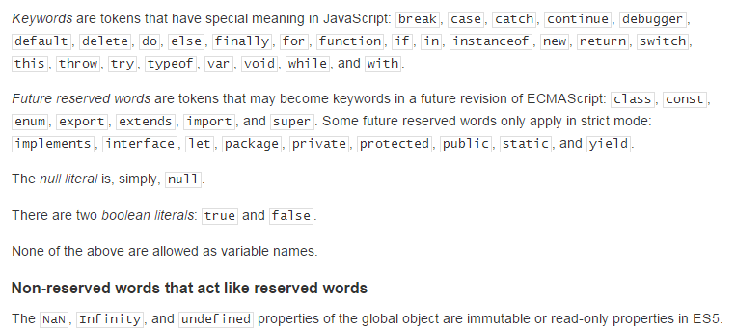
JavaScript Reserved Words
TKHTS
Techknow Heights

Slide 51
JavaScript EventHandling
TKHTS
Techknow Heights
Click
Focus
Blur
Change
Dbclick
Error
Submit
KeyPress
Hover (mouseover, mouseout)

Slide 52
Object
TKHTS
Techknow Heights
Notes:
DOM Parsing Example
Object Oriented vs Functional Programming Example
Dynamic Language example
Loosly Typed example

Slide 53
JavaScript Objects
TKHTS
Techknow Heights
Almost everything in JavaScript can be an Object:
Strings (primitive also)
Number (primitive also)
Boolean (primitive also)
Functions
Arrays
Dates
Objects are just data
Properties are values associated with objects
Methods are actions that objects can perform

Slide 54
JavaScript Array
TKHTS
Techknow Heights
Store multiple values in a single variable
Collection of any type of data
Two ways to create JavaScript Object are
var subject = new Array( “HTML", “C++", “Java“ );
var subject = [ “HTML", “C++", “Java“, 8085 ];

Slide 55
TKHTS
Techknow Heights
Array Demo
Date Demo
Notes:
DOM Parsing Example
Object Oriented vs Functional Programming Example
Dynamic Language example
Loosly Typed example

Slide 56
Creating Objects
TKHTS
Techknow Heights
Object literal / Curly braces { }
Instantiating Object( )
Using constructor
var person = { name: ‘Mark’, age: 21 }
var person = new Object();
person.name = ‘Mark’;
person.age = 21;
var Person = function(name, age){
this.name = name;
this.age = age;
}
var person = new Person(‘Mark’, 21);

Slide 57
JavaScript Objects are mutable & dynamic
TKHTS
Techknow Heights
JavaScript objects are addressed by reference
var Person = function(name, age){
this.name = name;
this.age = age;
}
var person = new Person(‘Mark’, 21);
var newPerson = person;
newPerson.name = ‘Carl’;
person.name == ‘Mark’; // fasle
person.name == ‘Carl’; // true
person.address = ‘delhi’;
delete person.age;

Slide 58
Quiz
TKHTS
Techknow Heights
What will be printed to the console?
var aString = { job: "I'm a String!" };
console.log(typeof aString);

Slide 59
JavaScript Features
TKHTS
Techknow Heights
Notes:
DOM Parsing Example
Object Oriented vs Functional Programming Example
Dynamic Language example
Loosly Typed example

Slide 60
JavaScript Features
TKHTS
Techknow Heights
Lightweight, Interpreted & Scripting language (Client or Server)
Make HTML Dynamic – Allowed DOM Parsing
Cross Browser Support
Supports Object Oriented Styling and Functional Styling
Dynamic Language – You can freely add and remove property of objects.
You can create object without creating an Blue Print(e.g. class).
Notes:
DOM Parsing Example
Object Oriented vs Functional Programming Example
Dynamic Language example
Loosly Typed example

Slide 61
JavaScript Features
TKHTS
Techknow Heights
Functions are First Class Objects
JavaScript Usage – Node JS, JSON ,NoSQL, HTML5
JavaScript Tools – Build Tools (Grunt), Test Tools (Mocha), IDE (Brackets, Light Table)
Loosely Typed – Variables and Objects properties can always hold values of any types.
Can Communicate Asynchronously
Prototype-based programming
Notes:
DOM Parsing Example
Object Oriented vs Functional Programming Example
Dynamic Language example
Loosly Typed example

Slide 62
DOM
TKHTS
Techknow Heights
Notes:
DOM Parsing Example
Object Oriented vs Functional Programming Example
Dynamic Language example
Loosly Typed example

Slide 63
Document Object Model
TKHTS
Techknow Heights
A model for describing HTML documents
A standard
Independent of browser, language
A common set of properties/methods to access everything in a web document
APIs in JavaScript, for Java, etc.

Slide 64
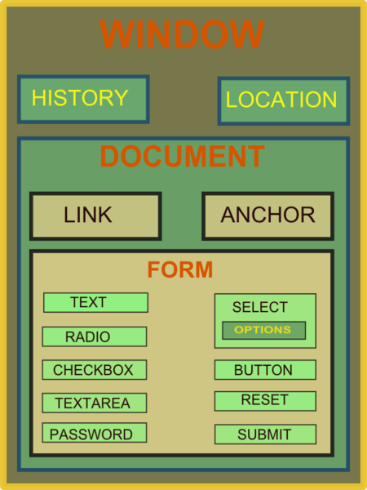
DOM
TKHTS
Techknow Heights

Slide 65
DOM
TKHTS
Techknow Heights
The Document Object Model is a platform- and language-neutral interface that will allow programs and scripts to dynamically access and update the content, structure and style of documents.
The document can be further processed and the results of that processing can be incorporated back into the presented page.
The Document Object Model is an API for HTML and XML documents. It provides a structural representation of the document, enabling the developer to modify its content and visual presentation. Essentially, it connects web pages to scripts or programming languages.
All of the properties, methods, and events available to the web developer for manipulating and creating web pages are organized into objects (e.g., the document object that represents the document itself, the table object that represents a HTML table element, and so forth). Those objects are accessible via scripting languages in most recent web browsers.
The DOM is a W3C (World Wide Web Consortium) standard.
Notes:
DOM Parsing Example
Object Oriented vs Functional Programming Example
Dynamic Language example
Loosly Typed example

Slide 66

DOM Nodes
TKHTS
Techknow Heights
In the HTML DOM, everything is a node. The DOM is HTML viewed as a node tree.
According to the W3C HTML DOM standard, everything in an HTML document is a node:
The entire document is a document node
Every HTML element is an element node
The text inside HTML elements are text nodes
Every HTML attribute is an attribute node
Comments are comment nodes
The following HTML code and the image shown alongside correspond to each other.
<!DOCTYPE html>
<html>
<head>
<title>My title</title>
</head>
<body>
<a href="">My link</a>
<h1>My header</h1>
</body>
</html>
Notes:
DOM Parsing Example
Object Oriented vs Functional Programming Example
Dynamic Language example
Loosly Typed example

Slide 67
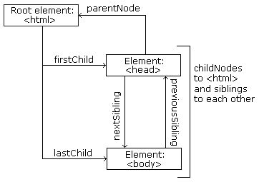
DOM
Parents, Children, Siblings
TKHTS
Techknow Heights
The nodes in the node tree have a hierarchical relationship to each other.
The terms parent, child, and sibling are used to describe the relationships. Parent nodes have children. Children on the same level are called siblings (brothers or sisters).
In a node tree, the top node is called the root
Every node has exactly one parent, except the root (which has no parent)
A node can have any number of children
Siblings are nodes with the same parent
The following image illustrates a part of the node tree and the relationship between the nodes
Notes:
DOM Parsing Example
Object Oriented vs Functional Programming Example
Dynamic Language example
Loosly Typed example

Slide 68
Quiz
TKHTS
Techknow Heights
Difference between
innerHTML and
innerTEXT
Notes:
DOM Parsing Example
Object Oriented vs Functional Programming Example
Dynamic Language example
Loosly Typed example

Slide 69
Navigator
TKHTS
Techknow Heights
The navigator object contains information about the browser
appCodeName
Returns the code name of the browser
appName
Returns the name of the browser
appVersion
Returns the version information of the browser
cookieEnabled
Determines whether cookies are enabled in the browser
Geolocation
Returns a Geolocation object that can be used to locate the user's position
Language
Returns the language of the browse
onLine
Determines whether the browser is online
Platform
Returns for which platform the browser is compiled
Product
Returns the engine name of the browser
javaEnabled()
Specifies whether or not the browser has Java enabled
Notes:
DOM Parsing Example
Object Oriented vs Functional Programming Example
Dynamic Language example
Loosly Typed example

Slide 70
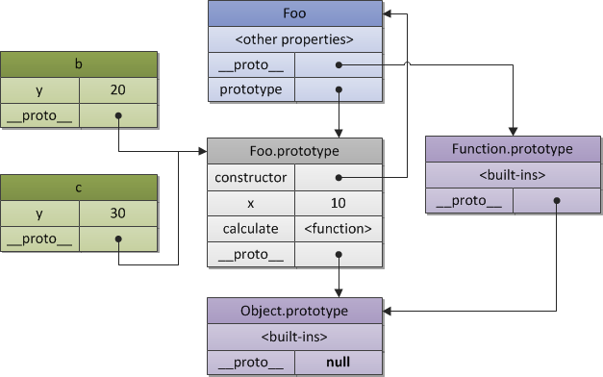
Prototype Object Layout
TKHTS
Techknow Heights

Slide 71
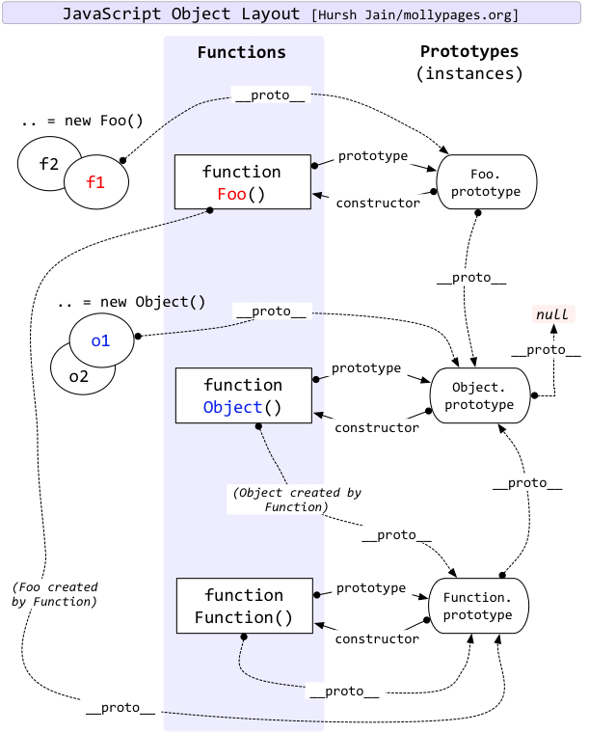
Prototype Object Layout
TKHTS
Techknow Heights

Slide 72
AJAX
TKHTS
Techknow Heights
Ajax
LocalStorage
WebWorker
Notes:
DOM Parsing Example
Object Oriented vs Functional Programming Example
Dynamic Language example
Loosly Typed example

Slide 73
TKHTS
Techknow Heights
Notes:
DOM Parsing Example
Object Oriented vs Functional Programming Example
Dynamic Language example
Loosly Typed example

Slide 74
JavaScript Function
TKHTS
Techknow Heights
Function is a block of code that will be executed when someone calls it
Define function by using
function keyword
A unique function name
List of parameters (might be empty) and
A statement block surrounded by { }
<script type="text/javascript">
function funcName(parameter/s)
{
//function code
}
funcName(arg);
</script>
Function
Function Calling

Slide 75
JavaScript Exception Handling
TKHTS
Techknow Heights
Exceptions can be handled with the common try/catch/finally block structure
try block must be followed by either one catch block or one finally block (or one of both)
<script type="text/javascript">
try {
//statements
} catch ( ev ) {
//catch code
} finally {
//code finally to be done
}
</script>

Slide 76
JavaScript Confirm & Alert
TKHTS
Techknow Heights
Alert
Used to show warnings or messages
Confirm
Used to take user input on any option
<script type="text/javascript">
var retVal = confirm("Do you want to continue ?");
if (retVal == true) {
var retVal = prompt("Enter your name-", ""); document.write(retVal);
return true;
} else {
alert("User does not want to continue!");
return false;
}
</script>
Breaks the code execution

Slide 77
JavaScript Page Redirection
TKHTS
Techknow Heights
Re-direction
Click a URL to reach to a page but you are witness to see another page
var browserName=navigator.appName;
if( browserName == "Netscape" )
{
window.location="http://www.location.com/ns.htm";
}
else if ( browserName =="Microsoft Internet Explorer")
{
window.location="http://www.location.com/ie.htm";
}
else
{
window.location="http://www.location.com/other.htm";
}

Slide 78
JavaScript Date Objects
TKHTS
Techknow Heights
Date objects are data type in Java Script
new Date( );
new Date(milliseconds) ;
new Date(datestring) ;
new Date(year,month,
date[,hour,minute,second,millisecond ]);

Slide 79
JavaScript Math Objects
TKHTS
Techknow Heights
Mathematical constants and functions
No any constructor
Math properies are static and can be called by using Math as an object without creating it
var pi = Math.PI;
var sinX = Math.sin(45);

Slide 80
Scopes & Closure - Detailed
TKHTS
Techknow Heights
Nested functions
a chain of LexicalEnvironments which can also be called a scope chain
var a = 1;
function f() {
function g() {
alert(a);
}
return g ;
}
var func = f();
func(); // 1
// LexicalEnvironment = window = {a:1, f: function}
var a = 1;
function f() {
// LexicalEnvironment = {g:function}
function g() {
// LexicalEnvironment = {}
alert(a);
}
return g ; }
Create a function sum that will work like that: sum(a)(b) = a+b
LexicalEnvironments form a chain from inside out
sum(11)(12) = 23
sum(15)(-11) = 4
Function g has access to g, a and f
Notes:
The idea is that sum should return a function which knows a and will take care about next argument.
function sum(a) {
return function(b) { // takes a from outer LexicalEnvironment
return a+b
}
}
alert( sum(1)(2) );
alert( sum(5)(-1) );

Slide 81
JavaScript RegExp
TKHTS
Techknow Heights
An object that describes a pattern of characters
Can be used to describe what you are searching for
Used to perform powerful pattern-matching and "search-and-replace" functions on text
var patt=new RegExp(pattern,modifiers); or var patt=/pattern/modifiers;

Slide 82
JavaScript RegExp
TKHTS
Techknow Heights
Pattern
A string that specifies the pattern of the regular expression or another regular expression
Modifier
An optional string containing any of the
"g” - global matches
"I” - case-insensitive matches
"m” - multiline matches

Slide 83
JavaScript RegExp
TKHTS
Techknow Heights
<script>
var str = "JavaScript is not Java";
var patt1 = /java/gi;
var result = str.match(patt1);
document.write=result;
</script>

Slide 84
AJAX
TKHTS
Techknow Heights

Slide 85
AJAX
TKHTS
Techknow Heights
AJAX
Asynchronous JavaScript and XML.
Not a new programming language, but a new way to use existing standards.
Without reloading the whole page, Art of
Exchanging data with a server
Updating parts of a web page

Slide 86
AJAX
TKHTS
Techknow Heights
Web pages without AJAX, must reload the entire page if the content is being changed
Examples of applications using AJAX:
Google Maps
Stock Market Sites
Sport Score Sites
Facebook

Slide 87
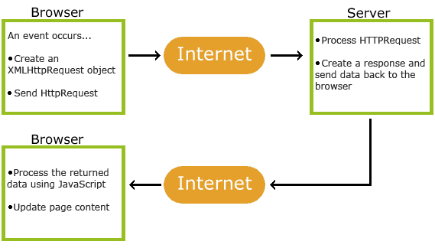
AJAX – How it works
TKHTS
Techknow Heights

Slide 88
AJAX – How it works
TKHTS
Techknow Heights
AJAX is Based on Internet Standards
Uses a combination of:
XMLHttpRequest object (to exchange data asynchronously with a server)
JavaScript/DOM to display/interact with data
AJAX applications
Browsers
Platform-independent

Slide 89
AJAX – Getting Started
TKHTS
Techknow Heights
<!DOCTYPE html> <html> <body> <h1>AJAX will change the text</h1> <button onclick=“callAjax()">Change Data</button> <div></div> </body> </html>
<script> function callAjax() { // code ... } </script>

Slide 90
AJAX – Getting Started
TKHTS
Techknow Heights
function callAjax() { var xmlhttp;
// code for IE7+, Firefox, Chrome, Opera, Safari
if (window.XMLHttpRequest)
{
xmlhttp = new XMLHttpRequest();
}
else
// code for IE6, IE5
{
xmlhttp = new ActiveXObject("Microsoft.XMLHTTP");
}
xmlhttp.onreadystatechange= function()
{
if (xmlhttp.readyState==4 && xmlhttp.status==200)
{
document.getElementsByTagName(“div")[0].innerHTML=xmlhttp.responseText;
}
}
xmlhttp.open("GET","ajax_info.txt",true);
xmlhttp.send();
}

Slide 91
AJAX – Request To a Server
TKHTS
Techknow Heights
use the open() and send() methods of the XMLHttpRequest object:
Type of request
URL
xmlhttp.open("GET",“url",true);
xmlhttp.send();
If the request should be asynchronous or not
Sends the request to the server

Slide 92
AJAX – Asynchronous
TKHTS
Techknow Heights
Asynchronous requests is a huge improvement for web developers
Many of the tasks performed on the server are very time consuming
JavaScript does not have to wait for the server response:
Execute other scripts while waiting for server response
Deal with the response when the response ready

Slide 93
AJAX – Response
TKHTS
Techknow Heights
responseText
get the response data as a string
responseXML
get the response data as XML data

Slide 94
AJAX – Event
TKHTS
Techknow Heights
When a request to a server is sent
The onreadystatechange event is triggered every time the readyState changes
The readyState property holds the status of the XMLHttpRequest
Three important properties of the XMLHttpRequest object:
Onreadystatechange
readyState
status

Slide 95
AJAX – Event
TKHTS
Techknow Heights

Slide 96
AJAX
TKHTS
Techknow Heights
Without jQuery, AJAX coding can be a bit tricky! Writing regular AJAX code can be a bit tricky, because different browsers have different syntax for AJAX implementation. This means that you will have to write extra code to test for different browsers. However, the jQuery team has taken care of this for us, so that we can write AJAX functionality with only one single line of code

Slide 97
AJAX –jQuery load()
TKHTS
Techknow Heights
Simple, but powerful AJAX method.
Loads data from a server and puts the returned data into the selected element

Slide 98
AJAX –jQuery load()
TKHTS
Techknow Heights
<script>
$(document).ready(function(){
$("button").click(function(){
$(“div").load(“data.txt");
});
});
</script>

Slide 99
AJAX –jQuery get
TKHTS
Techknow Heights
The $.get() method requests data from the server with an HTTP GET request
$.get(URL, data, callback);
$("button").click(function(){ $.get(“servlet",{
userid : “tkhts”,
pwd : “tkhts.com”
} ).success(function(result){
$('div').html(result);
$('form').hide(2500);
}); });

Slide 100
JavaScript vs Java
TKHTS
Techknow Heights
JavaScript is interpreted while Java is compiled
But server-side JavaScript is compiled
JavaScript is object-based while Java is object-oriented
Object-based languages can utilize pre-defined objects, but you are limited in terms of creating your own objects

Slide 101
JavaScript vs Java
TKHTS
Techknow Heights
JavaScript has loose data typing, while Java has strong data typing
Loose data typing means that a variable can hold any kind of data
JavaScript code is embedded in an HTML document while Java applets are stand-alone applications that can be accessed from HTML

Slide 102
JavaScript vs Java
TKHTS
Techknow Heights
JavaScript has dynamic binding, while Java has static binding
Names bound at runtime
JavaScript can access browser objects and functionality, while Java cannot

Slide 103
Expressive JavaScript
TKHTS
Techknow Heights
Flexibility of JavaScript
Loosely Typed Language
Functions as First-Class Objects
Object Mutability

Slide 104
Loosely Type Language
TKHTS
Techknow Heights
Do not declare a type when defining a variable
Different types depending on data it contains
Three primitive types:
Booleans, Numbers, and Strings
Treats float and integer as same
Functions contain executable code
Objects are composite data types
Null and Undefined datatypes
Primitive datatypes are passed by value
Other datatypes are passed by reference
Notes:
Typeof to check data defined in variables
Null and undefined difference
Passed by value and passed by reference

Slide 105
Loosely Type Language
TKHTS
Techknow Heights
Primitive data types can also be cast from one type to another
toString, parseFloat, parseInt
Double negation casts a string or a number to a boolean
var bool = !!num;
Loosely typed variables provide a great deal of flexibility as JavaScript converts type itself.
Notes:
Cast examples toString, parseFloat, parseInt
Double negation example

Slide 106
Functions as First-Class Objects
TKHTS
Techknow Heights
Can be stored in variables, passed
Into other functions as arguments
out of functions as return values, and constructed at run-time
Provide a great deal of flexibility and expressiveness when dealing with functions
Create anonymous functions
Create functions using the function(){ ... } syntax
Without name, but they can be assigned to variables
Notes:
Anonymous Function example

Slide 107
Mutability of Object
TKHTS
Techknow Heights
Everything is an object
Except for the three primitive datatypes
All objects are mutable
Modify classes
After they have been defined
Objects after they have been instantiated
Reflection
Examine any object at run-time to see what attributes and methods it contains

Slide 108
Invocation Patterns
TKHTS
Techknow Heights
Invoking a function suspends the current execution and passes control & parameters to other function
Two additional parameters: this and arguments
No runtime error with mismatch number of arguments and the number of parameters
Notes:
Explain function literal (four parts)

Slide 109
Invocation Patterns
TKHTS
Techknow Heights
Method Invocation Pattern
‘this’ is bound to object with invocation of method
Function Invocation Pattern
Function is not the property of object
‘this’ is bound to the global object
Inner function do not share the access

Slide 110
Invocation Patterns
TKHTS
Techknow Heights
Constructor Invocation Pattern
Functions intended to be used with the new prefix are called constructors
Apply Invocation Pattern
Apply method lets us construct an array of arguments to use to invoke a function
It also lets us choose the value of this

Slide 111
Arguments
TKHTS
Techknow Heights
Arguments array
Function gets access to all of the arguments that were supplied
Because of a design error, arguments is not really an array but array-like object
Arguments have a length property but lacks all of the array methods

Slide 112
Return
TKHTS
Techknow Heights
Return
The return statement can be used to return early without executing the remaining statements
Function always returns a value. If the return value is not specified, then undefined is returned
If function was invoked with the new prefix and the return value is not an object, then this (the new object) is returned instead

Slide 113
Exception
TKHTS
Techknow Heights
Exceptions are unusual mishaps that interfere normal flow of a program
When mishap is detected program should throw an exception
The throw statement interrupts execution of the function
Exception object contains a name (type of the exception) and a message
If an exception is thrown within a try block, control will go to its catch clause
Other properties can be added

Slide 114
Exception
TKHTS
Techknow Heights
Are there built-in exception types (like NullPointerException)?
ECMAScript defines some standard error classes: Error and its subtypes EvalError, RangeError, ReferenceError, SyntaxError, TypeError, URIError.
HIowever there are browser implementation issues
try { nonexistentvar; }
// gives TypeError under IE instead of ReferenceError.

Slide 115
Scope
TKHTS
Techknow Heights
Scope controls the visibility and lifetimes of variables and parameters
Reduces naming collisions and provides automatic memory management
JavaScript does not have block scope even though its block syntax suggests that it does
This confusion can be a source of errors
JavaScript does have function scope
Parameters and variables defined in a function are not visible outside of the function

Slide 116
Scope
TKHTS
Techknow Heights
Scope is the environment that the function executes in
Default scope for executing functions is Window object
Browser level object that represents the page window or tab these days
Always runtime
This means that the scope of a function is always the context in which it executes, not the context in which it was defined
Notes:
Show 01 Creation

Slide 117
Augmenting Types
TKHTS
Techknow Heights
JavaScript allows the basic types of the language to be augmented
Adding a method to Object.prototype makes that method available to all objects.
Works for functions, arrays, strings, numbers, regular expressions,and booleans.
Number.method('integer', function ( ) {
return Math[this < 0 ? 'ceiling' : 'floor'](this);
});
Notes:
Example Static and Instance Method
Number.method('integer', function ( ) {
return Math[this < 0 ? 'ceiling' : 'floor'](this);
});

Slide 118
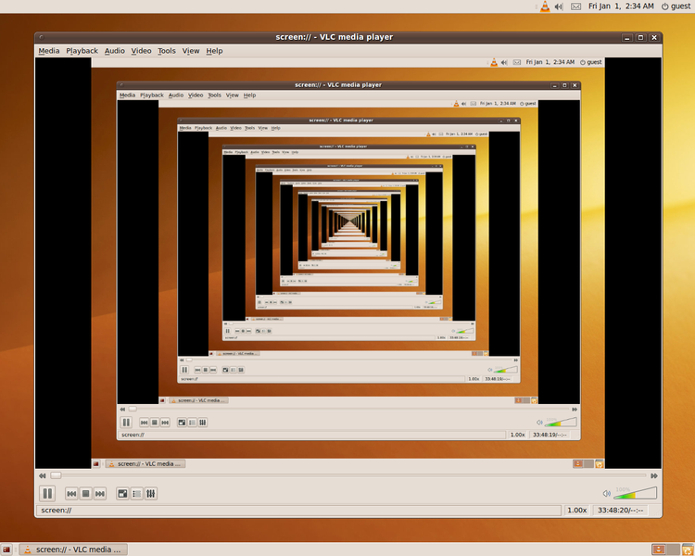
Recursion
TKHTS
Techknow Heights

Slide 119
Closure
TKHTS
Techknow Heights
Closures are functions that refer to independent variables
Function defined in the closure 'remembers' the environment in which it was created in

Slide 120
Closure
TKHTS
Techknow Heights
Closures are especially useful in AJAX code
More often than not, you'll find yourself passing a function to the AJAX library to run after a particular server call is finished
Closures are a great way to use
If you need function to have access to any special data that you don't want to give the library

Slide 121
Closure – Use Cases
TKHTS
Techknow Heights
Event handlers in a loop
for (var i = 0; i < 10; i++) {
document.getElementById('box' + i).onclick = function() {
alert('You clicked on box #' + i);
};
}
for (var i = 0; i < 10; i++) {
document.getElementById('box' + i).onclick = (function(index){
return function() {
alert('You clicked on box #' + index);
};
})(i);
}

Slide 122
Closure – Use Cases
TKHTS
Techknow Heights
Private Variables and Giving a Unique ID
var getUniqueId = (function(){
var id = 0;
return function(element) {
if (!element.id) {
element.id = 'generated-uid-' + id++;
}
return element.id;
};
})();

Slide 123
Callback
TKHTS
Techknow Heights
A callback function is a function that is passed to another function as parameter
Callback function is called inside other Function
A callback function is essentially a pattern
Use of a callback function is also known as a callback pattern
document.getElementById(“id”).onclick(function() { alert("Btn 1 Clicked"); });

Slide 124
Curry
TKHTS
Techknow Heights
Currying is a useful technique
Partially evaluate functions
Currying is a technique mostly known from functional programming languages
In theory it is a little bit more complicated
The practical realization of currying is quite simple
It is a transformation process which takes a function with multiple arguments as input and outputs a new function providing same behavior but lesser arguments

Slide 125
Curry
TKHTS
Techknow Heights
JavaScript does not have a curry method, but we can fix that by augmenting Function.prototype
The curry function does not exist in native JavaScript.
Curry method works by creating a closure that holds that original function and the arguments to curry

Slide 126
Memoization
TKHTS
Techknow Heights
Functions can use objects to remember the results of previous operations
Making possible to avoid unnecessary work
JavaScript’s objects and arrays are very convenient for this

Slide 127
Object, Functions, Scope Revisited
TKHTS
Techknow Heights
Creating Object
Accessing Data
Function as objects
Using this
More Details Scope and resolution at runtime
Prototype & Closure

Slide 128
Prototype
TKHTS
Techknow Heights
Most ‘Object Oriented' languages today use class based inheritance
JavaScript uses prototypes
There is no class construct here still very powerful language

Slide 129
Inheritance in JavaScript
TKHTS
Techknow Heights
In most languages, there are classes and objects. Classes inherit from other classes
In JavaScript, the inheritance is prototype-based.
There are no classes.
An object inherits from another object

Slide 130
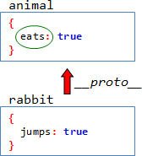
Prototypal Inheritance
TKHTS
Techknow Heights
If the property is found in rabbit, then __proto__ is not checked

Slide 131
Prototypal Inheritance
TKHTS
Techknow Heights
Reading looks up, writing doesn't
When a property is read, like this.prop, the interpreter looks it in the prototype.
When a property is assigned
like this.prop = value
Then there is no reason to search
Property is written directly into the object
Same with delete obj.prop
It only deletes the property on object itself, and leave it intact if it is in the prototype

Slide 132
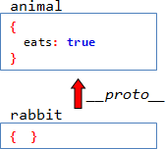
Object.create, Object.getProtorypeOf
TKHTS
Techknow Heights
Once the rabbit is created, we can add properties to it

Slide 133
The Prototype
TKHTS
Techknow Heights
There is a good and crossbrowser way of setting __proto__
The code
Rabbit.prototype = animal
literally means the following: ”set __proto__ = animal for all objects created by new Rabbit”

Slide 134
The Prototype
TKHTS
Techknow Heights
What is the result of the code? Why?
function Rabbit(name) {
this.name = name
}
var john = new Rabbit('John')
var animal = { eats: true }
Rabbit.prototype = animal
alert(john.eats)
Changing the prototype has no effect on already-created objects
Output:

Slide 135
Initialization of Function & Variables - Detailed
TKHTS
Techknow Heights
Function Declarations become ready-to-use functions
Call a function before declaration
Variables start as undefined
All assignments happen later, when the execution reaches them
Notes:
In JavaScript, all local variables and functions are properties of the special internal object, calledLexicalEnvironment.

Slide 136
Scopes & Closure - Detailed
TKHTS
Techknow Heights
Nested functions
a chain of LexicalEnvironments which can also be called a scope chain
var a = 1;
function f() {
function g() {
alert(a);
}
return g ;
}
var func = f();
func(); // 1
// LexicalEnvironment = window = {a:1, f: function}
var a = 1;
function f() {
// LexicalEnvironment = {g:function}
function g() {
// LexicalEnvironment = {}
alert(a);
}
return g ; }
Create a function sum that will work like that: sum(a)(b) = a+b
LexicalEnvironments form a chain from inside out
sum(11)(12) = 23
sum(15)(-11) = 4
Function g has access to g, a and f
Notes:
The idea is that sum should return a function which knows a and will take care about next argument.
function sum(a) {
return function(b) { // takes a from outer LexicalEnvironment
return a+b
}
}
alert( sum(1)(2) );
alert( sum(5)(-1) );

Slide 137


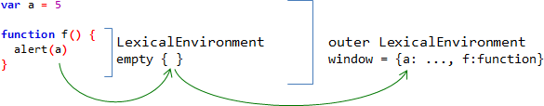
Scopes & Closure - Detailed
TKHTS
Techknow Heights
When function f is created, it is not created in an empty space. There is a current LexicalEnvironment object
When a function is created, it gets a hidden property, named [[Scope]], which references current LexicalEnvironment
when the function runs, it creates it’s own LexicalEnvironment and links it with [[Scope]]
Notes:
when a variable is not found in the local LexicalEnvironment, it is searched outside

Slide 138
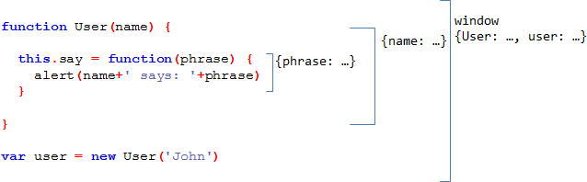
Scopes & Closure - Detailed
TKHTS
Techknow Heights
Nested function may continue to live after the outer function has finished
When this.say is created, it gets an internal reference this.say.[[Scope]] to current LexicalEnvironment. So, the LexicalEnvironment of the current User execution stays in memory
function User(name) {
this.say = function(phrase) {
alert(name + ' says: ' + phrase)
}}
var user = new User('John‘)
Not related to scopes and variables

Slide 139
Scopes & Closure - Detailed
TKHTS
Techknow Heights
function makeArmy() {
var shooters = [] ;
for(var i=0; i<10; i++) {
var shooter = function() // a shooter is a function
{
alert(i) // which should alert it's number
}
shooters.push(shooter) ;
}
return shooters;
}
Why all shooters alert the same? How to make each shooter output it’s number?
Notes:
var army = makeArmy();
var shooter = army[0] // first shooter
shooter() // alerts 10, should be 0
shooter = army[5] // 5th shooter
shooter() // alerts 10, should be 5
// all shooters alert same: 10 instead of 1,2,3...10.

Slide 140
Scopes & Closure - Detailed
TKHTS
Techknow Heights
var shooter = function(i) {
return function() {
alert( i );
} shooters.push(shooter);
}(i);
Actual shooting function is created as the result of an anonymous function(i) created and executed in one place. So, when it comes to executing alert(i), it will be taken from LexicalEnvironment of the anonymous function the anonymous function traps current i into it’s LexicalEnvironment and allows the shooter to access it. The last way is to wrap the whole loop into temporary function. Sometimes that’s more readable
Notes:
The (function(i) { ... }) definition is wrapped into brackets to make sure the interpreter treats that as expression

Slide 141
Scopes & Closure - Detailed
TKHTS
Techknow Heights
Closure
Inner function keeps a reference to outer LexicalEnvironment
Inner function may access variables from it any time even if the outer function is finished
Browser keeps the LexicalEnvironment and its properties in memory
Until there is an inner function which references it
Variable has their scope after the loops as well

Slide 142
Function.prototype Vs Object.prototype
TKHTS
Techknow Heights
Extending Object
By augmenting Function.prototype, we can make a method available to all functions:

Slide 143
Prototype Object Layout
TKHTS
Techknow Heights

Slide 144
Prototype Object Layout
TKHTS
Techknow Heights

Slide 145
JavaScript Gotchas
TKHTS
Techknow Heights
Double-equals - performs a comparison with type coercion
“1” == 1 //true
Number(“1”) === 1 //true
double-equals frequently breaks the transitivity rule, due to type-coercing behavior
Number(“1”) === 1 //true

Slide 146
JavaScript Gotchas
TKHTS
Techknow Heights
parseInt doesn't assume base-10 – if you omit second parameter, base will determine by following rules
By default, assume a radix 10.
If the number begins with 0x then assume radix 16.
If the number begins with 0 then assume radix 8.
parseInt("8"); //8
parseInt("08"); //0 begins with a 0, Radix 8 (octal) is then used
parseInt("8", 10); //8 second parameter included
parseInt("08", 10); //8 second parameter included

Slide 147
JavaScript Gotchas
TKHTS
Techknow Heights
String replace – only replace the first match
"bob".replace("b", "x"); // "xob"
"bob".replace(/b/, "x"); // "xob" (regular expression version)
To replace all matches, you must use a Regular Expression
"bob".replace(/b/g, "x"); // "xox"
"bob".replace(new RegExp("b","g"), "x"); // "xox“ (alternate explicit RegExp)
It ensures that the replacement does not stop after the first match

Slide 148
JavaScript Gotchas
TKHTS
Techknow Heights
The "+" Operator Both Adds and Concatenates
JavaScript doesn’t operator for string concatenation - so "a + b" always results in concatenation when either of the operands is a string
1 + document.getElementById("inputElem").value; // Concatenates
1 + Number(document.getElementById("inputElem").value); // Adds
subtract operator attempts to convert the operands to Number
"3" - "1"; // 2
3 + ""; // "3“ convert number to string by concatenating with empty string
It’s not very nice, so use String(3) instead.

Slide 149
JavaScript Gotchas
TKHTS
Techknow Heights
typeof - returns the type of an instance of a fundamental type (typeof anArray object is Object)
typeof {} === "object" //true
typeof "" === "string" //true
typeof [] === "array"; //false
You will get the same result (typeof = "object") when you use this operator against instances of your own objects
"typeof null" yields "object", which is a bit weird

Slide 150
JavaScript Gotchas
TKHTS
Techknow Heights
instanceof - returns whether the object was constructed using the specified constructor
"hello" instanceof String; //false
new String("hello") instanceof String; //true
Since Array isn't really one of the built-in types ( hence typeof doesn't work as expected ), instanceof does work as expected:
["item1", "item2"] instanceof Array; //true
new Array("item1", "item2") instanceof Array; //true
var args = Array.prototype.slice.call(arguments, 0); // "arguments", // which gives an array of arguments passed to the function

Slide 151
JavaScript Gotchas
TKHTS
Techknow Heights
Math.min and Math.max - give you the max or min of the arguments
Math.max(); // -Infinity (without any arguments)
Math.min(); // Infinity (without any arguments)
It does make sense really, since Math.max() is returning the largest of an empty list of numbers. But if you're doing that, you're probably after Number.MAX_VALUE or Number.MIN_VALUE.

Slide 152
JavaScript Gotchas
TKHTS
Techknow Heights
Types and Constructors - JavaScript has the types Object, Array, Boolean, Number, String, and Function
Explicit (bad) | Literal (good)
var a = new Object(); a.greet = "hello"; | var a = { greet: "hello" };
var b = new Boolean(true); | var b = true;
var c = new Array("one", "two"); | var c = ["one", "two"];
var d = new String("hello"); | var d = "hello"
var e = new Function("greeting", "alert(greeting);"); | var e = function(greeting) { alert(greeting); };

Slide 153
JavaScript Gotchas
TKHTS
Techknow Heights
Number using the new keyword will be of type Object;
typeof new Number(123); // "object“
typeof Number(123); // "number”
typeof 123; // "number"

Slide 154
JavaScript Gotchas
TKHTS
Techknow Heights
Constructing Anything Else Without the 'new' Keyword -
var Car = function(colour) {
this.colour = colour;
};
var aCar = new Car("blue");
console.log(aCar.colour); // "blue“
var bCar = Car("blue");
console.log(bCar.colour); // error
console.log(window.colour); //"blue"

Slide 155
JavaScript Gotchas
TKHTS
Techknow Heights
There is no Integer - numerical calculations are comparatively slow because there is no Integer type
0.1 + 0.2 === 0.3 //false
0.0 === 0; //true
there's no distinction between integers and floats, unlike C# or Java, this is true
Contd..

Slide 156
JavaScript Gotchas
TKHTS
Techknow Heights
var a = 0 * 1; // This simple sum gives 0
var b = 0 * -1; // This simple sum gives -0 (you could also just
// do "b = -0" but why would you do that?)
a === b; //true: 0 equals -0
1/a === 1/b; //false: Infinity does not equal -Infinity
specification of Number allows for both positive and negative zero values. Positive zero equals negative zero, but positive infinity does not equal negative infinity

Slide 157
JavaScript Gotchas
TKHTS
Techknow Heights
Scope
No Block Scope - there is no concept of block scoping, only functional scoping
for(var i=0; i<10; i++) {
console.log(i);
}
var i; console.log(i); // 10
possible to create a scope by writing an immediately-executing function
(function (){
for(var j=0; j<10; j++) {
console.log(j);
}
}());
var j; console.log(j); // undefined

Slide 158
JavaScript Gotchas
TKHTS
Techknow Heights
Using VAR
var x = 3;
(function (){
console.log(x + 2); // 5
x = 0; //No var declaration
}());
if you re-declare x as a var in the inner function, there is strange behaviour
var x = 3;
(function (){
console.log(x + 2); //NaN - x is not defined
var x = 0; //var declaration
}());

Slide 159
JavaScript Gotchas
TKHTS
Techknow Heights
'this' and Inner Functions
var obj = {
doSomething: function () {
var a = "bob";
console.log(this); // obj
(function () {
console.log(this); // window - "this" is reset console.log(a); // "bob" - still in scope
}());
}
};
obj.doSomething();

Slide 160
JavaScript Gotchas
TKHTS
Techknow Heights
The Absence of data: 'null' and 'undefined’
var a;
a === null; //false
a === undefined; //true
'a' is in fact undefined
If you want to check that a variable actually has a value, and also follow the rule of never using double-equals, you need to do the following
if(a !== null && a !== undefined)
{ ... }

Slide 161
JavaScript Gotchas
TKHTS
Techknow Heights
Redefining Undefined - you can redefine undefined, as it isn't a reserved word
undefined = "surprise!";
you can get it back by assigning an undefined variable or using the "void" operator

Slide 162
JavaScript Gotchas
TKHTS
Techknow Heights
Optional Semicolons - Semicolons are optional so that it's easier for beginners to write
return
{
a: "hello“
};
NaN - The type of NaN (Not a Number) is... Number
typeof NaN === "number" //true
NaN compared to anything is false
NaN === NaN; // false
you can't do a NaN comparison, the only way to test whether a number is equal to NaN is with the helper function isNaN

Slide 163
JavaScript Gotchas
TKHTS
Techknow Heights
The 'arguments' Object - you can reference the arguments object to retrieve the list of arguments, within a function
(function(){
console.log(arguments instanceof Array); // false
var argsArray = Array.prototype.slice.call(arguments); console.log(argsArray instanceof Array); // true
}());
(function(a){
alert(arguments[0]); //1
a = 2; alert(arguments[0]); //2
}(1));

