Slide 1
agenda

Slide 2
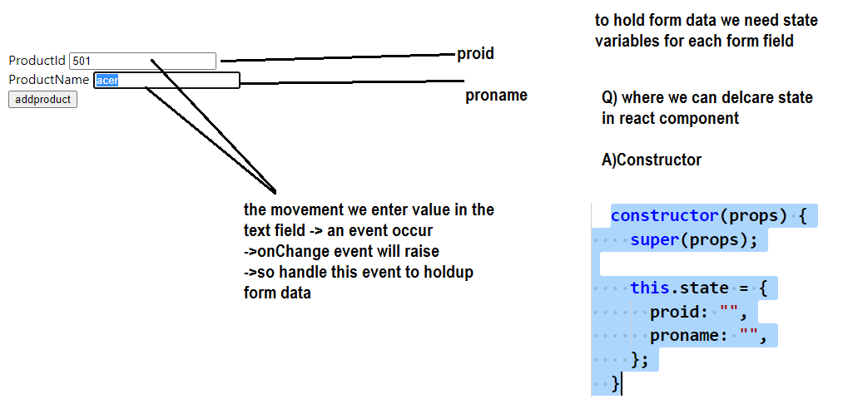
plan the state to bind form data

Slide 3
bind form data to state throgh onChange event

Slide 4
send form data to api through onsubmit event

