Slide 1

Research Progress Overview
Agromet Service For IMD
Arun M
23122110
Mission
Christ University is a nurturing ground for an individual’s holistic development to make effective contribution to the society in a dynamic environment
Vision
Excellence and Service
Core Values
Faith in God | Moral Uprightness
Love of Fellow Beings | Social Responsibility | Pursuit of Excellence

Slide 2
CHRIST
(Deemed to be University)
Introduction
Our project, Automating Farmer-Friendly Weather Advisories Using Machine Learning and Large Language Models, aims to address key challenges faced by the Indian Meteorological Department (IMD) in generating weather advisories for farmers. Currently, the process is manual, time-consuming, and often results in technical language that is difficult for farmers to comprehend. Additionally, the advisories lack sufficient region-specific insights, limiting their effectiveness. To overcome these issues, we are leveraging Machine Learning (ML) to automate and enhance accuracy while employing Large Language Models (LLMs) to simplify the language, ensuring the advisories are precise, actionable, and easily understandable for farmers.
Excellence and Service

Slide 3
CHRIST
(Deemed to be University)
Problem Statement
The Indian Meteorological Department's manual process for generating weather advisories is time-consuming and often too technical for farmers to understand. Additionally, the lack of regional specificity reduces the relevance of these advisories, limiting their effectiveness in supporting informed agricultural decisions. An automated, farmer-friendly system is needed to deliver accurate and region-specific weather insights.
Excellence and Service

Slide 4
CHRIST
(Deemed to be University)
Proposed Solution
We propose developing an automated system that generates region-specific, farmer-friendly weather advisories. By integrating real-time weather data with advanced analytics and natural language processing, the system will simplify technical information into actionable insights tailored for farmers. This solution will enhance accessibility, improve decision-making, and ensure timely delivery of weather updates to support agricultural practices effectively.
Excellence and Service

Slide 5
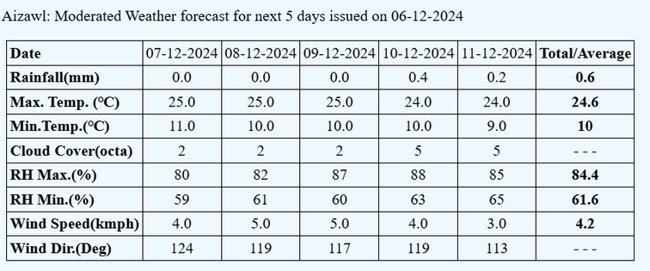
CHRIST
(Deemed to be University)
Christ University
Dataset
Total 300 datasets collected with their manually written summaries.
Excellence and Service
Excellence and Service

Slide 6
CHRIST
(Deemed to be University)
Christ University
Methodologies
Manual Weather Summaries
Our study examines the traditional approach of manually creating weather summaries, simulating how people might generate these without any technological assistance.
Technological Weather Summaries
We also explore the use of advanced technology to automatically generate weather summaries, allowing us to compare the simplicity and accuracy of traditional methods with modern tools.
Excellence and Service
Excellence and Service

Slide 7
CHRIST
(Deemed to be University)
Christ University
Model’s Used
Tools Used:
BART-large-CNN
GPT-2
SkyNarrator, developed as part of this research, builds upon the Gemini LLM
Excellence and Service
Excellence and Service

Slide 8
CHRIST
(Deemed to be University)
Christ University
Results
Data Summarization
PDF Creation
Tabular Data Format
English Summary
Regional-Based Summary
Proper Structure
Excellence and Service
Excellence and Service

Slide 9
CHRIST
(Deemed to be University)
Christ University
Challenges
Inconsistent and incomplete weather data.
Limited access to hyperlocal datasets.
Complexity in developing accurate predictive algorithms.
Real-time data processing and latency issues.
Accessibility for farmers with varying literacy levels.
Digital divide in rural areas.
Scalability and reliability in low-connectivity regions
Excellence and Service
Excellence and Service

Slide 10
CHRIST
(Deemed to be University)
Christ University
Conclusion
Our project focuses on developing an advanced weather prediction system that leverages machine learning models to provide accurate forecasts. By addressing the challenges faced by the IMD, including limited data processing capabilities and unpredictable weather patterns, the system aims to deliver reliable, real-time weather predictions. Through the use of innovative methodologies, datasets, and models, this project contributes to better decision-making for farmers and industries. The continuous enhancement of the system and future developments will further strengthen its ability to manage climate risks and optimize resource usage.
Excellence and Service
Excellence and Service

