Slide 1

Sales Analysis Dashboard & Data Storytelling
Task 4 – Data Analyst Internship | Prepared by: Arunraj V
POWER BI
EXCEL
PYTHON
GOOGLE COLAB

Slide 2
Project Overview
Transforming raw Superstore sales data into actionable business insights through visualization, storytelling, and interactive dashboarding.
Goals
Dataset: Superstore Sales
Understand business performance using sales data
Identify top-performing categories and regions
Analyze sales trends over time
Build an interactive Power BI dashboard
Present insights through data storytelling
Orders
Customers
Order dates, IDs & revenue
Segments & demographics
Products
Regions
Categories & sub-categories
Geographic sales data

Slide 3

Data Preparation Process
Before any analysis, the raw dataset was rigorously cleaned and structured to ensure accuracy and reliability in all downstream reporting.
01
02
03
Check Missing Values
Remove Duplicates
Format Dates
Identified and handled null entries across all fields
Eliminated redundant records to maintain data integrity
Converted date columns to proper datetime format using Pandas
04
05
Feature Engineering
Standardize Data
Created derived columns for time-based and categorical analysis
Ensured consistent formatting across all text and numeric fields
Outcome: A clean, analysis-ready dataset was generated in Google Colab and exported for Power BI dashboard development.

Slide 4
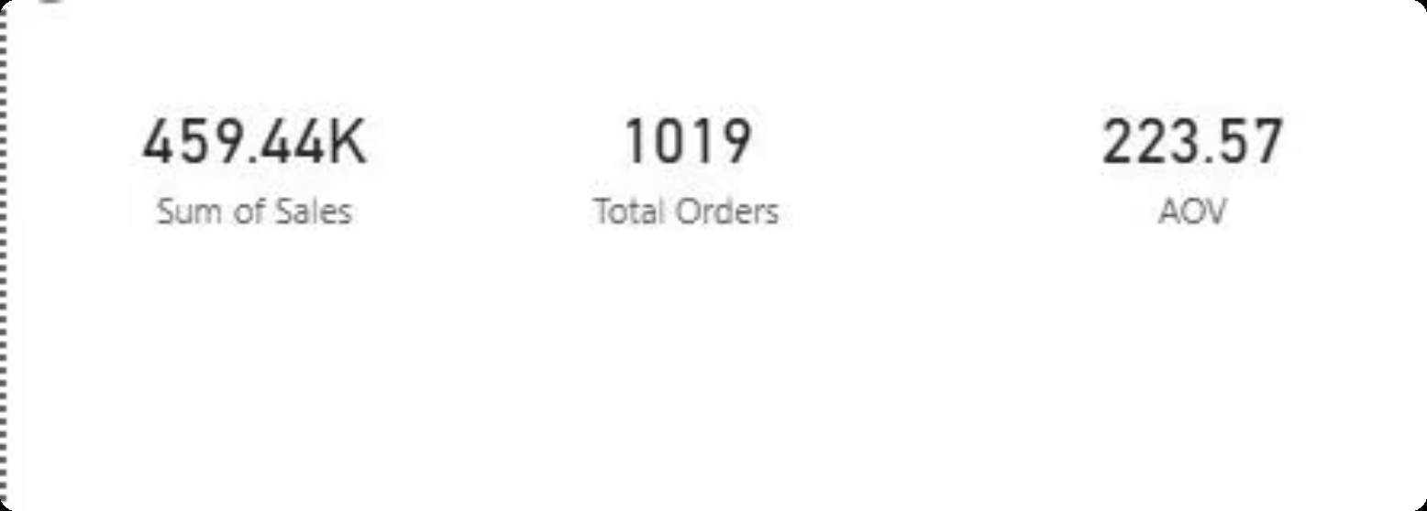
Key Performance Indicators
Three core KPIs frame the business performance picture — measuring scale, volume, and transaction quality.
2.26M
9800+
$230
Total Sales
Total Orders
Avg. Order Value
Total revenue generated across all orders and regions
Customer orders analyzed in the Superstore dataset
Average revenue generated per individual customer order
Why KPIs Matter
These metrics serve as the foundation for evaluating business health — tracking growth trajectories, understanding customer purchasing behavior, and benchmarking revenue performance over time.

Slide 5
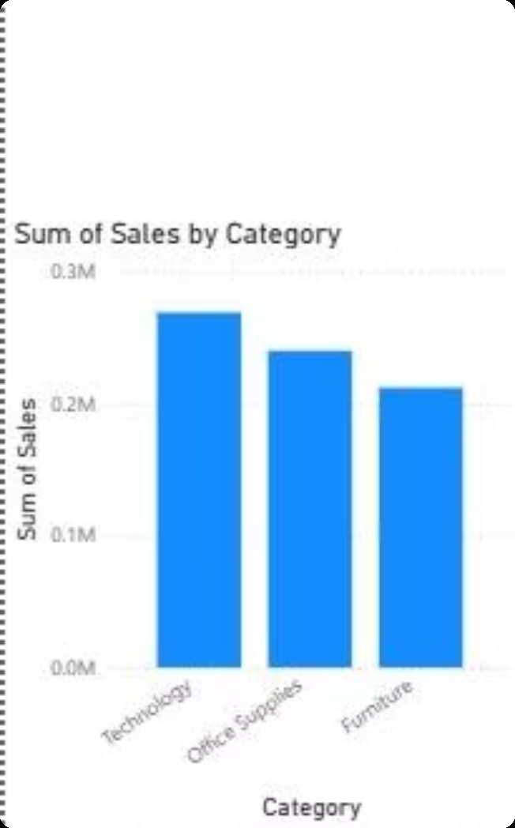

Sales by Category
Key Findings
Technology generated the highest total sales — the clear revenue leader
Office Supplies contributed stable, consistent volume across periods
Furniture showed moderate performance with room for improvement
Business Impact
High demand for technology signals a strong growth opportunity
Targeted promotions in Technology can amplify ROI
Office Supplies' consistency makes it a reliable revenue pillar
Technology products are the primary revenue drivers and the most promising category for strategic investment.

Slide 6
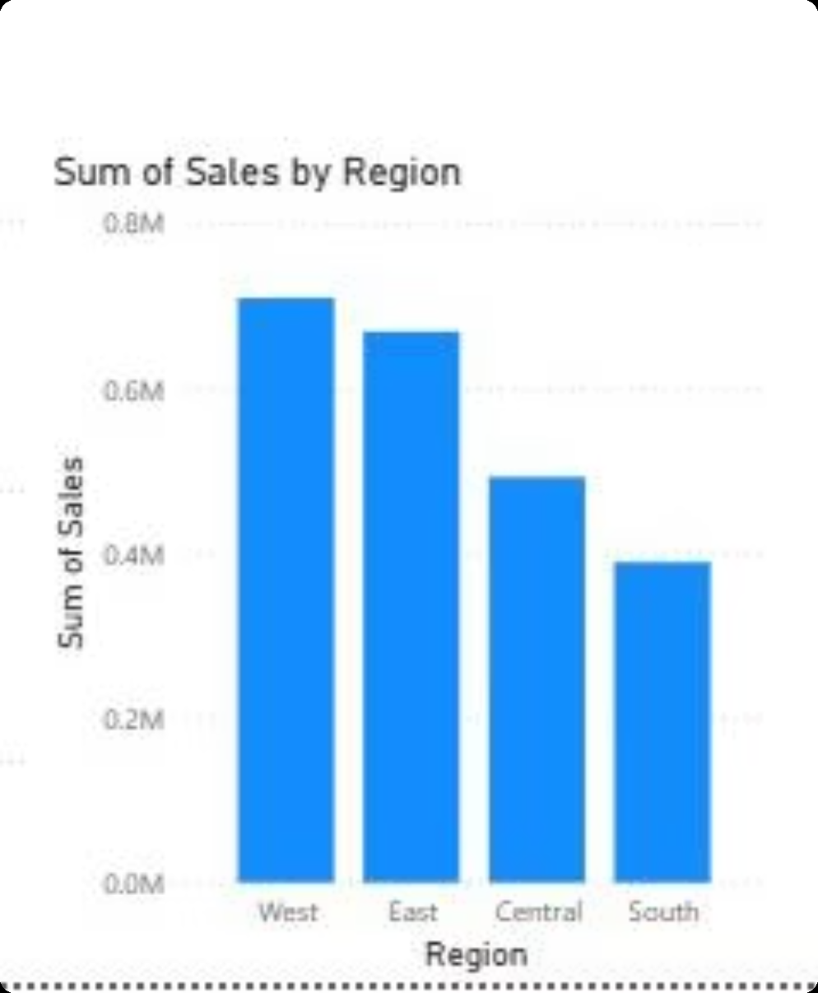
Sales by Region
Regional Breakdown
West contributed the highest regional sales — the top-performing market
East demonstrated strong performance as a close second
Central and South regions generated comparatively lower revenue
Strategic Recommendations
Replicate West region's winning strategies in underperforming markets
Invest in targeted marketing campaigns in Central and South
Use regional slicers in Power BI for granular performance monitoring

Slide 7
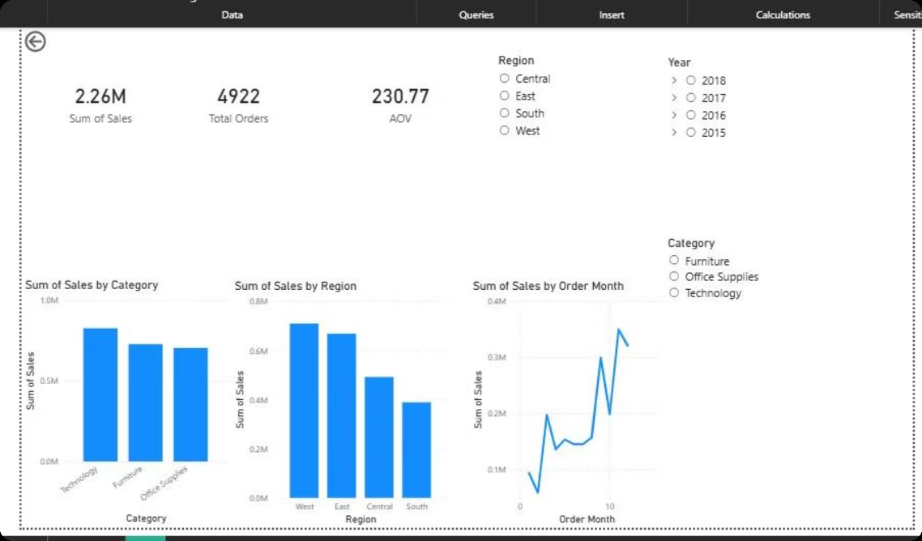
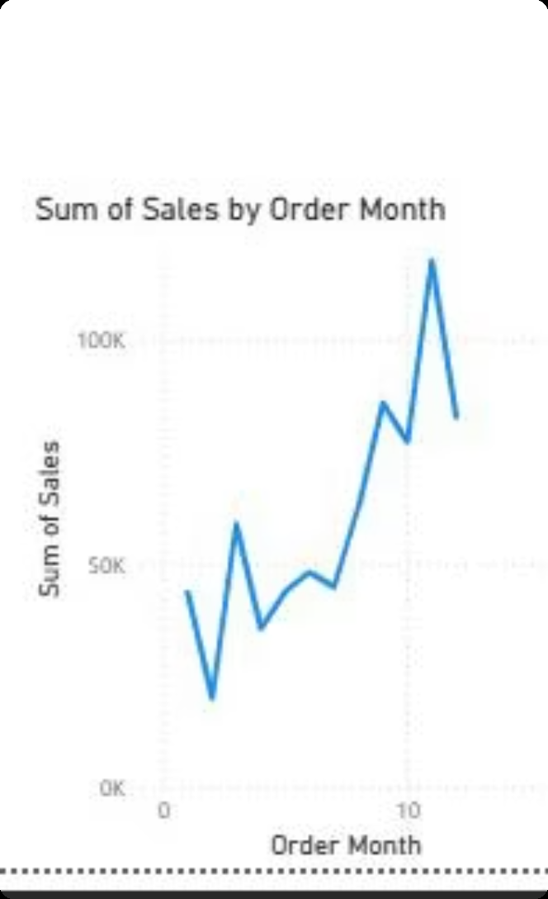
Monthly Sales Trend & Power BI Dashboard
Trend Observations
Monthly sales show a consistent upward trajectory over the analysis period
Notable seasonal spikes observed in later months — likely holiday-driven demand
Customer engagement and purchase frequency improved steadily over time
Power BI Dashboard Features
KPI cards, category chart, regional chart, and trend line
Interactive slicers for Region, Category, and Year
Enables real-time filtering for faster business decisions

Slide 8

Statistical Validation & Data Story
Hypothesis Tested
The Business Data Story
H0: No significant difference in sales among product categories.
Total sales reached ~$2.26M, reflecting strong overall business health
Technology products emerged as the undisputed top-performing category
The West region generated the highest geographic revenue
Monthly trends confirm steady, sustained growth with seasonal acceleration
H1: Technology category generates significantly higher sales.
Method: Comparative analysis using category-wise sales aggregation in Python.
Result: H1 supported — Technology recorded the highest total sales by a clear margin.
Together, these findings paint a clear picture: the business is on a strong growth trajectory, with well-defined opportunities for further expansion in underserved regions and product lines.

Slide 9


Recommendations & Future Scope
Strategic Recommendations
Future Scope
Double Down on Technology
Customer Segmentation
Expand product range, allocate higher marketing spend, and prioritize inventory for the top revenue category
RFM analysis to identify high-value customer groups
Revitalize Underperforming Regions
Profit Analysis
Deploy targeted campaigns in Central and South regions, replicating West's successful strategies
Extend beyond revenue to include margin and cost data
Leverage the Dashboard
Predictive Forecasting
Use Power BI's interactive slicers for ongoing monitoring and faster, data-driven planning decisions
Time-series models to project future sales performance
ML Models
Advanced classification for churn and demand prediction

Slide 10
Learning Outcomes & Thank You
This project delivered hands-on experience in every stage of a real-world business analytics workflow — from raw data to executive-ready insights.
Data Cleaning
EDA
Dashboard Dev
Preprocessing & feature engineering with Python & Pandas
Exploratory analysis to uncover patterns and outliers
Interactive Power BI dashboard with slicers and KPI cards
Data Storytelling
Hypothesis Testing
Translating data findings into clear business narratives
Statistical validation of category performance claims
Thank you for reviewing this project. — Arunraj V | Data Analyst Internship, Task 4

