Slide 1
Movie Book Library
Full Stack Web Application — React + Node.js + Express + MongoDB Atlas
Internship submission — Naviotech Solution Pvt Ltd
Live: https://movie-book-library-1.onrender.com (API: https://movie-book-library-ii96.onrender.com)
Team: Arun Kumar Jain (Backend Developer & Integration Engineer) · Ansh (Frontend Developer) · Jheel (Documentation & Project Delivery)
Notes:
30-second hook — one searchable library for movies and books, live in production on Render + MongoDB Atlas.

Slide 2
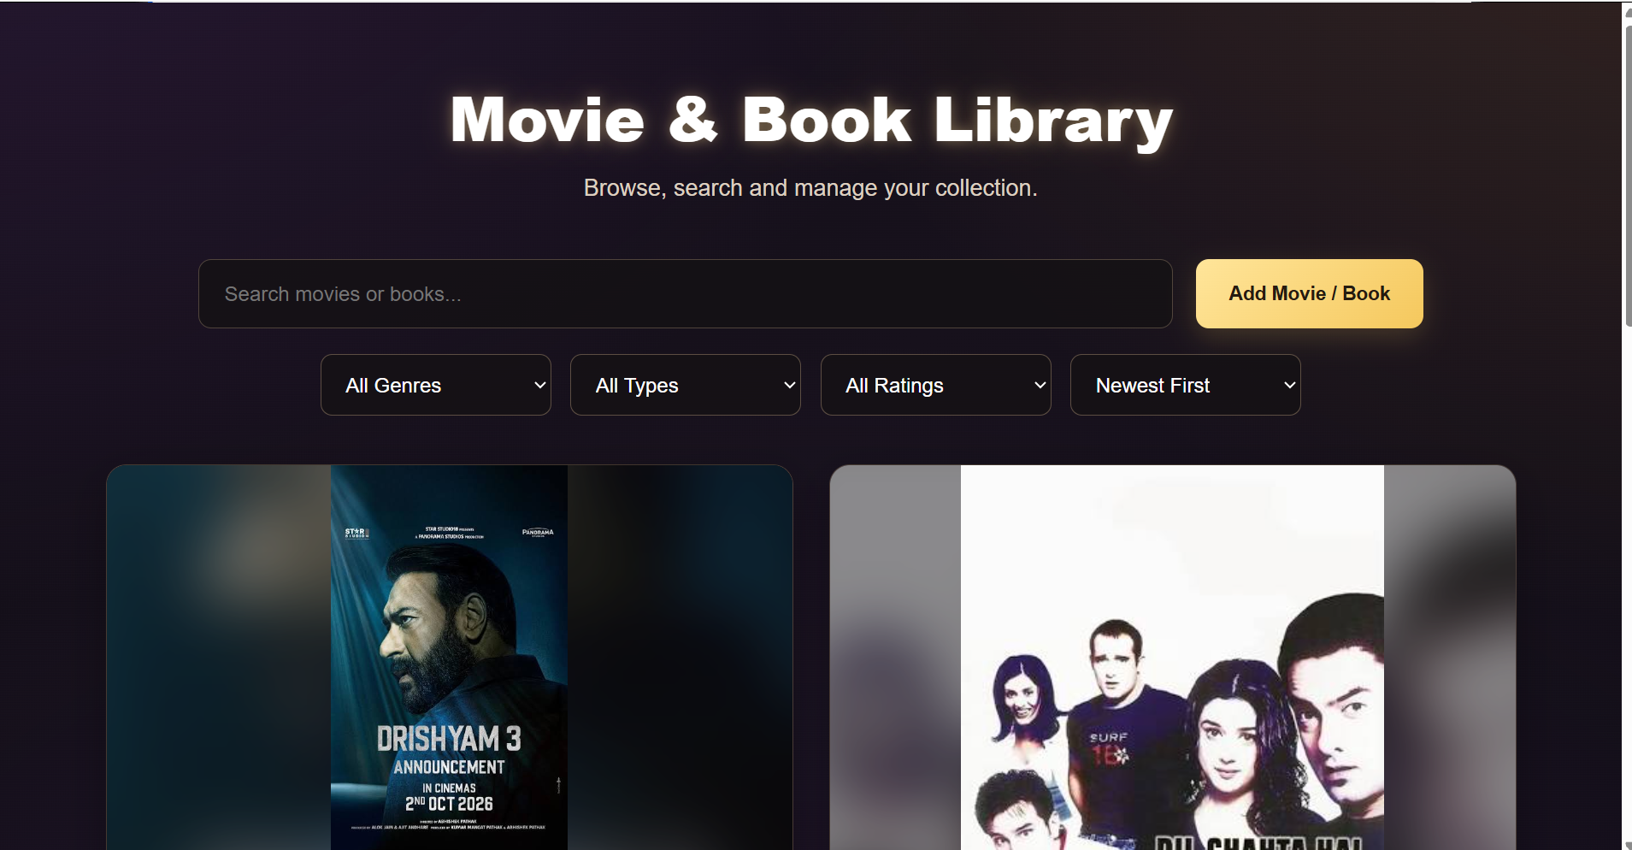
Introduction
Personal media collections outgrow notes and spreadsheets
One web library for movies AND books: posters, genres, ratings, directors
React SPA + Express REST API + Atlas persistence, verified end to end
Notes:
Frame the demo — everything shown next is running code, not mockups.

Slide 3
Problem Statement
Collections scattered across notes, files and streaming apps
Manual lists: no combined movie/book store, no real search or filters
Unvalidated entry produces inconsistent records
Need: persistent, validated, searchable, multi-device web access

Slide 4
Objectives
Full CRUD over REST endpoints
Search by title/director; genre, type and rating (≥) filters
Newest / oldest / top-rated sorting; server-side pagination, 4 per page
Shared 1–5 rating scale from form to validation to display
Zero-mapping UI↔API field contract; loading/error/empty states

Slide 5
Technology Stack
Frontend: React 19, Vite 8, custom CSS dark theme
Backend: Node.js, Express 4, Mongoose 8 (schema + validation)
Database: MongoDB Atlas — database `movie`, collection `items`
Tools: VS Code REST client, MongoDB Compass, oxlint
Notes:
Atlas means zero-ops cloud persistence; Mongoose enforces every write.

Slide 6
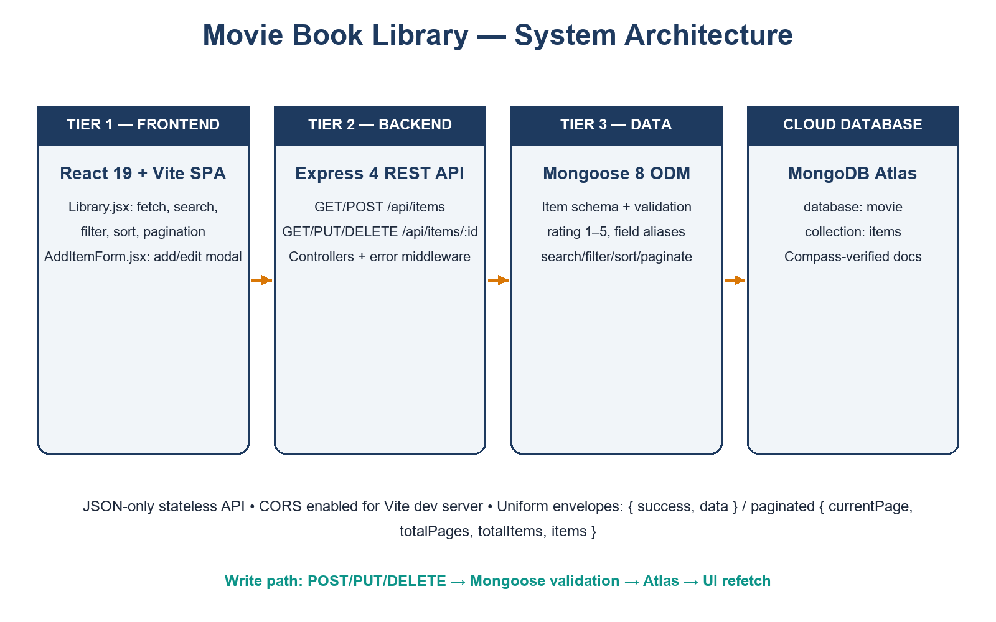
System Architecture
Three tiers: React SPA → Express REST API (`/api/items`) → Mongoose → Atlas
Stateless JSON API, CORS enabled; controllers map query params to Mongo queries
Flow: filter change → query string → Mongo filter/sort/skip/limit → cards re-render
Hosting: frontend = Render Static Site, backend = Render Web Service, database = MongoDB Atlas
Notes:
Walk the request-flow diagram on the next click if asked.

Slide 7
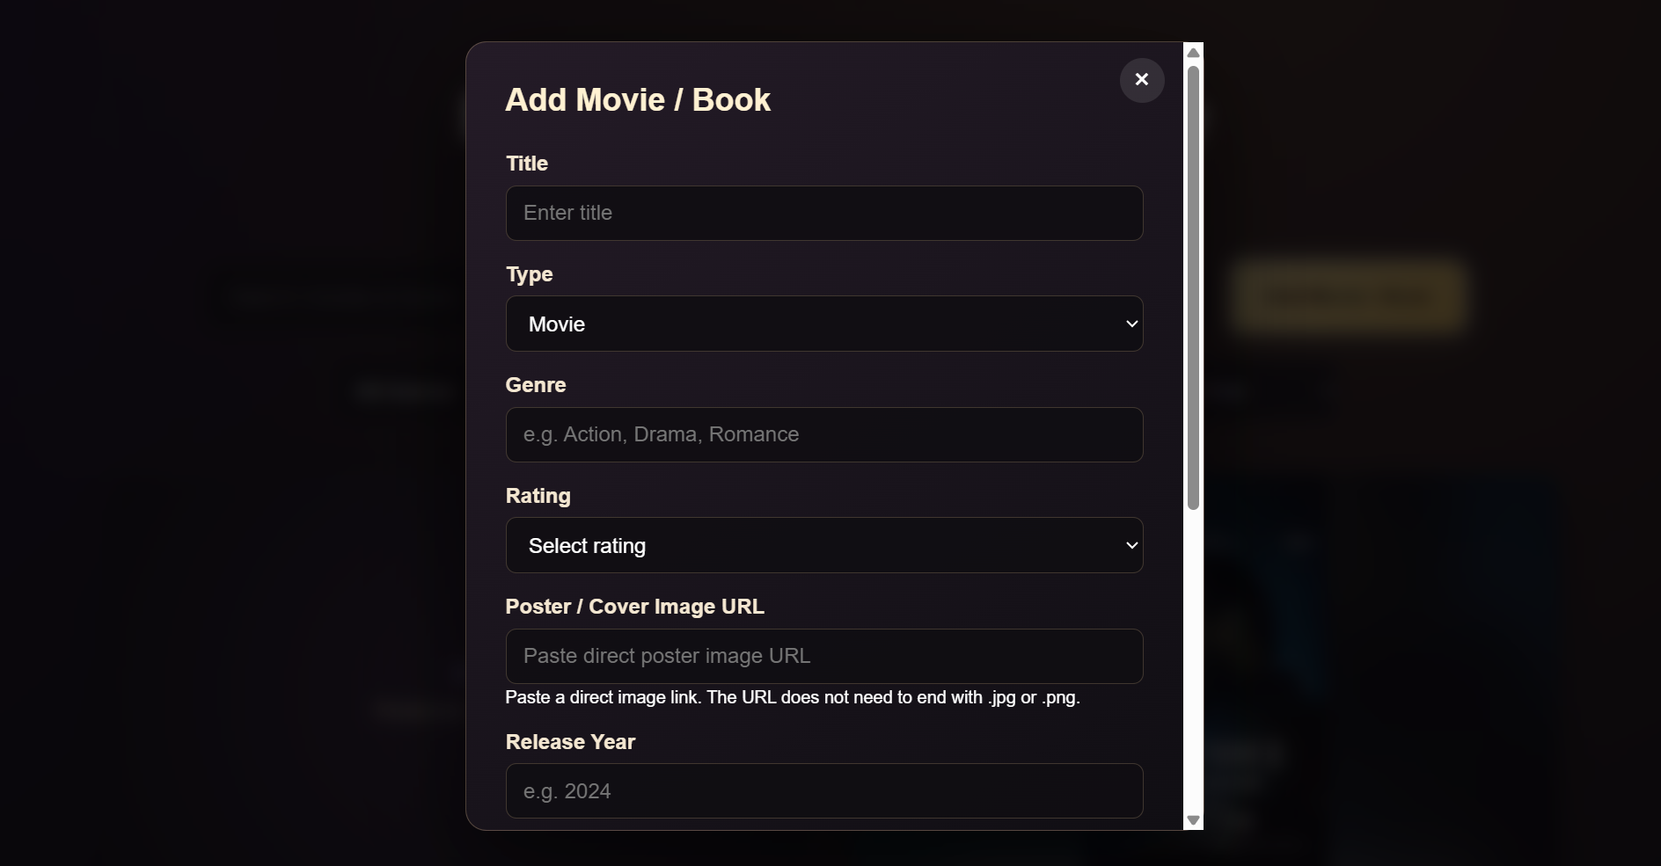
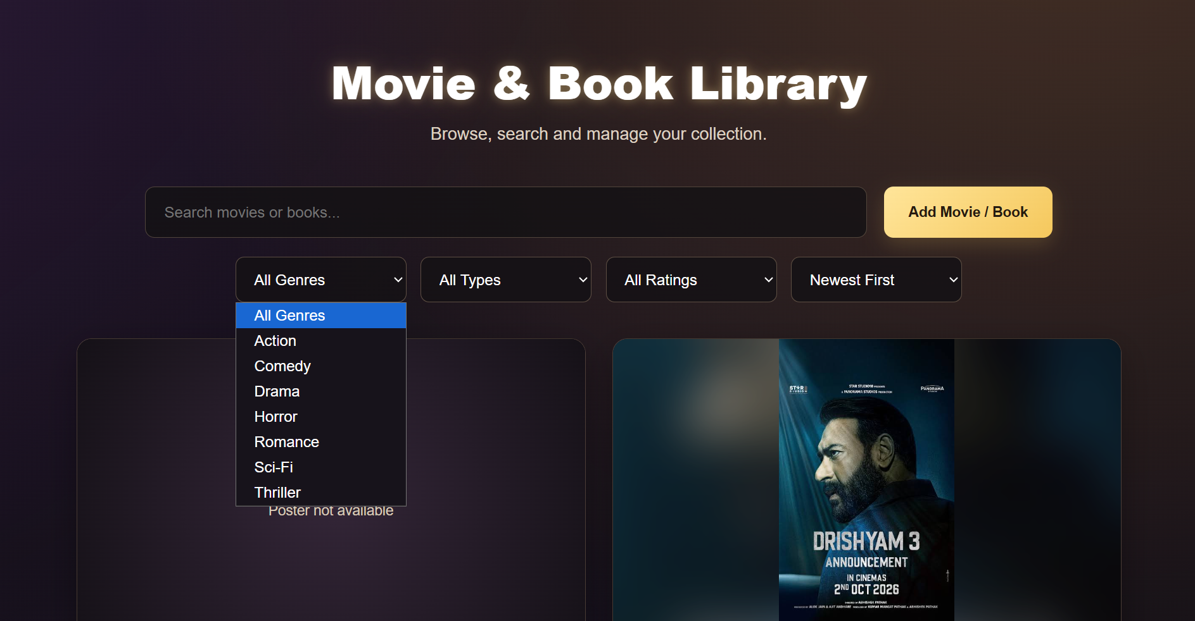
Frontend Overview
`Library.jsx`: debounced search, AbortController, `_id`→`id`, payload sanitizer, server totals, Type/Sort controls
`AddItemForm.jsx`: String-coercion (numeric years can't crash `.trim()`), prefill, live poster preview
Styling untouched; Edit/Delete/View Details preserved

Slide 8
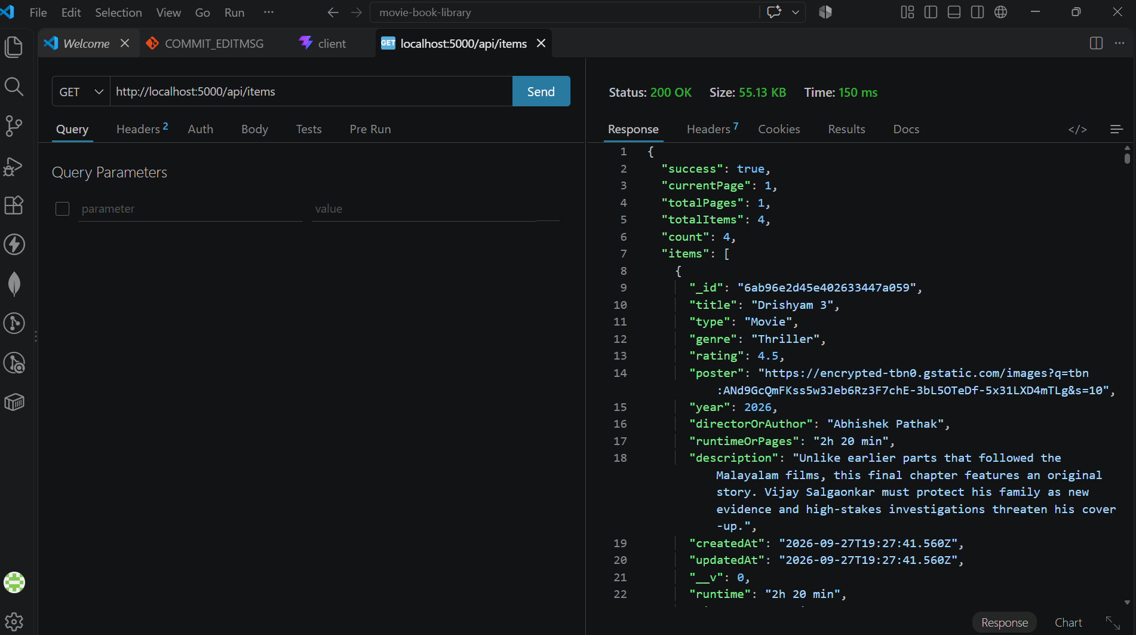
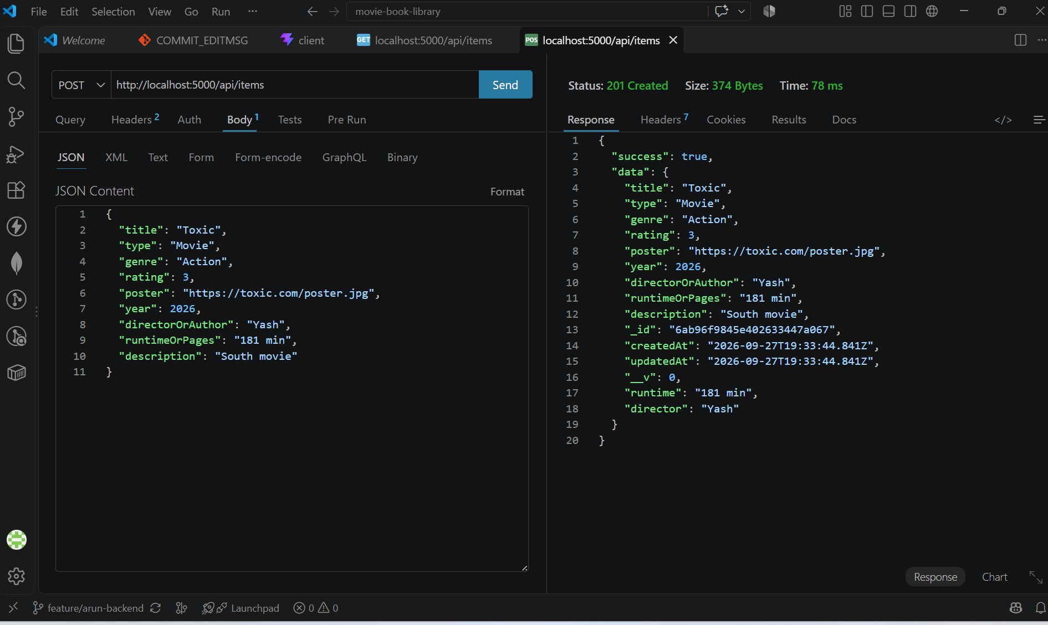
Backend Overview
5 controllers: create, list (search/filter/sort/paginate), get, update, delete
Aliases: `runtime`=`runtimeOrPages`, `director`=`directorOrAuthor` on every payload
Centralized errors: 400 validation/id, 404 missing, 500 fallback; uniform envelopes

Slide 9
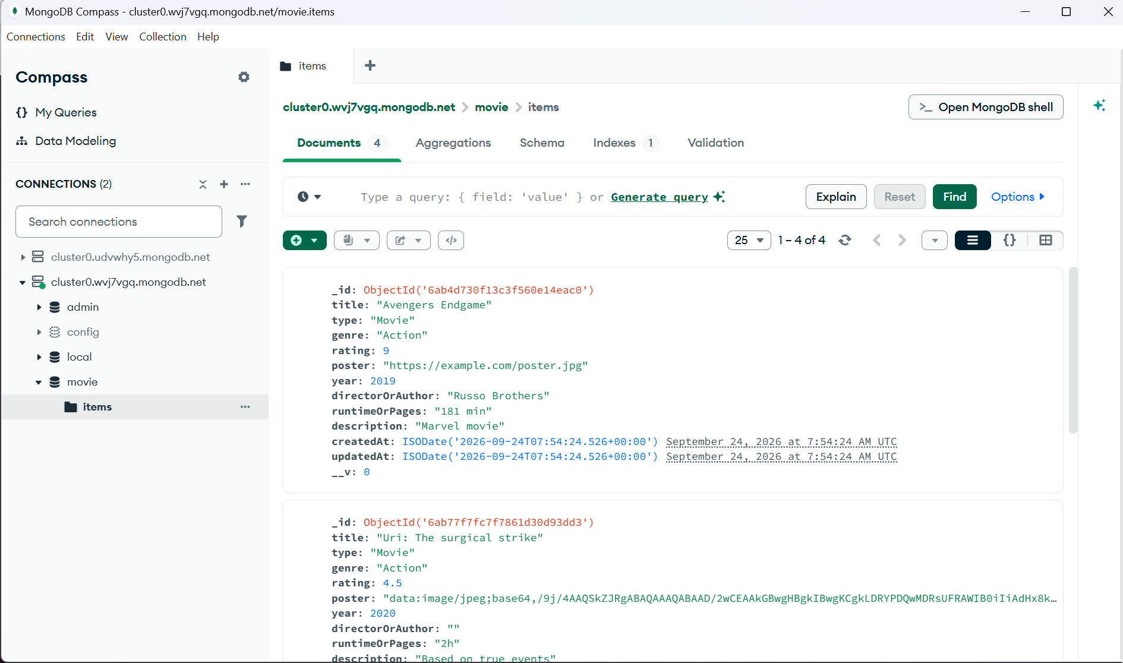
Database Design
`movie.items`: title*, type* (Movie/Book), genre*, rating* 1–5, poster, year, directorOrAuthor, runtimeOrPages, description + timestamps
Single collection with type discriminator; default `_id` index
Notes:
Point out canonical vs alias fields in the Compass shot.

Slide 10
Features Implemented
Add / View / Edit / Delete with confirmation and refetch
Search, genre / type / rating filters, 3 sort orders, server pagination
Details modal, loading / error-retry / empty / no-results states
13 features, each traced to UI control + API mechanism + proof
Notes:
Every item here maps to a screenshot or a passing test.

Slide 11
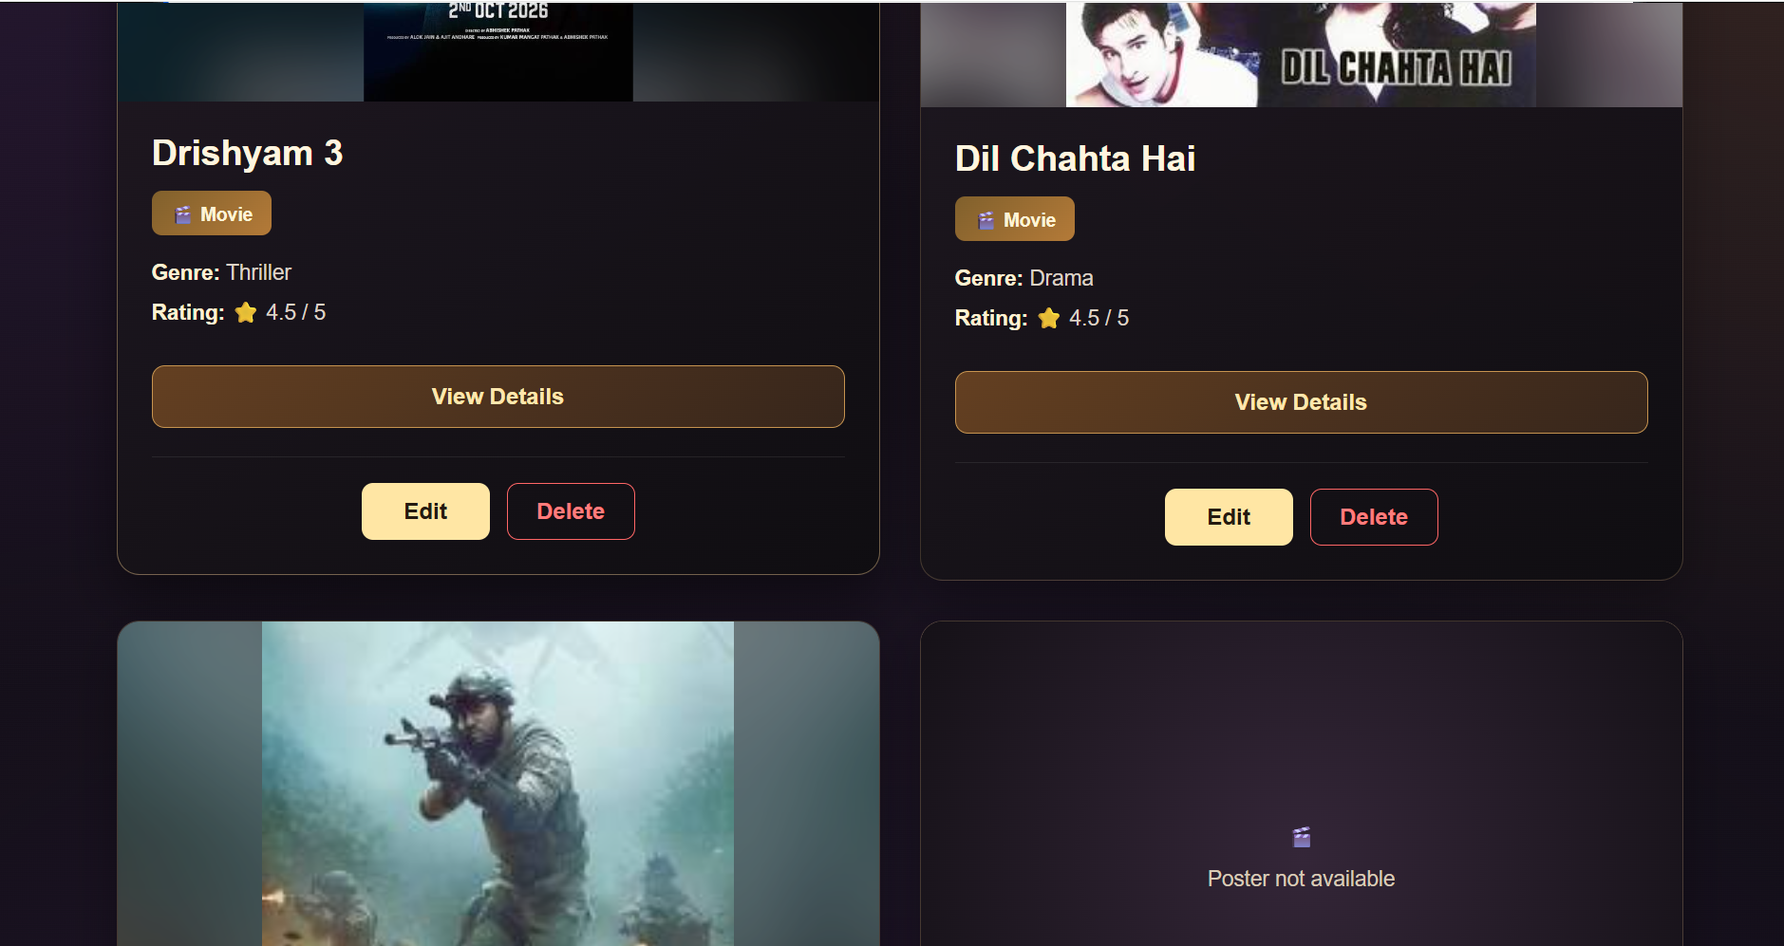
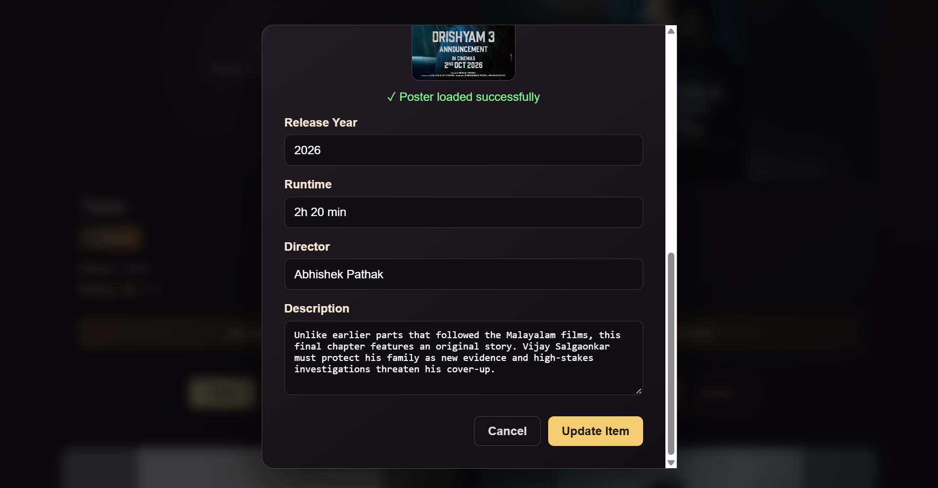
Screenshots and Demo
Homepage + filters (S01), cards with Edit/Delete (S02), prefilled Edit form (S07)
Live demo at https://movie-book-library-1.onrender.com — order: search → filter → add → edit → delete
Notes:
Do the live demo from this slide (see Slide 16 for URLs).

Slide 12
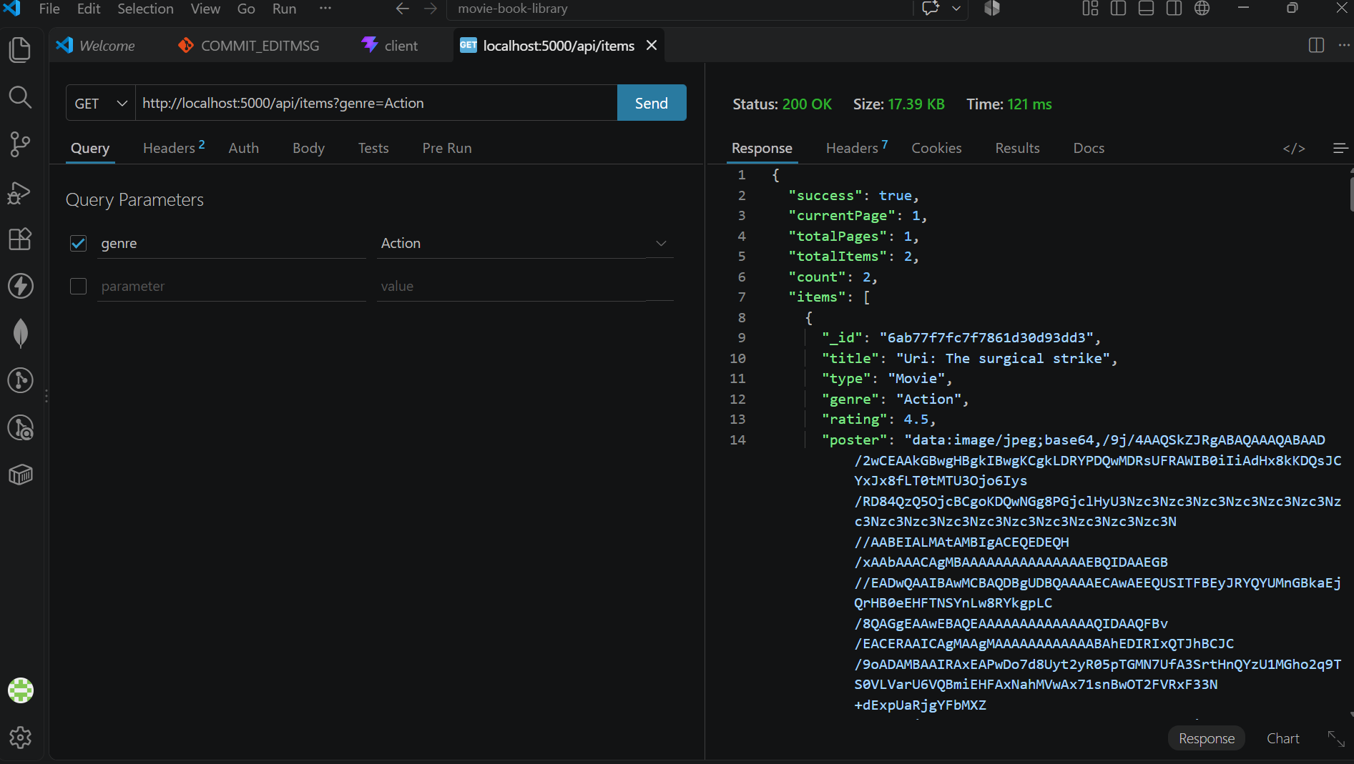
Testing
`vite build` clean (19 modules); `oxlint` 0 errors
20/20 live Atlas API checks: CRUD round-trip, all filters, pagination, sorting, 400/404 paths
Manual UI pass + Compass persistence proof
Notes:
Emphasize test docs were created and deleted — DB left clean.

Slide 13
Challenges
Numeric `year` crashing `.trim()` → String-coercion + empty-year stripping
Field-name divergence → backend alias layer, zero UI mapping
Rating-scale drift → schema `max: 5`, documented ≥ semantics
Client vs server pagination → server contract + page clamp; merge conflicts resolved with build+lint proof

Slide 14
Future Scope
JWT auth with per-user collections; watchlists and favourites
Reviews/comments; poster image uploads; shareable filter URLs
PWA offline support; automated test suites with CI

Slide 15
Conclusion
All objectives met against live Atlas: CRUD, search, filters, sorting, pagination
Clean three-tier architecture with a zero-mapping UI↔API contract
Released live: frontend https://movie-book-library-1.onrender.com, backend https://movie-book-library-ii96.onrender.com
Team: Arun Kumar Jain (backend/integration/release) · Ansh (frontend/UI) · Jheel (docs/packaging)
Thank you — open for questions
Notes:
Close on the alias contract as the engineering highlight.

Slide 16
Live Deployment & Release
Frontend: Render Static Site — https://movie-book-library-1.onrender.com
Backend: Render Web Service — https://movie-book-library-ii96.onrender.com (health endpoint verified live)
Database: MongoDB Atlas (`movie.items`); frontend built with production `VITE_API_URL`
Live demo order: search → filter → add → edit → delete, then confirm in Atlas
No CRUD, UI or schema changes were needed for release
Notes:
Open both URLs live from this slide; expect a cold-start delay on the free tier.

