Slide 1

EdiFungi: Prepare
Machine Learning Model to Safeguard Foragers by Distinguishing Poisonous from Edible Mushrooms

Slide 2
Objective
The overarching objective of this project is to develop a robust and accurate machine learning model capable of predicting the edibility status of mushrooms, discerning between poisonous and edible varieties.
Through extensive analysis and predictive modeling, the goal is to create a reliable tool for differentiating between mushroom types, ensuring the safety of individuals engaging in mushroom foraging or related activities.

Slide 3
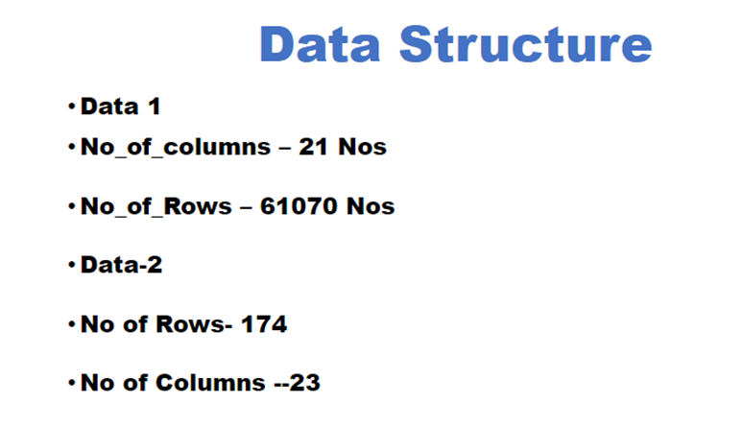
Dataset Info

Slide 4
Features in Dataset
- Class ---poisonous=p, edibile=e (binary)
- Variable Information: (n: nominal, m: metrical; nominal values as sets of values)
- cap-diameter (m):float number in cm
- cap-shape (n): bell=b, conical=c, convex=x, flat=f, sunken=s, spherical=p, others=o
- cap-surface (n): fibrous=i, grooves=g, scaly=y, smooth=s, shiny=h, leathery=l, silky=k, sticky=t, wrinkled=w, fleshy=e
- cap-color (n): brown=n, buff=b, gray=g, green=r, pink=p,purple=u, red=e, white=w, yellow=y, blue=l, orange=o, black=k
- does-bruise-bleed (n): bruises-or-bleeding=t,no=f
- gill-attachment (n): adnate=a, adnexed=x, decurrent=d, free=e, sinuate=s, pores=p, none=f, unknown=?
- gill-spacing (n): close=c, distant=d, none=f
- gill-color (n): see cap-color + none=f
- stem-height (m): float number in cm
- stem-width (m): float number in mm

Slide 5
- stem-root (n): bulbous=b, swollen=s, club=c, cup=u, equal=e, rhizomorphs=z, rooted=r
- stem-surface (n): see cap-surface + none=f
- stem-color (n): see cap-color + none=f
- veil-type (n): partial=p, universal=u
- veil-color (n): see cap-color + none=f
- has-ring (n): ring=t, none=f
- ring-type (n): cobwebby=c, evanescent=e, flaring=r, grooved=g, large=l, pendant=p, sheathing=s, zone=z, scaly=y, movable=m, none=f, unknown=?
- spore-print-color (n): see cap color
- habitat (n): grasses=g, leaves=l, meadows=m, paths=p, heaths=h, urban=u, waste=w, woods=d
- season (n): Sring=s, summer=u, autumn=a, winter=w

Slide 6
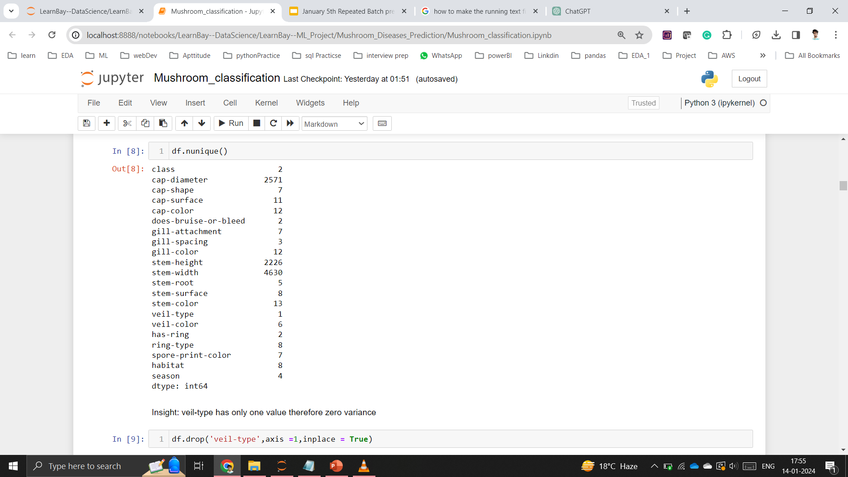
Exploratory Data Analysis

Slide 7
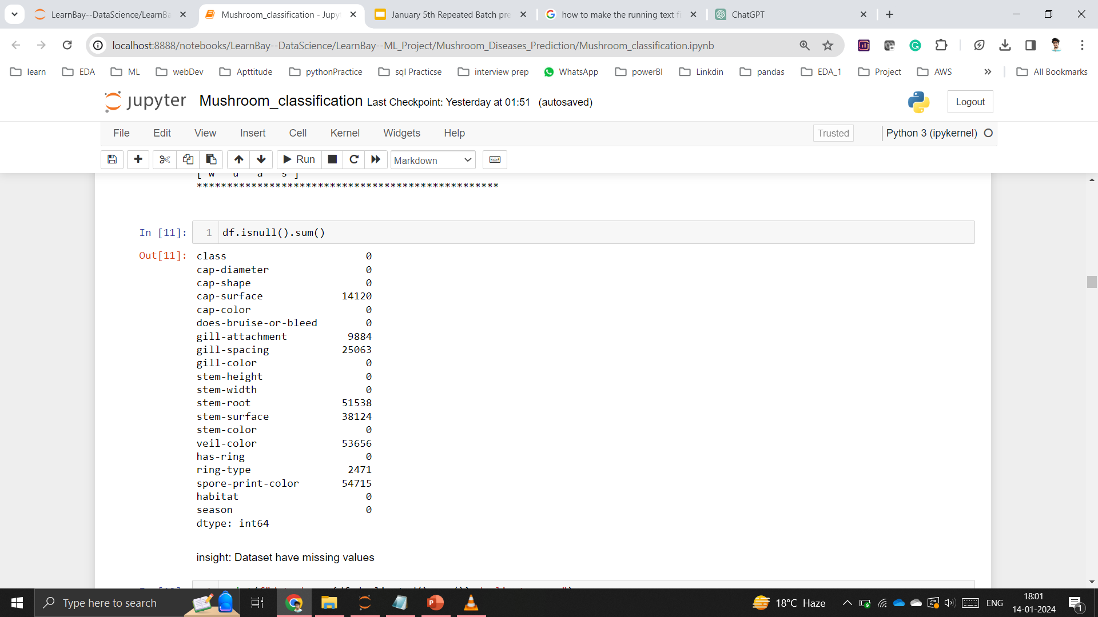
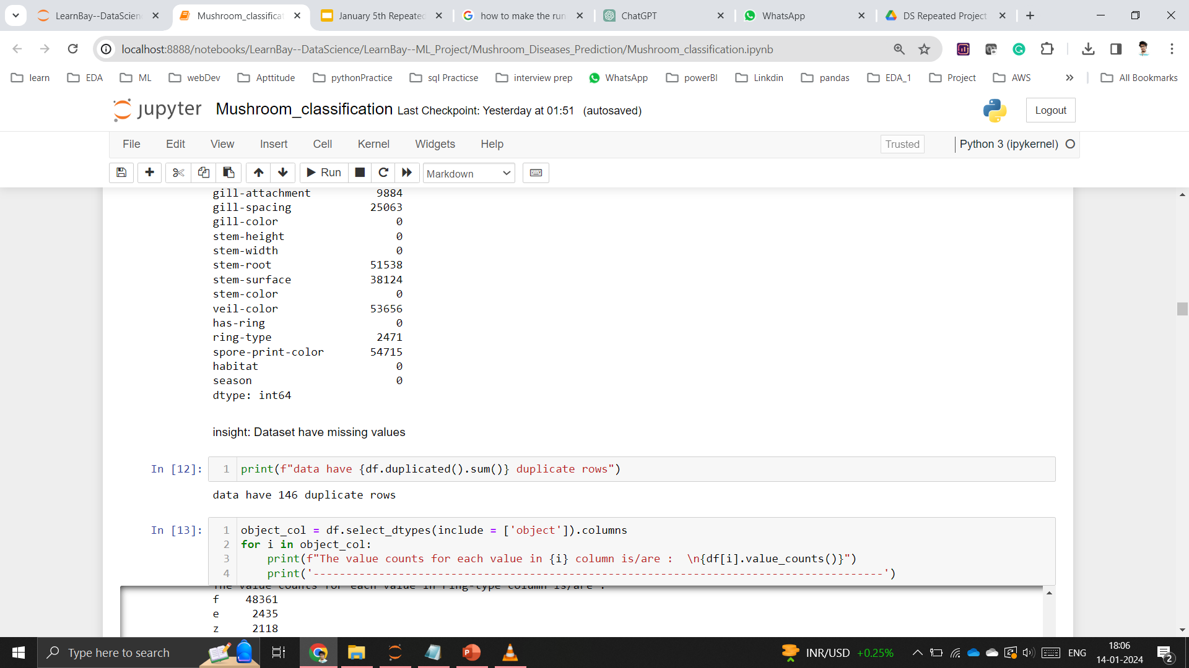

Slide 8
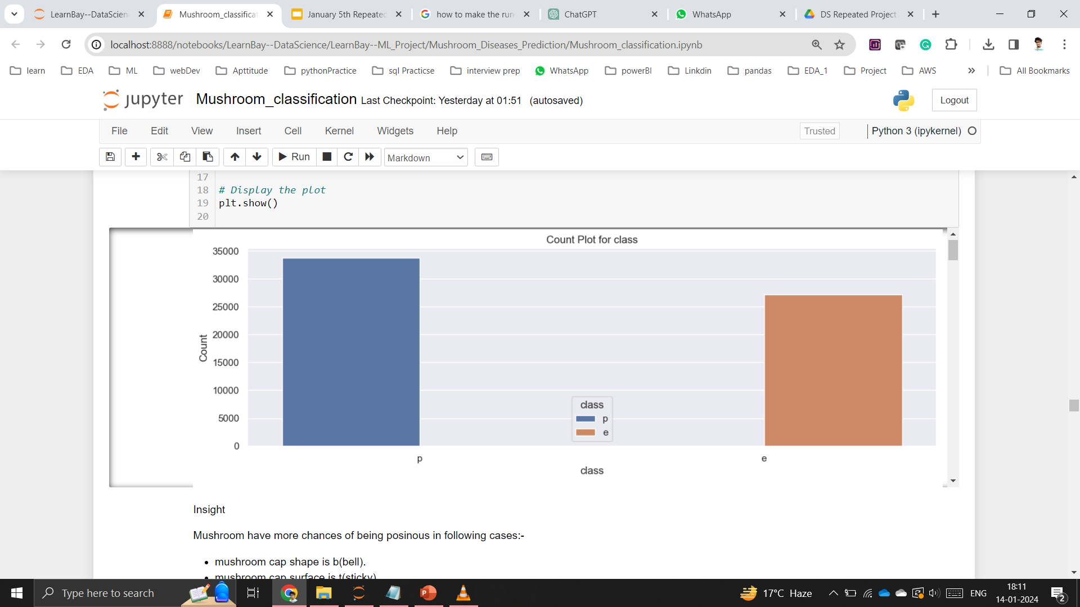
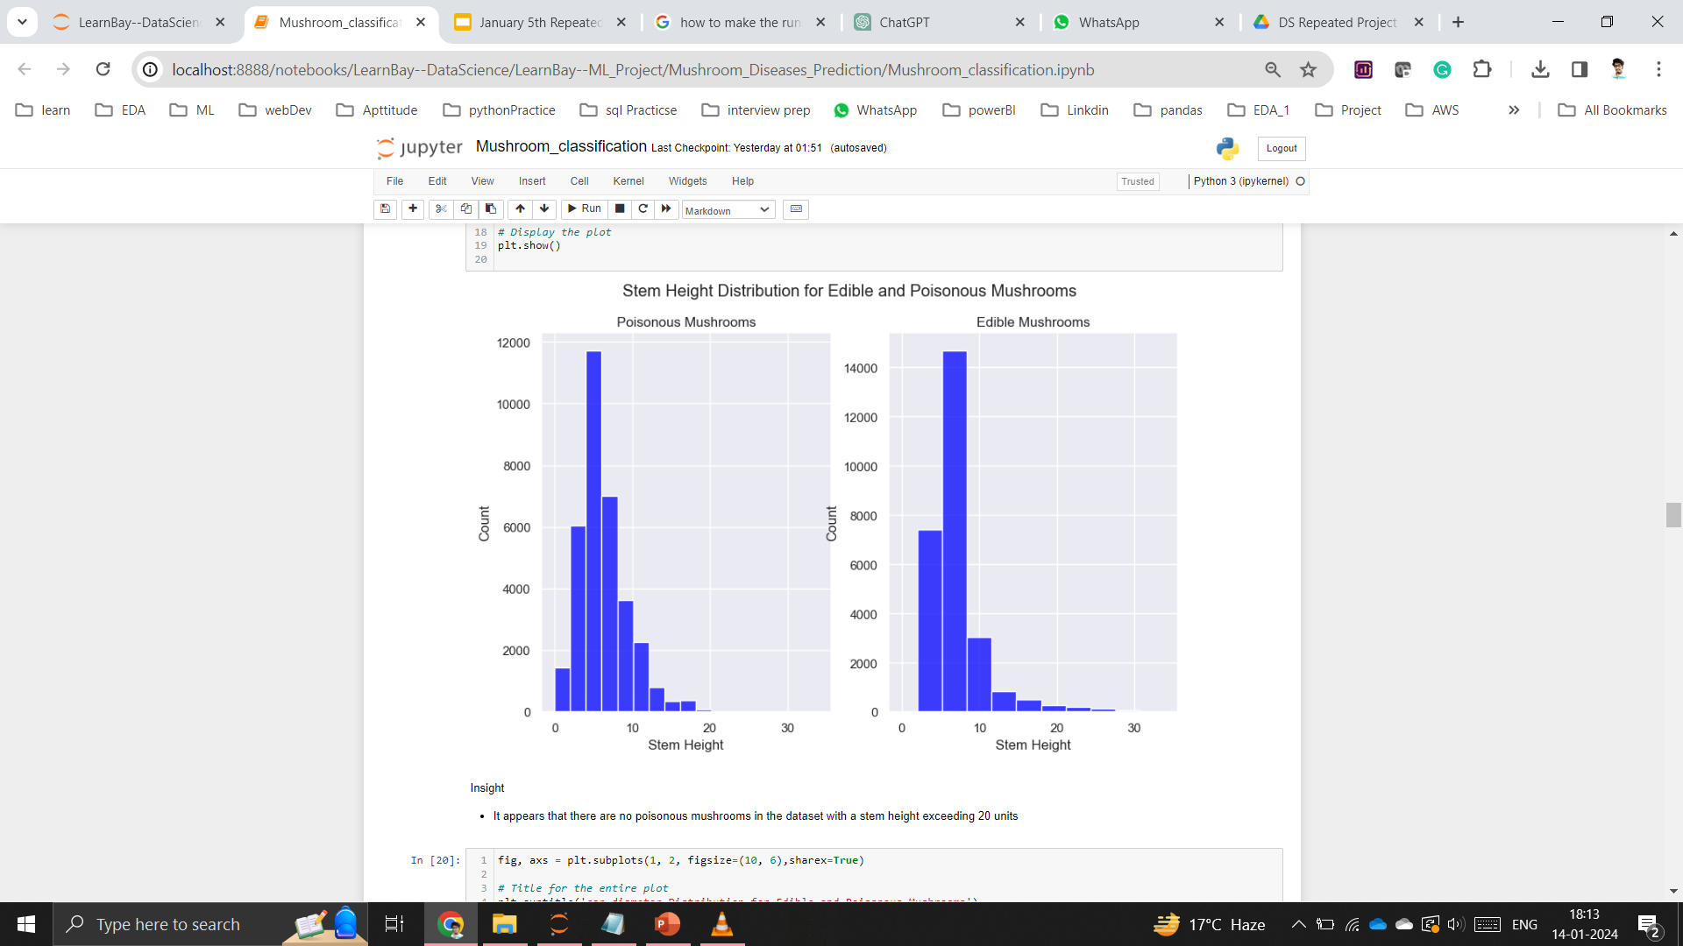

Slide 9
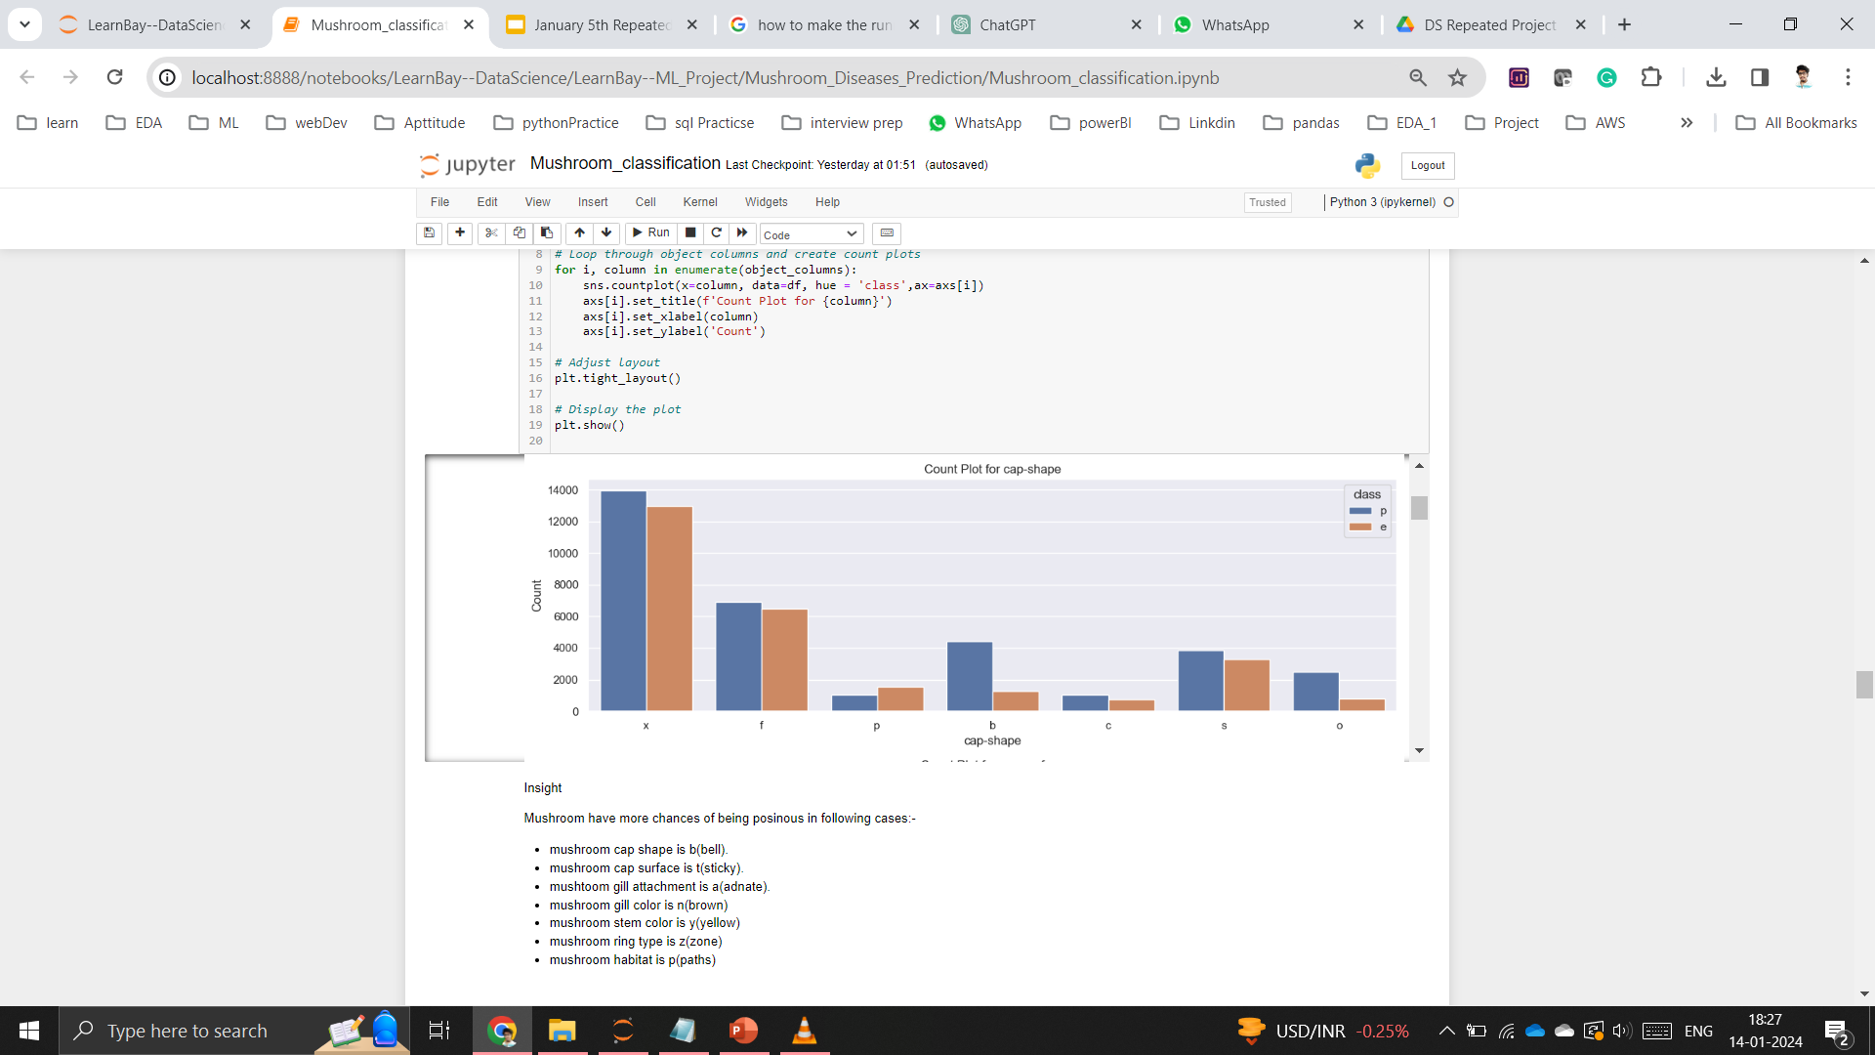
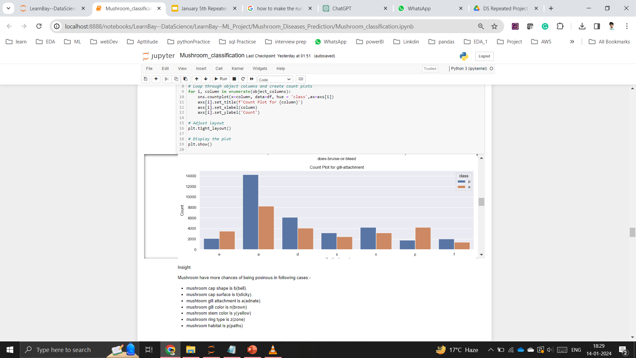

cap-shape (n):
bell=b, conical=c, convex=x, flat=f, sunken=s, spherical=p, others=o

Slide 10
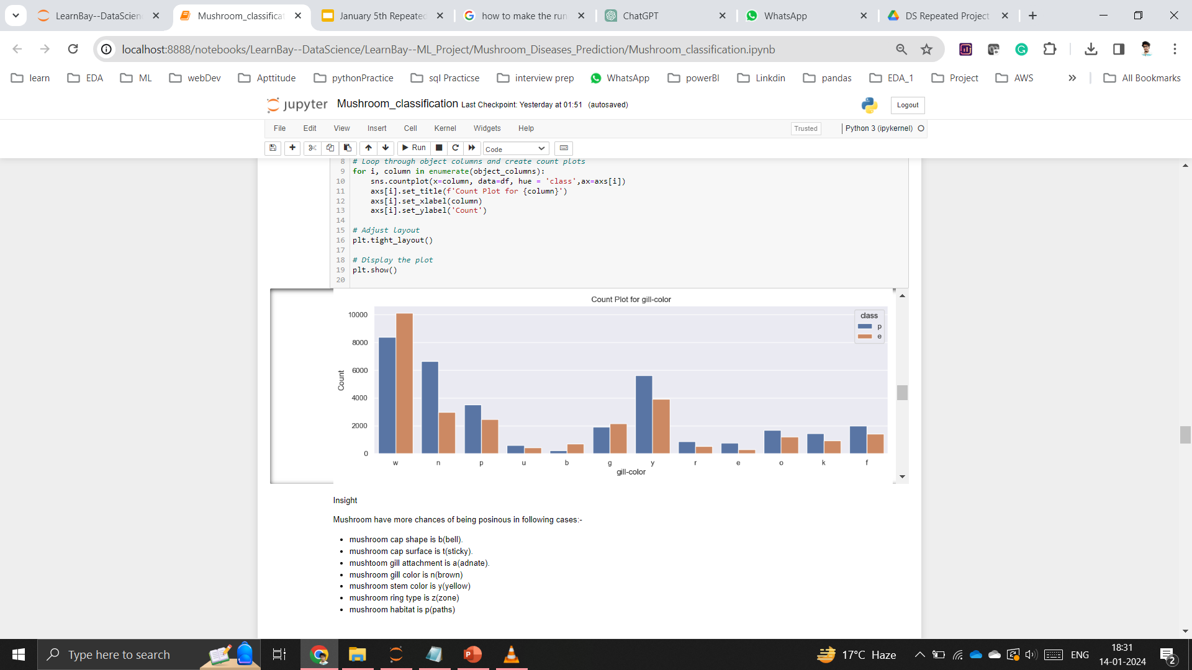
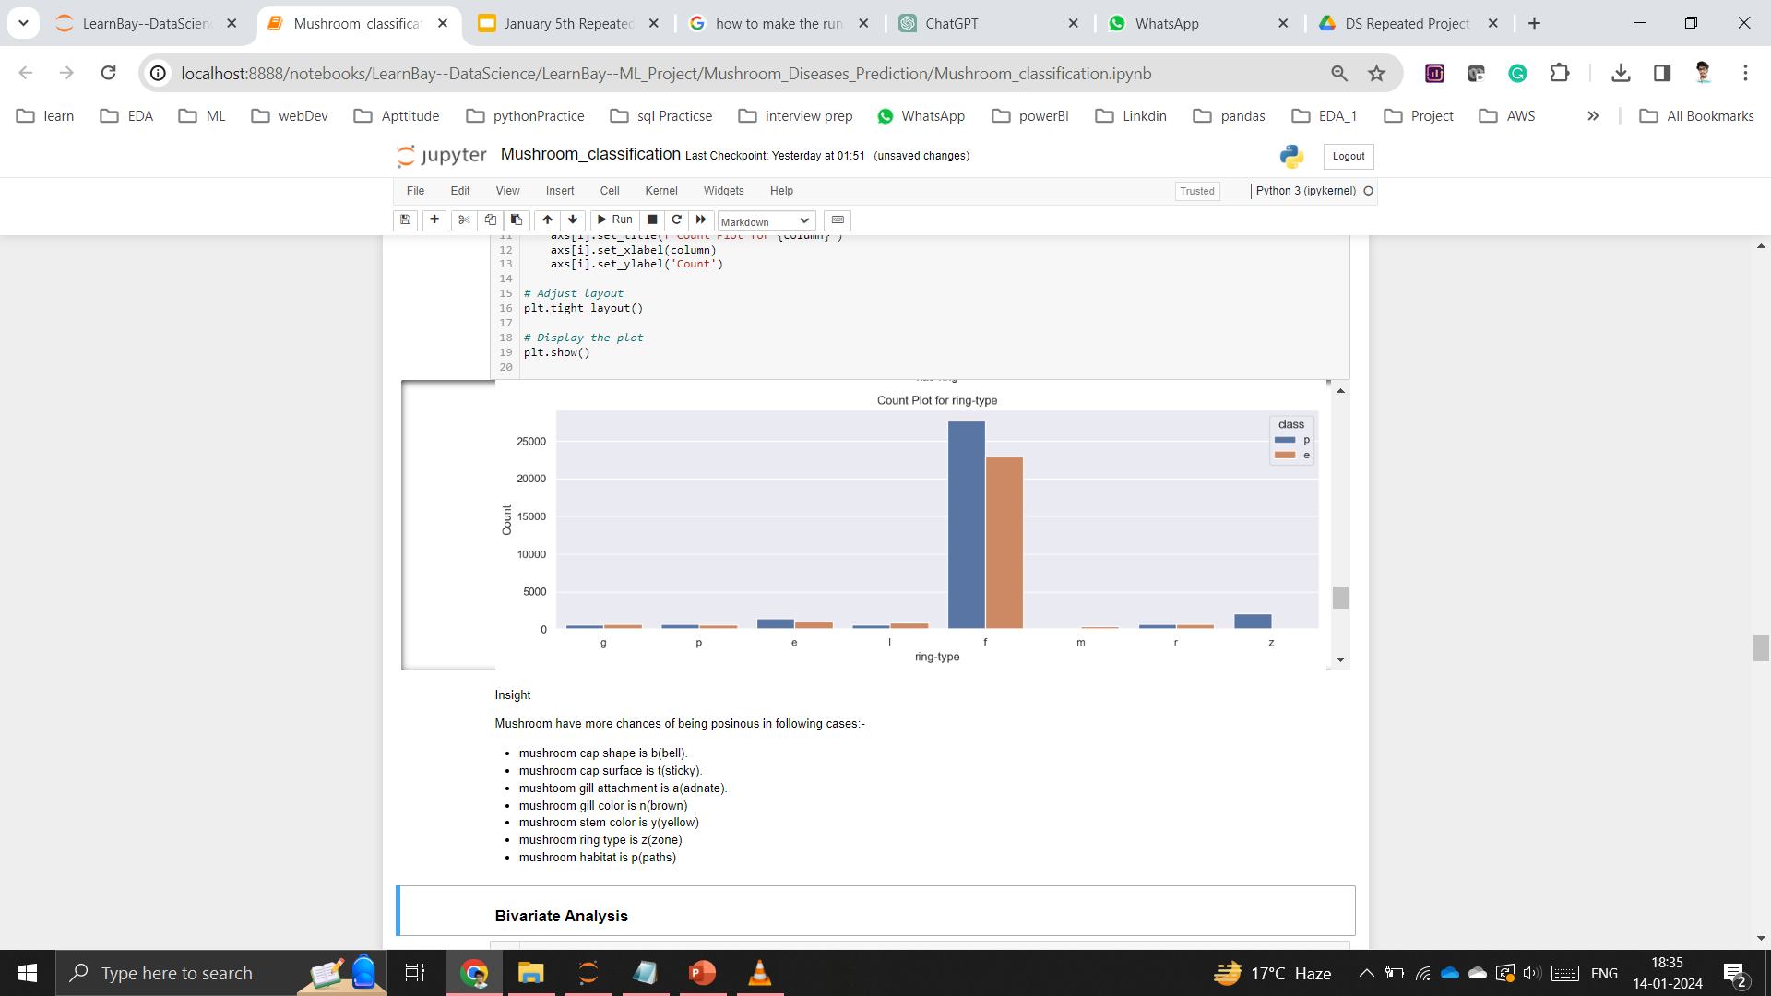
Gill color (n): brown=n, buff=b,
gray=g, green=r, pink=p,purple=u,
red=e, white=w, yellow=y, blue=l,
orange=o, black=k, none=f
Ring type : cobwebby=c, evanescent=e, flaring=r, grooved=g, large=l, pendant=p, sheathing=s, zone=z, scaly=y, movable=m, none=f

Slide 11
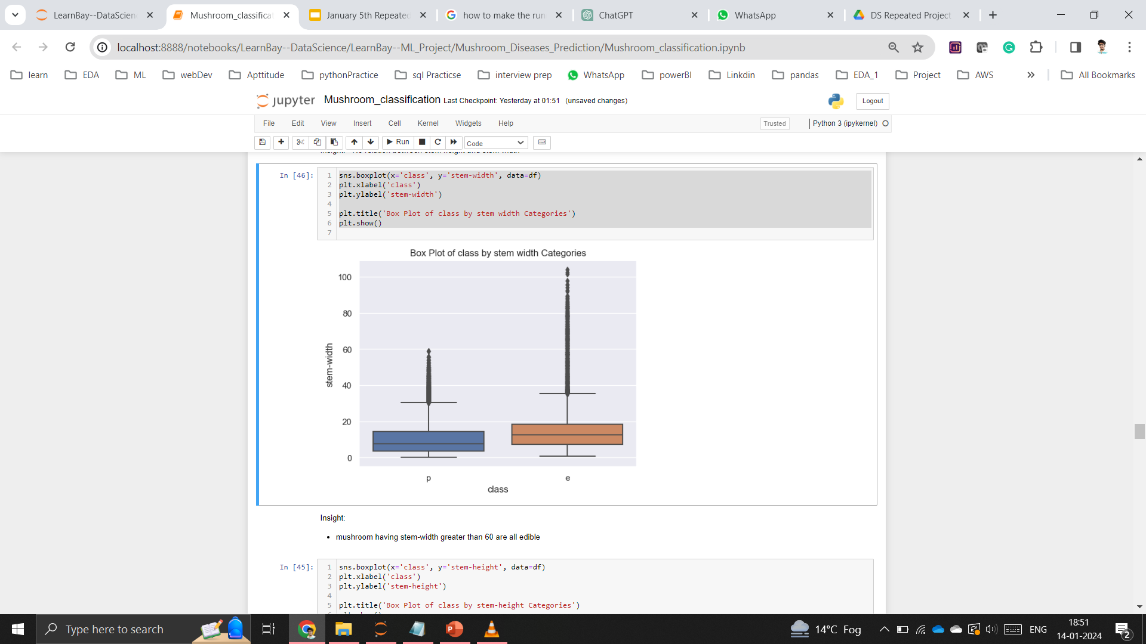
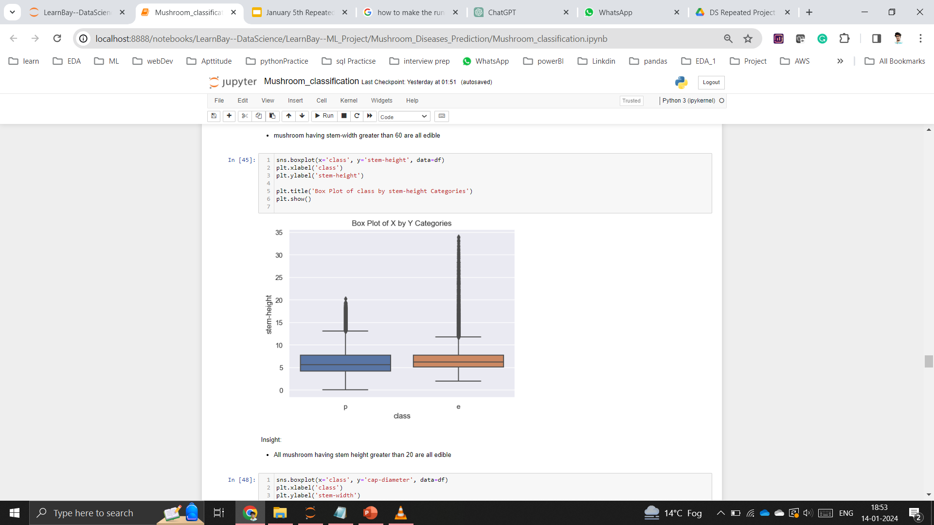
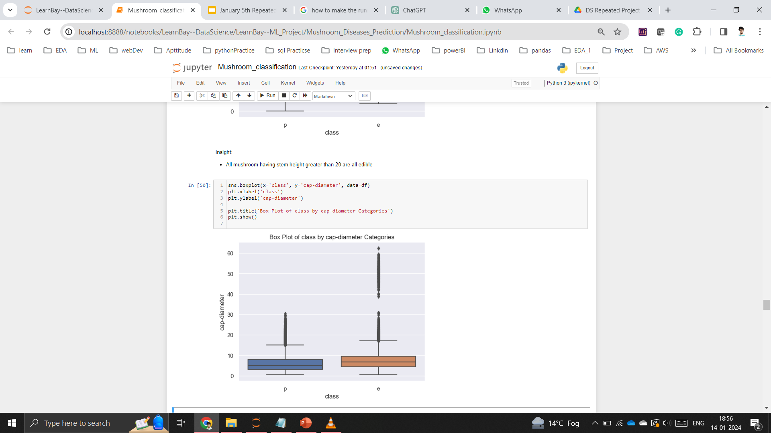

Slide 12
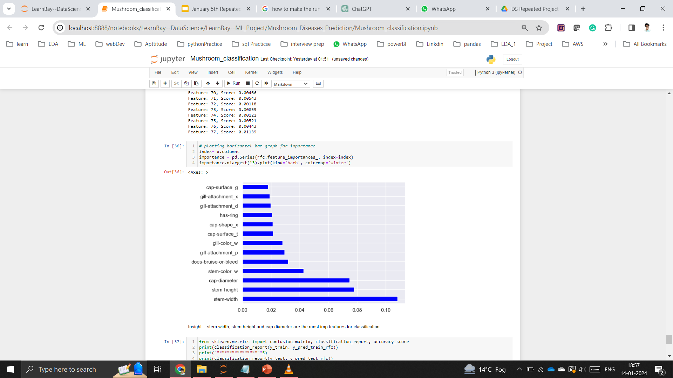

Slide 13
Data Preprocessing
Missing Value Tratement
Encoding (label and dummy)
Outlier Tratement
Feature Scaling

Slide 14
Model Building
Splitted data into train and test (80% train and 20% test).
Used Random Forest Classifier with default parameter .
Used cross validation to test the model on different set of train and test set.
Accuracy, Classification Report, Confusion Matrix are used for Evaluating the model performance.

Slide 15
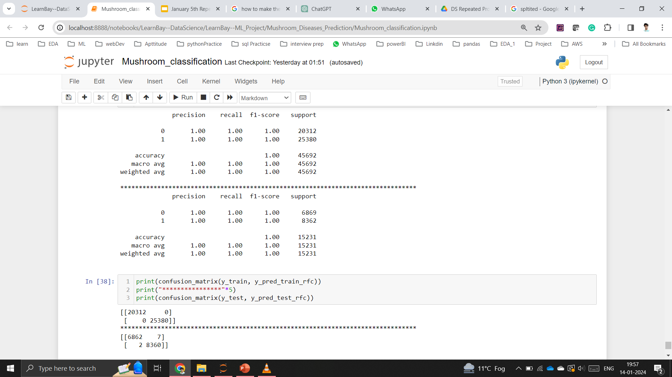

Slide 16
Suggestion based on Data
Mainly focus on the mushroom stem-width and stem length.
If the mushroom stem width is greater than 60 units and stem height is greater than 20 unit than in that case it is mostly eatable.
If the above criteria doesn’t match than perform necessary testing before eating.

