Slide 1

Efficient Frontier

Slide 2
Background
The Interactive Efficient Frontier is an application that helps students visualize and understand diversification, risk/return trade-off, and risk tolerance in the portfolio creation process.
Link: https://wrds-www.wharton.upenn.edu/classroom/efficient-frontier/

Slide 3
Objectives
After this assignment, students will understand the following portfolio concepts and how they are influenced by changes in portfolio composition and risk characteristics:
Capital Market Line
Efficient Frontier
Minimum Variance Portfolio
Optimal Risky Portfolio
Optimal Complete Portfolio
Indifference Curve
Portfolio Distribution
Volatility & Sharpe Ratio

Slide 4
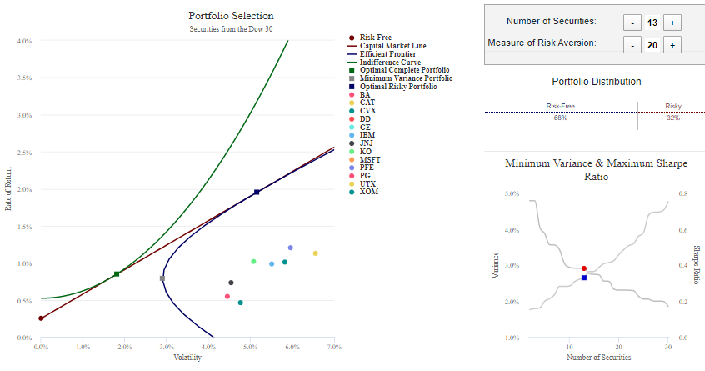
Interactive Platform

Slide 5
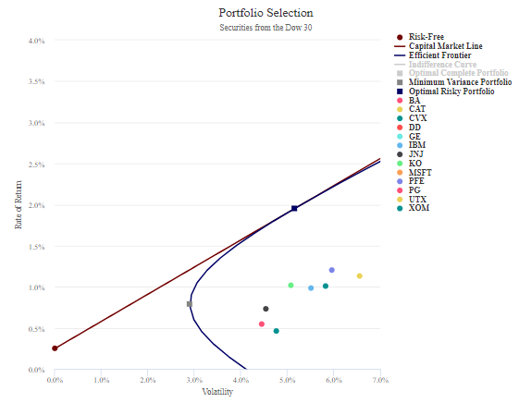
Capital Market Line
Capital Market Line

Slide 6
Capital Market Line (cont.)
The Capital Market Line (CML) depicts the trade-off between portfolio risk and return for portfolios containing both the risk-free and risky securities.
The point on the CML that intersects the y-axis represents the Risk-Free asset.
The point located at the tangency point of the Efficient Frontier represents the Optimal Risky Portfolio.

Slide 7
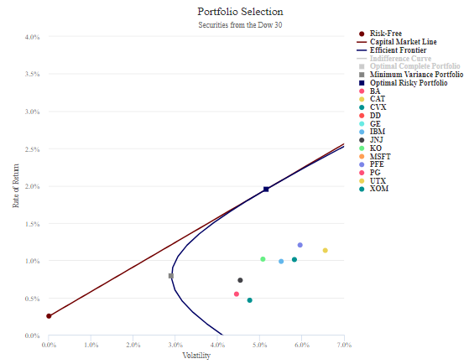
Capital Market Line (cont.)
Optimal Risky Portfolio
Risk-Free Asset

Slide 8
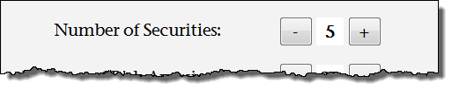
Capital Market Line (cont.)
Students can increase and decrease the Number of Securities in the portfolio and observe the resulting effect on the Capital Market Line.
Securities are added randomly from the Dow 30.

Slide 9
Efficient Frontier and the Minimum Variance Portfolio
Minimum Variance Portfolio
Efficient Frontier

Slide 10
Efficient Frontier (cont.)
The Efficient Frontier is the portion of the curve in the previous slide that continues above and to the right of the Minimum Variance Portfolio.
Each point on the Efficient Frontier represents a uniquely weighted portfolio of risky securities that offers the highest rate of return for a given level of risk.

Slide 11
Minimum Variance Portfolio (cont.)
The Minimum Variance Portfolio (MVP) is always the left-most point on the Efficient Frontier.
The MVP is the portfolio on the Efficient Frontier with the lowest volatility.

Slide 12
Efficient Frontier and the Minimum Variance Portfolio (cont.)
Students can increase and decrease the Number of Securities in the portfolio and observe the resulting effects on the Efficient Frontier and the Minimum Variance Portfolio.

Slide 13
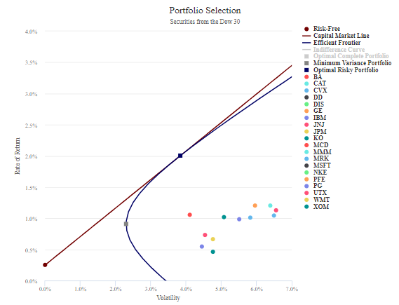
Optimal Risky Portfolio
Optimal Risky Portfolio
Capital Market Line
Efficient Frontier

Slide 14
Optimal Risky Portfolio (cont.)
The Optimal Risky Portfolio represents the portfolio of risky assets with the best risk and return trade-off. In other words, it is the portfolio with the highest Sharpe Ratio.
As stated earlier, the Optimal Risky Portfolio is located graphically at the tangency point of the Capital Market Line and the Efficient Frontier.

Slide 15
Optimal Risky Portfolio (cont.)
Students can increase and decrease the Number of Securities in the portfolio and observe the resulting effect on the Optimal Risk Portfolio.

Slide 16
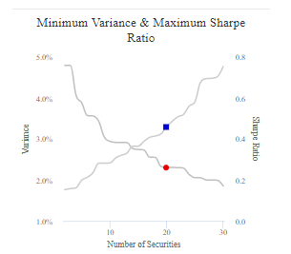
Minimum Variance and Maximum Sharpe Ratio of the Efficient Frontier

Slide 17

Minimum Variance and Maximum Sharpe Ratio of the Efficient Frontier (cont.)
The Minimum Variance and Maximum Sharpe Ratio graph plots the Minimum Variance and Maximum Sharpe Ratio of the Efficient Frontier as a function of the Number of Securities.
The Sharpe Ratio is given by:
$${Sharpe=\left({{(\overline{R}−rf)}^{T}Σ}_{p}^{−1}(\overline{R}−rf)\right)}^{1/2}$$
The Sharpe Ratio measure divides average portfolio excess returns by the portfolio’s risk.
This measures the reward to variability trade-off.

Slide 18
Minimum Variance and Maximum Sharpe Ratio of the Efficient Frontier (cont.)
Students can increase and decrease the Number of Securities in the portfolio and observe the resulting effect on the Minimum Variance and Maximum Sharpe Ratio graph.

Slide 19
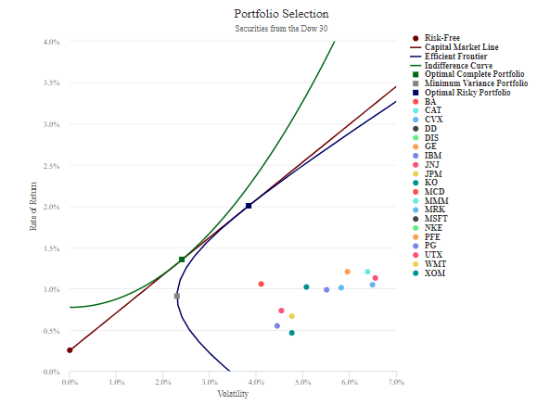
Indifference Curve
Indifference Curve

Slide 20

Indifference Curve (cont.)
The Indifference Curve represents an individual’s particular preference for risk and return. As risk aversion increases, investors demand higher returns for bearing the same amount of additional risk. Therefore, the Indifference Curve will be steeper as risk aversion increases.
The Indifference Curve is represented by the following utility function:
$$U=r_{p}−0.05×A×σ_{p}^{2}$$

Slide 21
Indifference Curve (cont.)
Students can increase and decrease the Number of Securities in the portfolio and observe the resulting effect on the Indifference Curve.

Slide 22
Optimal Complete Portfolio
Capital Market Line
Indifference Curve
Optimal Complete Portfolio

Slide 23
Optimal Complete Portfolio (cont.)
The Optimal Complete Portfolio combines both risky assets and the risk-free asset in order to satisfy investors’ particular risk preferences.
Graphically, it is represented as the intersection between the Capital Market Line and the Indifference Curve.
Investors must be willing to bear a reasonable degree of risk in order to invest in portfolios that lie along the Efficient Frontier.

Slide 24
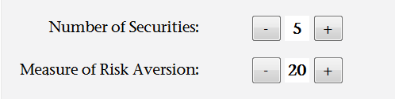
Optimal Complete Portfolio (cont.)
Students can alter both the Number of Securities and the Measure of Risk Aversion and observe the resulting effect on the value/location of the Optimal Complete Portfolio.

Slide 25
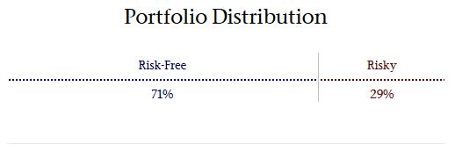
Composition of the Optimal Complete Portfolio
Portfolio Distribution shows the composition of the Optimal Complete Portfolio, by Risk-Free vs. Risky assets (Optimal Risky Portfolio).

Slide 26
Conclusion
The Interactive Efficient Frontier is an application that helps students visualize and understand diversification, risk/return trade-off, and risk tolerance in the portfolio creation process.
The interactive platform allows students to manipulate portfolio parameters and observe comparative statics instantly.

