Slide 1
MovieLens Recommender System
Team 27
Arunaabh Pant, Tanu Batra, Vipul Gharde

Slide 2
Introduction
Personalization and recommendations help increase business value and sales of products
Example Companies: Netflix, Amazon, Spotify, Zillow, Uber Eats, LinkedIn
Goal is to predict ‘rating’ which a user gives to a product or a ‘recommendation’ to a user based on past preferences
This project: Build a Movie Recommendation Engine to recommend most relevant movies to users

Slide 3
Recommender Systems
Recommender systems are the systems that are designed to recommend things to the user based on many different factors. These systems predict the most likely product that the users are most likely to purchase and are of interest to. Companies like Netflix, Amazon, etc. use recommender systems to help their users to identify the correct product or movies for them.
The recommender system deals with a large volume of information present by filtering the most important information based on the data provided by a user and other factors that take care of the user’s preference and interest. It finds out the match between user and item and imputes the similarities between users and items for recommendation.

Slide 4
Benefits
Both the users and the services provided have benefited from these kinds of systems
The quality and decision-making process has also improved through these kinds of systems

Slide 5
Dataset
MovieLens Dataset [1] (Latest, small)
Widely used dataset in the field of recommender systems
9,000 movies
100,000 ratings
600 users

Slide 6
Data Cleaning + Preprocessing
The dataset is clean for the most part. The following data cleaning and preprocessing methods have been performed:
Check for null values and eliminate them. The dataset had no null values.
Extract year from movie title and remove entries where the year could not be obtained
Extract genres and remove entries with genres like “(no genres listed)”
Drop timestamp columns since they lend no value

Slide 7


Data Cleaning + Preprocessing

Slide 8
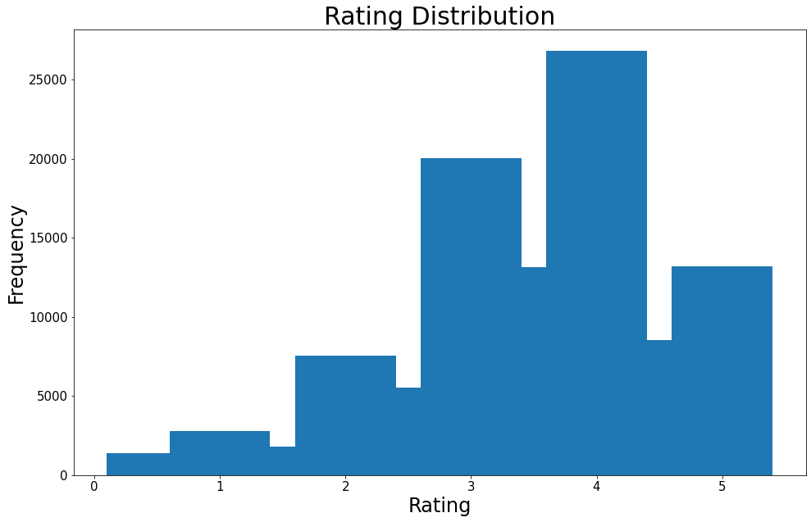
Data Analysis - Rating
Notes:
If a movie is old I would rather recommend more recent movie

Slide 9
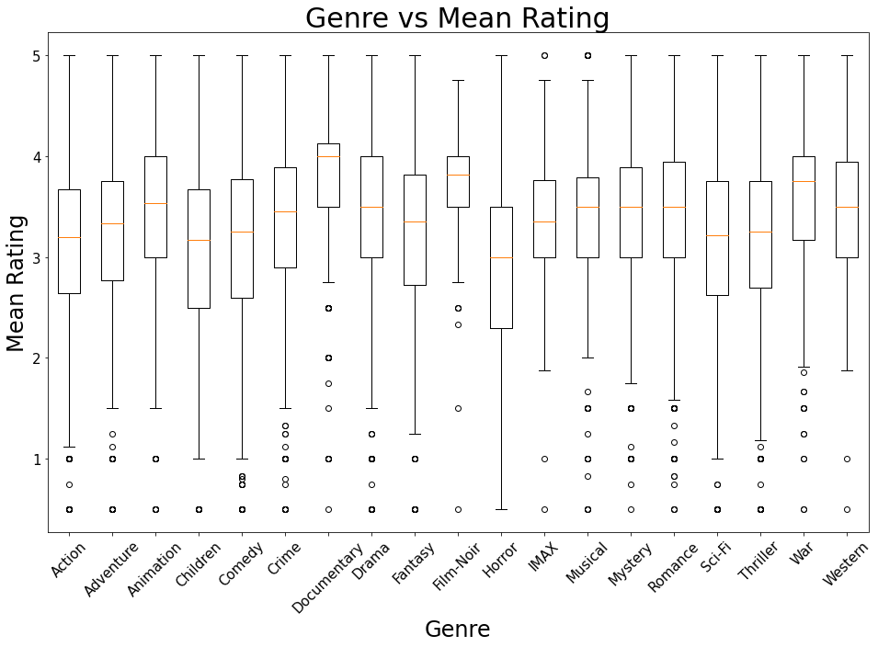
Data Analysis - Genre

Slide 10
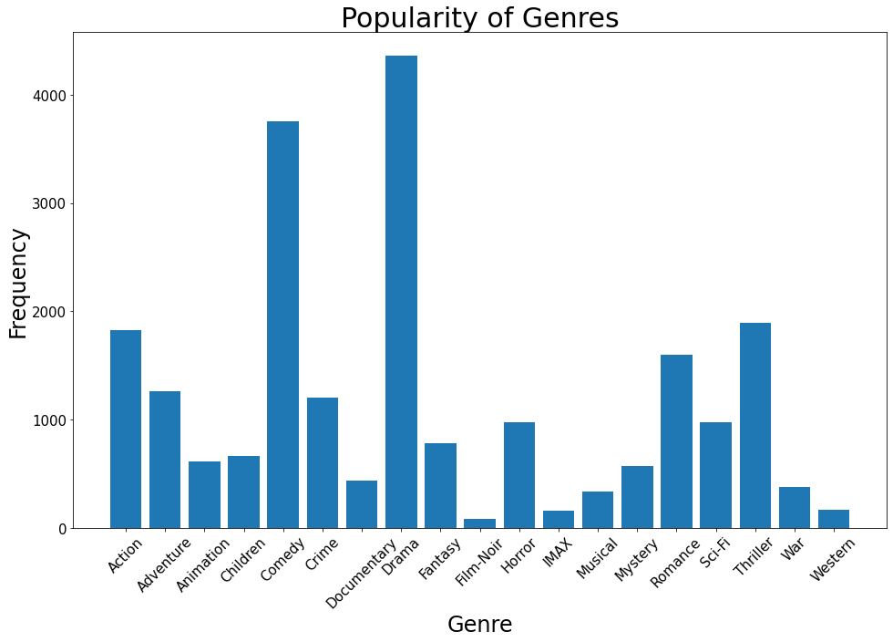
Data Analysis - Genre

Slide 11
Our Approach
Using Surprise Python library [2], conduct performance analysis on different Collaborative Filtering models
Start with a BaselineOnly model
Extend analysis to other models:
KNNBasic
KNNWithMeans
KNNWithZScore
KNNBaseline
Select model with a low RMSE and MAE and high Precision@k, Recall@k and F1 Score as final model for the recommender system
SVD
SlopeOne
CoClustering

Slide 12
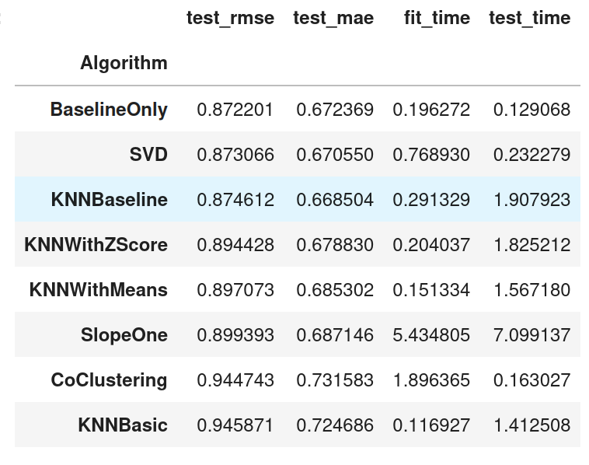
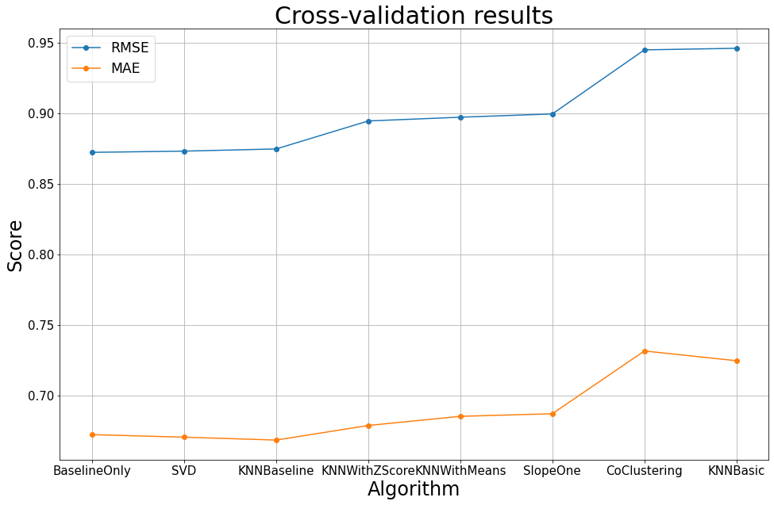
Model Evaluation - Rating Prediction RMSE/MAE
Using 5-Fold CV

Slide 13
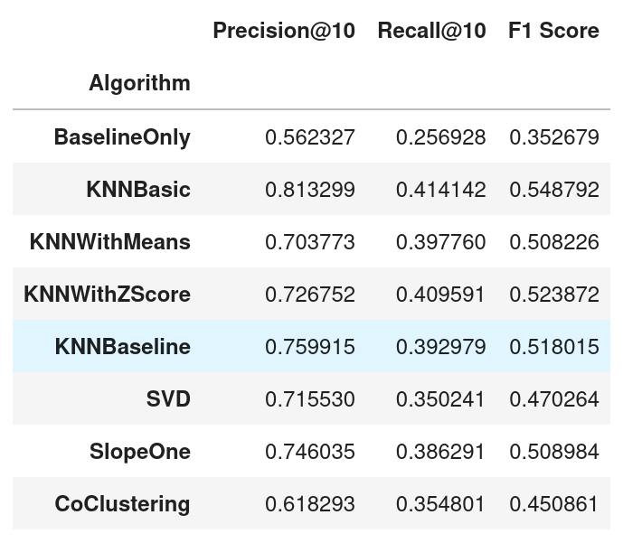
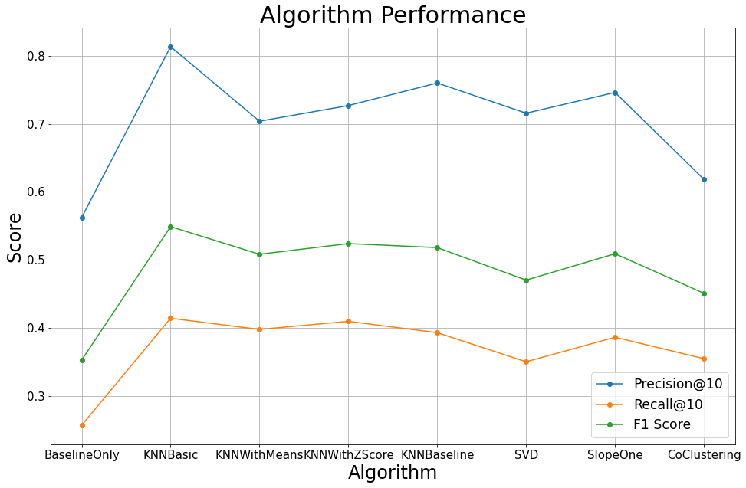
Model Evaluation - Recommender Precision@k, Recall@k, and F1 Score
Using 5-Fold CV, k = 10, Rating threshold = 4

Slide 14
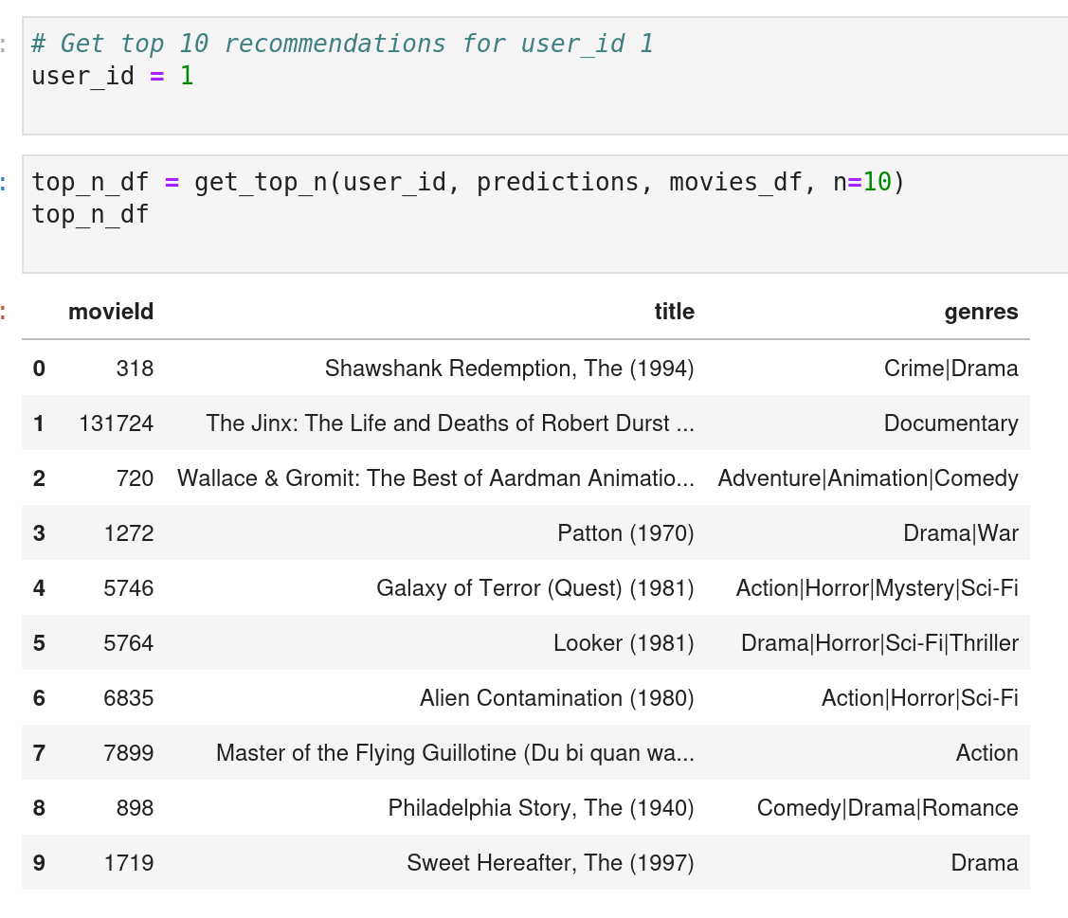
KNNBaseline Recommendations

Slide 15
Conclusion and Future Work
Recommender Systems offer personalization and help in increased profits for companies and also allow users to find the most relevant products for their use
Extensive hyperparameter tuning of existing models can increase the scalability, performance, and efficiency of these systems
A hybrid approach and implementation of deep learning techniques can further improve the accuracy and efficiency of recommender systems
New hybrid technologies may also solve existing issues with individual methods

Slide 16
References
[1] Dataset: https://grouplens.org/datasets/movielens/latest/
[2] Surprise: https://surpriselib.com/

