Slide 1
CNN
Arunabh Singh

Slide 2
What is a Convolutional Neural Network?
CNN works by passing filters through images.
These filters capture intrinsic relation between different sections of the images
As these filters are passed through the image, features get detected like eyes, nose, mouth ears and other facial features or image features.
These layers form input to the other layers.
These layers capture relationship between these features.
This goes on along with relu activation layer between each Convolutional Layer to get a final prediction of which class the image belongs to.
Convolutional Neural Networks are very powerful in detecting all kinds of images

Slide 3
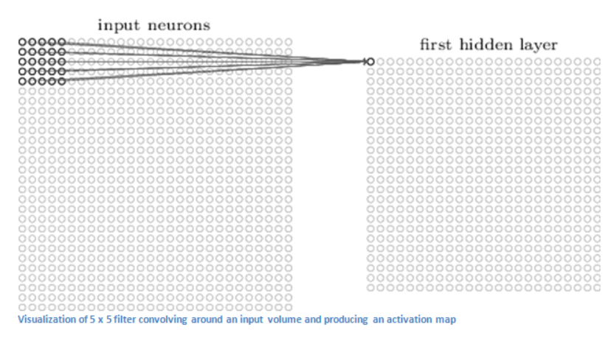
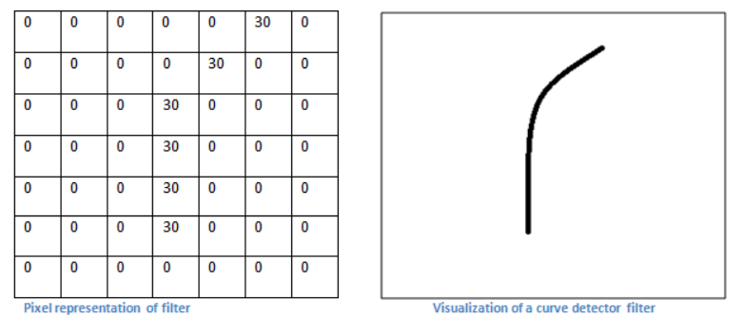
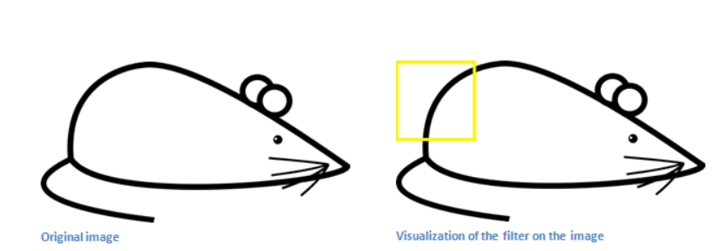
Convolution Layer
A filter is passed through an image like below to detect features like edge, colour and other curves in an image
A feature like image 2 will be used to detect a specific part of a mouse in image 3
Image1
Image 2
Image 3

Slide 4
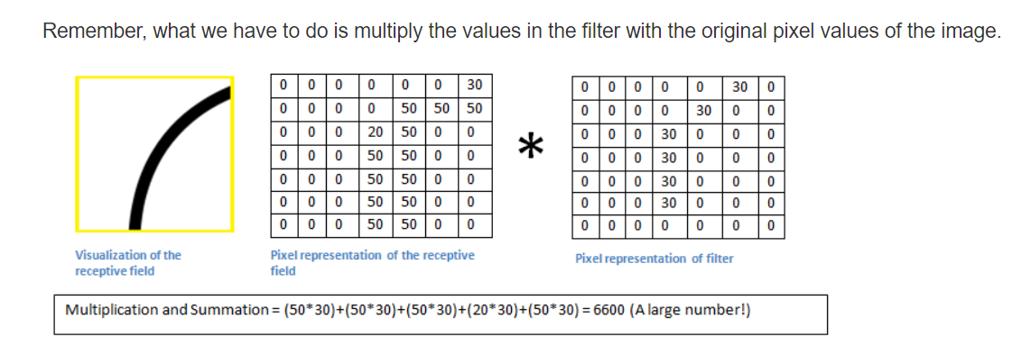
Edge Detection using dot product
When taking dot product of filter with image, if that specific feature exists, a large value is obtained.
When no detection happens value is low or 0.

Slide 5
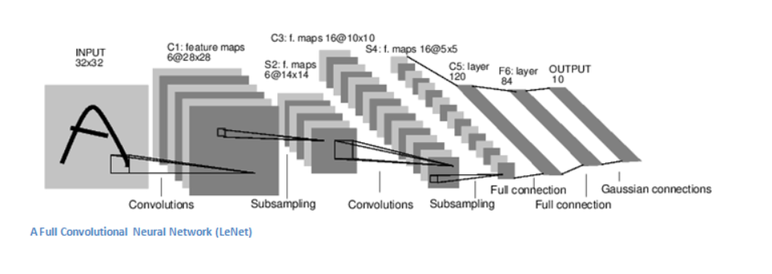
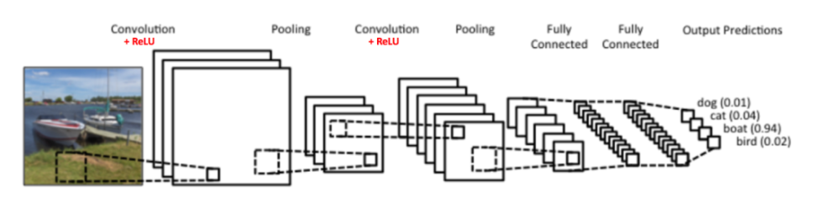
What does a CNN look like?
It consists of Conv Layers, pooling layers and fully connected Layers

Slide 6
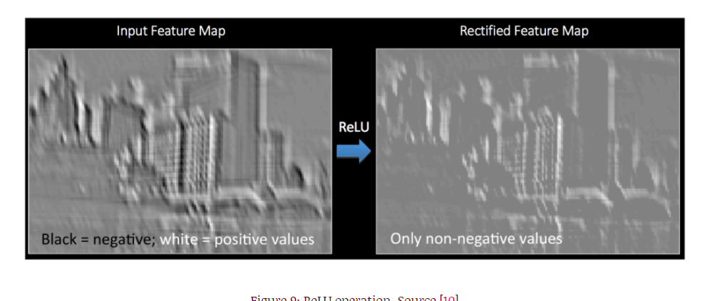
Why we need ReLU after convolving ?
ReLU removes negative values from a map/filter and only positive ones are retained.
It removes some unnecessary noise which is not useful in capturing features.
Below Image is an example of how it transforms the image.

Slide 7
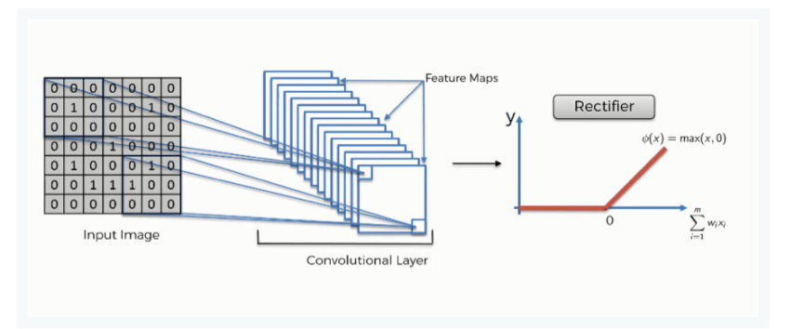
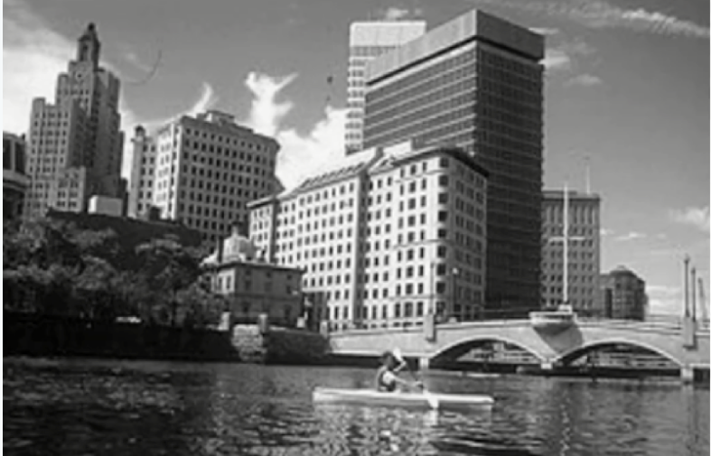
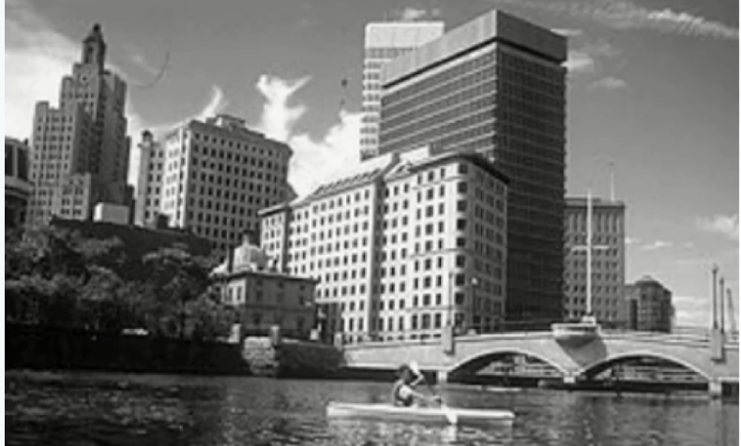
Convolution followed by ReLU
ReLU introduces non linearity in the image.
NN’s need non linearity to represent all kinds of relationships.
When you look at any image, you'll find it contains a lot of non-linear features (e.g. the transition between pixels, the borders, the colors, etc.).
Original image
Convoluted image followed by ReLU. Has a lot more in between grey scale values for pixels

Slide 9
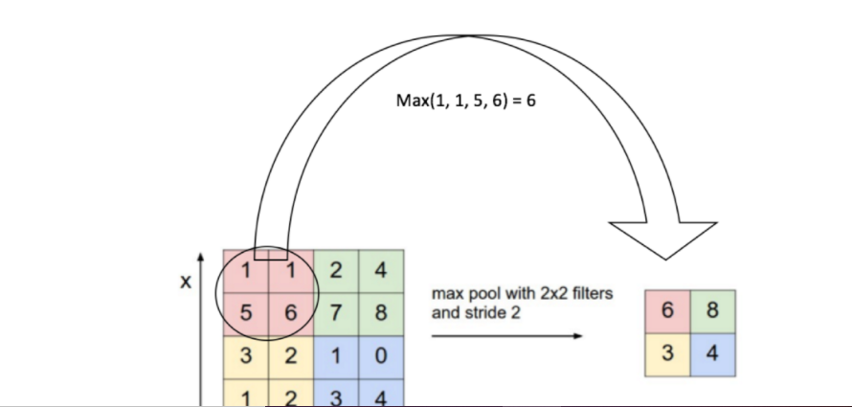
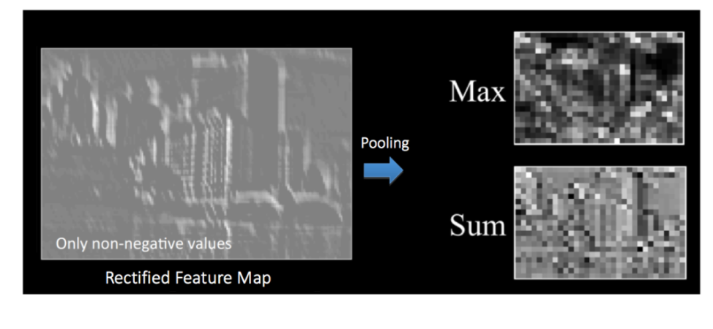
Why is pooling needed?
Pooling (also called subsampling or downsampling) reduces the dimensionality of each feature map but retains the most important information. Spatial Pooling can be of different types: Max, Average, Sum etc.
In case of Max Pooling, we define a spatial neighborhood (for example, a 2×2 window) and take the largest element from the rectified feature map within that window. Instead of taking the largest element we could also take the average (Average Pooling) or sum of all elements in that window. In practice, Max Pooling has been shown to work better.

Slide 10
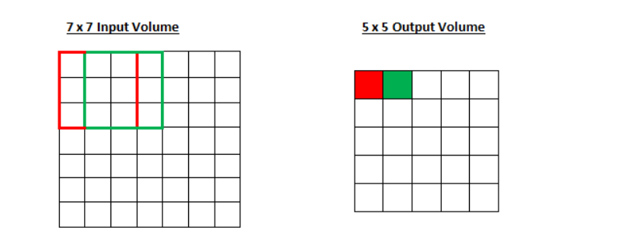
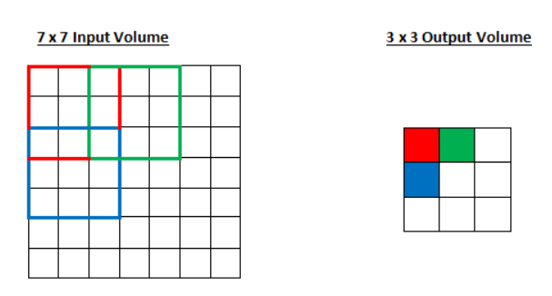
Filter sizes and Strides
Using a 3x3 filter on a 7x7 Input will result in a 5x5 output with stride 1
Using a 3x3 filter on a 7x7 Input will result in a 3x3 output with stride 2

Slide 11
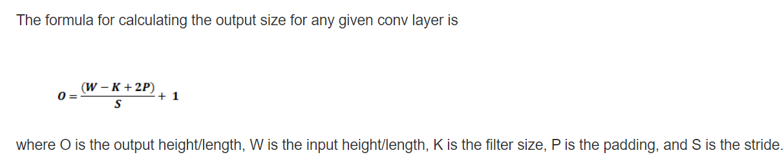
Calculating output from a Convolution Layer
Below is the formula
It also considers Padding which is bunch of 0s around a filter to detect edges of images which may otherwise be missed.

