Slide 1
GANs
Arunabh – Lighthouse Labs W9D3 July 2020 Cohort

Slide 2
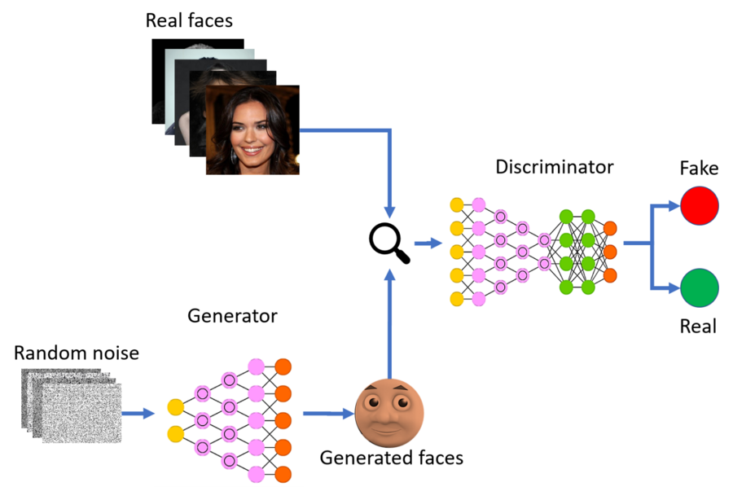
What are GAN’s
GAN stands for Generative Adversarial Networks
It consists of two Neural Networks trying to outwit each other.
These 2 networks are known as Generator and Discriminator.
GAN representation

Slide 3
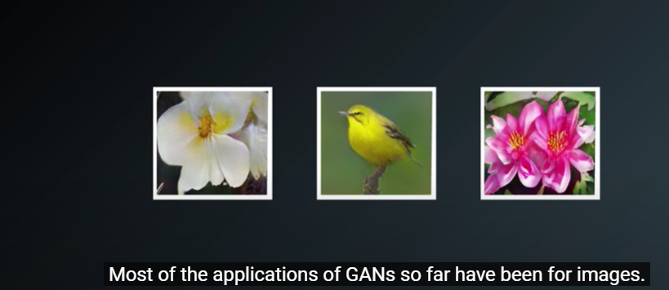
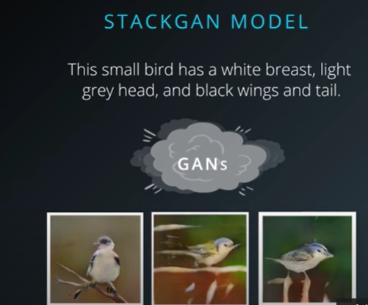
Applications of GAN
Source: Udacity

Slide 4
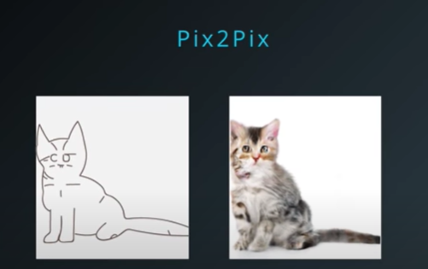
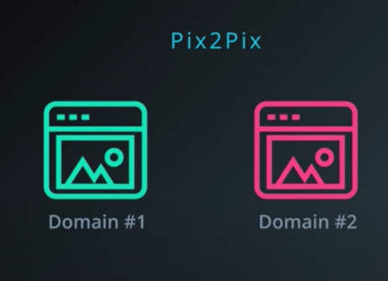
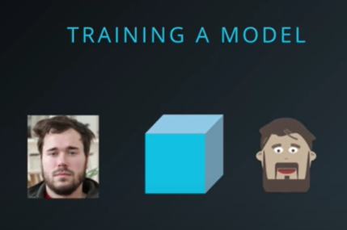
Applications of GAN
Source: Udacity

Slide 5
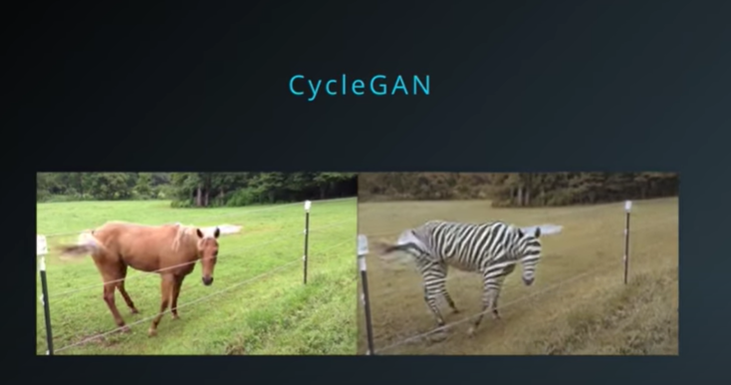
Applications of GAN
At Berkeley, cycleGAN performs unsupervised image to image transformation.
For example it transformed video of horse to video of Zebra.
It also incorporates grassland changes as per zebra natural habitat.
Source: Udacity

Slide 6
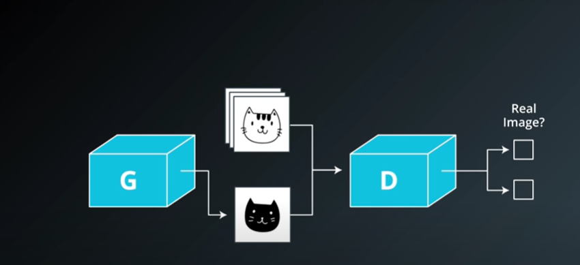
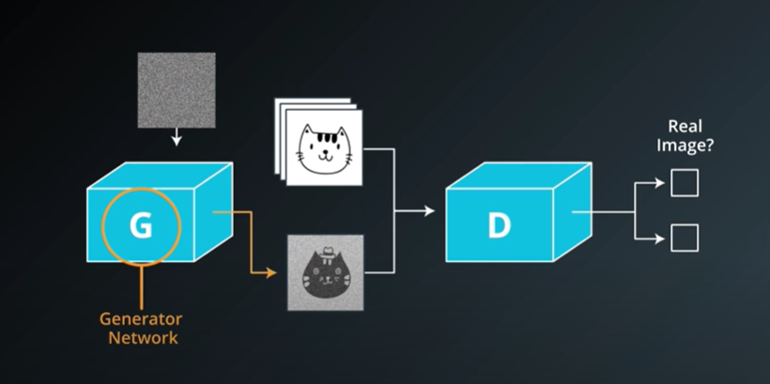
GAN Architecture
GAN use fake images generated by generator
Discrimnator discriminates between real and fake images which are labelled
Eventually Generator and Discriminator learn to create better images and distinguish between real and fake images respectively.
Generator and Discriminator act as adversaries and thus GAN is a generative adversarial network.

Slide 7
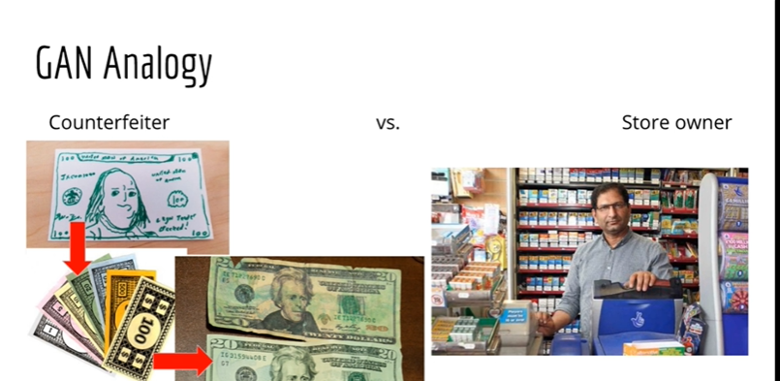
GAN Analogy
GANs can be thought of similar to a store owner and customer trying to use counterfeit notes.
The counterfeiter learns and tries to create more realistic counterfeit notes.
The shopkeeper learns to discriminate between fake and real.
This is similar to discriminator and generator in a GAN.
This process can keep going on forever.
GANs do not use anything we haven’t already learnt.
Source: Udemy-Lazy Programmer

Slide 8
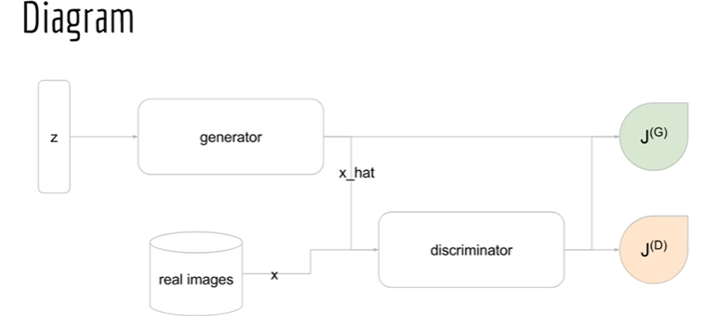
Final GAN diagram
Starting from left we have z which is a latent variable generated from a uniform distribution.
Generator will use the distribution to generate x_hat or fake samples.
Discriminator will be fed both real and fake images.
Then we have cost functions which optimize both the networks respectively.
Source: Udemy-Lazy Programmer

Slide 9
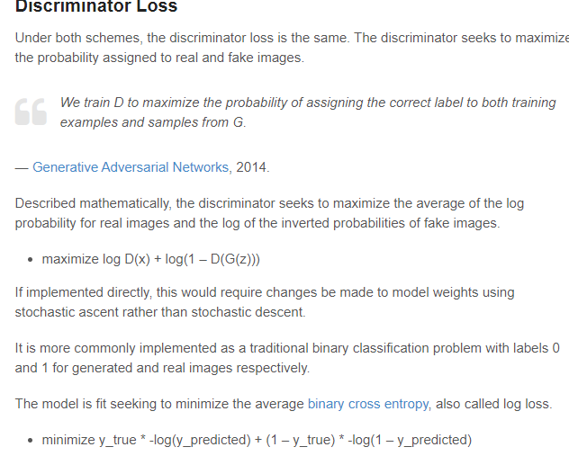
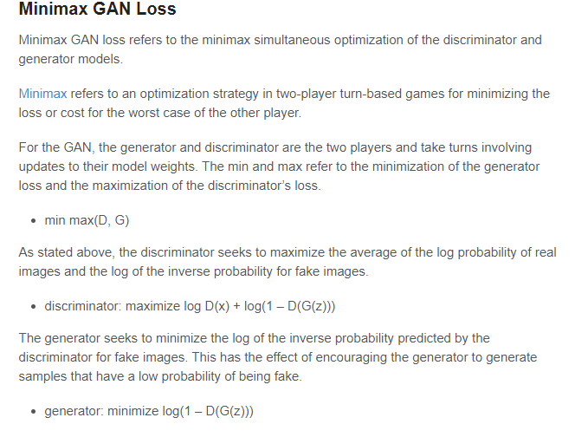

Slide 10
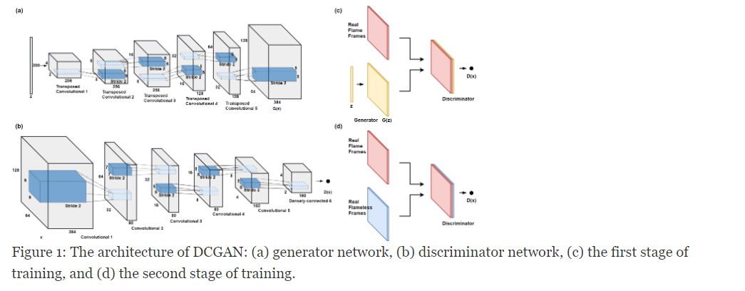
DCGAN overall structure

Slide 11
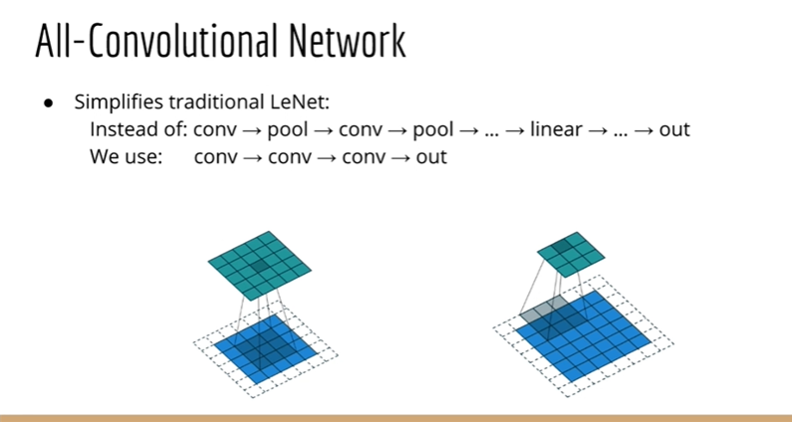
DCGAN
A.k.a Deep Convolutional GAN.
Uses batch normalization which means normalizing the data at every layer in a Neural Network.
DCGAN follows a style of Neural Network called All Convolutional Network.
This Network does not uses pooling layer to reduce dimensions. Instead just uses bigger stride of 2.

Slide 12
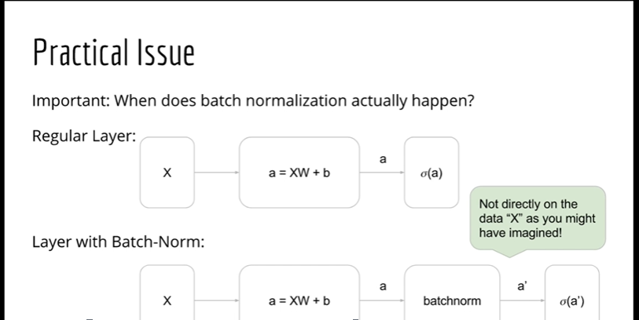
Batch Normalization 1
Batch normalization happens as follows:
First-→ weights*X + bias
Second → Batch Normalization
Third → activation function

Slide 13
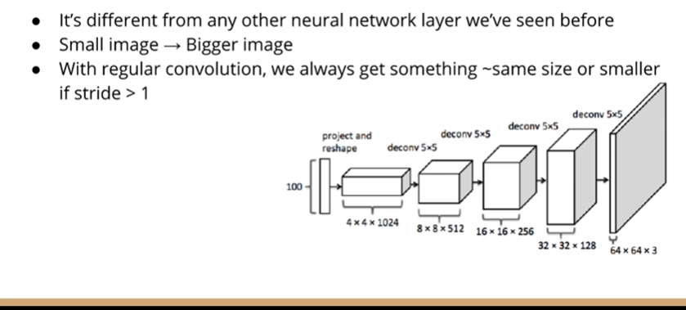
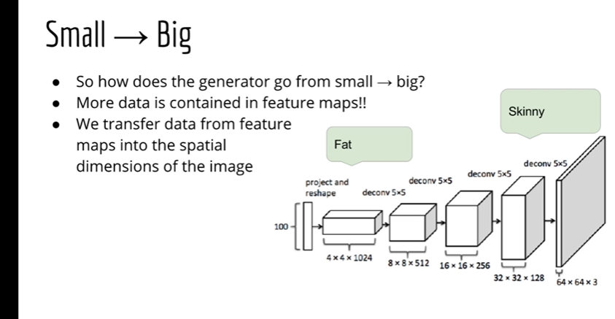
Strided Convolution

Slide 14
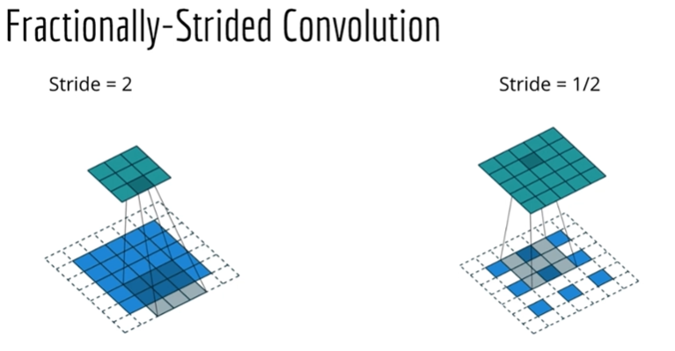
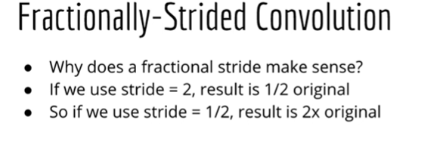
Fractionally Strided Convolution
Takes ½ strides and creates gaps between pixels.
This creats images that are bigger in size.

