Slide 1
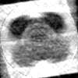
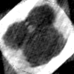
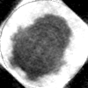
Experiment 1
20% noise
20000 angles
3 classes
Uniform distribution of angles
25.53%
28.03%
19.41%

Slide 2
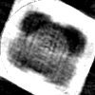
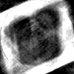
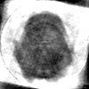
Experiment 2
25% noise
20000 angles
3 classes
Non-Uniform distribution of angles
28.99%
33.38%
23.61%

Slide 3
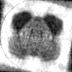
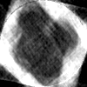
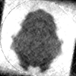
Experiment 3
30% noise
20000 angles
3 classes
Uniform distribution of angles
23.34%
39.49%
18.97%

Slide 4
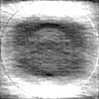
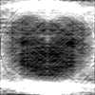
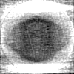
Experiment 4
50% noise
20000 angles
3 classes
Uniform distribution of angles
28.60%
36.25%
28.42%

