Slide 1

DAMS-Doctor Appointment Management System
Presented by- Group 1
Arunabha Sarkar
Amisha Bharti
Alok kumar Sahu
Aparna
Abburi Harshitha Chowdary

Slide 2
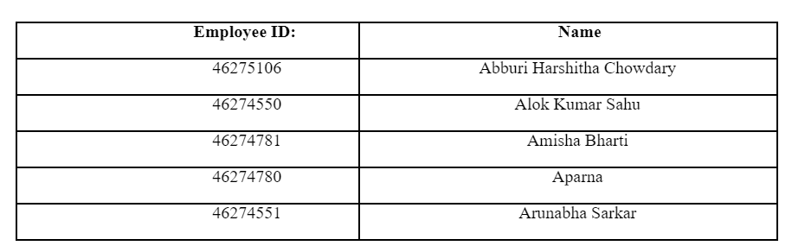
Members

Slide 3
Members contribution
Amisha Bharti : UT – IT test plan initial contribution , Coding part execution , Design part review and correction , schedule updation ,created makefile
Alok Kumar Sahu :Design documentation with flowcharts , SRS part also , Code execution , Inside cut folder done with code inspection log and UT-IT test plan
Arunabha Sarkar: UT-IT test plan , Coding part , Ppt preparation , MOM and Schedule updation on time, Code checklist review , flowchart review.
Aparna: SRS part done, coding execution , schedule and MOM update , uploaded the codes in .c and .h files inside the cut folder, updated storyboard ,valgrind report
Abburi Harshitha Chowdary: SRS part done , CUT file , coding execution , MOM and Plan update ,update storyboard, updated src, inc folders

Slide 4
Overview of our project
1. Login/Register
2. Admin Panel
3. Take appointment 4. View appointment 5. Add, Update, Delete Query

Slide 5
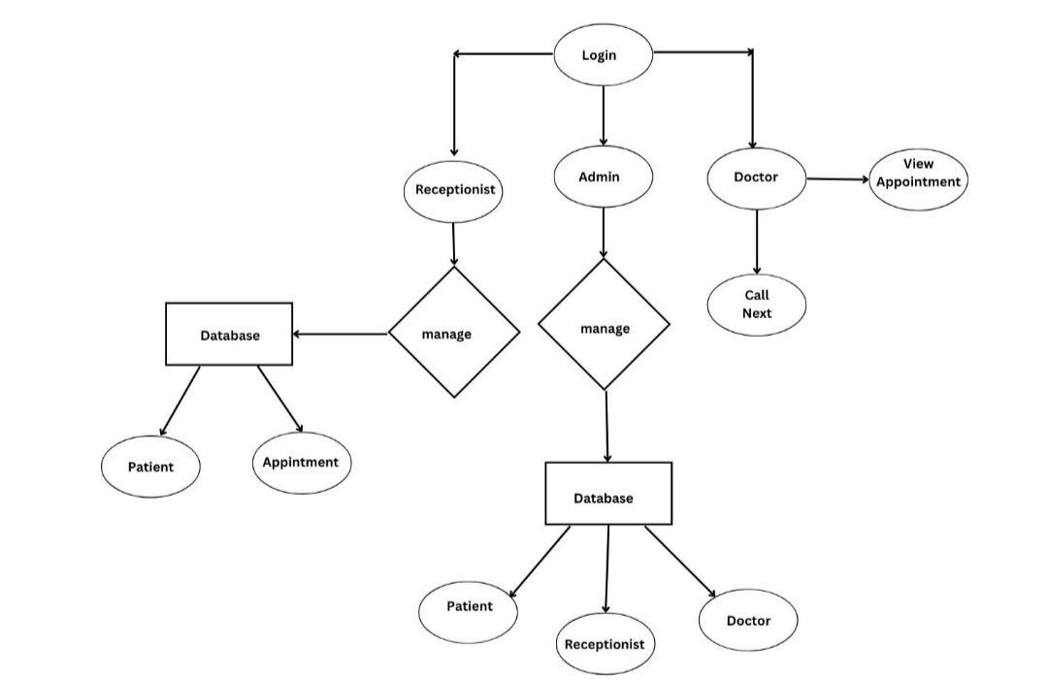
Flowchart

Slide 6
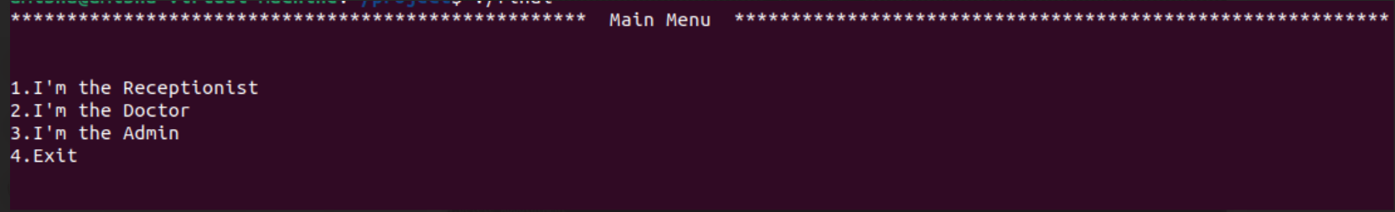
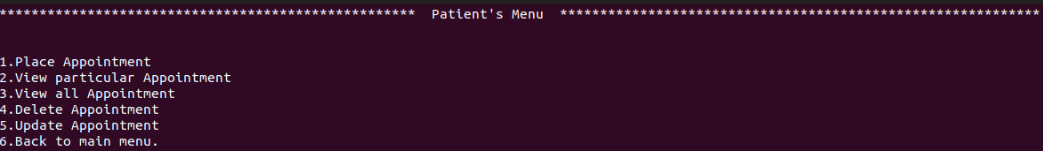
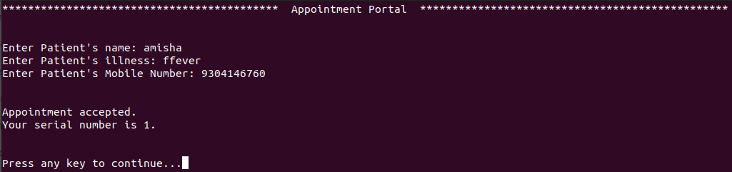
Output Screenshots

Slide 7
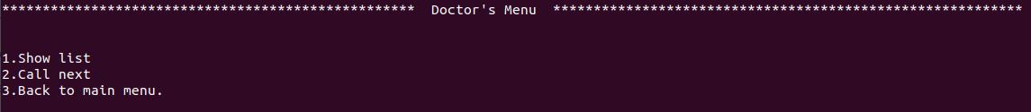
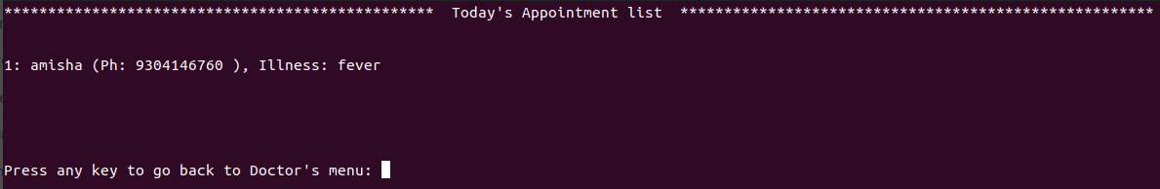
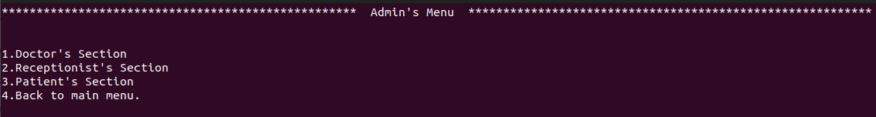

Slide 8
Members Challenges
Amisha Bharti : Rectified some mistakes for SRS , designed data flow diagram , created Admin function and maintained some coding guidelines and debugged all test cases .
Arunabha Sarkar : Validated and tracked the requirements , faced difficulties to make case diagram , made PPT , created doctor function and debugged test cases often .
Alok kumar sahu : Maintained SRS , developed HLD and LLD , created the ER diagram , created .cfile and .hfile and faced some difficulties to understand the testcases .
Aparna: Understood large and complex system requirements , created textual analysis for Design document , created receptionist function and gained some coding ideas from internet and implemented.
Abburi Harshitha Chowdary: learned how to define functionality , faced difficulties to find the references , understood how to make design documentation and gained some coding ideas from internet and implemented it in the code .

Slide 9
THANK YOU

